Slide 1
Java Programming
Lecture 03

Slide 2
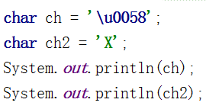



Character and String Literals
char字符类型，存储单个字符变量。占用16bits，以’’单引号声明字面量
除8种基本数据类型，Java通过java.lang.String类，提供了对字符串的特殊支持，使用“”双引号声明创建一个String类型对象(后面学习中单独讨论)

Slide 3
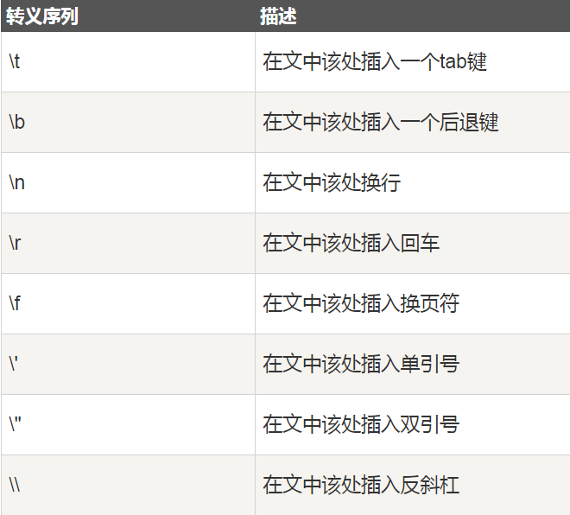
转义序列。当需要输出对编译器有特殊含义的字符时，需要通过转义实现，以“\”反斜杠前缀

Slide 4




例如，需要输出双引号。希望输出:
"It's freezing in here", he said coldly.
不使用转义符编译错误
++++++++++++++++++++++++++++++++
使用转义符\ " ，替换输出双引号
++++++++++++++++++++++++++++++++

Slide 5
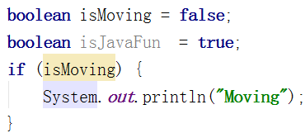
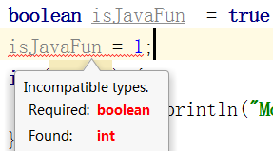
Boolean Values
A boolean type is declared with the boolean keyword and can only take the values true or false.
布尔类型(Boolean)，仅具有true/false(真/伪)2个值的java基本数据类型
与C/C++不同，无法与零/非零数替换
++++++++++++++++++++++++
零/非零均为整数类型
禁止直接与boolean替换

Slide 6
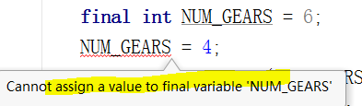
Declare a Constant
不允许改变值的变量为，常量(Constant)
通过final关键词修饰变量，变量赋值后，不能再修改
CC： Constant常量命名规范。常量所有字母大写，字母间由下划线分隔
试图修改常量的值，编译错误

Slide 7
Arrays
An array is a container object that holds a fixed number of values of a single type. The length of an array is established when the array is created. After creation, its length is fixed.
Each item in an array is called an element, and each element is accessed by its numerical index.
数组是按顺序存放单一类型，长度固定，的容器对象
数组中的每一个项，称为元素
数组一旦创建，就不能更改长度，即，如需增/删数组元素而改变数组长度，必须创建一个新数组
通过[index]索引访问数组元素
通过length成员常量(而非方法)，获取数组长度

Slide 8

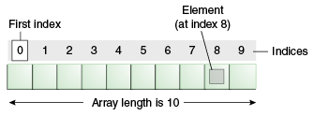
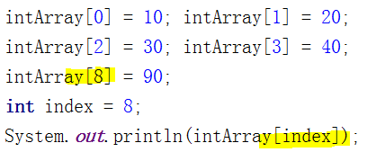
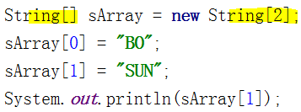
通过new操作符，创建指定长度的数组
声明变量类型
声明变量为数组
创建指定类型
指定长度的数组对象
即，声明了数组变量，且
指定了数组容器中的元素类型
通过数组下标操作元素

Slide 9
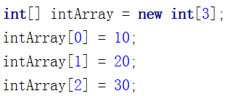

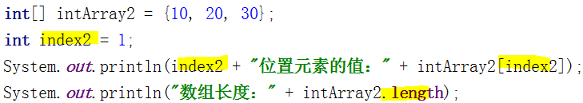

当创建数组即能确定数组中元素时，无需new操作符，创建数组的同时，初始化数组中的元素；{}大括号声明元素
等效
length，获取数组长度(元素的个数)
为数组中名为length的属性
而非方法

Slide 10



数组长度3
试图修改索引为3的
第4个元素的值
索引下标越界异常
CC：声明数组类型。数组类型[]括号，必须声明在类型，禁止声明在变量
正例
反例

Slide 11
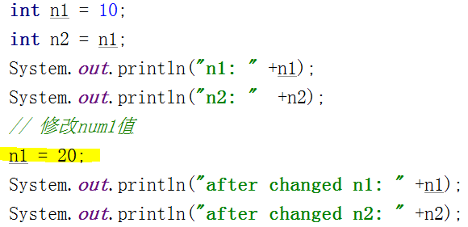
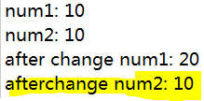
Literals
Primitive values do not share state with other primitive values
所有基本类型变量不与其他变量共享值，基本数据类型为值传递，而非引用传递。因此当被"引用"的值改变时，不会影响"引用"其值的变量
n2”引用”n1
n1将字面量值10，赋值给n2
而非n2引用n1的值
因此n1的值改变，不影响n2的值

Slide 12
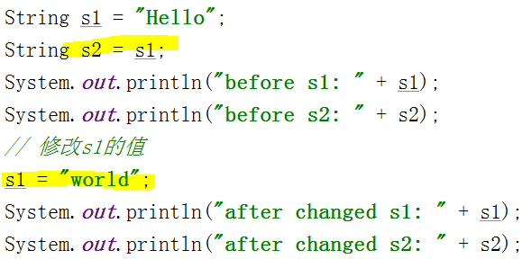
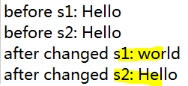
String类型变量虽然为对象，但依然为值传递
即，8+1类型变量，均为值传递
String类型变量
值传递
s2没有随s1修改而改变

Slide 13
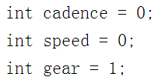
Operators
Operators are special symbols that perform specific operations on one, two, or three operands, and then return a result.
运算符，执行特定操作的特殊符号
Assignment Operator. assignment operator "=". It assigns the value on its right to the operand on its left:

Slide 14
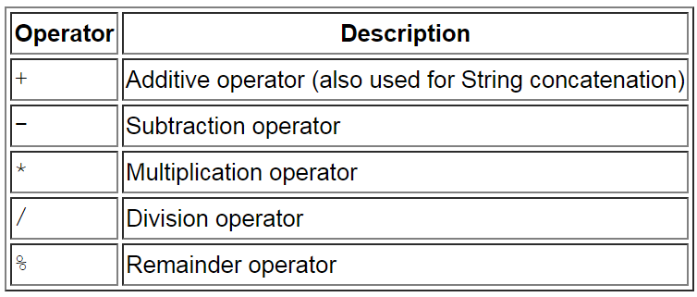
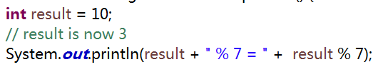

The Arithmetic Operators
左操作数除以右操作数后
的余数

Slide 15
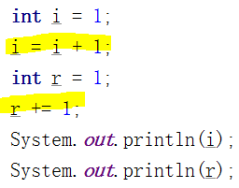

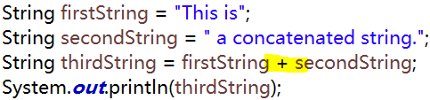
You can also combine the arithmetic operators with the simple assignment operator to create compound assignments.
The + operator can also be used for concatenating (joining) two strings together, as shown in the following
CC：操作数与操作符，由空格分隔
i = i + 1;
等价于
I += 1;

Slide 16
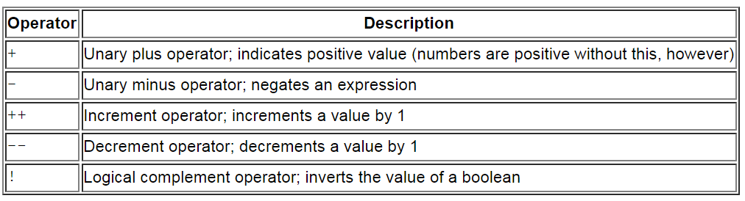
The Unary Operators
The unary operators require only one operand; they perform various operations such as incrementing/decrementing a value by one, negating an expression, or inverting the value of a boolean.
一元运算符只需要一个操作数; 它们执行将值递增/递减，否定表达式或反转布尔值。

Slide 17
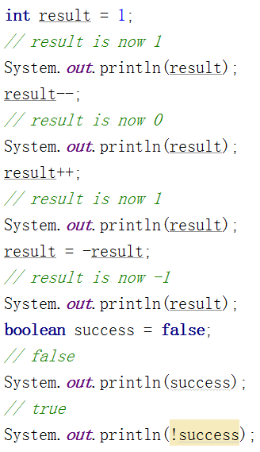

Result = result的负数

Slide 18
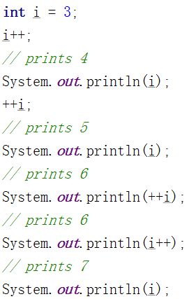

i++与++i，仅在表达式内部有区别，单独一行时结果相同
++i，等价于 i = i + 1; return i;
即，当前 i = i + 1
i++，等价于 return i; i = i+1;
即，当前i = i，当所在语句执行完后，i = i+1

Slide 19
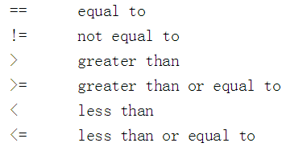
The Equality & Relational Operators
The equality and relational operators determine if one operand is greater than, less than, equal to, or not equal to another operand. Keep in mind that you must use "==", not "=", when testing if two primitive values are equal.
当判断8个基本数据类型的关系时，使用等式与关系运算符；返回布尔类型结果

Slide 20
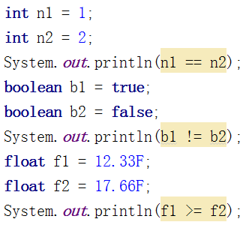

返回，判断关系的结果
即，是否是这个关系，的boolean类型结果

Slide 21
The Conditional Operators
The && and || operators perform Conditional-AND and Conditional-OR operations on two boolean expressions. These operators exhibit "short-circuiting" behavior, which means that the second operand is evaluated only if needed.
条件运算符。&&和|| 运算符对两个布尔表达式执行条件或/与操作。条件运算符表现出“短路”，即，第二个操作表达式仅在需要时被判断；返回boolean类型结果

Slide 22
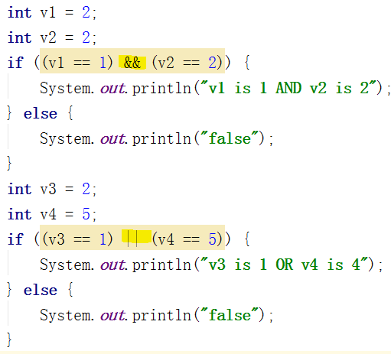

判断左表达式结果
如果为false，则不再执行右表达式
返回false
如果为true，继续执行右表达式结果
结果也为true
返回true
否则，返回false
判断左表达式结果
如果为true，则不再执行右表达式
返回true
如果结果为false，继续执行判断右表达式

Slide 23
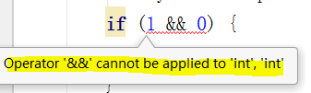
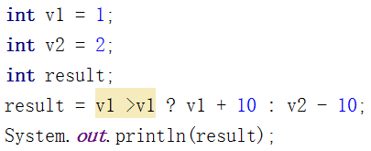

C/C++，非零即为真，支持整数
Java，或与两端必须为boolean类型
不支持其他类型
ternary operator, which can be thought of as shorthand for an if-then-else statement.
条件表达式A ? 表达式X : 表达式Y，三元运算符(三目运算符)，当条件表达式A结果为真，执行表达式X，假，执行表达式Y

Slide 24
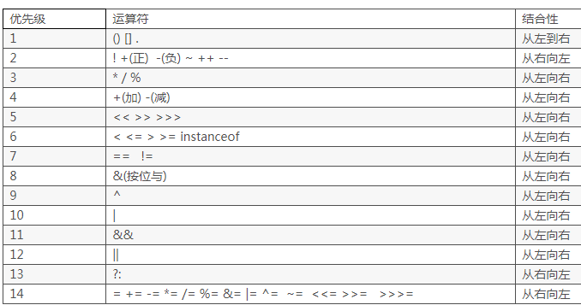
Operator Precedence

Slide 25
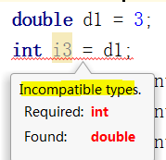

Converting
基本数字类型间可以转换
小向大转换，可直接转换(例如int to double)
大向小转换，必须声明强制转换(例如double to int)
向小范围转换时，可能造成数据错误或丢失。例如double向int转换时超出int范围，产生int无限大数；因此需显式声明强制类型转换
声明强制转换
(目标类型名称)

Slide 26
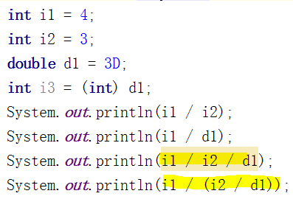
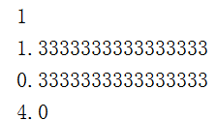
当操作数的类型不同时，自动向高精度类型转换
CC：为避免错误，使用优先级最高的括号包裹操作
i1/i2，按int计算，结果为int，与double计算，则最终结果为double
i2/d1，按double计算，结果为double，与int计算，最终结果为double

Slide 27

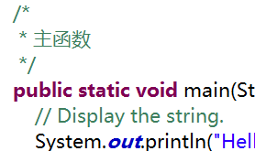
Source Code Comments
Comments are ignored by the compiler but are useful to other programmers.
the compiler ignores everything from // to the end of the line. 单行注释
The compiler ignores everything from /* to */. 多行注释

Slide 28
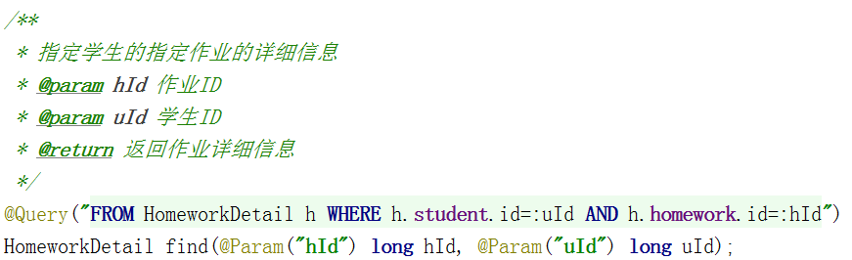
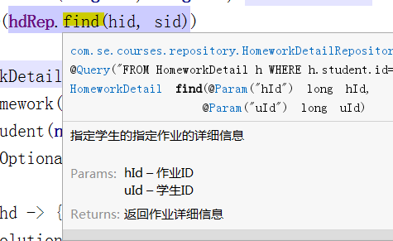
/** documentation */
This indicates a documentation comment.
文档注释，可生成API文档
声明文档注释
使用时可查看注释信息

Slide 29
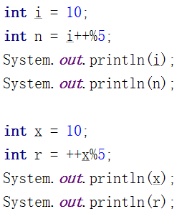

Questions

Slide 30
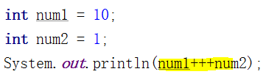


CC：严禁写表述性差的代码；多使用括号显式声明优先级
按优先级
等效
num1在语句结束后+1

Slide 31
Control Flow Statements
The statements inside your source files are generally executed from top to bottom, in the order that they appear. Control flow statements, however, break up the flow of execution by employing decision making, looping, and branching, enabling your program to conditionally execute particular blocks of code.
Decision-making statements:
if-then, if-then-else, switch
Looping statements:
for, while, do-while
Branching statements:
break, continue, return

Slide 32
The if-then-else Statement
The if-then statement is the most basic of all the control flow statements. It tells your program to execute a certain section of code only if a particular test evaluates to true.
The if-then-else statement provides a secondary path of execution when an "if" clause evaluates to false
当if表达式结果为true时，执行then代码块；结果为false时，执行else代码块
If(表达式) {
then代码块
} else {
else代码块
}

Slide 33
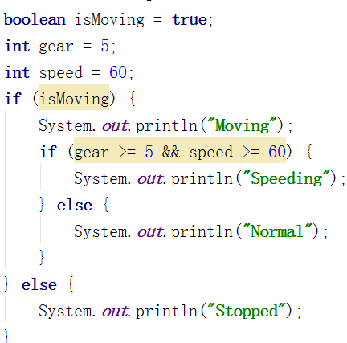
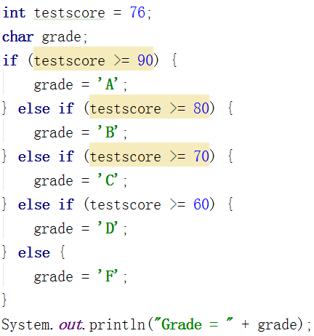
CC：if语句代码块必须显式使用大括号。使用大括号声明代码块可以使代码结构清晰

Slide 34
The switch Statement
The switch statement can have a number of possible execution paths. A switch works with the byte, short, char, and int primitive data types. It also works with enumerated types, the String class.
A statement in the switch block can be labeled with one or more case or default labels. The switch statement evaluates its expression, then executes all statements that follow the matching case label.

Slide 35
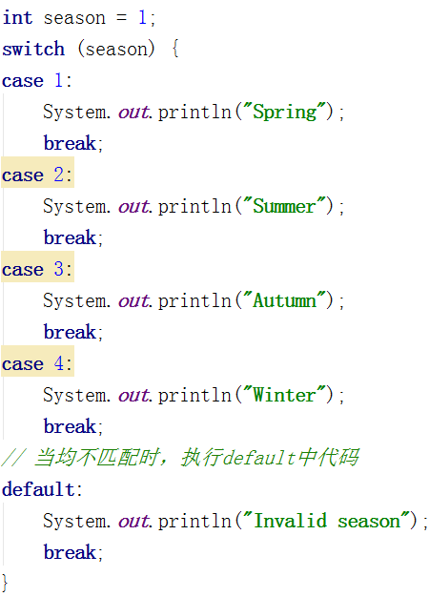

Slide 36
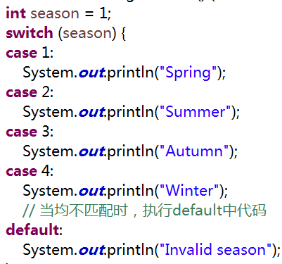
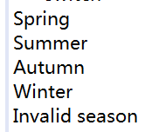
All statements after the matching case label are executed in sequence, regardless of the expression of subsequent case labels, until a break statement is encountered.
Switch支持整数/枚举/字符串作为表达式；当匹配case中表达式时，执行相应代码块；并顺次执行之后的全部case分支直到break语句。
从匹配的case执行
如果case没有break
则继续执行下一个case
直到break或switch结束

Slide 37
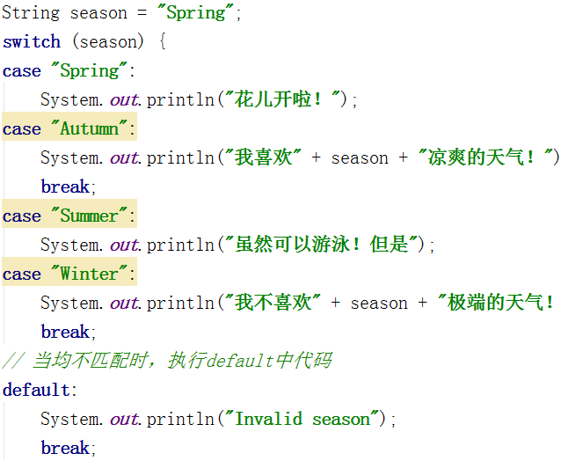


You can use a String object in the switch statement's expression.
当执行本case时
需要同时执行下一个case
因此，无需break
session = Autumn
基于具体需求决定
是否需要default
Case是否需要break

Slide 38
基于可读性和预执行的表达式，选择恰当的决策语句
If，支持基于值/条件范围/运算符等的复杂表达式，但表达式结果仅支持boolean类型
Switch，支持整数/枚举/字符串等多种类型，但分支固定
当表达式使用switch不支持的类型时

Slide 39
The while and do-while Statements
The while statement continually executes a block of statements while a particular condition is true.
The while statement evaluates expression, which must return a boolean value. If the expression evaluates to true, the while statement executes the statement(s) in the while block. The while statement continues testing the expression and executing its block until the expression evaluates to false.
The difference between do-while and while is that do-while evaluates its expression at the bottom of the loop instead of the top. Therefore, the statements within the do block are always executed at least once
while(expression) {
statements
}

Slide 40
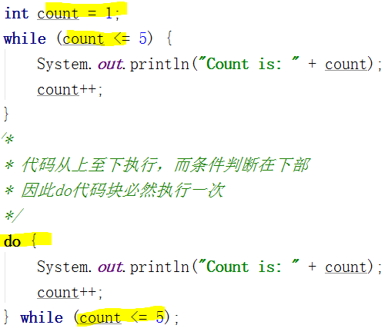
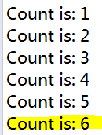

Slide 41
The for Statement
The for statement provides a compact way to iterate over a range of values. Programmers often refer to it as the "for loop" because of the way in which it repeatedly loops until a particular condition is satisfied.
initialization expression，循环开始时，执行初始化表达式一次
termination expression ，当终止表达式结果为false时，终止循环
increment expression，在循环的每次迭代之后调用，增加/减少一个值
for(initialization; termination; increment) {
statements
}

Slide 42

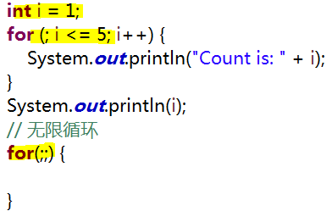
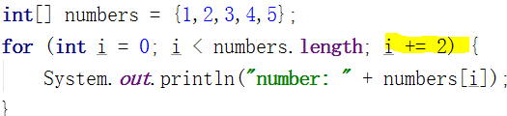
仅初始化时，执行一次
每次迭代时，执行
每次迭代后，执行
++++++++++++++++++++++++++++++++
可由由外部获取
++++++++++++++++++++++++++++++++
步进2

