Slide 1
DBBC3
integrated pc (2 ports ; lan1 and lan2)
ip address are not set (yet) using only 1 port would be sufficed
fiber optic card (core3H ; 8 card)
alphabetic ordering ; IFA IFB IFC … IFH
1 card provide 4 eth port ; eth0 eth1 eth2 eth3
ip address are repeating for odds and evens NIC
 | IFA IFC IFE IFG (1,3,5,7) | IFB IFD IFF IFH (2,4,6,8)
eth0 | 192.168.1.16 | 192.168.1.28
eth1 | 192.168.1.17 | 192.168.1.29
eth2 | 192.168.1.18 | 192.168.1.30
eth3 | 192.168.1.19 | 192.168.1.31

Slide 2
DBBC3
dbbcs ip
already set (default) for multicast mode (134.104.30.208)
destination (dbbc <-------> mk6)
destination 0 192.168.1.2 <-------> eth2
destination 1 192.168.1.3 <-------> eth3
destination 2 192.168.1.4 <-------> eth4
destination 3 192.168.1.5 <-------> eth5

Slide 3
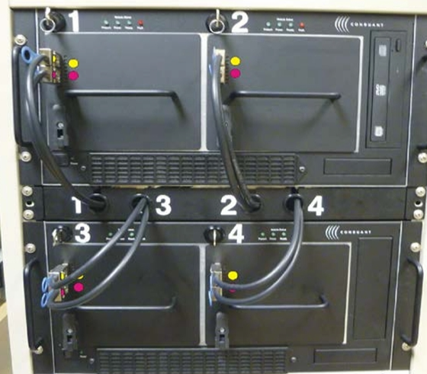
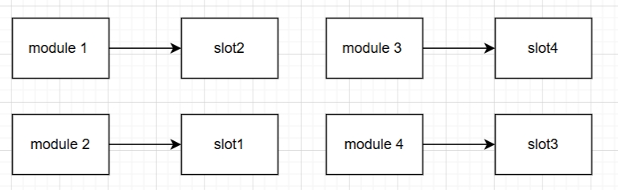
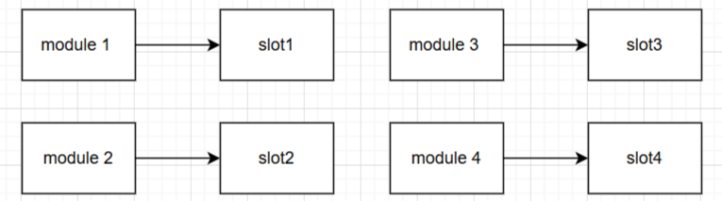
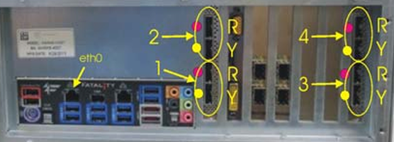
MK6
Fiber cable
modules (hdd) and its NIC are not connect correctly to its’ pair

Slide 4
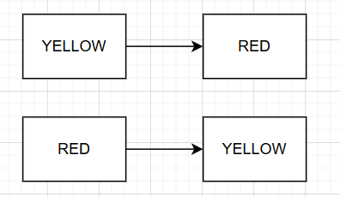
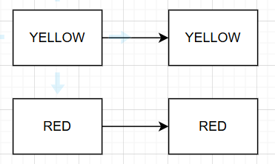
MK6
Wrong color code
modules (hdd) and its NIC are not connect correctly to its’ pair

