Slide 1
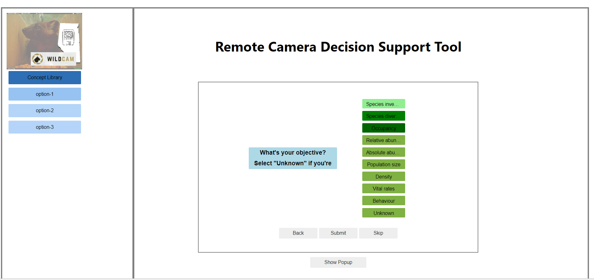
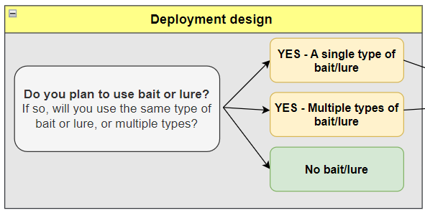
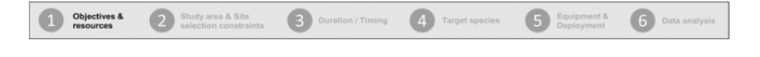
[LATER?] ### There are the options that should display on side bar
library-button-1 == "Objectives & Resources“
library-button-2 == "Study area & Site selection constraints“
library-button-3 == "Duration & Timing“
library-button-4 == "Target species“
library-button-5 == “Equipment & Deployment“
library-button-6 == "Data & Analysis“
Can you grey out the inner box?

Slide 2
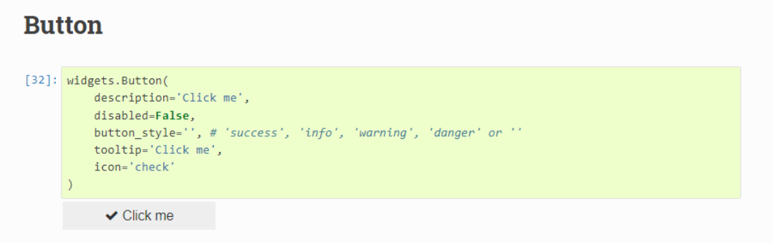
?? possible to make add checkbox when selected?
Eventually, we’ll want to increase padding around questions / make blue box bigger
sp_size_medium.icon='check’
sp_size_medium.tooltip='Click me'

Slide 3
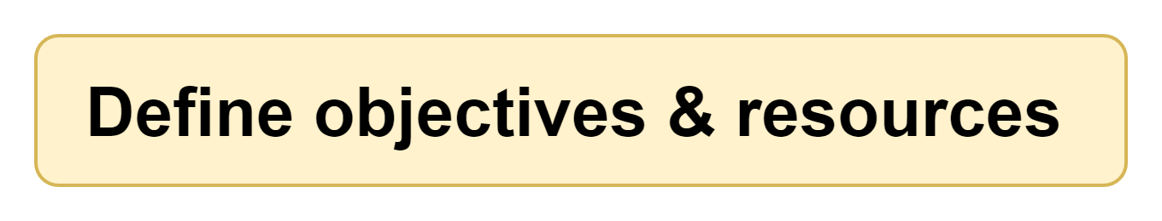
Decrease width of side panel
Add image as header instead of text “Remote Camera Decision Support Tool” OR include as banner on the box itself (which was how it looked in mockups) e.g., --→
- Move “Next” and “Submit” buttons to left / right
- Remove “skip”; should not be able to skip
<< Back
Submit >>
Progress bar should be above popup
- create grid of 7 (see next slide)
Instead of “Show popup” include markdown file see →Jupyter-web-app\02_dialog-boxes\0_dialog-box_template\template_dialog-box.ipynb

Slide 4

Grid might have to be 21 wide (7 x 3) so that a block of 3 is really one section / the text spans two cells
### text to display → Jupyter-web-app\04_lu_tables\lu_progress-bar_text_icons.csv
### icons display →Jupyter-web-app\03_icons
E.G., “icon_progress-bar_num1.png”
Notice that these are the same as the “library-button” in slide 1 with one additional “progress-7 == “Recommendations”
If you create the grid with the text and any one of the icons (could all be “icon_progress-bar_num1.png”), I can create the 7 formats required

