Slide 1
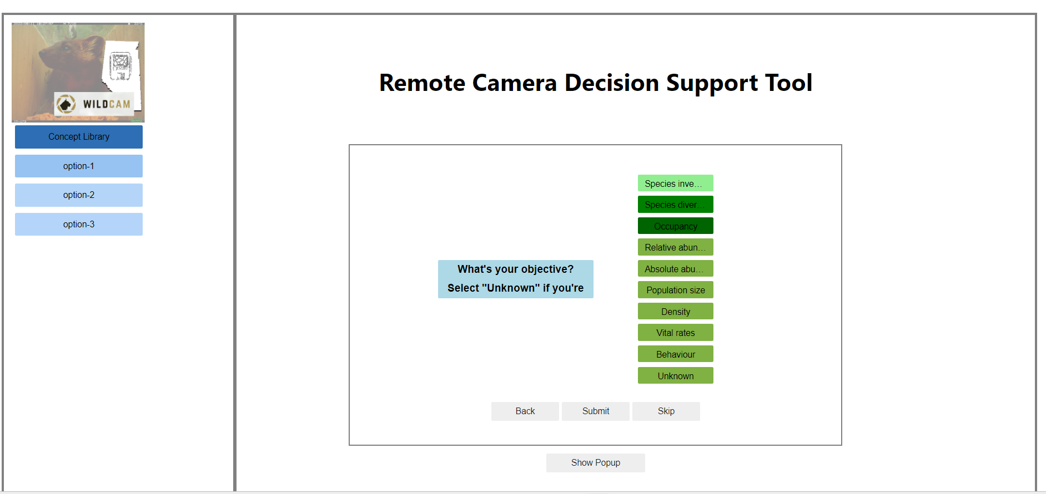
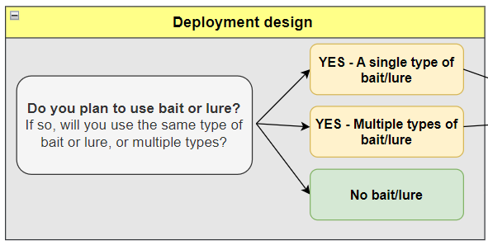
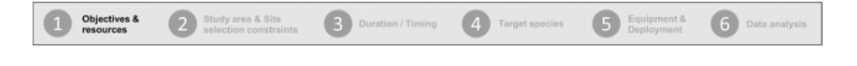
[LATER?] ### There are the options that should display on side bar
library-button-1 == "Objectives & Resources“
library-button-2 == "Study area & Site selection constraints“
library-button-3 == "Duration & Timing“
library-button-4 == "Target species“
library-button-5 == “Equipment & Deployment“
library-button-6 == "Data & Analysis“
Can you grey out the inner box?

Slide 2
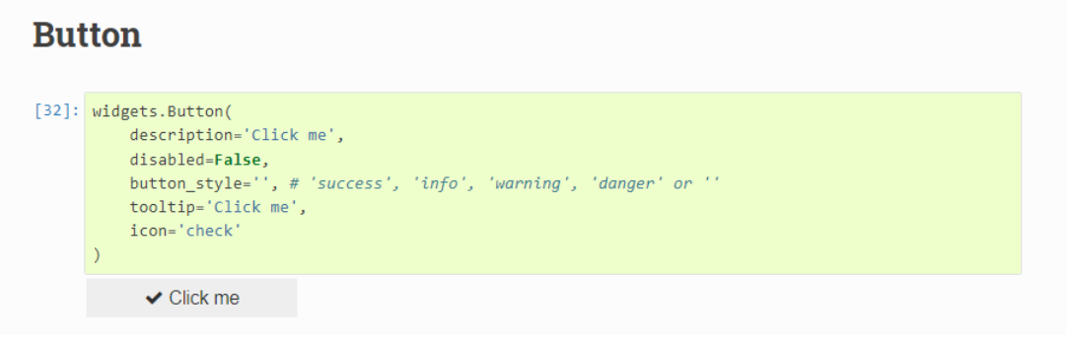
?? possible to make add checkbox when selected?
Eventually, we’ll want to increase padding around questions / make blue box bigger
sp_size_medium.icon='check’
sp_size_medium.tooltip='Click me'

Slide 3
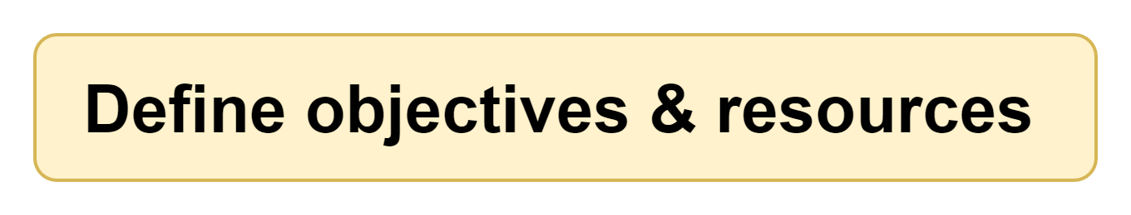
Decrease width of side panel
Add image as header instead of text “Remote Camera Decision Support Tool” OR include as banner on the box itself (which was how it looked in mockups) e.g., --→
- Move “Next” and “Submit” buttons to left / right
- Remove “skip”; should not be able to skip
<< Back
Submit >>
Progress bar should be above popup
- create grid of 7 (see next slide)
Instead of “Show popup” include markdown file see →Jupyter-web-app\02_dialog-boxes\0_dialog-box_template\template_dialog-box.ipynb

Slide 4

Grid might have to be 21 wide (7 x 3) so that a block of 3 is really one section / the text spans two cells
### text to display → Jupyter-web-app\04_lu_tables\lu_progress-bar_text_icons.csv
### icons display →Jupyter-web-app\03_icons
E.G., “icon_progress-bar_num1.png”
Notice that these are the same as the “library-button” in slide 1 with one additional “progress-7 == “Recommendations”
If you create the grid with the text and any one of the icons (could all be “icon_progress-bar_num1.png”), I can create the 7 formats required

Slide 5
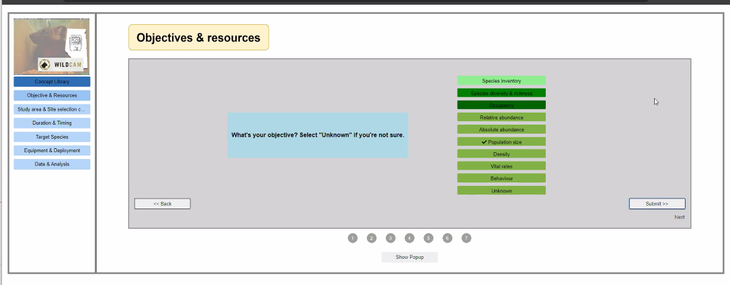
image smaller
text size larger
space out more
Increase buffer between text within box
add border
text size larger +
space out

Slide 6
increase height of grey box
use lighter grey
less space between edge of grey box and concept left panel
Species inventory
text size larger
space out more
Increase buffer between text within box
add border
Species diversity & richness
Occupancy
Relative abundance
Absolute abundance
Population size
text size larger; remove bold
add buffer around text
Vital rates
Behaviour
turn this into one button; text size larger
Unknown
add text->
text size larger
read from markdown (later)

Slide 7
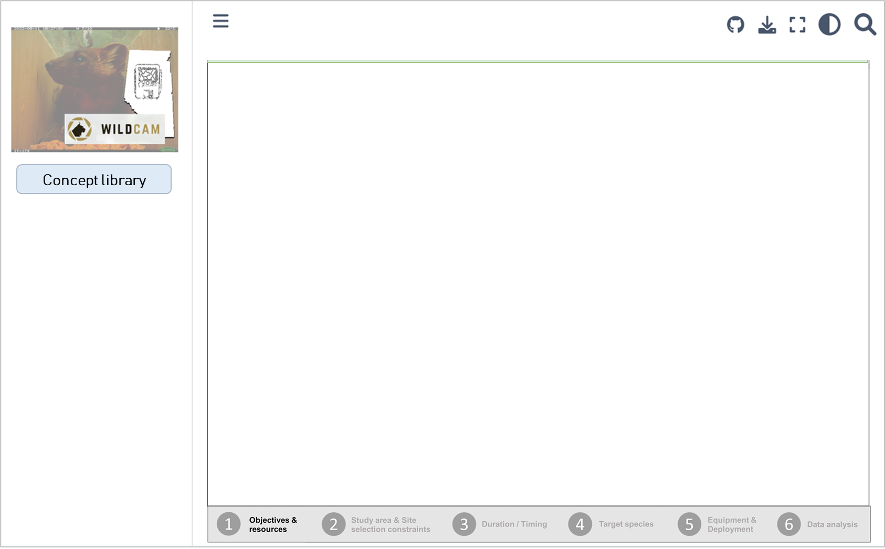
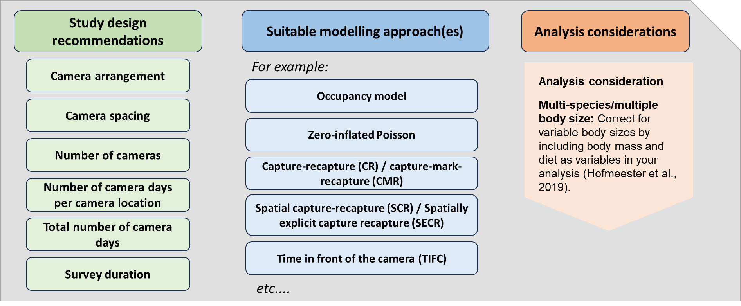
RC Decision Support Tool – Phase 2 (what’s next)
Camera arrangement
Random
Stratified
Targeted

Slide 8
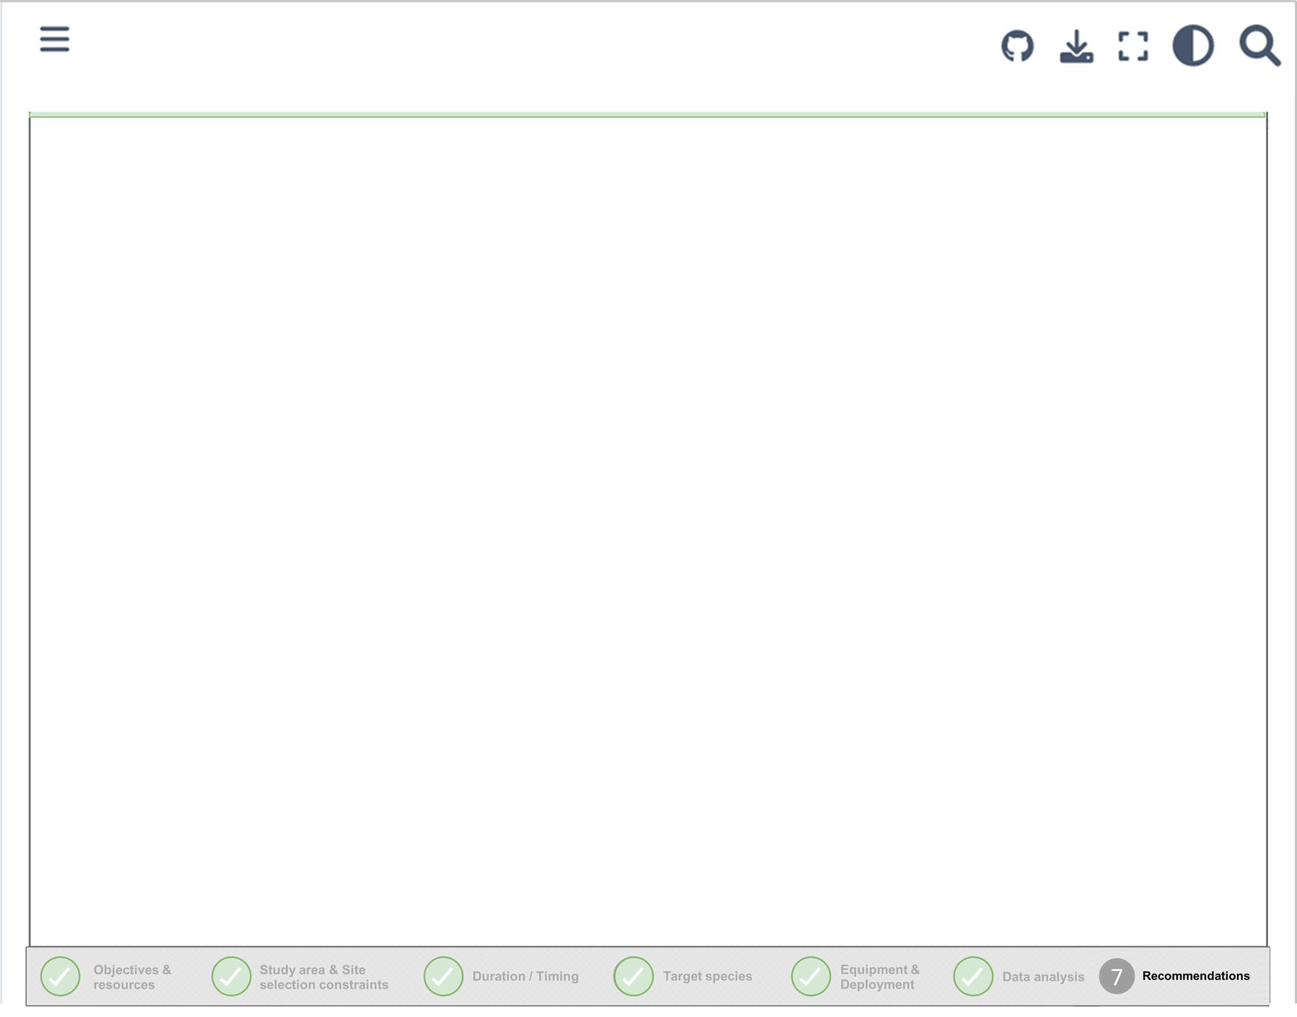
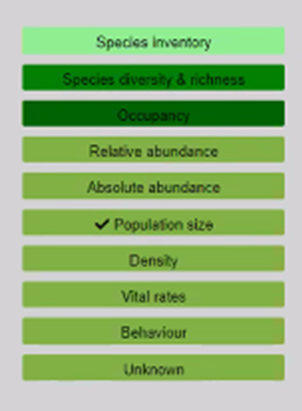
Random
Stratified
Targeted

Slide 9
cam_arrange_1==Targeted
cam_arrange_2==Random

Slide 10
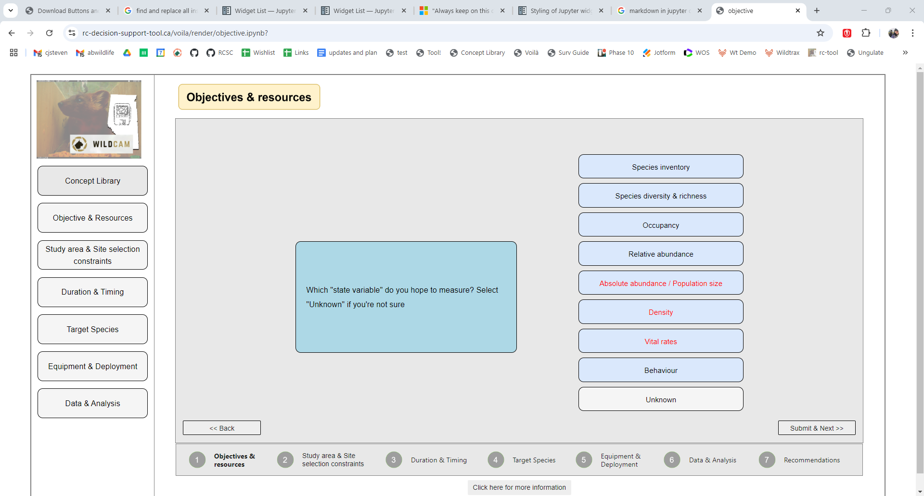
Current

Slide 11
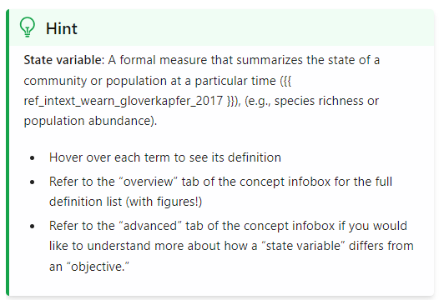
None-clickable button; because we’re going to want to change colours
Decrease size of question / answers, add text box on right. If able to use markdown, would be easier to format (see hint on right), but don’t get lost in trying to make this work
Text box; info populated from CSV for each page (or most).
color =#FFFFCC
Home
Start over
Concept library TOC
Glossary
References
Open concept infobox as separate window
Click here for more information
^^^ Check out:
https://ipywidgets.readthedocs.io/en/latest/examples/Widget%20List.html#accordion

