Slide 1

F1 Race Performance Analysis Tool
Group #23 (OOAD - Spring 2026)
Abhi Bhardwaj
Ankita Vilas Pimpalkar

Slide 2
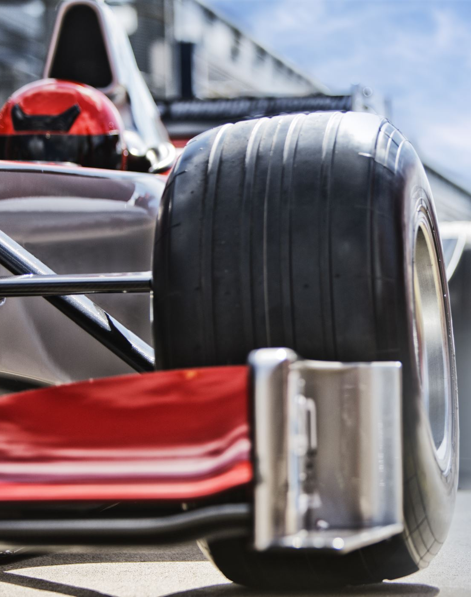
Project Description
The F1 Race Performance Analysis Tool is a web-based application that enables Formula 1 fans and analysts to explore and compare race performance data using the FastF1 API.
Users can select a specific season, race, and session, choose drivers to compare, and generate interactive visualizations including lap time comparisons, position tracking over laps, and tyre stint strategies.
The system retrieves real-time telemetry and timing data from the FastF1 library, processes it through a backend service, and presents the results as dynamic charts.
This tool bridges the gap between raw race data and meaningful visual insights, making it easier for enthusiasts and professionals to analyze race strategies and driver performance.

Slide 3
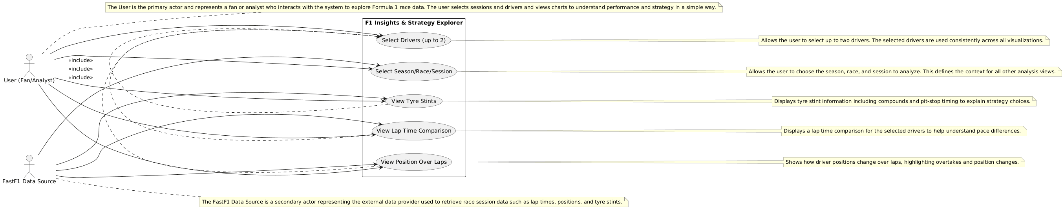
Use Case Model

Slide 4
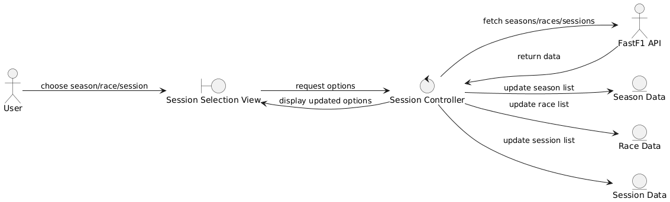
Robustness Diagram: Select Season, Race & Session

Slide 5
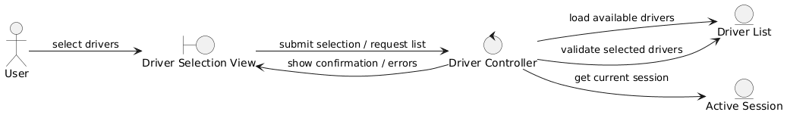
Robustness Diagram: Select Drivers

Slide 6
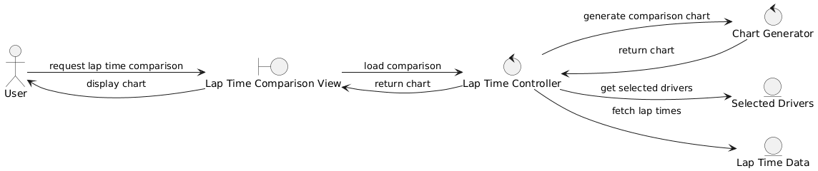
Robustness Diagram: View Lap Time Comparison

Slide 7
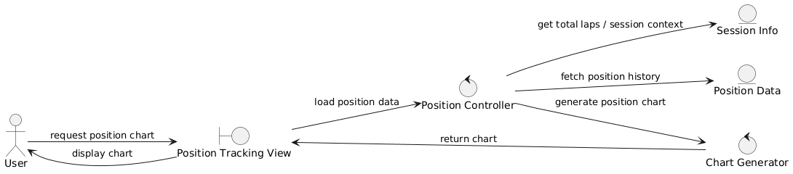
Robustness Diagram: View Position Over Laps

Slide 8
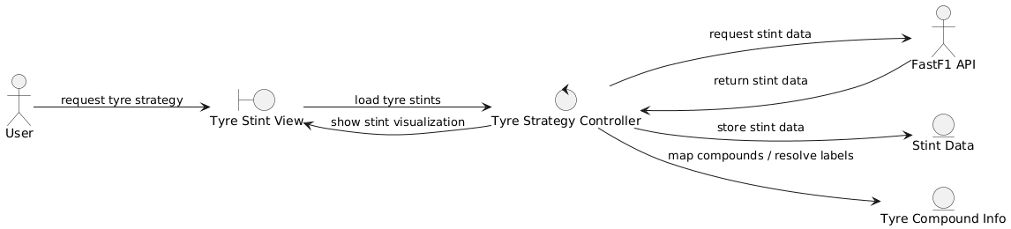
Robustness Diagram: View Tyre Stints

Slide 9
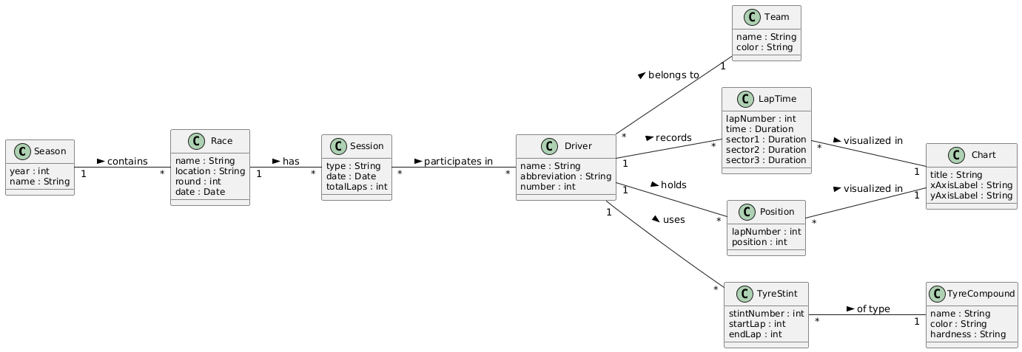
Domain Model (UML Class Diagram)

Slide 10
GitHub Repository
https://github.com/AnkitaVilasPimpalkar08/CSCI_6234_Spring_2026_G23

