Slide 1

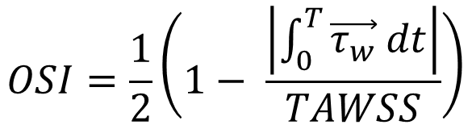
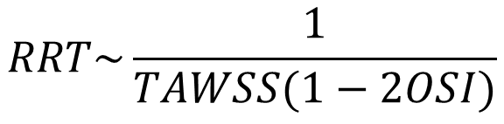
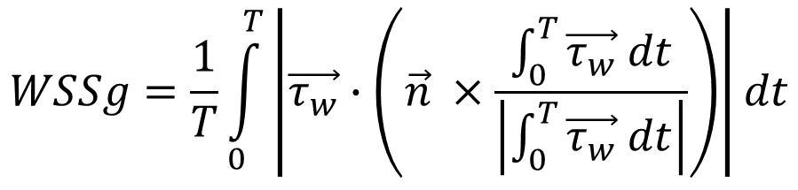
Post-Processing: TAWSS/OSI/RRT/WSSg/ECAP/HOLMES
$$TAWSS=\frac{1}{T}\int_{0}^{T}{\left|\vec{τ_{w}}\right|dt}$$
$$OSI=\frac{1}{2}\left(1− \frac{\left|\int_{0}^{T}{\vec{τ_{w}} dt}\right|}{TAWSS}\right)$$
Measures average of the degree of forward/backward fluid movement on a surface over time.
Measures average WSS on a surface over time.
$$WSSg=\frac{1}{T}\int_{0}^{T}{\left|\vec{τ_{w}}∙\left(\vec{n} ×\frac{\int_{0}^{T}{\vec{τ_{w}} dt}}{\left|\int_{0}^{T}{\vec{τ_{w}} dt}\right|}\right)\right|dt}$$
$$RRT\sim \frac{1}{TAWSS(1−2OSI)}$$
Measures a fluid particle’s relative time spent in a particular location on a surface over time.
Measures multidirectional WSS on a surface over time.

Slide 2
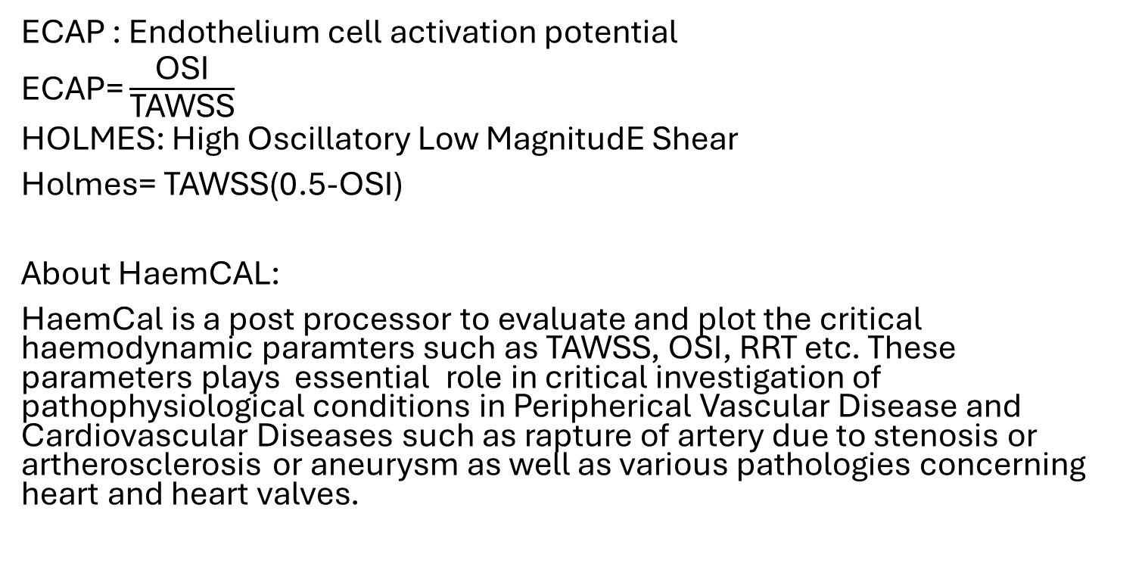
ECAP : Endothelium cell activation potential
ECAP= $\frac{\text{OSI}}{\text{TAWSS}}$
HOLMES: High Oscillatory Low MagnitudE Shear
Holmes= TAWSS(0.5-OSI)
About HaemCAL:
HaemCal is a post processor to evaluate and plot the critical haemodynamic paramters such as TAWSS, OSI, RRT etc. These parameters plays essential role in critical investigation of pathophysiological conditions in Peripherical Vascular Disease and Cardiovascular Diseases such as rapture of artery due to stenosis or artherosclerosis or aneurysm as well as various pathologies concerning heart and heart valves.

Slide 3
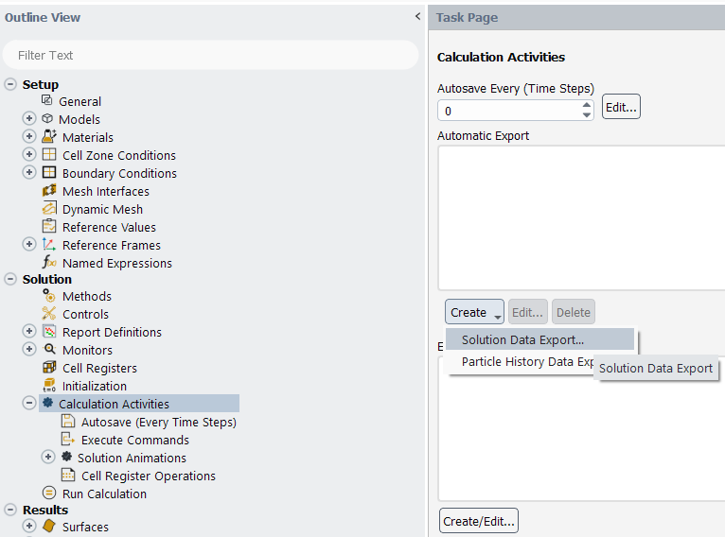
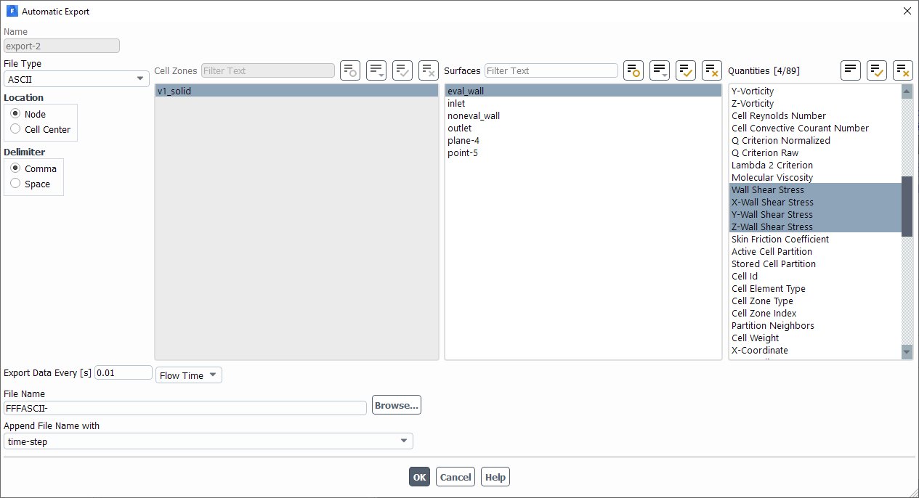
Setting Up Fluent Export
Calculation Activities → Create → Solution Data Export
File Type: ASCII
Location: Node
Delimiter: Comma
Surface: Surface whose OSI/TAWSS you’re interested in
Quantities: Wall Shear Stress and XYZ Wall Shear Stress

Slide 4
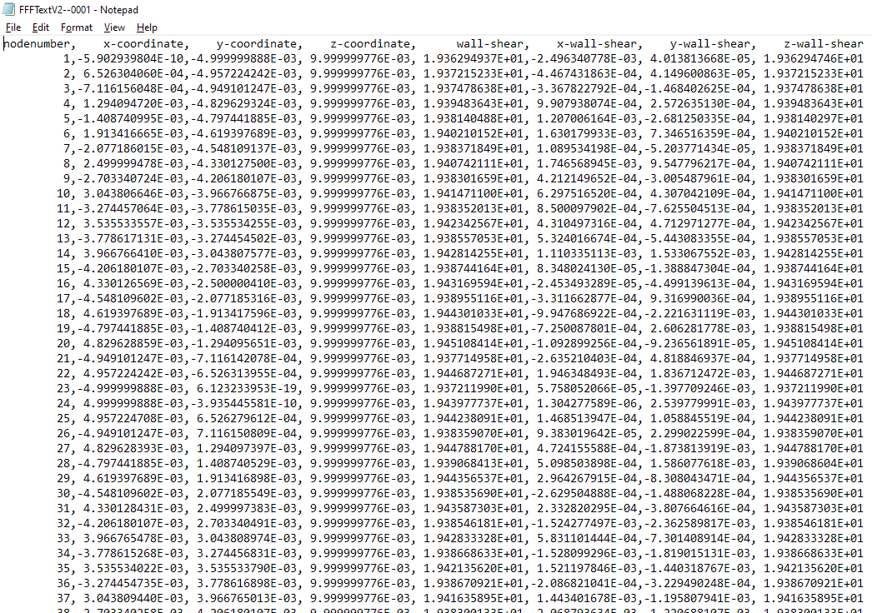
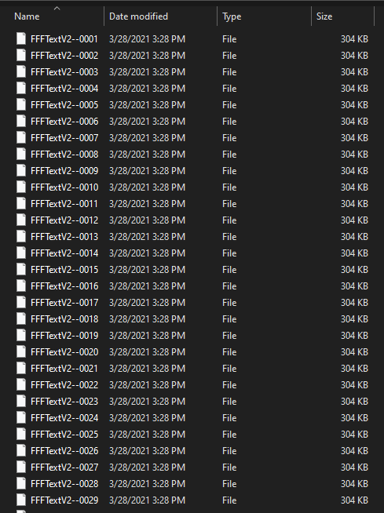
Exported Data

Slide 5
How to use:
Import ASCII files of solution output containing WSS, WSSx, WSSy, WSSz, x,y,z coordinate values. Use comma delimiter.
Enter the simulation start time( flow time of simulation for 1st file) in Start time.
Enter the simulation end time ( flow time corresponding to last file ) in End time.
Enter the time step size in Time step(s).
Enter the Cardiac cycle time for 1 cardiac cycle ( it can vary between 0.8 to 1 s).
If error comes that the number of time steps doesn’t match with number of files→ multiply time step size with number of files and replace the product with End time value.

Slide 6
Future Improvements
Proper surface/element plotting rather than point cloud
Reporting of Average +/- Standard Deviation for the exported surface

