Slide 1
Can one
SENTENCE
change your life?
The Power of Words
Notes:
0:00-0:20 HOOK. Look at the class. Ask slowly: 'Can ONE SENTENCE change your life?' Pause 3 seconds. Say: 'Today, one sentence nearly cost a man his life.' Do not explain 'sentence' yet - the pun comes back on slide 10.

Slide 2
1 · DESCRIBE
3
WHO
Nelson Mandela
WHEN
20 April 1964
hours
WHERE
Rivonia Trial,
from the dock
Notes:
0:20-0:50 DESCRIBE. Key words: my document = a speech / Nelson Mandela / 20 April 1964 / Rivonia Trial, South Africa / about 3 hours / from the dock = where the accused stands. Say it from memory, one fact per breath.

Slide 3
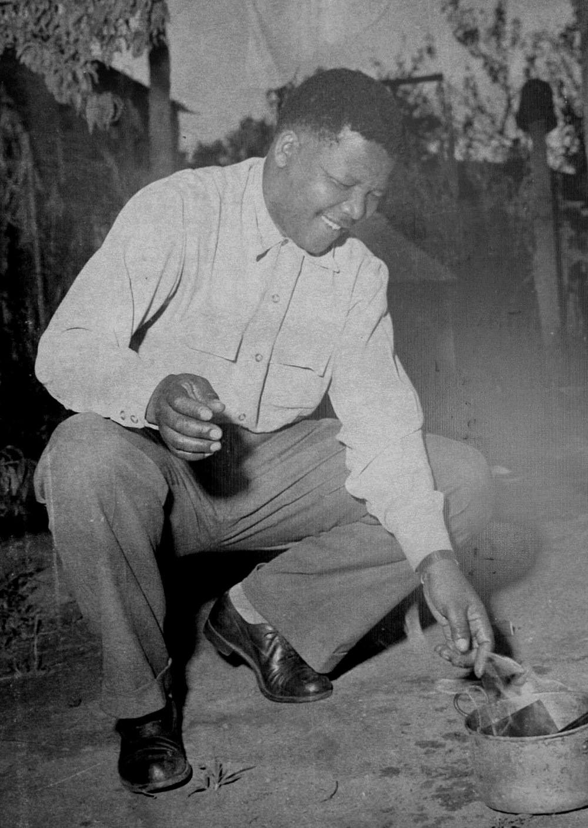
2 · CONTEXT
APARTHEID
Racist laws.
Unequal rights.
Photo: Mandela burning his pass, 1960. Public domain, Wikimedia Commons. Converted to black and white.
Notes:
0:50-1:10 CONTEXT. Key words: apartheid = racist laws, unequal rights / laws are made of WORDS / Mandela and others accused of sabotage / photo: 1960, he burns his pass (a document Black South Africans had to carry). Transition: 'In 1964 he stood in court.'

Slide 4
3 · EXPLAIN
His ideal
DEMOCRACY
an ideal
EQUALITY
HARMONY
Notes:
1:10-1:25 EXPLAIN. His ideal = a free and democratic society, everybody lives together in harmony, equal opportunities. Three words, one breath each: democracy, equality, harmony. Then: 'And here is how he ended.'

Slide 5
3 · EXPLAIN · THE LAST SENTENCE
It is an ideal
Nelson Mandela · 20 April 1964
Notes:
1:25-1:50 THE LAST SENTENCE (4 clicks). Click 1: 'It is an ideal'. Say nothing for a second.

Slide 6
3 · EXPLAIN · THE LAST SENTENCE
It is an ideal
for which
Nelson Mandela · 20 April 1964
Notes:
Click 2: 'for which'. Slow.

Slide 7
3 · EXPLAIN · THE LAST SENTENCE
It is an ideal
for which
I am prepared
Nelson Mandela · 20 April 1964
Notes:
Click 3: 'I am prepared'. Slow. Look at the class.

Slide 8
3 · EXPLAIN · THE LAST SENTENCE
It is an ideal
for which
I am prepared
to die.
Nelson Mandela · 20 April 1964
Notes:
Click 4: 'to die.' Then SILENCE - count 5 seconds in your head and look at the class in the eyes, like he looked at the judge (fact: he looked Judge de Wet in the eye on this line). Then say: 'He said this three hours into his speech.' Careful: do NOT say 'it was the first line' - it is the LAST line.

Slide 9



4 · HOW WORDS WORK
Three tools
IF NEEDS BE
REPETITION
CALM
he added it to the last sentence
I have fought against…
I have fought against…
“a calm and sober assessment”
Notes:
1:50-2:35 THREE TOOLS (about 15 s each). (1) IF NEEDS BE: lawyers wanted him to cut the last sentence (risk of death sentence). He refused but added 'if needs be'. (2) REPETITION: 'I have fought against white domination, and I have fought against black domination.' (3) CALM: 'a calm and sober assessment of the political situation' - reason, not anger. Link: 'Words can be soft AND strong.'

Slide 10

5 · LINK
One word, two meanings
WORDS
THE RISK
THE RESULT
His last
A death
A life
SENTENCE
SENTENCE?
SENTENCE
Notes:
2:35-3:00 WORD PLAY. Key words: 'sentence' has TWO meanings = words, and punishment. His last SENTENCE could lead to a death SENTENCE. Result: a life SENTENCE (prison for life, not death). Pause, smile: 'Words, again.' This is the payoff of the hook.

Slide 11
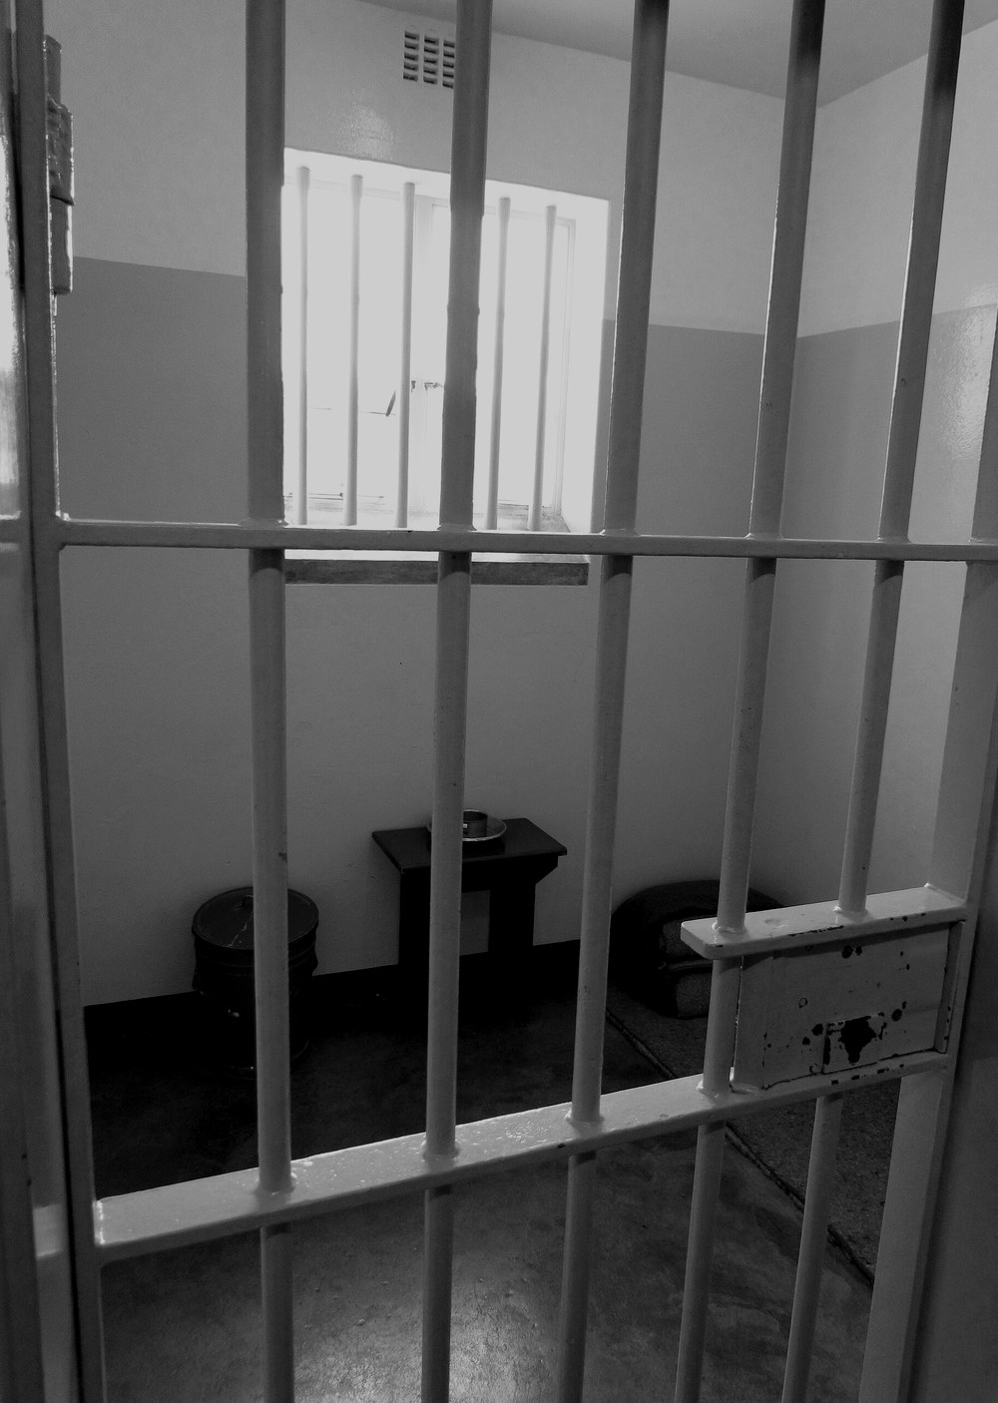
5 · LINK
WORDS
vs
POWER
He “dared” the judge.
Photo: Mandela's cell, Robben Island. © Schavda, CC BY-SA 3.0, Wikimedia Commons. Converted to black and white.
Notes:
3:00-3:25 LINK TO THEME (Art and Power). Key words: in court he had no weapons - only words / WORDS vs POWER / he believed his words 'dared' the judge / class notes: art can serve power (propaganda) OR challenge it - here, words CHALLENGE power. If asked: he did admit planning sabotage in this speech; he explained why. My focus = his words in court.

Slide 12
6 · WHY THIS DOCUMENT
Why this speech?
1
Life or death: real stakes
2
One man vs. a whole system
3
27 years later: president
And for me…
Notes:
3:25-3:45 JUSTIFY. Three reasons, one breath each: life or death = real stakes / one man against a whole system / 27 years later he was president. Then PAUSE and say your PERSONAL reason in ONE sentence: [WRITE IT HERE IN YOUR OWN WORDS BEFORE THE ORAL].

Slide 13
CONCLUSION
Words can control.
Words can FREE.
Which ideal would you speak up for?
Notes:
3:45-4:00 CONCLUSION. Back to the class question: 'How can words manipulate and control?' Words can control (apartheid = laws made of words)... but Mandela used words to FREE. End by asking the class, slowly: 'Which ideal would you speak up for?' Stop. Say 'Thank you.' Do not add anything after the question.

Slide 14
SOURCES · NOT PRESENTED
Speech facts: Wikipedia, “I Am Prepared to Die” (CC BY-SA 4.0).
Speech text: famous-trials.com, “I Am Prepared To Die”; Nelson Mandela Foundation / mandela.gov.za.
Photo (slide 3): Mandela burning his pass, 1960. Public domain, Wikimedia Commons.
Photo (slide 11): Mandela's cell, Robben Island. © Schavda, CC BY-SA 3.0, Wikimedia Commons.
Both photos converted to black and white. No AI-generated images.
Notes:
Do not present this slide. It is for the teacher / evidence of sources.

