Slide 1
Drinks Selection Program
CSE-1307
Nahidul Islam Khan - 41220300334
Zunayed Ahmed - 41220300324

Slide 2
Inheritance
Base Class
drinks
Derived Classes
softdrinks
juice
dairy
coffee_tea
Object Oriented Programming

Slide 3
Polymorphism
Function Overload
Function Override
Operator Override
Object Oriented Programming

Slide 4
START
DISPLAY OPTIONS
CHOOSE OPTION
FLOW CHART
OPTION 1
OPTION 2
OPTION 3
OPTION 4
ASK SIZE
CONFIRM
END

Slide 5
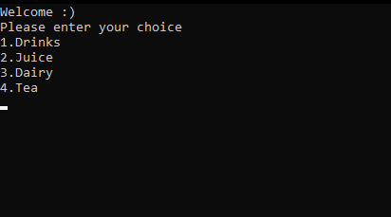
Output

Slide 6
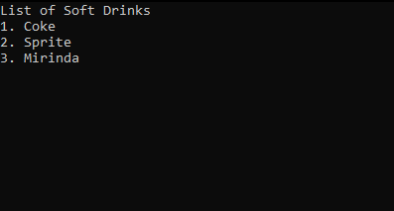
Output

Slide 7
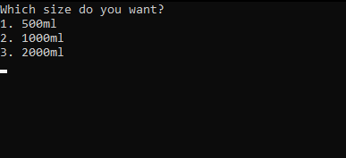
Output

Slide 8
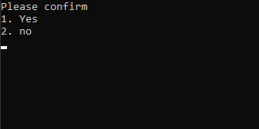
Output

Slide 9
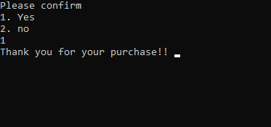
Output

Slide 10
END
THANK YOU

