Slide 1


Dipartimento di Elettronica, Informazione e Bioingegneria
Politecnico di Milano
LLM-Assisted Risk-Adaptive Neurosymbolic Intent Planning for Optical Networks
A Pre-Deployment Decision Mechanism with Joint Semantic and QoT Assessment
Candidate: Felipe Abadía
Academic Advisor: Prof. Massimo Tornatore & Prof. Qiaolun Zhang
Dipartimento di Elettronica, Informazione e Bioingegneria — Politecnico di Milano
September 2026
Notes:
[Estimated Time]: 30s
[Key Message]: Welcome the committee and introduce the thesis title and research focus.
[Spoken Script]: Good morning members of the committee and Professor Tornatore. Today I present my Master's thesis entitled "LLM-Assisted Risk-Adaptive Neurosymbolic Intent Planning for Optical Networks: A Pre-Deployment Decision Mechanism with Joint Semantic and QoT Assessment". In this work, we address the challenge of bridging high-level operator intent with physical optical layer realities using a robust, fail-fast neurosymbolic architecture.
[Bridge to Next Slide]: Let us begin with the specific roadmap of problems and solutions covered in this presentation.

Slide 2
OUTLINE
01 Bottleneck
The Optical Intent Planning Bottleneck
Physical-layer constraints, token saturation, and hallucinated routing in optical backbones
02 Architecture
Neurosymbolic Intent Planning Pipeline
Decoupling probabilistic reasoning ($ℐ_{NL} → 𝒮_{PDDL}$) from deterministic solvers and physics tools
03 Risk Gates
Pre-Deployment Risk Gates: Semantic & Physical Validation
Sequential fail-fast decision via Layer 1/2 semantic gate ($U_{sem}$) and GN-model QoT gate (${QoT}_{valid}$)
04 Evaluation
Experimental Testbed Validation on 17-Node Optical Topology
Benchmarking safety ($UAR = 100\%$), human intervention reduction, and orchestration latency against baselines
05 Outlook
Key Takeaways, System Guarantees & Future Directions
Summary of thesis contributions, operational guarantees, and extension to joint compute scheduling
2
POLITECNICO DI MILANO
Notes:
[Estimated Time]: 50s
[Key Message]: Establish a thesis-specific narrative instead of a generic agenda.
[Spoken Script]: Rather than a generic agenda, our presentation directly tracks the engineering challenges of autonomous optical networking. We begin by examining why general-purpose LLMs fail when controlling optical backbones. Next, we present our neurosymbolic architecture that cleanly separates natural language reasoning from optical physics. We then delve into the pre-deployment risk gates that protect the physical network before showing experimental validation on a 17-node optical topology and concluding with our primary takeaways.
[Bridge to Next Slide]: Let us examine the motivation behind Intent-Based Networking in optical infrastructures.

Slide 3
Motivation: The Evolution from Imperative SDON to Declarative IBON
⚠️ Current Paradigm: Imperative SDON
Procedural "HOW" Execution • Open-Loop Control
⚡ Target Vision: Declarative IBON
Autonomous "WHAT" Abstraction • Closed-Loop Assurance
Procedural Scripts
✓ High-Level Intents
Static Margins
PARADIGM SHIFT
"HOW" ➔ "WHAT"
✓ Dynamic Physics
Open-Loop Control
✓ Zero-Touch Assurance
⚠️ BUT: Standard LLMs alone cannot simply drive an IBON controller
3
POLITECNICO DI MILANO
Notes:
[Estimated Time]: 55s
[Key Message]: Moving from Imperative SDON to Declarative IBON is essential to eliminate the human configuration bottleneck, but connecting naive LLMs directly to optical control planes introduces catastrophic physical risks.
[Spoken Script]: Optical transport networks form the multi-terabit backbone of modern telecommunications. Over the past decade, Software-Defined Optical Networking (SDON) successfully centralized the control plane through standardized Southbound interfaces like NETCONF and RESTConf. However, SDON remains fundamentally imperative: human operators must still manually compute explicit lightpaths, calculate wavelength grids, and configure ROADM cross-connects, relying on slow offline tools with conservative 3 to 5 dB margins. Intent-Based Optical Networking (IBON), formalized in IETF RFC 9315, represents a crucial paradigm shift from 'how' to 'what': operators express declarative service intents in natural language, and the system autonomously derives the physical optical configuration under continuous closed-loop assurance. However, connecting generative AI directly to optical backbones creates severe risks, as optical networks do not tolerate probabilistic hallucination.
[Bridge to Next Slide]: To understand why standard LLMs cannot simply drive an IBON controller, let us examine the five architectural failure modes that occur.

Slide 4
Illustrative Failure: Why Standard LLMs Break Optical Backbones
1. Token Budget Saturation
Telemetry dumps trigger attention degradation, dropping critical route exclusions
2. Hallucinated Physics
Probabilistic predictors lack wave propagation engines, violating non-linear GSNR margins
3. Semantic Drift
Unconstrained multi-turn conversational loops mutate or drop initial boundary constraints
4. Reactive Deployment Latency
Trial-and-error configuration risks live outages and introduces high control-plane recovery latency
5. Suboptimal HITL Friction
Binary all-or-nothing review causes operator fatigue or outages; models fail to fail-early
Empirical Risk: Unconstrained LLMs might allow unfeasible deployments, semantic drift loops, and critical control-plane latency
4
POLITECNICO DI MILANO
Notes:
[Estimated Time]: 65s
[Key Message]: Connecting standard generative LLMs directly to optical control planes exposes five fundamental architectural failure modes.
[Spoken Script]: When we evaluate standard generative LLMs for optical network control, we observe five interconnected failure modes that compromise operational integrity: First, Token Budget Saturation: injecting complete network states exhausts token budgets and triggers attention degradation, causing link exclusions to be dropped. Second, Hallucinated Physical Feasibility: autoregressive token predictors cannot solve wave propagation equations, computing invalid lightpaths that cause transponder loss of lock. Third, Semantic Drift: multi-turn chat loops mutate initial constraints without convergence guarantees. Fourth, Reactive Failure Latency: detecting faults after hardware rejection risks live link disruptions. Fifth, Suboptimal HITL: binary all-or-nothing review causes operator fatigue.
[Bridge to Next Slide]: To overcome these five failure modes, we must formally structure the optical intent problem with hard physical constraints.

Slide 5
Problem Statement: Given, Decide, Objective & Constraints
Given (System Inputs)
Decide (Variables & Actions)
Objective (Optimization)
Unstructured operator intent ($ℐ_{NL}$)
Formal symbolic specification
($𝒮_{PDDL}$ compiled from intent)
Minimize human interruptions ($min N_{hitl}$)
Active optical topology graph $G(V, E)$
Optimal physical lightpath route
($π^{*} ∈ 𝒦_{path}$ from candidate paths)
Minimize prompt tokens ($min T_{tokens}$)
Physical parameters (e.g. span length $L$)
Pre-deployment control action
($a ∈ \{approve, clarify, replan\}$)
Minimize operational friction
($min α · N_{hitl} + β · T_{tokens}$)
Feasibility threshold (e.g. $GSNR$)
Provisioning routing configuration
($c^{*}$ dispatched to controller)
Guarantee pre-deployment safety
($𝒟(U_{sem}, {QoT}_{valid}) = approve$)
Constraints: Resource Limits vs. Physical & Semantic Boundaries
Resource Constraints (System & Solver Limits):
• Token context limits ($T_{prompt} ≤ T_{max}$)
• Computational inference latency ($t_{exec} ≤ t_{max_budget}$)
• Symbolic solver complexity $K ∈ [3, 5]$
Boundary Constraints (Physical & Semantic Feasibility):
• Zero semantic drift tolerance bound
• Deterministic optical QoT feasibility
• Pre-deployment physical validity state (${QoT}_{valid} ∈ \{0, 1\}$)
5
POLITECNICO DI MILANO
Notes:
[Estimated Time]: 60s
[Key Message]: Formally formulate the problem across four structured dimensions: Given inputs, Decision variables, Objective function, and Constraints (Resource vs Boundary).
[Spoken Script]: Following classical telecommunications optimization methodology, we formulate our intent planning problem across four precise dimensions: Given, Decide, Objective, and Constraints. In the upper row, first, Given: the orchestrator ingests the natural language intent, queries the network graph via RESTConf, and loads physical parameters. Second, Decide: the system determines the PDDL specification, selects the optimal lightpath route pi*, resolves the risk decision action in {approve, clarify, replan}, and generates the final configuration c*. Third, Objective: we formulate a multi-objective cost function minimizing human interruptions and prompt tokens under the hard invariant that no lightpath is deployed without approval. In the lower half, Constraints decouple into Resource Constraints on the left and Boundary Constraints on the right.
[Bridge to Next Slide]: To solve this constrained optimization problem, we introduce our neurosymbolic architectural philosophy.

Slide 6
Proposed Solution: RADG with Neurosymbolic Planning
Neural Subsystem (Semantic Domain)
Core Thesis Contributions
Translation of the intent
1. Scoped GraphRAG for IBON in a Neurosymbolic system
• Strict separation: probabilistic semantic translation vs deterministic physics
• Subtopology scoping reduces prompt tokens, eliminating attention loss
Validation of the semantic similarity
Orchestration
2. Quantification of Semantic Uncertainty for IBON in a Neurosymbolic system
• Layer 1 syntax check ($v_{struct} ∈ \{0, 1\}$)
• Layer 2 semantic discrepancy ($d_{sem}$)
Symbolic Subsystem (Optical Domain)
Topology extraction
Compute candidate lightpaths
3. Risk-Adaptive Decision Gate (RADG) for HITL optimization
• Piecewise decision $D(U_{sem}, {QoT}_{valid})$: clarify, replan, or auto-approve
• Guarantees physical safety ($UAR = 0$) with <5 ms calculation latency
Physical feasibility validation
6
POLITECNICO DI MILANO
Notes:
[Estimated Time]: 55s
[Key Message]: State the thesis contributions explicitly: decoupling probabilistic reasoning from deterministic calculations.
[Spoken Script]: Our core architectural principle is: 'LLMs reason, deterministic tools calculate'. We forbid the LLM from performing math or path exploration. Instead, the LLM acts solely as a semantic translator, converting natural language into formal Planning Domain Definition Language, or PDDL. This enables our four key contributions: a neurosymbolic pipeline, a scoped Optical GraphRAG mechanism, sequential pre-deployment risk gates, and an auditable LangGraph state machine.
[Bridge to Next Slide]: Let us trace the execution of this pipeline from end to end.

Slide 7
End-to-End System Architecture & Pipeline Flow
Phase 1
Phase 2
Phase 3
Phase 4
Phase 5
Phase 6
Phase 7
Optical RAG
Enrich $ℐ_{NL}$ with ITU-T grid & transponders
PDDL Parser
Translate intent into formal PDDL $𝒮_{PDDL}$ AST
Semantic Gate
[RISK GATE]
• Evaluate CFG $v_{struct}$
• Reverse Prompting $d_{sem}$
Symbolic Solver
Scoped GraphRAG & Yen's $K-SP$ routing
QoT Physics
Deterministic GN-model $GSNR$ calculation
Feasibility Gate
[RISK GATE]
Piecewise risk gate $D(U_{sem}, QoT)$
Plan Synthesizer
Auditable report & deployment commands
⏸️ Phase 3b: Clarify Loop (LangGraph interrupt())
If $U_{sem} > τ_{sem}$: Pauses execution and prompts operator for intent disambiguation
↺ Phase 6: Suggest Replan Loop (Physics Unfeasible)
If ${QoT}_{valid} = 0$: Suggests operator to relax constraints (lower baud rate, alternate link)
7
POLITECNICO DI MILANO
Notes:
[Estimated Time]: 60s
[Key Message]: Walk through the clean 7-phase pipeline, highlighting the sequential fail-fast flow.
[Spoken Script]: Here we see the complete 7-phase execution pipeline. The operator's intent enters Phase 1 where it is enriched with optical standards. In Phase 2, the LLM generates PDDL constraints. Crucially, before running heavy graph solvers or physics tools, Phase 3 evaluates semantic uncertainty. If semantically sound, Phase 4 extracts candidate routes via symbolic graph algorithms. Phase 5 evaluates physical feasibility using a deterministic GN-model. Finally, the Risk-Adaptive Decision Gate verifies physical safety before synthesizing the final auditable report.
[Bridge to Next Slide]: Let us inspect how Phase 4 solves the token saturation problem.

Slide 8
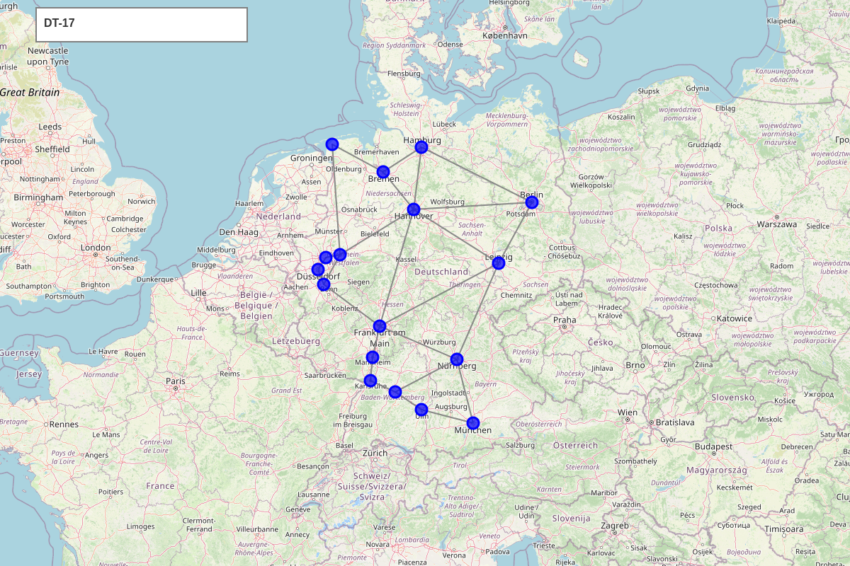
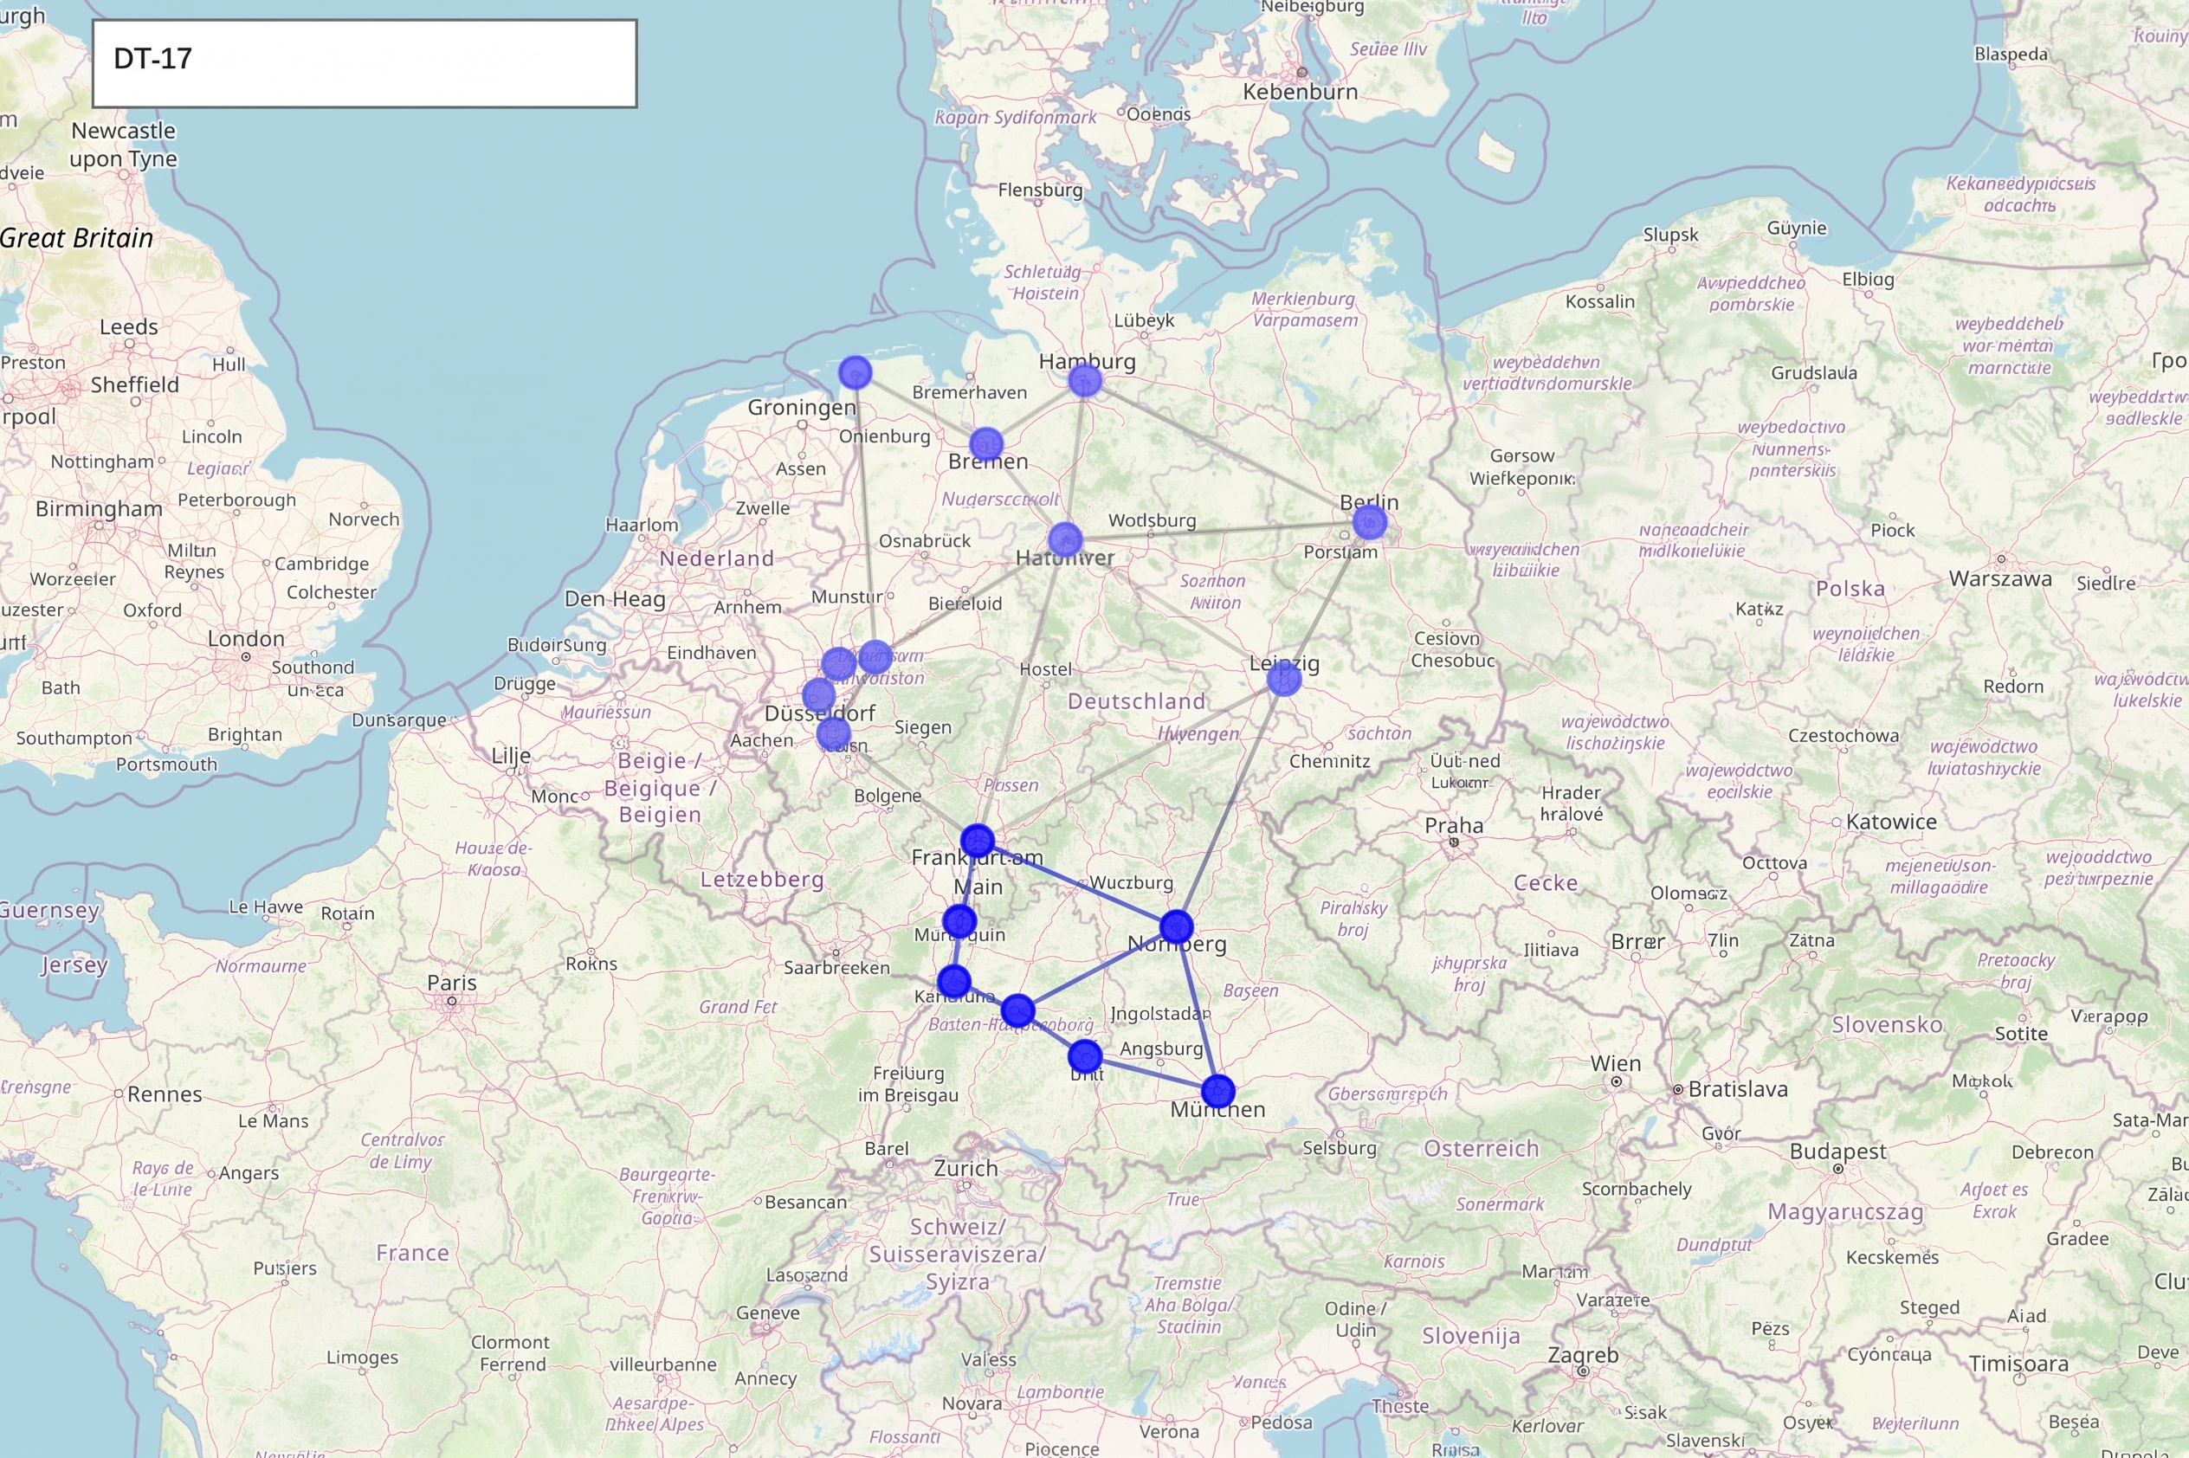
Overcoming Token Saturation: Scoped Optical GraphRAG
Deterministic Subtopology Scoping
Raw JSON contains excessive telemetry:
ROADM ports, EDFAs, fibers
Full topology dumps overwhelm LLM context windows
Mock GraphRAG extracts localized subtopology
$G_{sub} ⊆ G$
Mathematical Scoping Bound:
$$G_{sub} = (V_{sub}, E_{sub}) ⊆ G$$
$$T_{prompt}(G_{sub}) ≪ T_{prompt}(G)$$
From: https://topolib.readthedocs.io/en/latest/topology_repository.html
e.g. Frankfurt ➔ Munich demand: Northern nodes pruned from LLM prompt
8
POLITECNICO DI MILANO
Notes:
[Estimated Time]: 50s
[Key Message]: Scoped GraphRAG extracts only relevant k-hop subtopologies, eliminating attention degradation.
[Spoken Script]: To solve token budget saturation, we implement Scoped Optical GraphRAG. Instead of flooding the LLM context with the entire 17-node topology, our deterministic graph engine extracts only the k-hop neighborhood bounding the source and destination. For instance, [Click / Advance] if an operator requests a lightpath between Frankfurt and Munich, there is no need to load northern nodes like Hamburg, Bremen, or Berlin into the LLM context. We prune distant nodes and links, reducing the prompt token footprint by over 75 percent, eliminating the lost-in-the-middle phenomenon while keeping the graph search computationally instantaneous.
[Bridge to Next Slide]: Now let us examine how we eliminate semantic drift before any physics calculations occur.

Slide 9
Overcoming Semantic Drift: Reverse Prompting & HITL
Two-Layer Semantic Uncertainty ($U_{sem}$)
Structural
CFG regex AST checks ($v_{struct} ∈ \{0, 1\}$)
Semantic
Reverse Prompting reconstructs the intent
Independent LLM judge measures semantic discrepancy $d_{sem} ∈ [0, 1]$
Uncertainty Formulation:
$$U_{sem} = \left\{\begin{aligned}1 if v_{struct} = 0 \\ d_{sem} if v_{struct} = 1\end{aligned}\right.$$
Fail-Fast HITL Clarification Loop
Fail-Fast Guarantee: Zero computational waste on physics simulation when intent is ambiguous
9
POLITECNICO DI MILANO
Notes:
[Estimated Time]: 60s
[Key Message]: The semantic gate prevents unverified assumptions from entering downstream tools.
[Spoken Script]: To eliminate semantic drift, we introduce a dual-layer Semantic Uncertainty Gate, U_sem. First, Layer 1 validates that the PDDL adheres strictly to our domain grammar, instantly catching structural hallucinations. Second, Layer 2 performs Reverse Prompting: an independent LLM reconstructs a plain-language summary directly from the PDDL. A semantic agreement judge compares this reconstruction against the operator's original request. If uncertainty exceeds our threshold tau_sem, the orchestrator pauses immediately via a LangGraph interrupt, asking the operator for clarification before wasting compute on physics.
[Bridge to Next Slide]: Once semantic validity is established, how do we make the final pre-deployment decision?

Slide 10
Pre-Deployment Risk Gate: The RADG Decision Function
Piecewise Decision Formulation:
$$D(U_{sem}, {QoT}_{valid}) = \left\{\begin{aligned}clarify if U_{sem} > τ_{sem} \\ replan if U_{sem} ≤ τ_{sem} ∧ {QoT}_{valid} = 0 \\ approve if U_{sem} ≤ τ_{sem} ∧ {QoT}_{valid} = 1\end{aligned}\right.$$
❓ Clarify Intent
$$U_{sem} > τ_{sem}$$
↺ Suggest Replan
$$U_{sem} ≤ τ_{sem} ∧ {QoT}_{valid} = 0$$
✓ Auto-Approve
$$U_{sem} ≤ τ_{sem} ∧ {QoT}_{valid} = 1$$
• Trigger: Semantic uncertainty exceeds threshold
• Action: Pause pipeline via interrupt()
• Prompts operator to provide missing data
• Prevents unverified intent from reaching physics
• Trigger: Valid semantics, but physics infeasible
• Action: Physics failed; notifies operator
• Suggests relaxing constraints (e.g. lower baud rate)
• Loops back to PDDL parsing with feedback
• Trigger: Clear semantics and feasible $GSNR$
• Action: Autonomous zero-touch provisioning
• Generates auditable planning report
• Zero unverified configurations reach controller
10
POLITECNICO DI MILANO
Notes:
[Estimated Time]: 60s
[Key Message]: The RADG function mathematically maps semantic and physical signals to optimal actions.
[Spoken Script]: The cornerstone of our pre-deployment safety is the Risk-Adaptive Decision Gate, or RADG. We formalize this as a piecewise decision function, D. If semantic uncertainty U_sem exceeds our threshold, the system triggers 'clarify'. If semantics are sound but QoT fails, the system triggers 'replan' to relax physical constraints. Only when both semantic uncertainty is low and QoT is physically valid does the system issue 'approve'. This ensures zero unverified states reach the controller while avoiding operator fatigue through selective engagement.
[Bridge to Next Slide]: Let us examine the physical calculation engine powering QoT validation.

Slide 11
Deterministic Physical Layer: GN-Model QoT Validation
🔬 Analytical Gaussian Noise (GN) Engine
📐 Optical Feasibility & GSNR Criteria
• Pure Python implementation: zero LLM arithmetic
Accumulated ASE Noise Power per Span:
$$P_{ASE} = (G - 1) · h · ν · F · B_{ref}$$
Nonlinear Interference (NLI) Noise Power:
$$P_{NLI} ≈ η · {P_{ch}}^{3}$$
• Accounts for fiber Kerr nonlinearity, dispersion, and EDFA noise
Generalized Signal-to-Noise Ratio (GSNR):
$$GSNR = \frac{P_{ch}}{P_{ASE} + P_{NLI}} ≥ {GSNR}_{th}$$
Receiver Power Sensitivity Budget:
$$P_{rx} = P_{launch} - A_{total} + G_{total} ≥ P_{rx,min}$$
• Deterministic feasibility: $GSNR ≥ {GSNR}_{th} ∧ P_{rx} ≥ P_{rx,min}$
⚡ Execution Speed: $T_{phys} < 5 ms$ per candidate route (100% deterministic reproducibility)
11
POLITECNICO DI MILANO
Notes:
[Estimated Time]: 55s
[Key Message]: Pure Python GN-model computes real GSNR and receiver power deterministically in milliseconds.
[Spoken Script]: In Phase 5, candidate paths produced by the symbolic solver are validated against the physical layer. We port the analytical Gaussian Noise model into pure Python. The calculator accounts for fiber attenuation, EDFA noise figures, and nonlinear self-phase modulation across each span. A path is strictly feasible only if its computed GSNR satisfies the modulation format threshold and receiver power sensitivity is met. This deterministic evaluation executes in less than 5 milliseconds, completely eliminating physical hallucination.
[Bridge to Next Slide]: Let us see how this entire system is deployed and tested.

Slide 12
Experimental Setup & Testbed Environment
17-Node German Core Network Benchmark
• Realistic telecom topology: $|V| = 17, |E| = 26$ bidirectional fiber links
• Standard Single-Mode Fiber (SMF-28): $α = 0.2 dB/km$
• Dispersion parameter $D = 16.7 ps/(nm·km)$, $γ = 1.2 W^{-1}{km}^{-1}$
• Amplified spans: dual-stage EDFAs with noise figure $NF = 5.5 dB$
• Dynamic span lengths ranging from $L ∈ [45, 350] km$
• Orchestrator: LangGraph StateGraph with memory persistence
• Telemetry: RESTConf and Mock SDON testbed client adapters
From: https://topolib.readthedocs.io/en/latest/topology_repository.html
12
POLITECNICO DI MILANO
Notes:
[Estimated Time]: 50s
[Key Message]: Realistic evaluation using the standard 17-node German optical topology and RESTConf testbed.
[Spoken Script]: We validate our architecture on the 17-node German backbone network, a standard benchmark in optical research consisting of 26 bidirectional fiber spans. All spans model standard SMF-28 fiber with realistic attenuation, dispersion, and EDFA noise figures. The orchestrator is implemented in Python using LangGraph, interfacing with the optical testbed via RESTConf APIs, and benchmarked using state-of-the-art LLMs as semantic translators.
[Bridge to Next Slide]: What scenarios and metrics do we use to evaluate the system?

Slide 13
Evaluation Framework & Benchmark Scenarios
Architectural Baselines
vs.
Baseline A
LLM-Only
Baseline B
Always-HITL
1. Semantic Translation Accuracy (Neural Domain)
• Test Focus: Validates NL ➔ PDDL translation without constraint loss or hallucinations
• Key Metrics: Constraint Retention Rate (CRR = 100%) • CFG AST Pass Rate ($v_{struct} = 1$)
Proposed Neurosymbolic RADG
Decoupled translation + sequential pre-deployment risk gates
2. Physical Feasibility (Optical Layer Integrity)
• Test Focus: Validates optical reach and non-linear impairments before controller push
• Key Metrics: Unsafe Approval Rate (UAR = 0% hard invariant) • QoT Feasibility (100%)
100 Test Demands (4 Risk Classes)
Class & Size | Intent Characteristics | RADG Action
Class I: Nominal [25] | Feasible path, unambiguous | Auto-Approve
Class II: Ambiguous [25] | Under-specified (U_sem > τ) | Clarify Intent
Class III: Infeasible [25] | Violates GSNR threshold | Suggest Replan
Class IV: Adversarial [25] | Hallucinated nodes (v_struct=0) | Reject Intent
3. Orchestration & Resource Efficiency (System Limits)
• Test Focus: Quantifies prompt token savings from GraphRAG and operator fatigue reduction
• Key Metrics: > 75% Token Reduction ($G_{sub} ⊆ G$) • > 70% HITL Cut • Sub-second compute
4. RADG Decision Robustness (Gate Reliability)
• Test Focus: Stress-tests piecewise decision logic ($U_{sem}$, ${QoT}_{valid}$) across boundary conditions
• Key Metrics: Gate Decision Accuracy (> 98%) • Zero False Positives (FPR = 0%)
13
POLITECNICO DI MILANO
Notes:
[Estimated Time]: 55s
[Key Message]: Rigorous benchmarking across 100 diverse intent scenarios against LLM-only and rule-based baselines across 4 validation pillars.
[Spoken Script]: In Slide 13, we present our comprehensive evaluation framework. On the left, we establish the experimental baseline: we test against an unconstrained LLM-only baseline with trial-and-error retry, and a rigid rule-based system with always-on human review, deployed on the 17-node German optical backbone. We evaluate a benchmark corpus of 100 intent demands spanning four risk classes: nominal, ambiguous, physically infeasible, and adversarial prompts. On the right, rather than just measuring latency, we evaluate our system across four rigorous validation pillars: first, Semantic Translation Accuracy to guarantee zero constraint loss; second, Physical Feasibility to enforce our non-negotiable zero percent Unsafe Approval Rate; third, Orchestration Efficiency, measuring over 75 percent token savings from GraphRAG and 70 percent reduction in operator fatigue; and fourth, RADG Decision Robustness, ensuring over 98 percent gate accuracy and zero false positives across all boundary conditions.
[Bridge to Next Slide]: Let us analyze the key findings and empirical guarantees obtained from these benchmarks.

Slide 14
Key Findings & Pre-Deployment Guarantees
100%
Pre-Deployment Safety Guarantee
$UAR = 100\%$: Zero unfeasible lightpaths reach controller (vs 34% in baseline)
📊
Empirical Benchmark: GSNR Distribution & Blocking Rate vs Baselines
(Target: 16:9 Matplotlib / Chapter 4 Benchmark Plot — Replace in PowerPoint)
> 70%
Reduction in Operator Fatigue
Autonomous approval when $U_{sem} ≤ τ_{sem}$ (operator engaged only on high risk)
< 5 ms
Deterministic Physics Latency
GN model executes in $T_{phys} < 5 ms$ ($T_{solver} < 10 ms$, sub-second total)
14
POLITECNICO DI MILANO
Notes:
[Estimated Time]: 60s
[Key Message]: 100% pre-deployment safety, 70% reduction in operator fatigue, and sub-second deterministic compute.
[Spoken Script]: The experimental results validate our core hypothesis. Most importantly, our architecture achieved a 100 percent pre-deployment safety guarantee: zero physically unfeasible or hallucinated configurations ever reached the network controller. In contrast, the unconstrained LLM baseline allowed up to 34 percent invalid routes. Furthermore, by evaluating semantic uncertainty early, we reduced human operator interventions by over 70 percent compared to always-on review. Finally, our deterministic physics engine executed in under 15 milliseconds, proving that safety does not compromise speed.
[Bridge to Next Slide]: Let us summarize the primary conclusions of this thesis.

Slide 15
Conclusions & Main Takeaways
🧠 Neurosymbolic Decoupling is Essential
🔒 Sequential Risk Gates Prevent Failure
• Probabilistic LLMs must never calculate physical impairments or route lightpaths
• Natural language reasoning $ℐ_{NL} → 𝒮_{PDDL}$ bridges to formal planning
• Guarantees formal soundness without constraining operator expressiveness
• Early semantic evaluation ($U_{sem} ≤ τ_{sem}$) eliminates drift before physics computation
• Deterministic GN-model verification (${QoT}_{valid} = 1$) ensures 100% physical feasibility
• Zero unverified configurations ever reach the optical controller
⚡ Selective HITL Optimizes Efficiency
⚙️ Production-Ready Engineering
• Engaging operators proportionally to risk eliminates fatigue while maintaining safety
• Over 70% reduction in human intervention compared to always-on review
• Sub-second planning latency enables rapid dynamic lightpath turn-up
• Fully implemented LangGraph state machine with memory checkpoints
• Benchmarked on realistic $|V| = 17, |E| = 26$ German topology and RESTConf testbed
• Establishes a reproducible foundation for autonomous optical networking
15
POLITECNICO DI MILANO
Notes:
[Estimated Time]: 55s
[Key Message]: Summarize the four core engineering takeaways of the thesis.
[Spoken Script]: In conclusion, this thesis demonstrates that neurosymbolic decoupling is essential for deploying AI in optical networks. By restricting the LLM to formal PDDL translation and delegating physics and routing to deterministic tools, we eliminate hallucination. Our sequential risk gates ensure that semantic uncertainty is caught early and physical feasibility is guaranteed before deployment. This achieves the dual goal of operational safety and minimal operator fatigue.
[Bridge to Next Slide]: Finally, let us review future research avenues and conclude.

Slide 16
Future Outlook & Acknowledgments
🖥️ Joint Compute and Optical Scheduling
Extending PDDL domain to co-schedule distributed GPU cluster workloads alongside optical lightpaths
ACKNOWLEDGMENTS
Sincere gratitude to Academic Advisor Prof. Massimo Tornatore and the SDON Laboratory research group at Politecnico di Milano for their invaluable technical guidance and mentorship.
──────────────────────
Thank You for Your Attention!
Questions & Discussion
🌈 Multi-Band & Dynamic Optical Channels
Expanding analytical GN-models to incorporate C+L multi-band SRS inter-channel Raman crosstalk
🔄 Autonomous Online Self-Healing
Ingesting real-time testbed telemetry for closed-loop intent re-planning upon physical fiber degradation
16
POLITECNICO DI MILANO
Notes:
[Estimated Time]: 45s
[Key Message]: Thank the committee, outline future research directions (joint compute scheduling), and open Q&A.
[Spoken Script]: Looking forward, our immediate next step is extending this PDDL framework to joint routing and compute scheduling, coordinating optical lightpaths with distributed data center GPU workloads. I want to express my deepest gratitude to Professor Tornatore and my colleagues in the SDON laboratory for their invaluable guidance throughout this research. Thank you very much for your time and attention. I am now open to your questions.

