Slide 1
User Story
Candidate Datasets
As a retail, cafe, restaurant, or bar business looking for commercial office space in the CBD I want to know the density businesses (by ANZSIC code) so I can rent commercial space either where there are few similar businesses or many similar or complementary businesses.
I want to know the density of residential dwellings in these areas of interest so I may determine the commercial viability of establishing a office or retail outlet there.
Residential Dwellings (rm92-h5tq)
Residential dwellings 2020 | Open Data | Socrata (melbourne.vic.gov.au)
Business establishment's location and industry classification (vesm-c7r2)
Business establishment and industry classification 2020 | Open Data | Socrata (melbourne.vic.gov.au)
Cafe, restaurant, bistro seats (dyqx-cfn5)
Cafe, restaurant, bistro seats 2020 | Open Data | Socrata (melbourne.vic.gov.au)

Slide 2
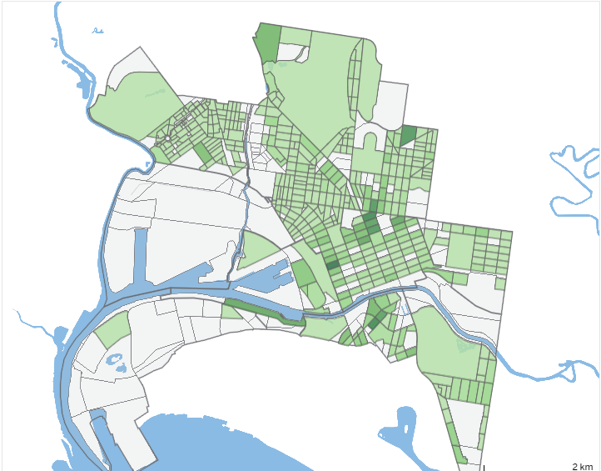
DATASET
Residential Dwellings (rm92-h5tq)
EXAMPLE DATASET VISUALISATION
Dwelling Density by CLUE Block
(Source: CLUE interactive visualisation - City of Melbourne)
Time
Census Year
Location
CLUE Small Area - 13 CLUE areas
Block ID - 606 Blocks
Lat,Long
Address
Dwelling Information
Dwelling Type eg. Apartments
Number of Dwellings eg. 192
DATA PROFILE

Slide 3
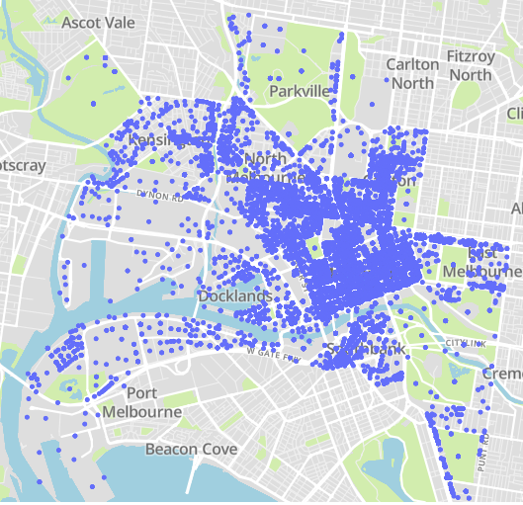
DATASET
Business establishment's location and industry classification (vesm-c7r2)
EXAMPLE DATASET VISUALISATION
Business Establishments by Location
Time
Census Year
Location
CLUE Small Area - 13 CLUE areas
Block ID - 606 Blocks
Lat,Long
Address
Business Information
ANZSIC4 Code,ANZSIC4 Description
DATA PROFILE

Slide 4
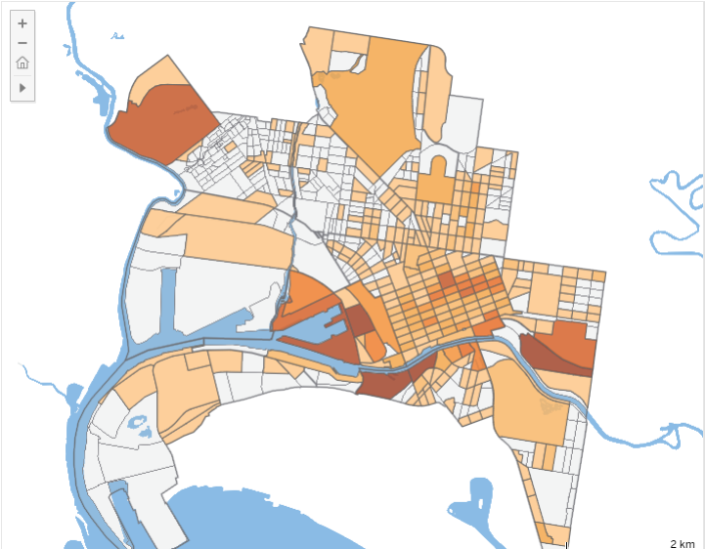
DATASET
Cafe, restaurant, bistro seats (dyqx-cfn5)
EXAMPLE DATASET VISUALISATION
Cafes & Restaurants by CLUE Block
(Source: CLUE interactive visualisation - City of Melbourne)
Time
Census Year
Location
CLUE Small Area - 13 CLUE areas
Block ID - 606 Blocks
Lat,Long
Address
Business Information
ANZSIC4 Code,ANZSIC4 Description
Seating Type
Number of Seats
DATA PROFILE

Slide 5
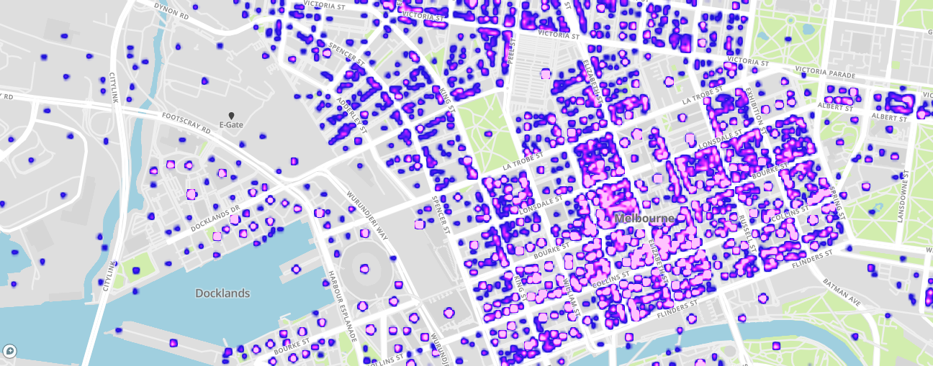
EXAMPLE USER STORY VISUALISATION
Description of Visualisation

Slide 6
PROJECT LINKS
City of Melbourne Open Data
City of Melbourne - Open Data Portal | Open Data | Socrata
CLUE Overview | https://www.melbourne.vic.gov.au/about-melbourne/research-and-statistics/city-economy/census-land-use-employment/Pages/clue.aspx
How CLUE Works | https://www.melbourne.vic.gov.au/about-melbourne/research-and-statistics/city-economy/census-land-use-employment/Pages/how-clue-works.aspx
CLUE Data | https://data.melbourne.vic.gov.au/stories/s/CLUE/rt3z-vy3t?src=hdr
Melbourne Open Data Playground
Open Data Playground (amazonaws.com)
Melbourne Open Data Playground GitHub
GitHub - D2I-Melbourne/POCOM: For capstone project unit of Deakin University

