Slide 1
Classification Machine Status Goal / Overview Title: Predict if a machine is working or faulty. Dataset Snapshot
Unique ID | Product ID | Quality | Ambient T (C) | Process T (C) | Rotation Speed (rpm) | Torque (Nm) | Tool Wear (min) | Machine Status
1 | K12965 | M | 24.95 | 35.45 | 1551 | 42.8 | 0 | 0
2 | Z62710 | L | 25.05 | 35.55 | 1408 | 46.3 | 3 | 0
3 | T20224 | L | 24.95 | 35.55 | 1498 | 49.4 | 5 | 0
4 | Z33024 | L | 25.05 | 35.45 | 1433 | 39.5 | 7 | 0
5 | Z52839 | L | 25.05 | 35.55 | 1408 | 40.0 | 9 | 0
Data Overview
Number of records: 20,000
Number of features: 9 (7 numerical, 2 categorical)
Target Variable: Machine Status (0 = working, 1= faulty)
- Unique ID is an identifier so exclude it from modeling.
Missing Values
Quality - 991
Process T (C) - 400
Rotation Speed (rpm) - 1188
Others - 0

Slide 2
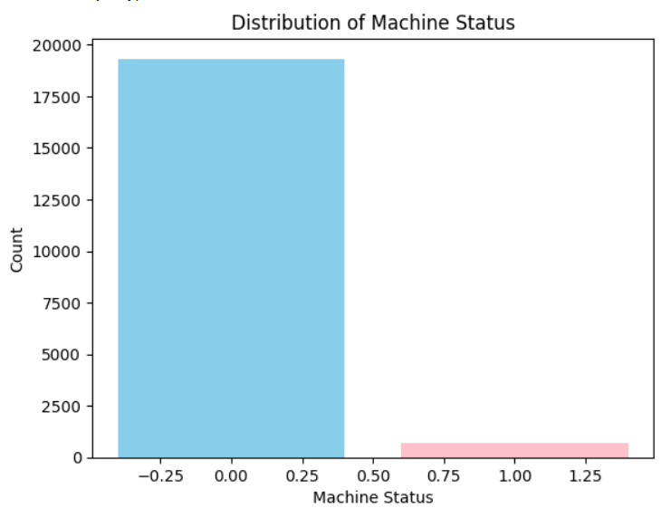
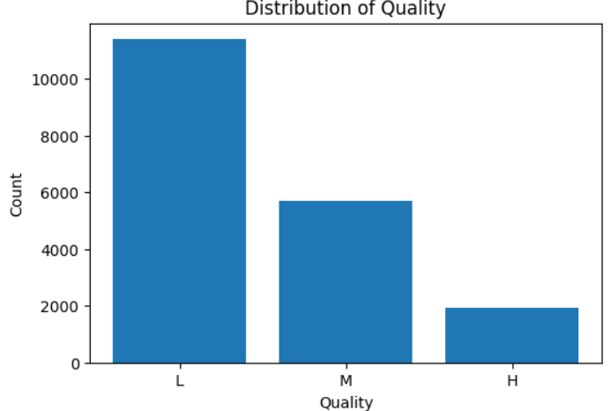
EDA & Data Cleaning Bar chart: Machine Status counts
Categorical Features
Bar chart: Quality counts
Quality L is the most common, followed by M, while H is the least frequent.
This means the dataset is slightly imbalanced across quality groups.
Insight: Highly imbalanced dataset (96.6% working,
3.4% faulty) Implication: Need to consider class imbalance in model metrics
Boxplots: Each numeric feature vs Machine Status
Histogram: Distribution of numeric features
-To compare the distribution with respect to Machine Status
Ambient T ~ multimodal, low variance
Process T ~ normal, low variance
Rotation Speed ~ right-skewed, high variance
Torque ~ normal , high variance
Tool Wear ~ uniform, high variance
Data Cleaning
1. Missing values
- Process T (C) & Rotation Speed (rpm) → filled with median (robust to outliers)
- Quality → filled with mode
Numerical
Features
2. Data types
- Converted categorical features → category type.

Slide 3
Feature Engineering & Preprocessing Categorical Features Feature: Quality Action: One-Hot Encoding applied (drop first to avoid multicollinearity) Categorical encoding applied ✅
Added Three New Features:
Torque_per_Speed = Torque ÷ Rotation Speed
→ captures mechanical stress
Temp_Diff = Process − Ambient Temperature
→ flags overheating
Torque_per_ToolWear = Torque ÷ Tool Wear
→ indicates wear-related issues
Dropped Columns
Unique ID and Product ID removed → no predictive value
Torque dropped in Linear Regression → to prevent multicollinearity
Dropped irrelevant identifiers ✅
Original Quality | Quality_L | Quality_M
L | 1 | 0
M | 0 | 1
H | 0 | 0
Numerical Features
Features: Ambient T, Process T, Rotation Speed, Torque, Tool Wear
Action: StandardScaler applied (mean=0, std=1)
Numeric features scaled ✅
Pipelines for Models
Each model uses the same preprocessing pipeline
Logistic Regression, KNN, SVC → scaling required
Decision Tree, Random Forest → scaling not required
Preprocessor + Classifier pipeline applied ✅

Slide 4
Model Selection & Performance Model Comparison Table
Hyperparameter Tuning with Optuna
Optimized Decision Tree for Recall
Best hyperparameters: max_depth=18, min_samples_split=2, min_samples_leaf=1, criterion=‘entropy’, max_features: 'sqrt'
Accuracy ↑ (0.992 → 0.994) Recall ↑ (0.875 → 0.882) Precision ↑ (0.888 → 0.923) F1 Score ↑ (0.881 → 0.902)
Model | Accuracy | Precision | Recall | F1
Logistic Regression | 0.973 | 0.776 | 0.279 | 0.411
KNN | 0.979 | 0.800 | 0.500 | 0.615
SVC | 0.976 | 0.855 | 0.346 | 0.492
Decision Tree | 0.992 | 0.888 | 0.875 | 0.881
Random Forest | 0.994 | 0.991 | 0.816 | 0.895
Decision Tree chosen for highest recall (0.875), critical for detecting faulty machines.
Confusion Matrix: [[3854 10]
[ 16 120]]
Low false positives → few working machines flagged
Low false negatives → most faulty machines detected

Slide 5
Feature Importance & Improvements Feature Importance – Optimized Decision Tree
Feature Engineering Improvements
New features added:
Torque_x_Rotation → combines torque and rotation speed for stronger signal
Wear_x_Torque → reflects combined effect of tool wear and torque
Temp_Ratio = Process Temperature ÷ Ambient Temperature → indicates abnormal temperature conditions
Preprocessing:
Categorical: Quality → One-Hot Encoding
Numerical: StandardScaler
Pipeline: Preprocessor + Decision Tree
Goal: Provide the model with domain-relevant numeric features to improve detection of faulty machines.
Feature | Importance
Torque (Nm) | 0.334
Temp_Diff | 0.274
Tool Wear (min) | 0.134
Rotation Speed (rpm) | 0.102
Torque_per_Speed | 0.053
Ambient T (C) | 0.036
Quality_L | 0.029
Process T (C) | 0.021
Torque_per_Tollwear | 0.015
Quality_M | 0.003
Torque & Temp_Diff → most predictive for machine faults
Tool Wear & Rotation Speed → moderate influence
Torque_per_Speed, Ambient T, Process T → some contribution
Quality (categorical) → low contribution
Decision Tree prefer numerical features with high information gain.
Baseline vs Tuned Decision Tree Performance
Metric | Baseline | Tuned(Feature Eng+Optuna)
Accuracy | 0.992 | 0.996
Precision | 0.888 | 0.947
Recall | 0.875 | 0.919
F1 Score | 0.881 | 0.933
Precision ↑ (0.923 → 0.947) → fewer false positives
Recall ↑ (0.882 → 0.919) → better detection of faulty machines
F1 Score ↑ (0.902 → 0.933) → overall balance improved

