Slide 1
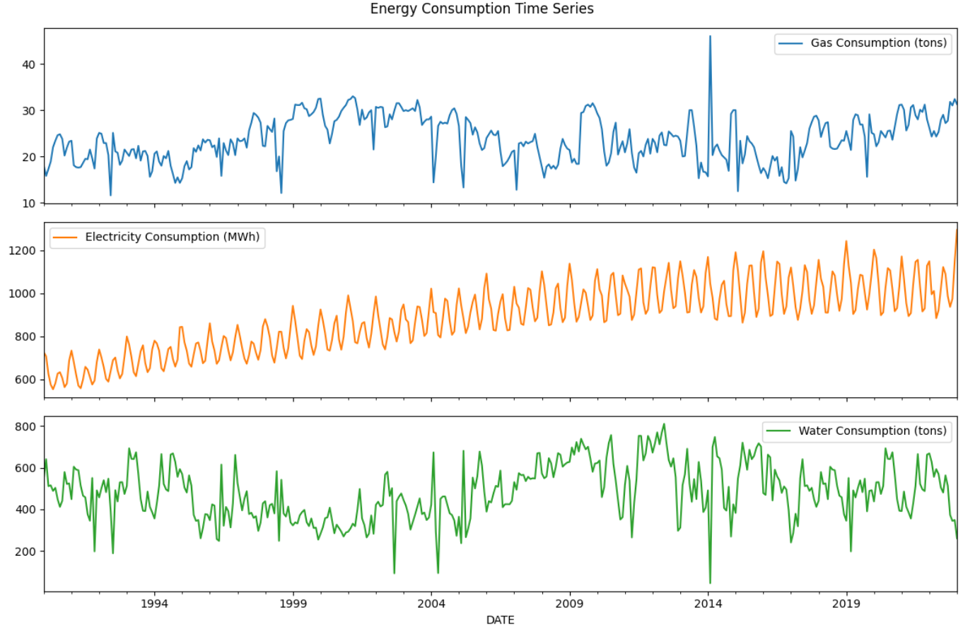
Part B: Time Series-energy consumption forecasting Title: Understanding the Energy Consumption Time Series
Dataset: 397 monthly records
Features: Gas (tons), Electricity (MWh), Water (tons)
Data Preparation:
Converted DATE to datetime
Set DATE as index for time series analysis
Set the time series frequency to monthly start (MS)
Goals of plotting:
Identify trend, seasonality, outliers, variability
Perform preprocessing and model selection
Key Observations
Gas: moderate upward trend, high volatility, occasional spikes → may require smoothing
Electricity: clear upward trend, strong seasonality, stable fluctuations → suitable for trend-based models
Water: irregular, noisy, weak seasonal pattern → forecasting may be challenging

Slide 2
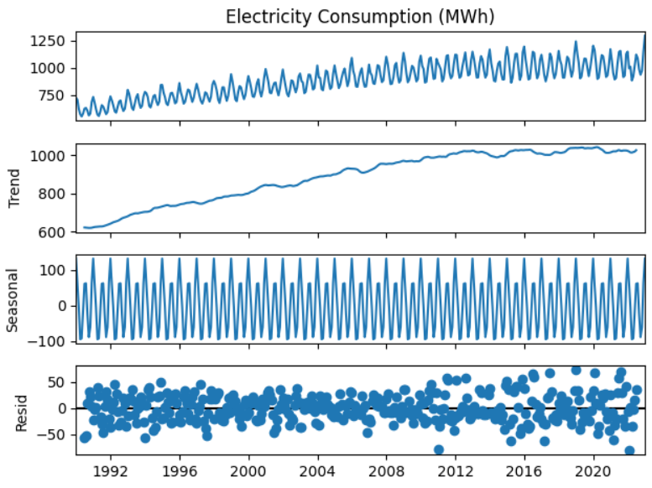
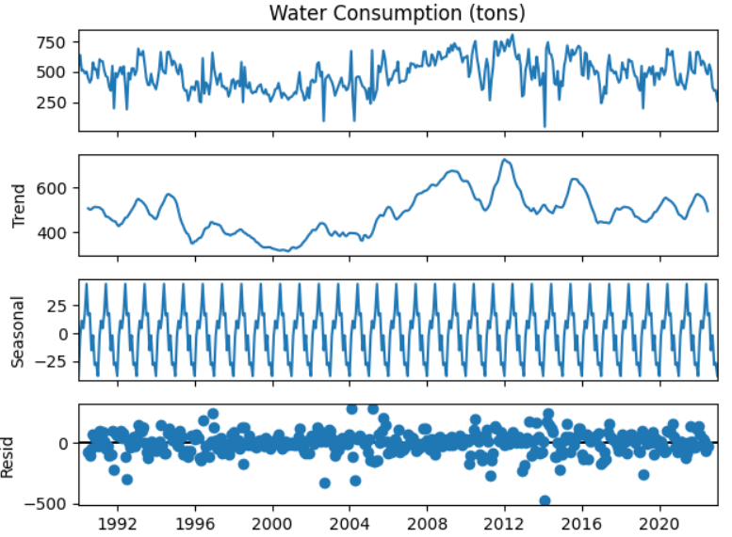
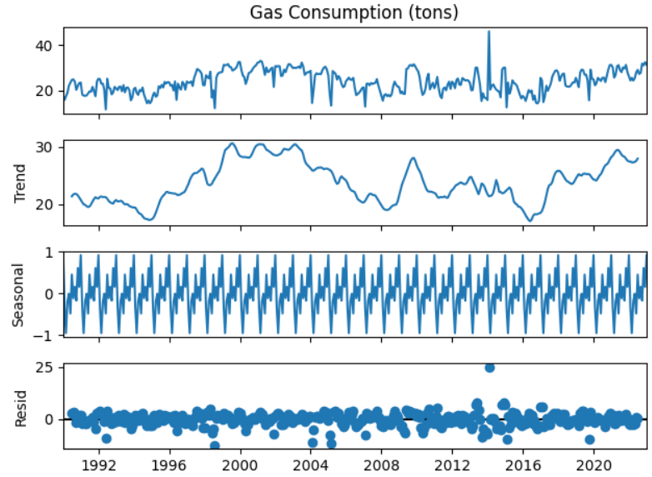

Title: Train / Validation / Test Split & Preprocessing
Data Split
Split by time, no shuffling
Training: first 70% (277 records)
Validation: next 15% (60 records)
Testing: last 15% (60 records)
Maintain chronological order can
avoid data leakage
Preprocessing Steps
Seasonal Decomposition (Monthly, period=12)
Gas: moderate trend, strong seasonality, irregular spikes
Electricity: strong upward trend, obvious seasonal pattern, stable residuals
Water: weak trend, noisy series, irregular seasonal pattern, several extreme values
Stationarity check (ADF test)
Gas & Water: stationary (p < 0.05) → use original series
Electricity: non-stationary (p > 0.05) → first-order differencing (d=1)

Slide 3
Title: Model Selection & Hyperparameter Tuning
Model Choice
Separate models for Gas, Electricity, Water due to different trends, seasonality, and volatility
Gas: SARIMA → seasonal structure, moderate volatility
Electricity: SARIMA → strong trend + seasonality, after differencing
Water: ARIMA & ETS → noisy series, ETS smooths extreme volatility
Baseline Models (before tuning)
Gas: SARIMA(1,0,1)(0,0,1,12)
Electricity: SARIMA(1,1,1)(0,1,1,12)
Water: ARIMA(1,0,1) / ETS (Additive trend + additive seasonality)
Observations
Gas: captures general level + short-term autocorrelation, may underrepresent seasonal spikes
Electricity: effectively captures trend + seasonality
Water: ETS better handles noise than ARIMA
Hyperparameter Tuning (Grid search)
Goal: minimize MAPE & RMSE on validation set
SARIMA (Gas & Electricity): tune (p,d,q) + (P,D,Q,s)
ETS (Water): tune trend type (none/add/mul), seasonal type (none/add/mul), damped type (True/False)
Metric: MAPE and RMSE
Series | Model | Baseline MAPE/RMSE | Tuned MAPE/RMSE | Notes
Gas | SARIMA | 0.201 / 5.702 | 0.208 / 5.636 | Slight lower RMSE, MAPE improved
Electricity | SARIMA | 0.062 / 70.667 | 0.025 / 33.055 | Significant improvement
Water | ETS | 0.391 / 174.608 | 0.377 / 165.291 | ETS outperforms ARIMA, moderate improvement
Key Insight
For Electricity, seasonal differencing (D=1) alone is sufficient → d=0 chosen
Tuning improves forecast accuracy, especially for Electricity and Water

Slide 4
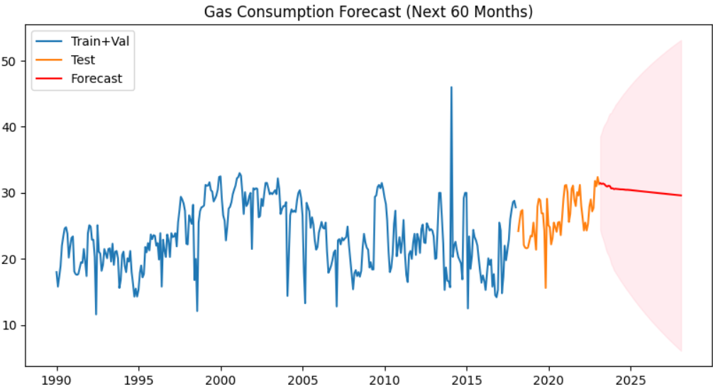
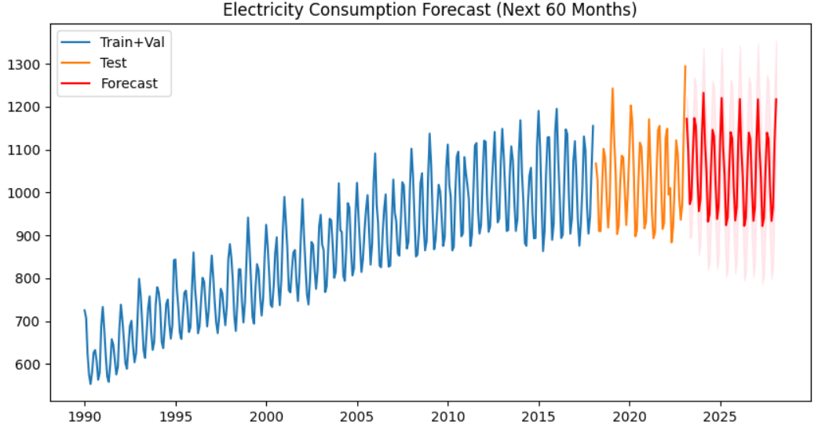
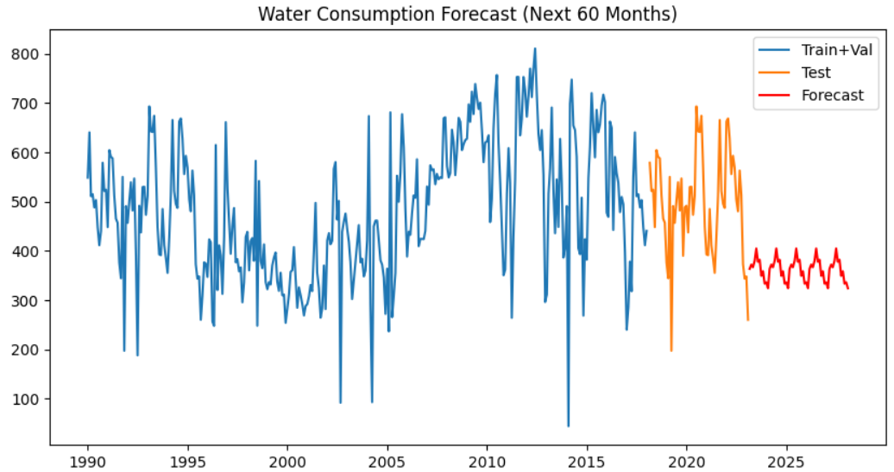
Title: Evaluation on Test Set & 60-Month Forecasting
Evaluation setup
Retrained tuned model on Train + Validation
Evaluated performance on Test set
Metrics: MAPE and RMSE
Forecast plots used for visual fit assessment
Series | Model | MAPE/RMSE | Note
Gas | SARIMA | 0.117 / 3.73 | Underestimates upward trend
Electricity | SARIMA | 0.028 / 41.60 | Best fit, strong seasonality captured
Water | ETS | 0.179 / 104.23 | High volatility, smooth predictions
Gas
Predictions relatively flat and downward
Residuals show autocorrelation → missing structure
Electricity
Predictions closely follows seasonal peaks and troughs
Residuals centered around zero → good model fit
Water
Smoother and fail to capture sudden spikes
Large residual swings and strong autocorrelation
Indicates noise-dominated series
Conclusion
Electricity series is highly predictable
Gas and water present structural and volatility challenges
Gas
Relatively flat and slightly downward trend
Stable forecast with widening confidence intervals
Electricity
Continues upward trend with seasonal peaks
Confidence intervals increasing uncertainty over time
Water
Mean-reverting and smooth
Limited ability to capture spikes
Key Observation
Forecast reliability strongly depends on the underlying time series structure. Seasonal and stable series outperform volatile and noisy ones.

Slide 5
Title: Model Improvement Through Tuning & Seasonality
Objective
Evaluate whether hyperparameter tuning and seasonality modeling improve forecasting accuracy
Compare baseline vs tuned models using test-set metrics
Baseline vs Tuned Performance
Gas
Minor improvements due to weak seasonal structure
Electricity
Largest improvements after tuning
Explicit seasonality modeling greatly reduced MAPE and RMSE
Water
Limited improvements due to high noise and irregular spikes
Why Improvement Worked (or Didn’t)
Successful improvement
Electricity has strong seasonality
SARIMA effectively captures trend + seasonal components
Limited improvement
Water series dominated by randomness
Even optimized models struggle with extreme volatility
Discussion: Outliers
No explicit outlier removal performed
Rationale:
Preserve real consumption behavior
Avoid subjective assumptions
Impact:
Increased error for water forecasts
Future improvements
Include exogenous variables (e.g. weather, population)
Handle outlier and noise
Compare with more advanced models
Final Conclusion
Electricity forecasting is highly robust
Gas and Water require richer data or more complex modeling
Model improvement depends more on data characteristics than model complexity

