Slide 1
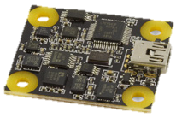
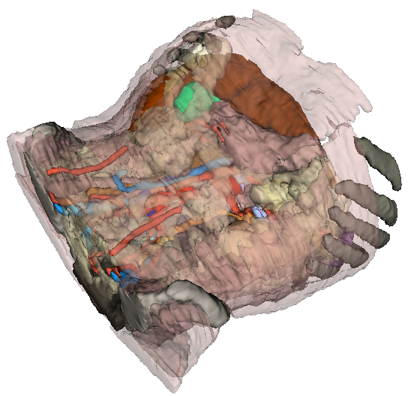
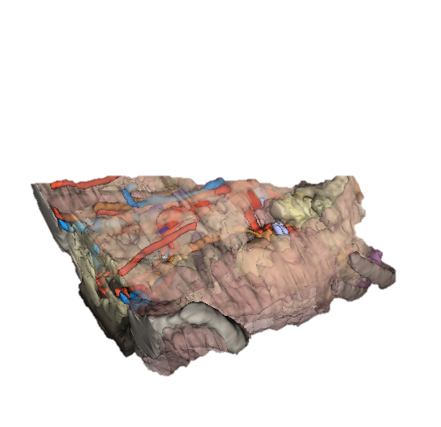
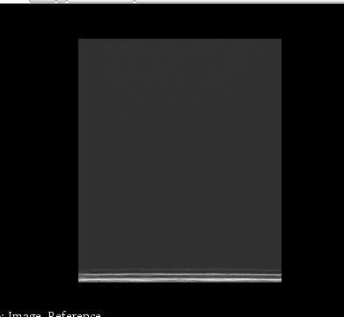
ImageToTransd
(from scan conversion)
OriSensorToOriSwd
(from PhidgetSpatial)
Z
Z
X
X
X
Transd = OriSensor
Image
OriSwd
Y
Z
Y
Y
OriSwdToRef
(from Slicer, by mouse)
Z
Ref = Renderer
Y
X
PhantomToRef
(from landmark registration or manual adjustment)
Z
Phantom
Y
X

Slide 2
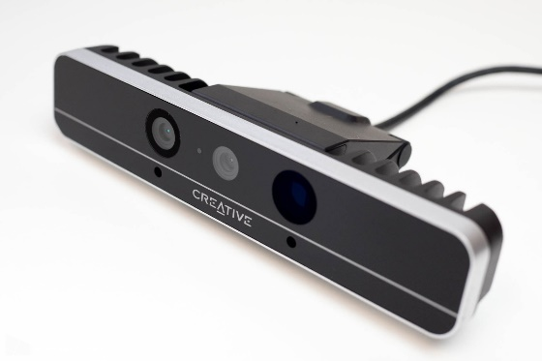
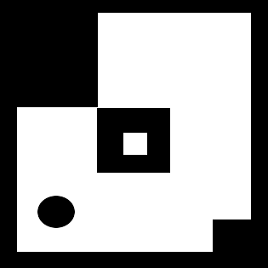
X
X
Y
Z
Probe
Y
Z
ImageToTransd
(from scan conversion)
OriSensorToOriSwd
(from PhidgetSpatial)
Z
Z
X
X
X
Transd = OriSensor
Image
OriSwd
Y
Z
Y
Y
OriSwdToRef
(from Slicer, by mouse)
Z
Ref = Renderer
Y
X
PhantomToRef
(from landmark registration or manual adjustment)
Z
Phantom
X
Y
X
Y
Z

Slide 3
Reference frame name | Origin | Unit | Axes directions
Tracker | Origin of the tracking system (position of the field generator, camera, etc.) | mm | as defined by the tracking system manufacturer
Stylus | Origin of the marker that is attached to the pointer tool | mm | as defined by the tracking system / marker manufacturer
Probe | Origin of the marker that is attached to the ultrasound probe (transducer) | mm | as defined by the tracking system / marker manufacturer
Ref | Origin of the marker attached to the object of interest (phantom, cadaver, patient, etc.) | mm | X: patient Right Y: patient Anterior Z: patient Superior
StylusTip | Tip of the stylus | mm | X axis: aligned with the Stylus coordinate system's X axis (unless StylusTip Z axis is parallel with the StylusTip Z axis - in this case the StylusTip Y axis is aligned with the Stylus X axis). Y axis: chosen to be the cross product of the Z and X axes. Z axis: the axis that points from the Stylus coordinate system origin towards StylusTip coordinate syste origin.
Image | Position of the pixel that is in the origin of the MF oriented image | pixel | X axis: towards the marked side of the transducer Y axis: towards the direction that points away (far) from the transducer Z axis: cross product of X and Y
Transducer | Center of the transducer crystal array | mm | X axis: towards the marked side of the transducer Y axis: towards the direction that points away (far) from the transducer Z axis: cross product of X and Y

