Slide 1
ABCD: an integrated Library Management System
Procedure to Import the WINISIS Database in ABCD

Slide 2
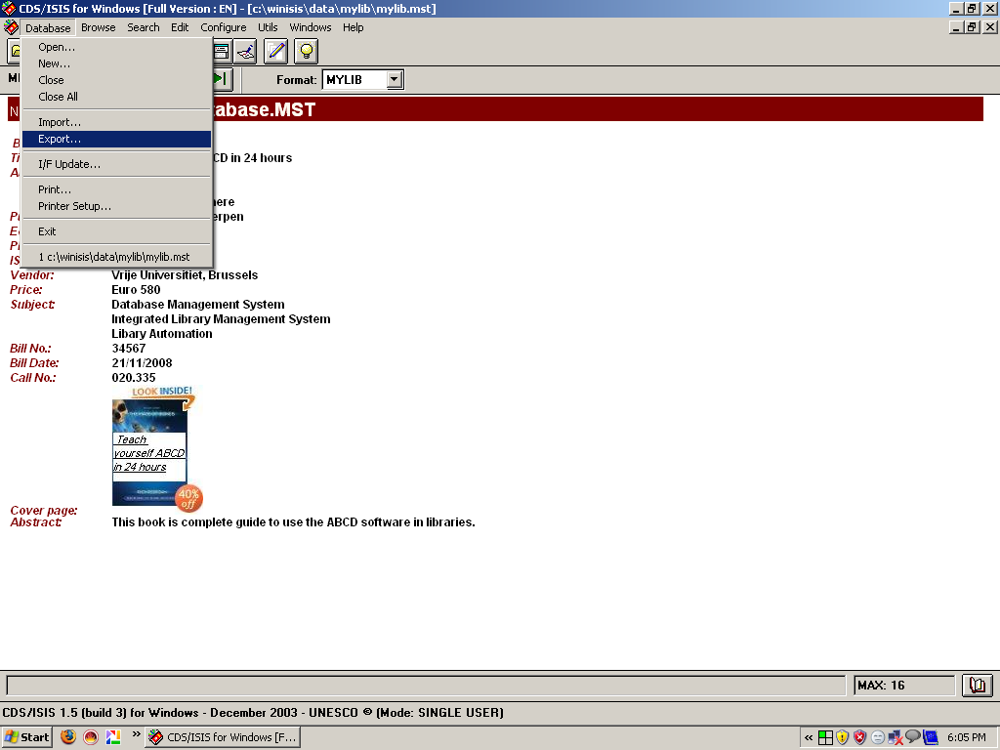
Exporting the database from Winisis
Open the Winisis Database and Click on Export in Database menu.

Slide 3
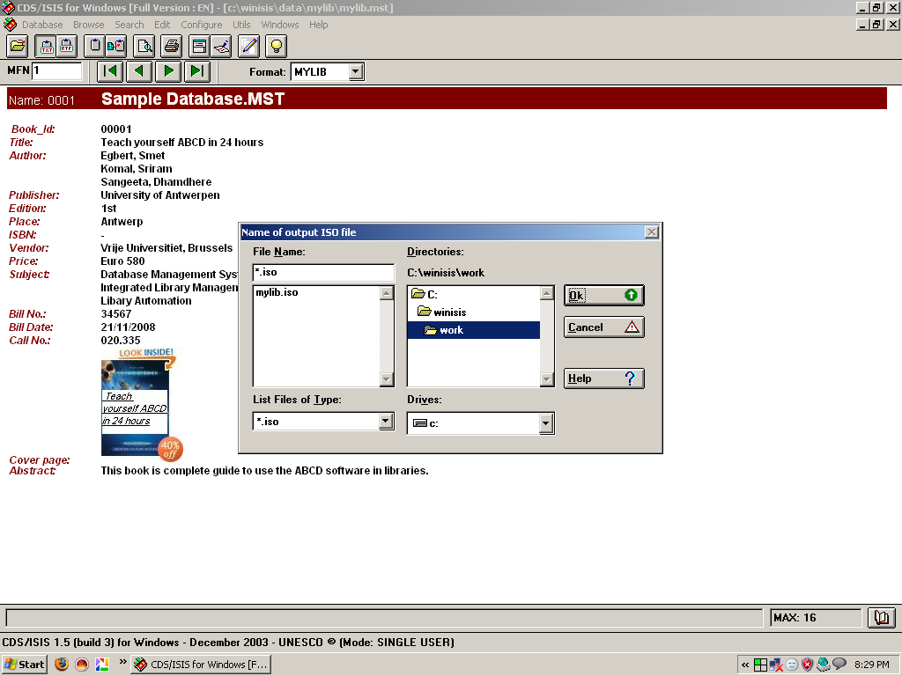
Save the iso file in Winisis Work folder

Slide 4
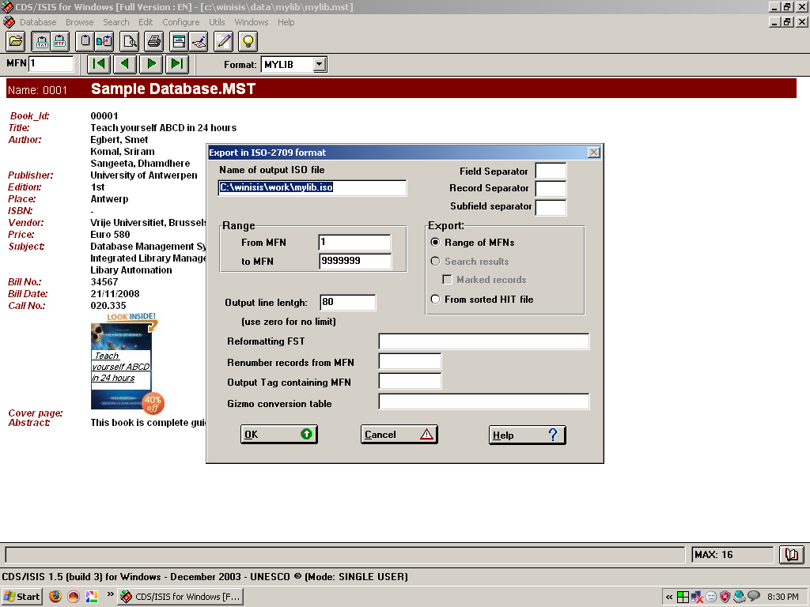
Assign the Name to iso file

Slide 5
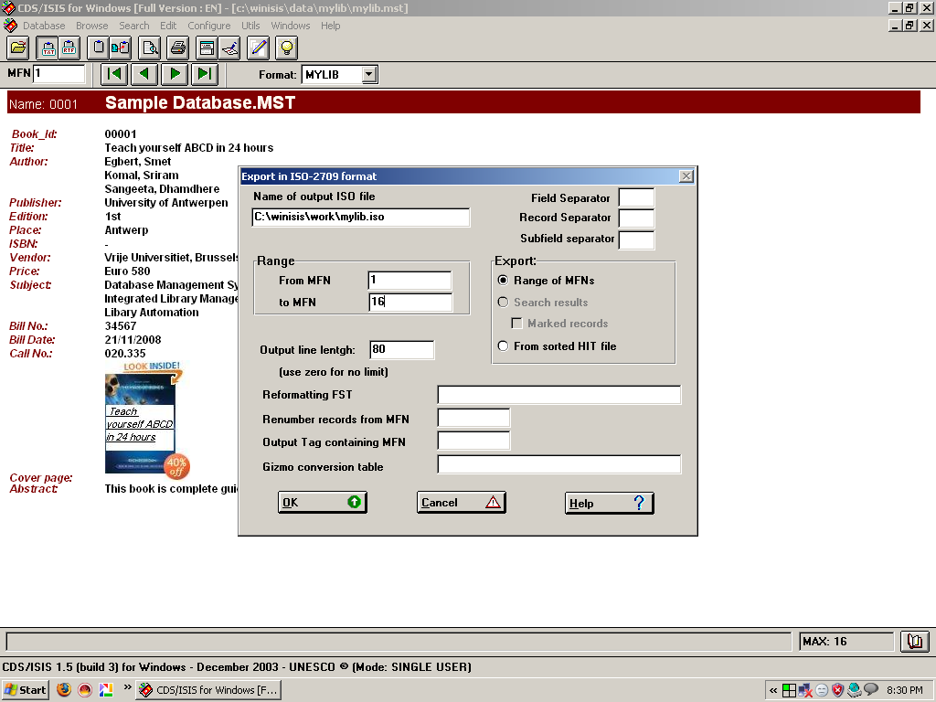
Assign the range/number of records to be exported

Slide 6
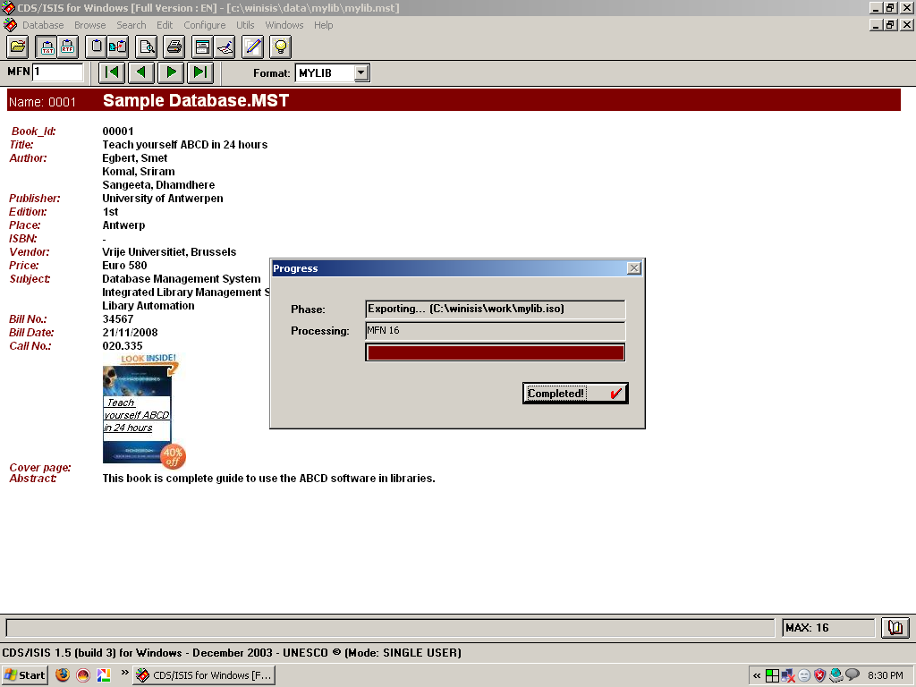
Process of exporting the database is completed here.

Slide 7
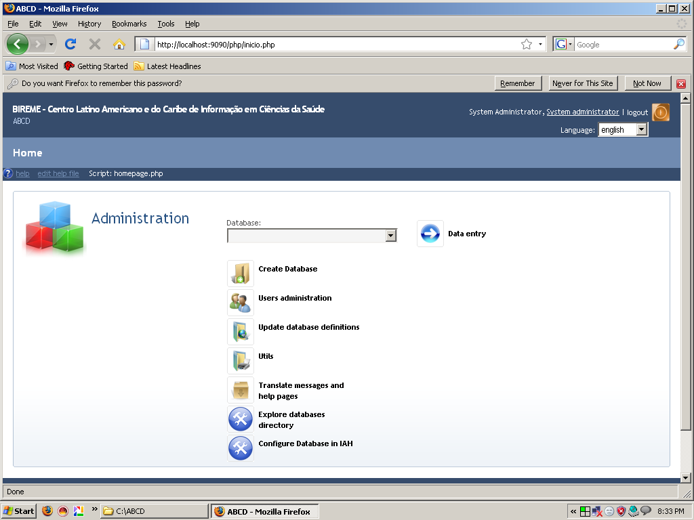
Importing the database in ABCD
Select Create Database in the Home page

Slide 8
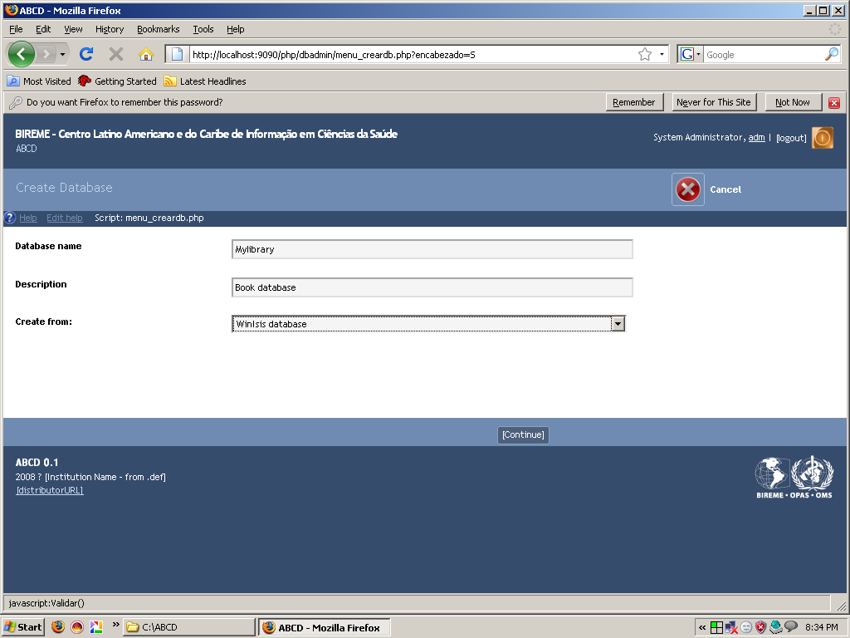
Assign Name and description of database. Select the Winisis database from the list in Create from:

Slide 9
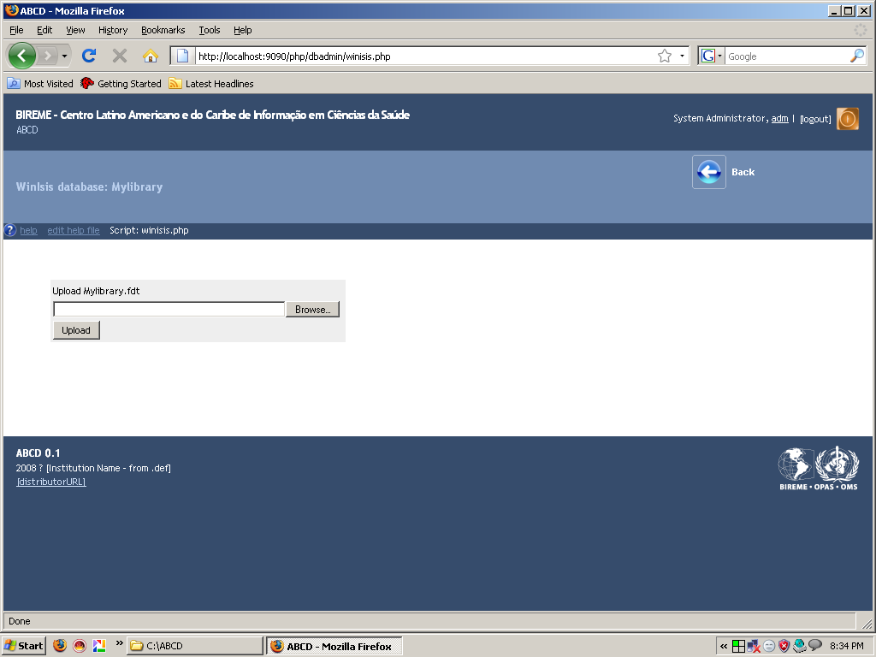
Select the fdt file of your winisis database by clicking on browse button

Slide 10
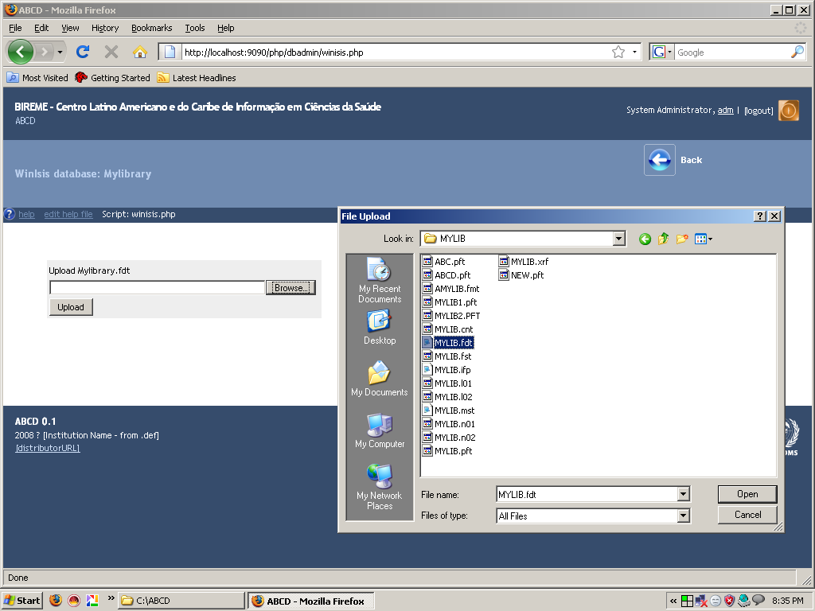
Select the fdt file of your database and open

Slide 11
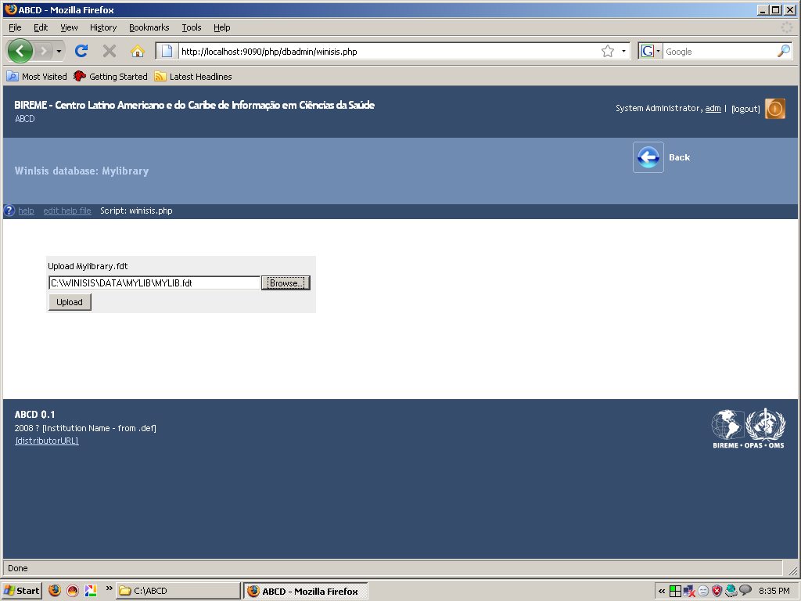
Upload the fdt file

Slide 12
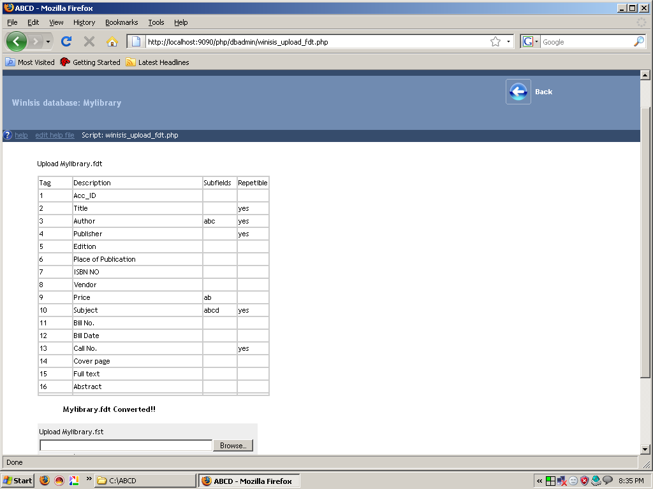
Next step is upload fst file of your database.

Slide 13
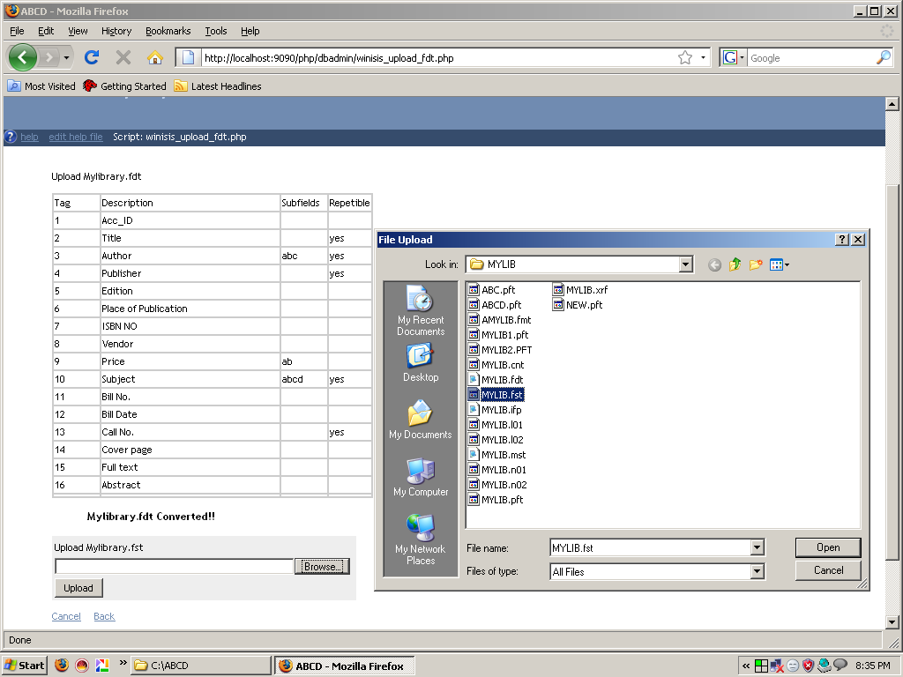
Browse and select the fst file of your database. Click open

Slide 14
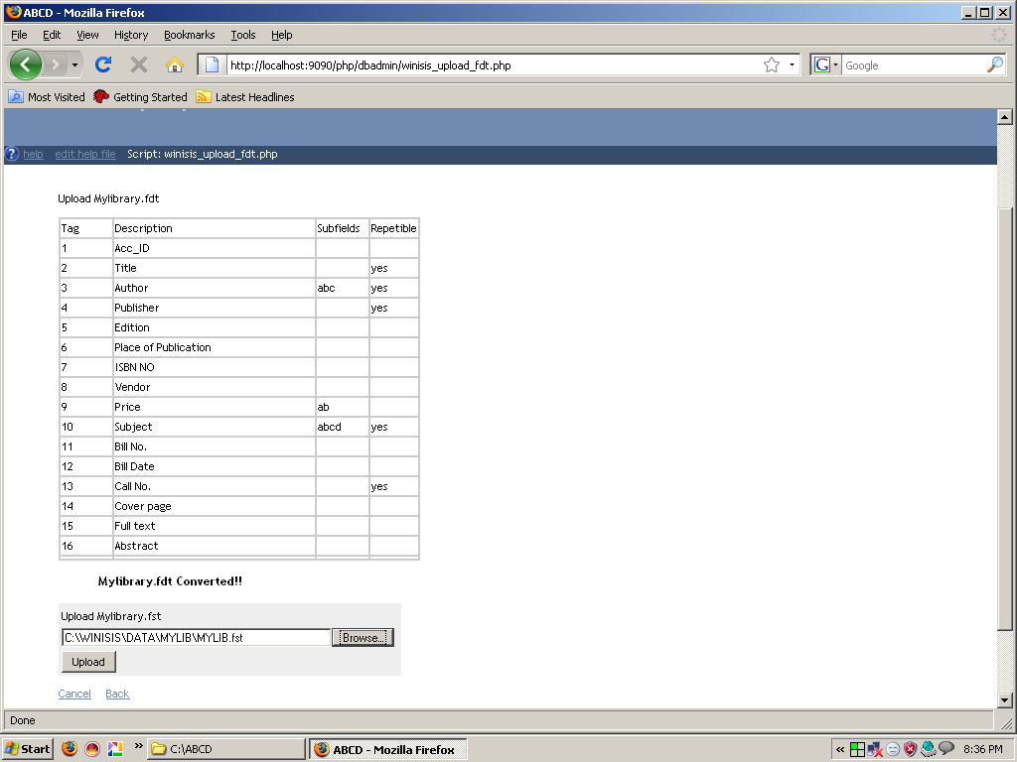
Upload the fst file

Slide 15
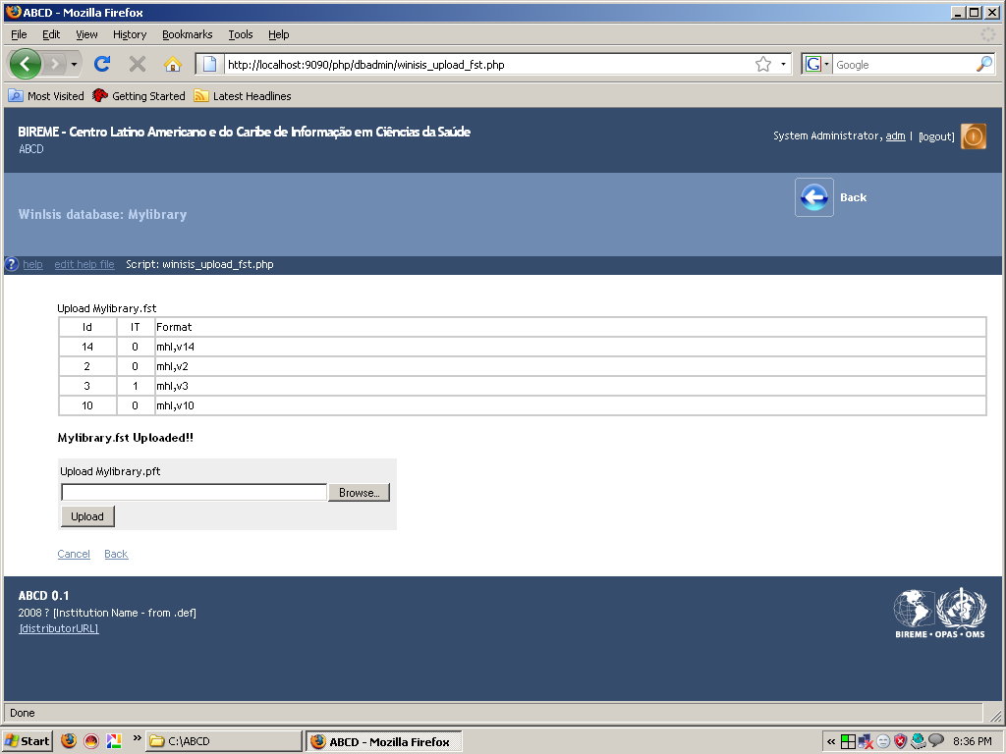
Now upload the pft file by clicking on Browse

Slide 16
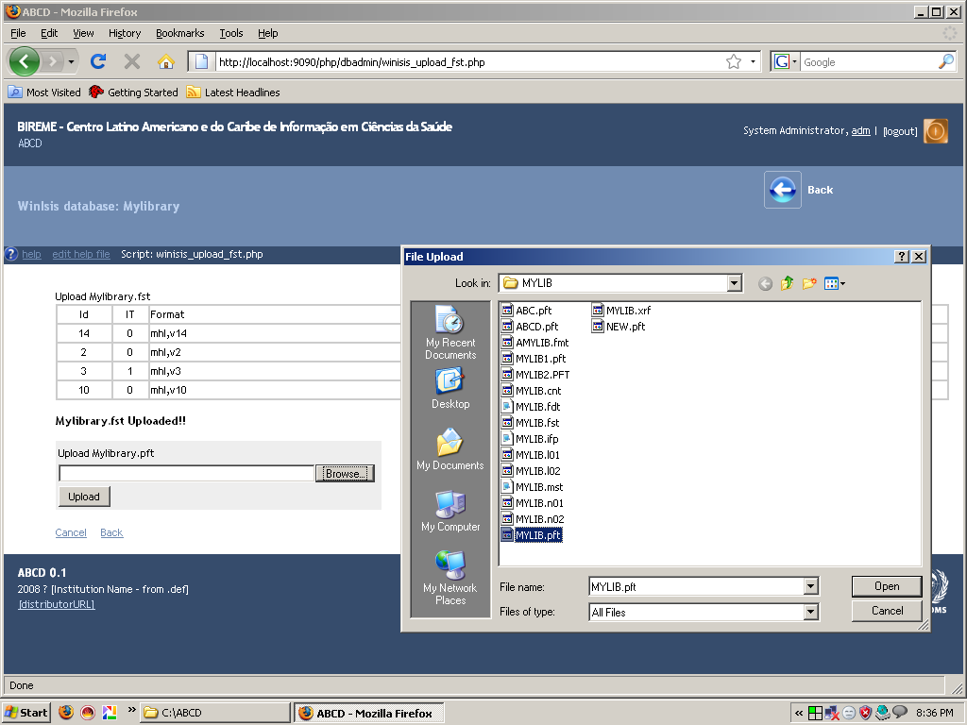
Select and open your pft file

Slide 17
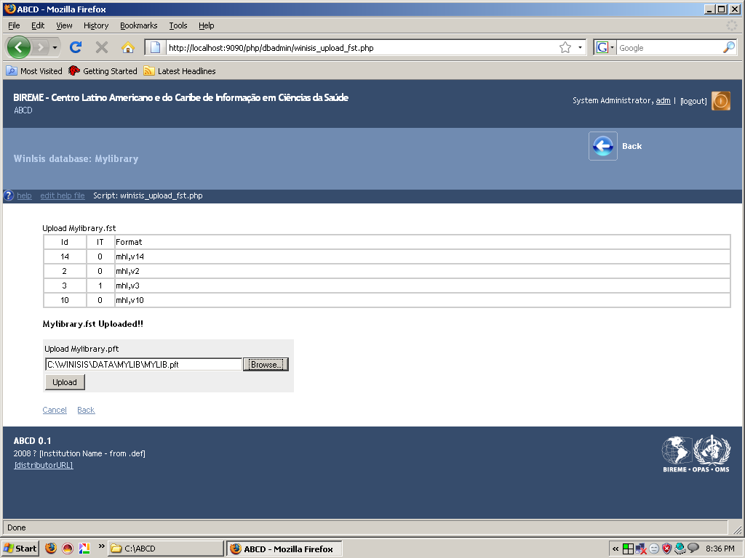
Upload the pft file

Slide 18
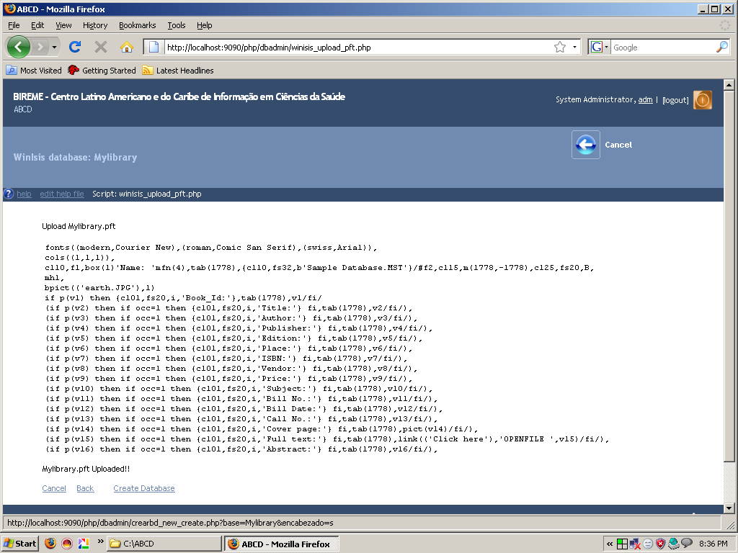
Click here to Create the database

Slide 19
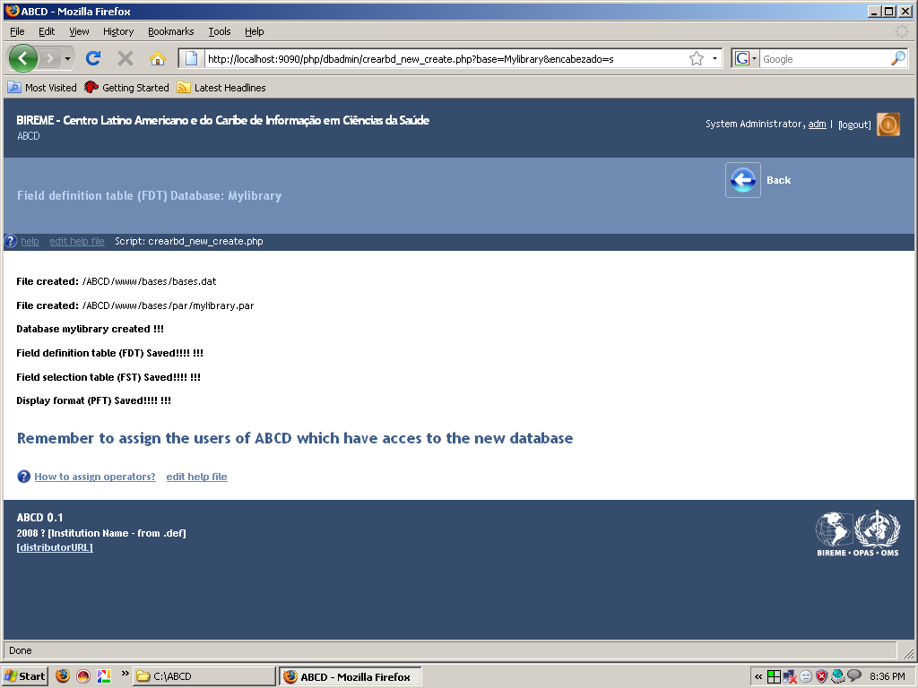
Your database is created now

Slide 20
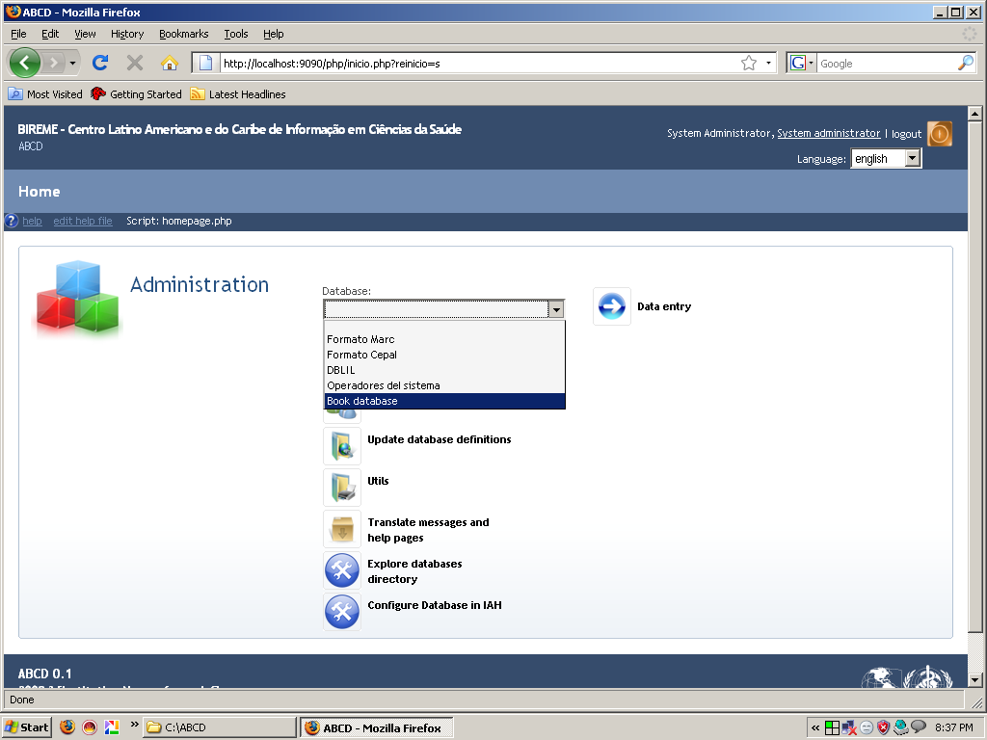
The database created is blank /without records.So for importing the records and iso file follow the following steps:
Select and open the database from the list

Slide 21
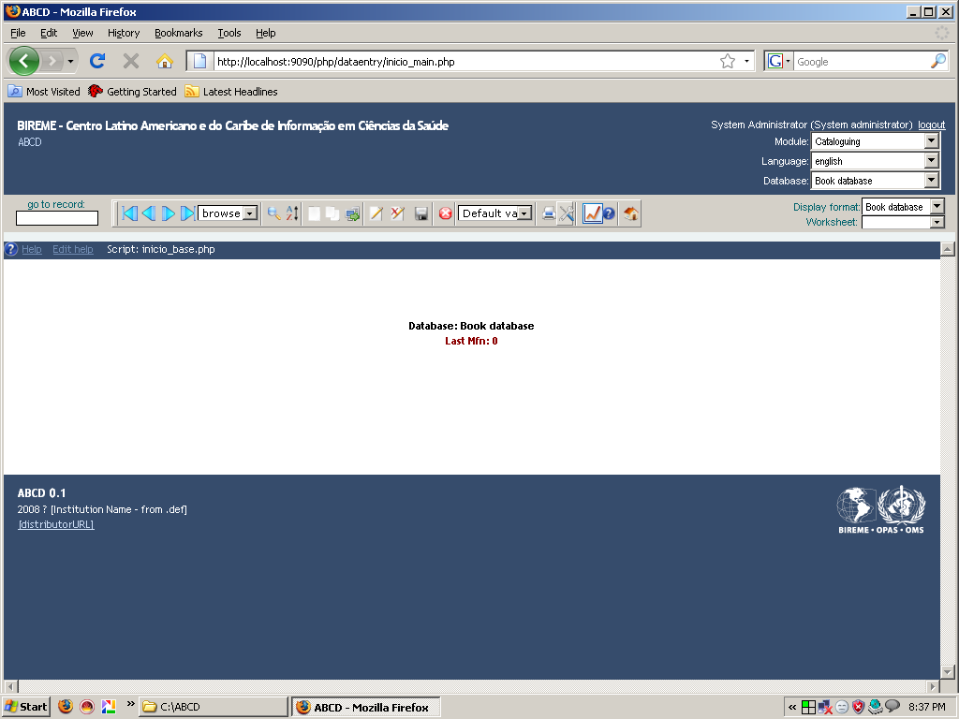
Click on Utils option to import iso file

Slide 22
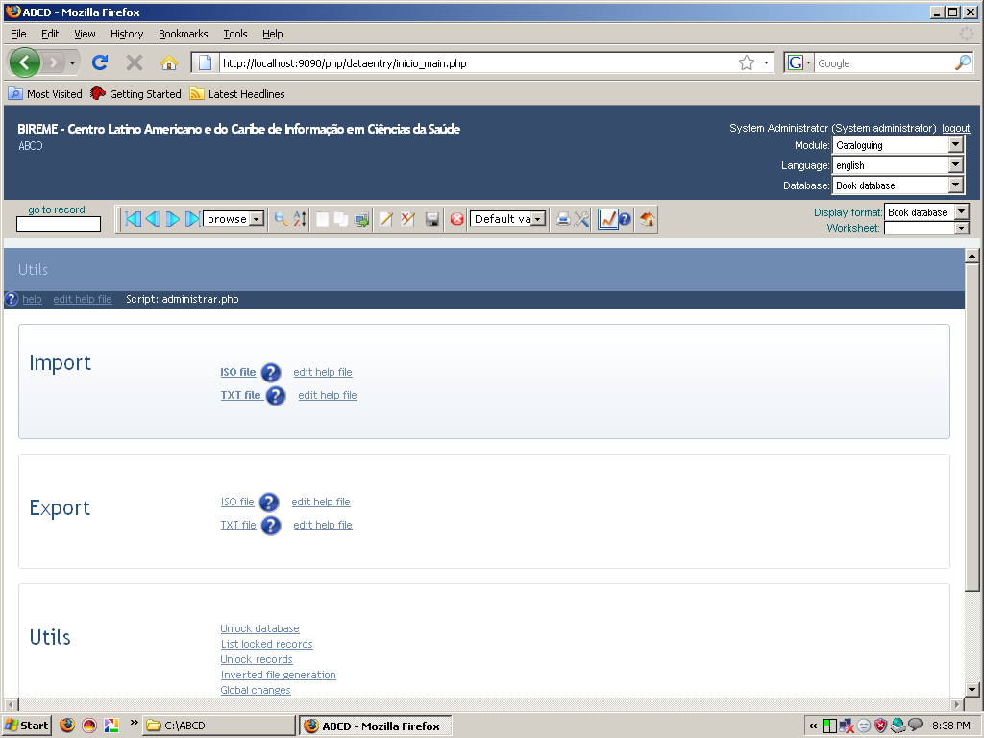
Click on ISO file

Slide 23
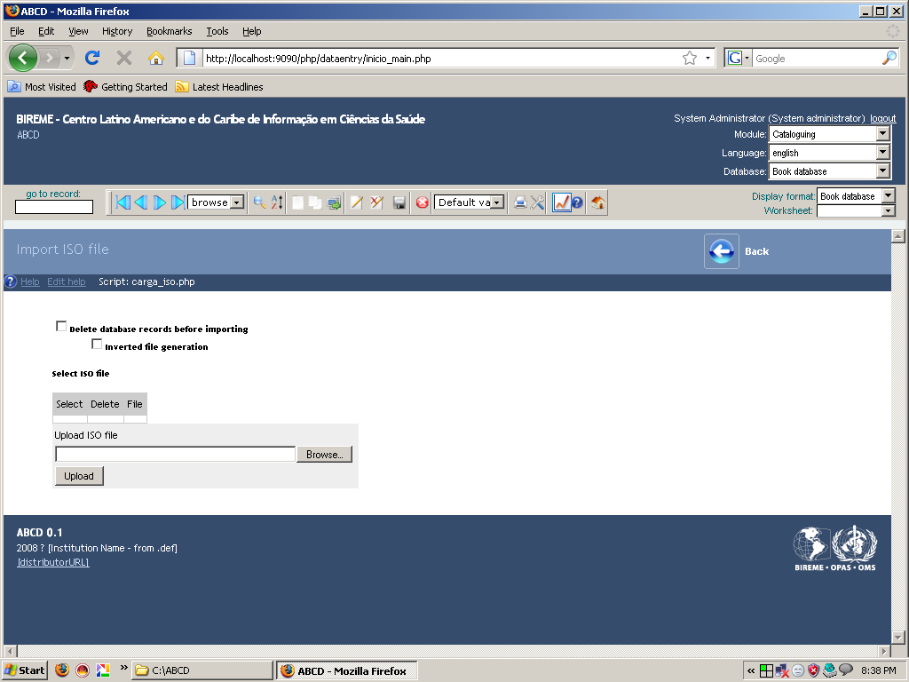
Click on Browse to select iso file of database

Slide 24
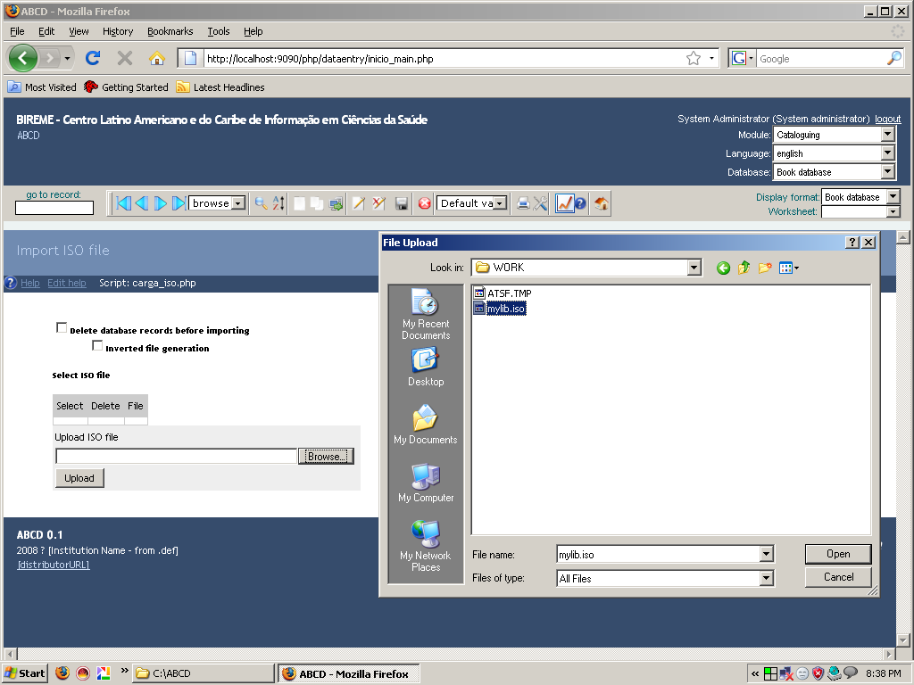
Open your iso file

Slide 25

Click here to upload the file

Slide 26
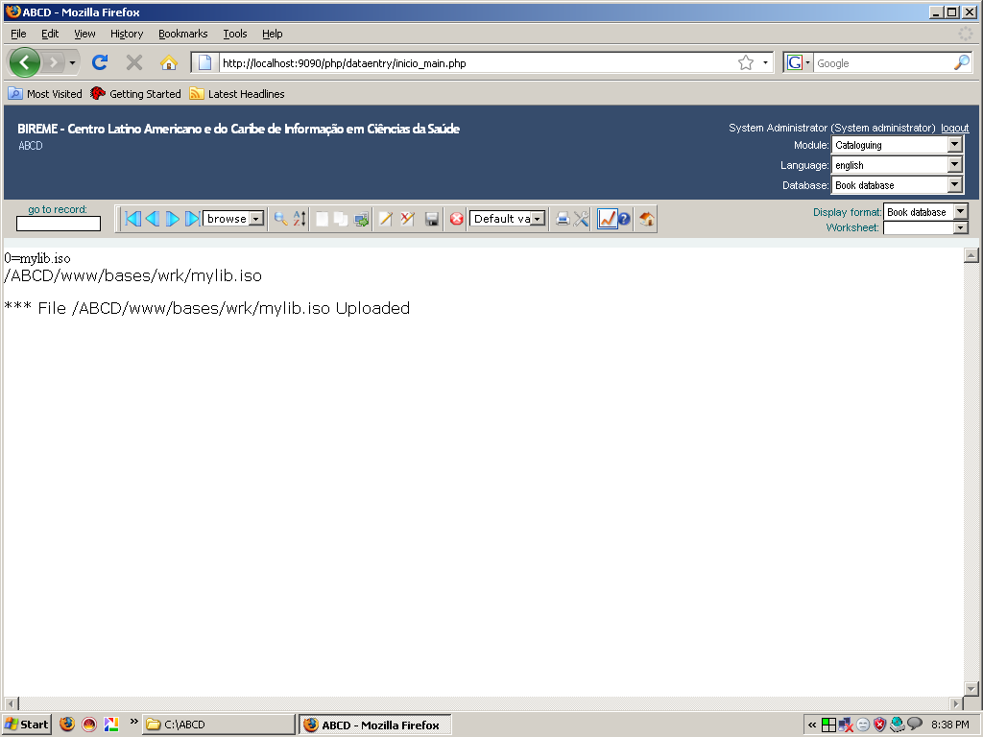

Slide 27
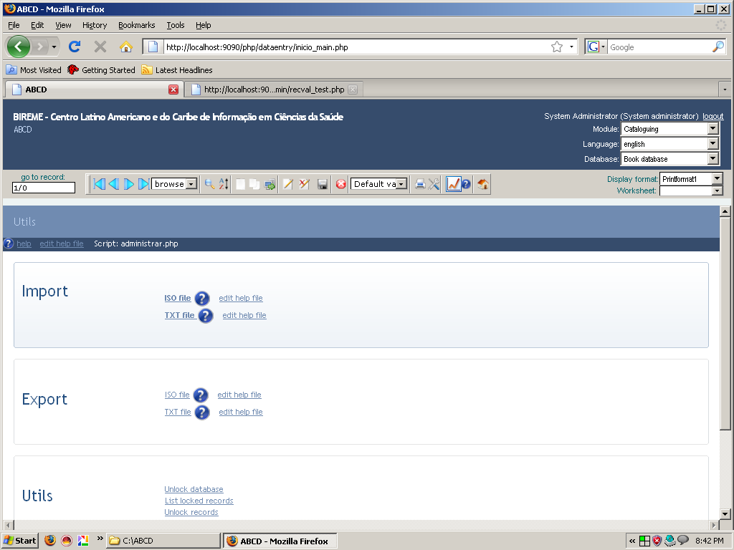
For importing the records again click on Utils option and then on ISO file

Slide 28
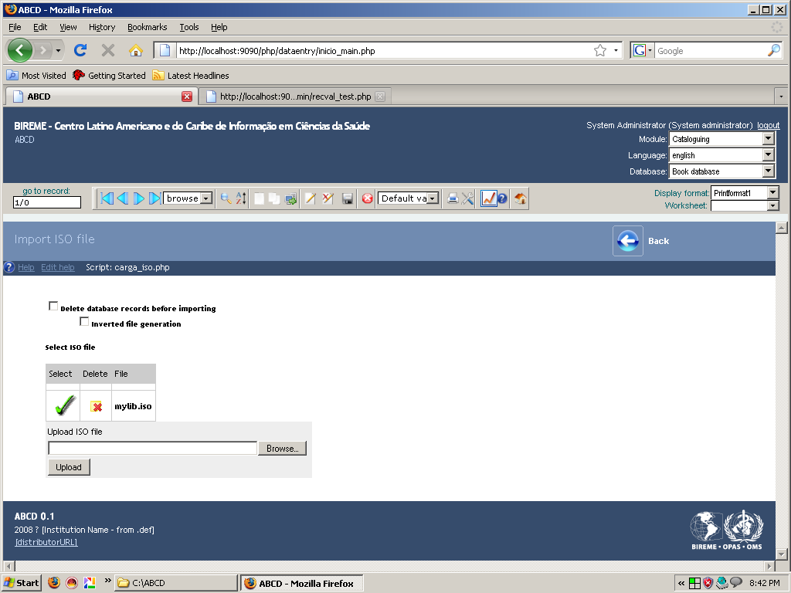
Click here to upload to invert the iso file and import records

Slide 29
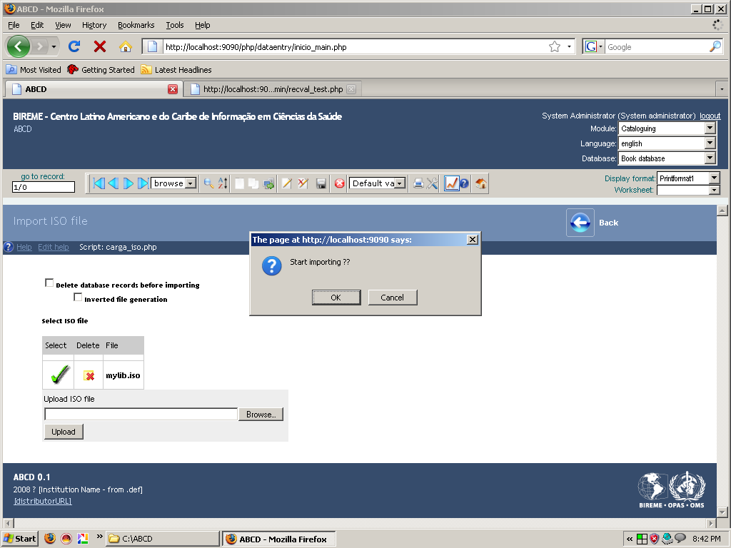

Slide 30
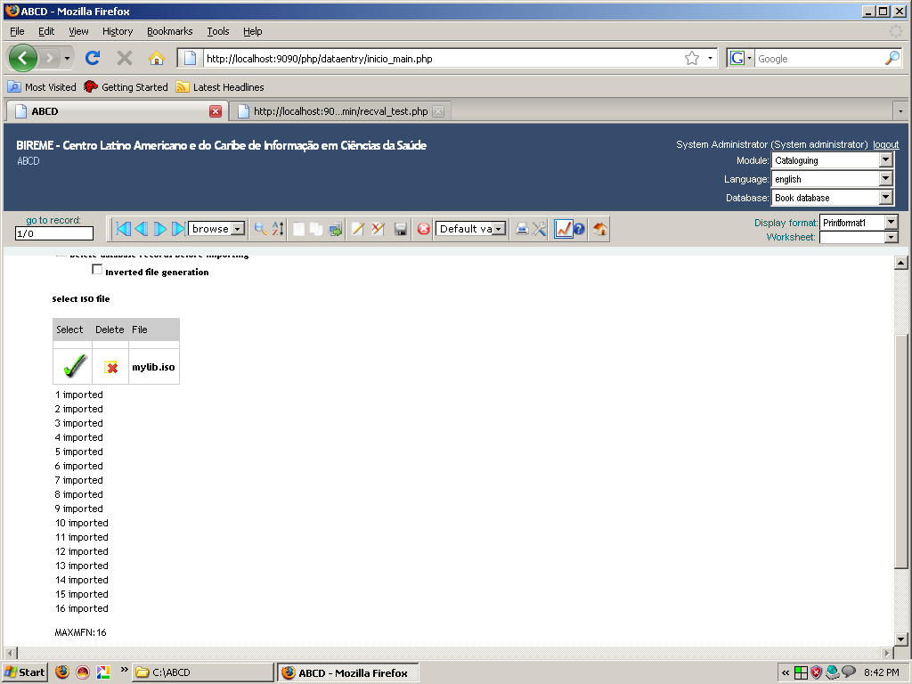

Slide 31
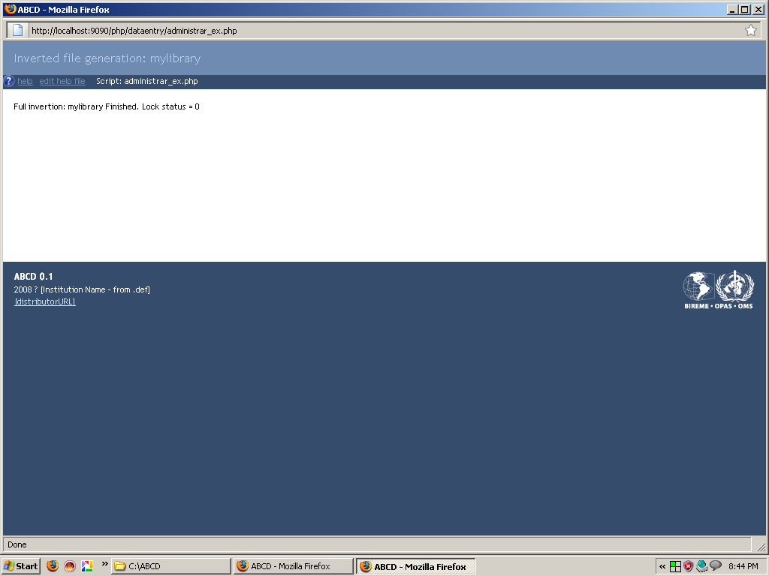

Slide 32
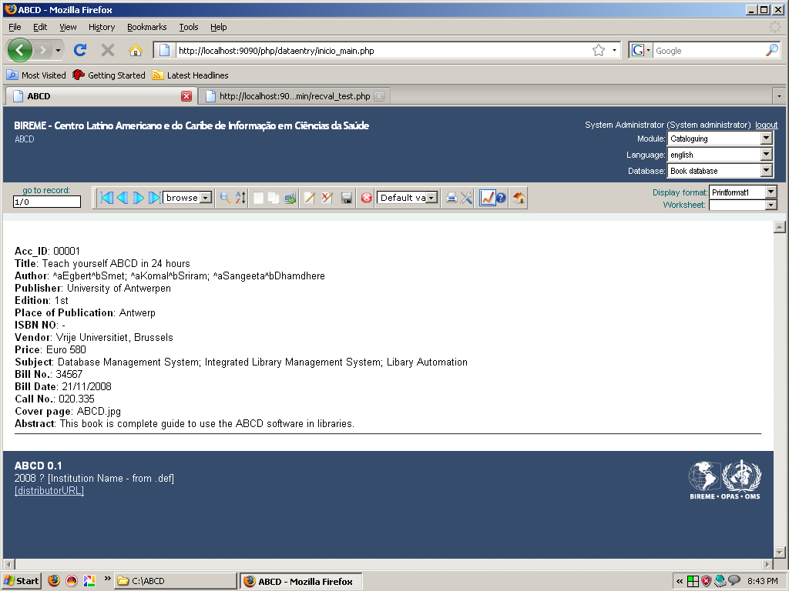
Records are available now to Edit,modify or add

Slide 33
