Slide 1

The GREENSTONE digital library software
An introduction
By Egbert de Smet
(Univ. of Antwerp)

Slide 2
Overview
Digital libraries : the concept
Introduction : some background info on GSDL
Installation of GSDL
The stages of building a simple application with the Librarian interface
Some more advanced features

Slide 3
Digital Libraries : the concept
A digital library, like a normal library, contains documents, catalogues and avails them to users.
But : documents are electronic (digital) files and availability is online
Cataloguing is called ‘adding metadata’…
So a digital library >< a database, but an indexed set of documents and a retrieval tool (similar to ‘Indexing software’ like e.g. Google Desktop)
Acquisition/Circulation functions are not covered for obvious reasons

Slide 4
Greenstone background info
See : http://www.greenstone.org
Developed by Waikatu university (New-Zealand) and supported by UNESCO and the Human Info NGO (Antwerp!)
Adopted by UNESCO in 2005 for distribution
Free and Open Source software (GNU GPL), running under both UNIX/Linux and Windows
Full Unicode support, fully multi-lingual
Almost no limits in size and capacity (in theory)
Current ‘stable’ version : 2.83 with a fully new JAVA-based version 3 developed in parallel (http://wiki.greenstone.org/index.php/Greenstone3_for_Greenstone2_Users)
- Advantages : XML/XSLT interface definition (no more Perl), distributed, multiple collections and interfaces

Slide 5
Greenstone features
FOSS (active community !) & Multi-platform
Proven technology : Perl-scripting, MG(PP) or Lucene indexing, Apache (or built-in webserver), XML
UNICODE
Separate modules :
  JAVA-based interface for management
  Web-browser based access to collections
  CLI client : remote collection building
Multi-metadata (with editor)
Practical GLI interface for editing/managing GSDL
Lots of 'plug-ins' for most document formats, also ISIS, Dspace, e-mails, MARC, MARCXML...

Slide 6
Greenstone vs. DSpace
Less aiming at 'repositories' with end-user based submission of content (but still possible)
Less aiming at long-time preservation
Less capable with large numbers or documents
Easier to install/run in Windows
More oriented to digital library collections (cultural heritage etc.)
More flexible on meta-data sets
Much easier to implement and use (also as stand-alone), easy installer
Aiming at librarians rather than IT-ers

Slide 7
Greenstone Technical Concepts 1
Technical concepts :
  A server (library.exe) uses (lots of) PERL-scripts to create web-pages and forms to deal with the library of documents and its indexes
  The documents are stored as such (PDF, DOC, HTML, XML…) ánd converted (‘imported’) as XML in a collection with their text-only content
  ‘Plug-ins’ for each type of content extract words from the documents and pass them onto the indexing engine
  Metadata on the documents are also stored in XML
  A web-interface allows searching, browsing results and opening full-text documents either in original or converted format.

Slide 8
Greenstone Technical Concepts 2
3 possible indexers :
  MG (‘Managing Gigabytes’) : at section level (=~field), Boolean or ranked (not both!)
  MGPP : word level indexing (field, phrase + proximity) with Boolean+ranking
  Lucene (from the Apache SF) : field+proximity indexing but either on whole document or section, Boolean+ranking plus : single-character wildcards and range-searching; allows incremental collection buidling (not possible with MG(PP))

Slide 9
Greenstone Technical Concepts 3
Metadata :
  Greenstone allows (unlike e.g. DSpace) several sets of metadata, including locally produced ones, even merged
  Dublin Core (v.1.1) is provided together with e.g. RFC 1807, Development Library Subset, others (e.g. LOM) are available
All metadata are stored in XML-format with the documents
Metadata can also be extracted from XML-statements within the documents
Metadata can be assigned easily through the GSDL Librarian interface
Since GSDL does not use a DB for handling its XML-data, this imposes real limitations on speed

Slide 10
the Greenstone Librarian Interface
A JAVA-PERL applet (gliserver.pl) provides an interactive graphical interface – the ‘Greenstone Librarian’ – with the main functions :
  1. ‘Gathering’ (or Downloading from OIA, WWW, Z39.50..) documents into a collection
  2. ‘Enriching’ with metadata (incl. a metadata set editor)
  3. Design (search/browse) and formatting
  4. Create : building the collection
  5. if build succesful : link to previewing the collection
  (6. Format of output adjustments)

Slide 11
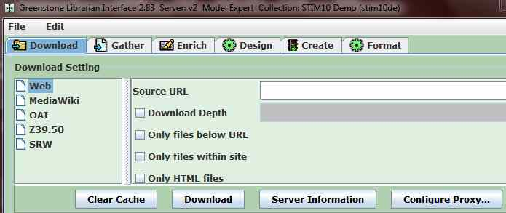
GLI : collecting documents
Dowloading using protocols :
  WWW
  OAI (Open Archives Initiative)
  Z39.50
  SRW (Search and Retrieve Web service)
  MediaWiki

Slide 12
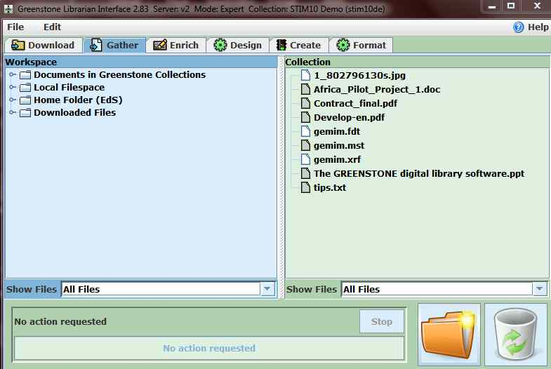
GLI : Gathering collection
Gathering :
  Selecting files from ‘local filespace’ or Local Network
  Simple dragging to collection area
  Hint : use hierarchy with ‘folders’ as metadata of folder-level are ‘inherited’ by subfolders/files

Slide 13
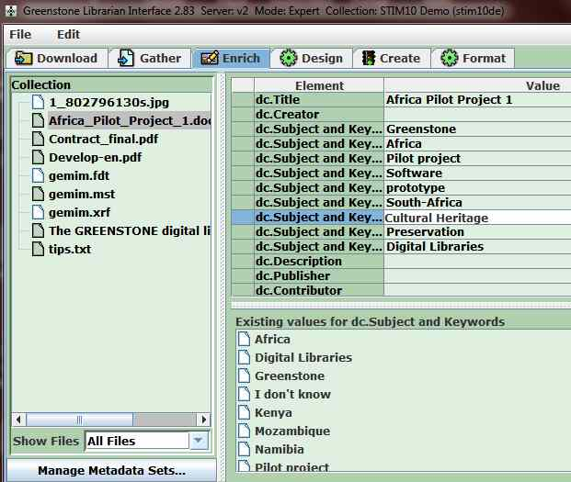
GLI : Enriching documents
Enriching = cataloguing with metadata, i.e. assign values to metadata-fields
Dublin Core and/or others or local sets
Metadata editor allows creating/changing sets
Assigning values :
  Automatic inheriting for lower levels
  Multiple values
  Picklists

Slide 14
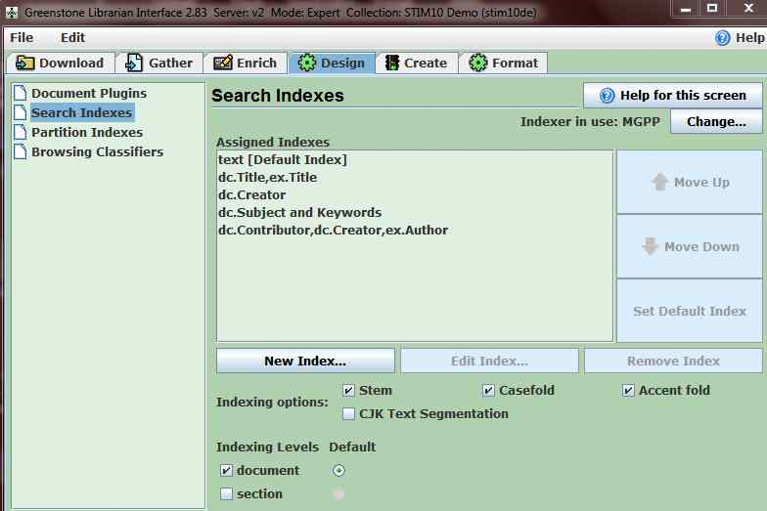
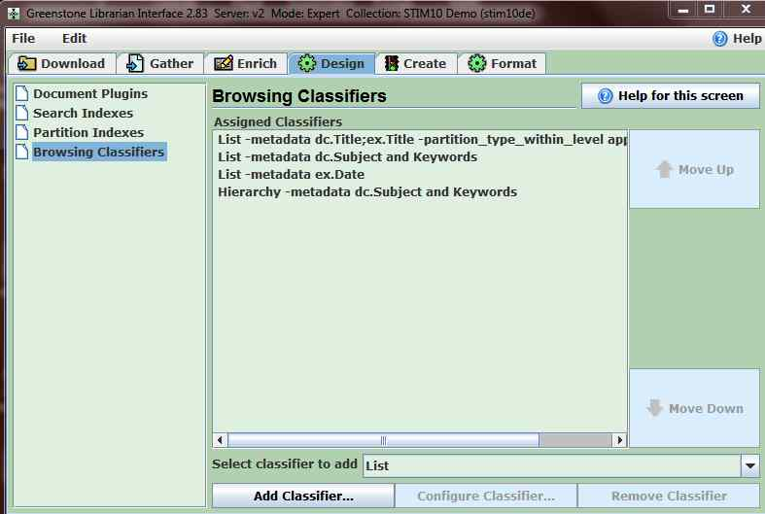
GLI : Design phase
Selection of plugins (e.g. GA, TEXT, PPT, Word, PDF, RTF, e-mail, XLS, Fox, DB, but also : ISIS, DSpace, MARC, ProCite…)
Search index definition
Partitioning (= subcollections)
Browsing classifiers, a.o. hierarchical, A-Z

Slide 15
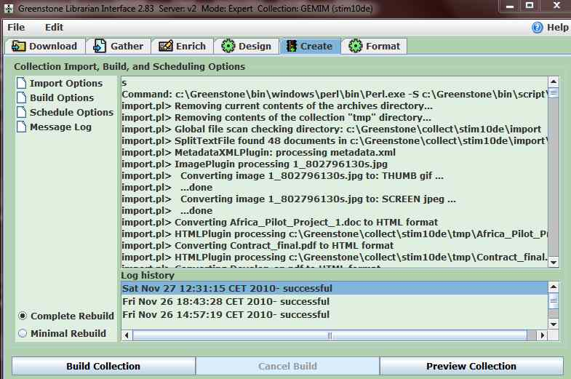
GLI : Create
The actual work of :
  Importing (converting into text-only), using different ‘plug-ins’ (filters)
  Indexing the documents
Complete rebuild : from scratch incl. import
Minimal : only new documents and indexing
Preview : direct access to webpage with search-interface produced by GLI

Slide 16
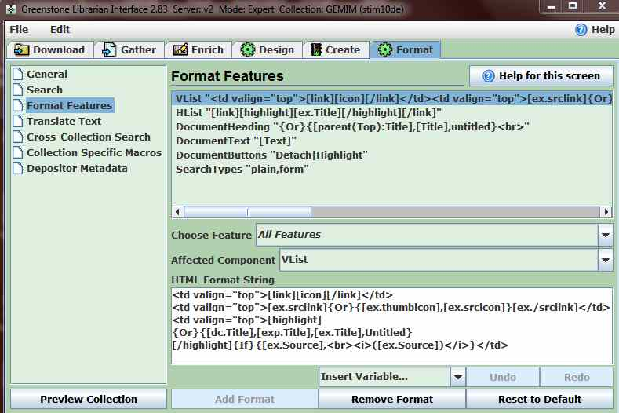
GLI : Output formatting
General : owners, images for home-pages, title, public or not
Search : names of search indexes
Format of results, e.g. [link][highlight][ex.Title][/highlight][/link]
Text translations
Cross-collection search : identify collections
Collection specific macros (e.g. adding links to new searches, see infra)

Slide 17
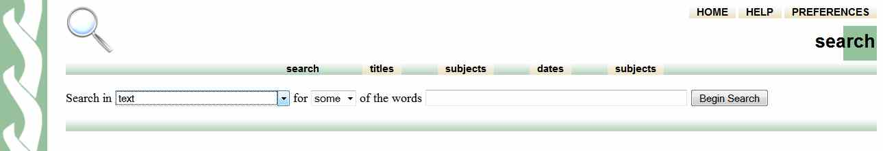
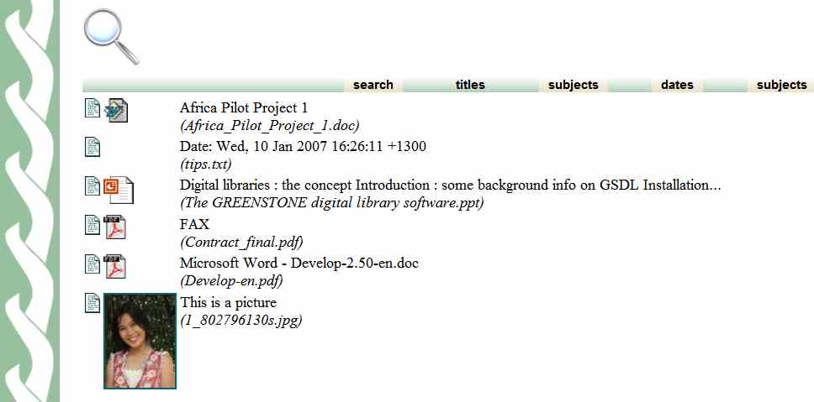
Preview the GSDL website

Slide 18
ISIS to Greenstone
2 methods :
  ‘as is’ : links are just copied from ISIS-databases with embedded links (mere ‘conversion’), the fields are entered as metadata
  Full-text : the referenced documents are imported into a GSDL collection
Conversion ‘as is’ with ISISPlug: the ISIS-records become GSDL-records and can be searched/ displayed as such
‘Explode database’ : the ISIS-fields become ‘ex’(tracted) GSDL-metadata and the documents themselves are stored as Full Text (referenced to in ISIS-record)
More info :
  portal.unesco.org/ci/en/ev.php-URL_ID=21746&URL_DO=DO_TOPIC&URL_SECTION=201.html
  or : greenstonesupport.iimk.ac.in/Documents/CDS-ISIS_to_DL.pdf

Slide 19
More technical info on :
http://greenstonewiki.cs.waikato.ac.nz/wiki/index.php/Greenstone_FAQ
Users discussion list : see https://list.scms.waikato.ac.nz/mailman/listinfo/greenstone-users

