Slide 1


Slide 2
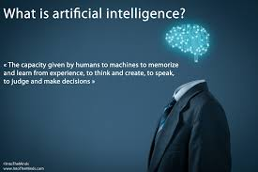

Slide 3
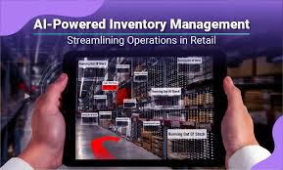

Slide 4
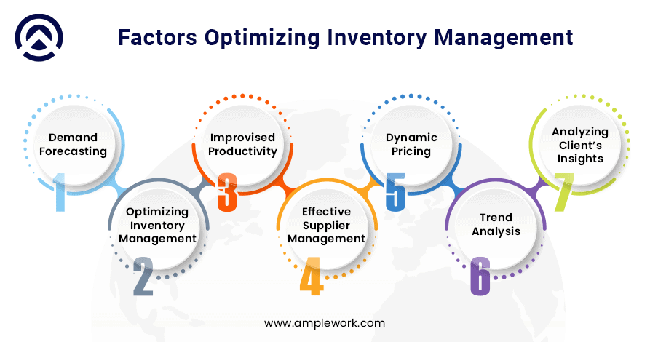

Slide 5
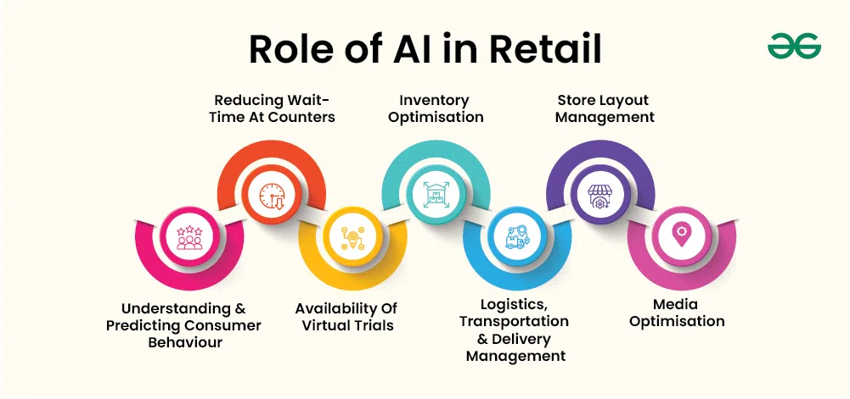

Slide 6


Slide 7
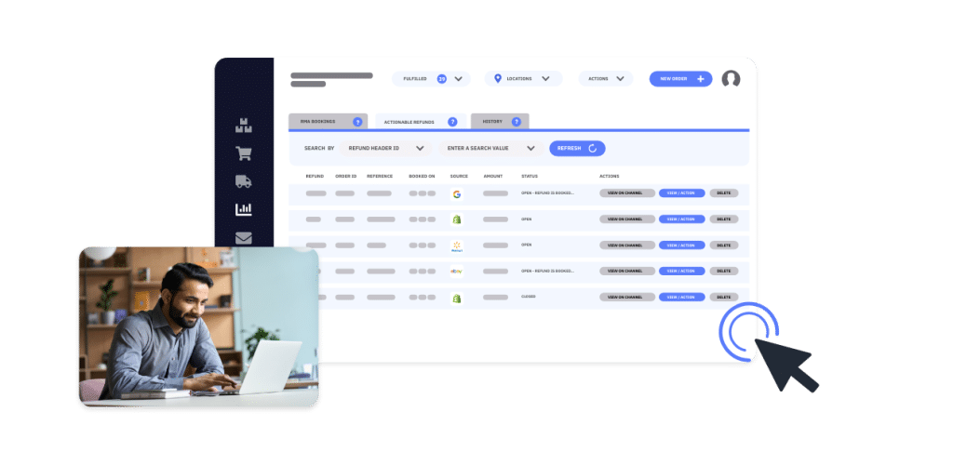

Slide 8




SEARCH
My Order
Categories
Notifications
ABOUT-APP
This Photo by Unknown Author is licensed under CC BY-SA

Slide 9
HERE WE USED APPLICATIONS FOR THE DEVELOPMENT OF RETAIL INVENTORY MANAGEMENT SYSTEM FOR
SMART OPERATIONS:
BACKEND FRAMEWORK :Spring BooT(Java)
DATABASE: MySQL
AI/ML FRAMEWORK:TENSFLOW,PYTORCH,SCIKKIT-LEARN
DEPLOYMENT:AWS,GOOGLE CLOUD
REAL-TIME DATA:WEBSOCKETS,KAFKA,RABBITMQ
AUTHENTICATION:JWT,OAUTH 2.0

Slide 10
WE CONSIDER THE INPUT DATA MAXIMUM IN THE FORMAT OF TABLES AS WE ARE USING SQL
FOR THE DATABASE:
PURCHASE ORDER DETAILS:
SUPPLIER NAME | PRODUCT NAME | UNITS ORDERED
VIDHARTH | LAPTOP | 134
MYTHILI | CHOCOLATES | 177
ASHWIN | GROCERIES | 200
STOCK SUMMARY DETAILS:
PRODUCT NAME | UNITS SOLD | UNITS IN STOCK
HALF SAREES | 289 | 85
BANGLES | 245 | 59
OREO BISCUIT | 177 | 55

Slide 11
SELL-IN SUMMARY DETAILS:
PRODUCT NAME | UNITS SOLD | TOTAL SALES AMOUNT
OVEN | 404 | 290000
SAREE | 170 | 4580
VANILLA | 280 | 7990
SELL-OUT SUMMARY DETAILS:
CUSTOMER NAME | UNITS ORDERED | TOTAL SALES AMOUNT
ADHEER | 234 | 150000
DHRUV | 457 | 23400
KARTHIK | 98 | 24500

Slide 12
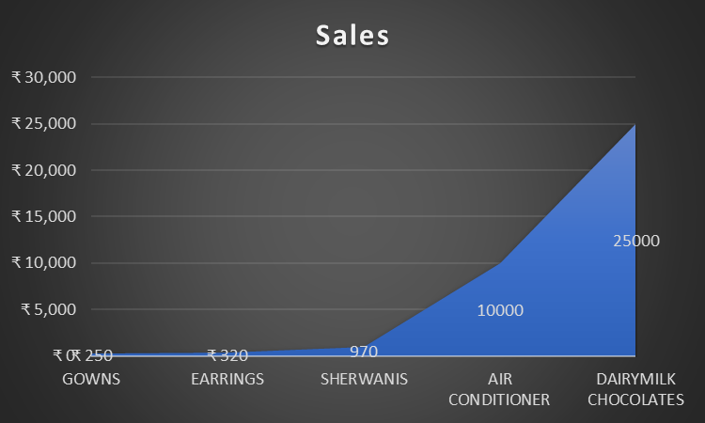
TOP 5 SELLING PRODUCTS DETAILS:

Slide 13
CONCLUSION:
In conclusion, an AI-enhanced retail inventory management system offers significant advantages for streamlining operations, optimizing stock levels, and improving overall efficiency. By leveraging advanced algorithms, machine learning, and real-time data analysis, such a system enables retailers to make smarter decisions, reduce human error, and anticipate demand fluctuations. This leads to enhanced customer satisfaction, minimized waste, and better profitability. As retail environments continue to evolve, AI-driven solutions will play a crucial role in helping businesses stay competitive, agile, and responsive to market dynamics. Embracing these innovations will not only transform inventory management practices but also pave the way for more sustainable, smart operations in the retail industry.

Slide 14
