Slide 1
Divide and Conquer Algorithms
Computer Science
A problem solving approach

Slide 2
Using the resources
This video covers learning objectives:
Understand the meaning of divide and conquer
Be able to identify divide and conquer algorithms

Slide 3

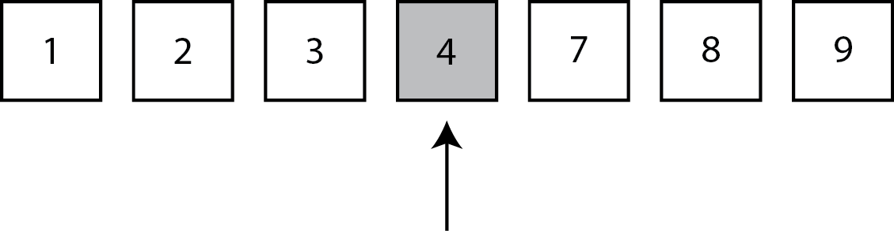
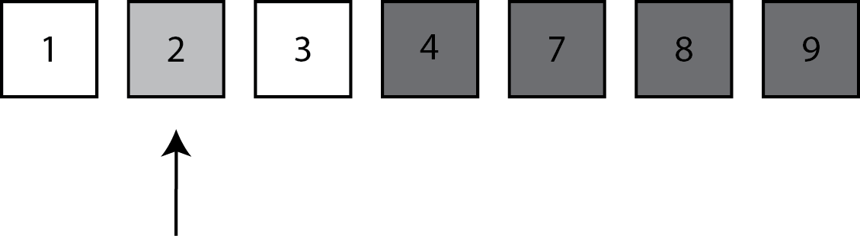
Binary Search

Slide 4
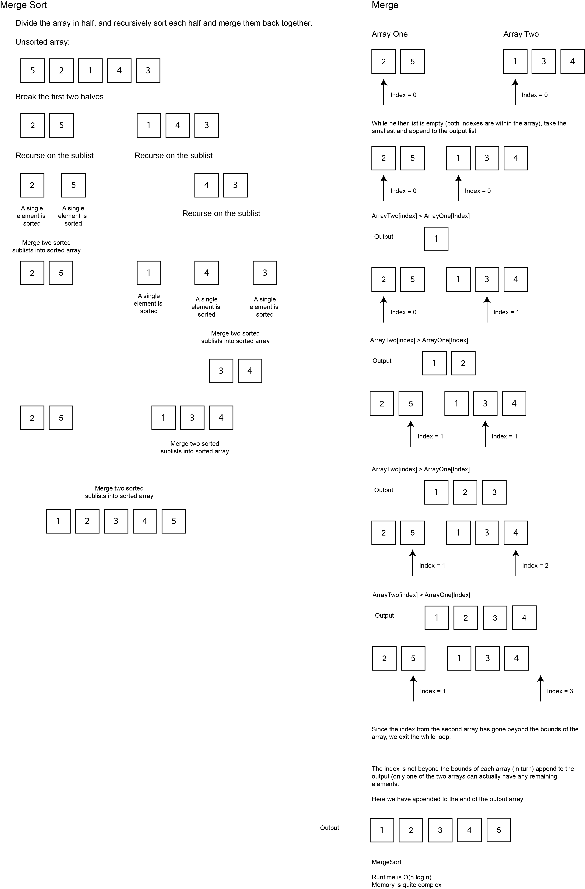
Merge Sort

Slide 5
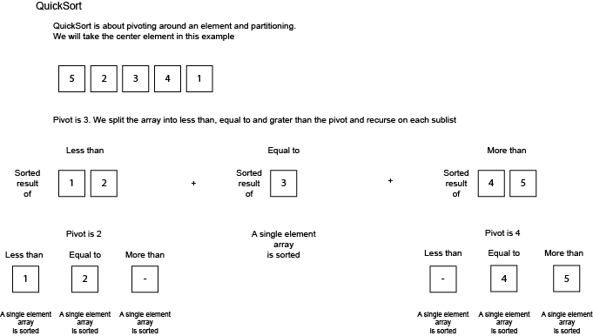
Quick Sort

