Slide 1


Racial Communities and Gun Violence
A look at the NYPD Shooting Data Set, and what it can tell us about violence within racial communities

Slide 2
Why talk about it?
Increased awareness of policing within and between different communities
Stop and Frisk
Black Lives Matter
Growing gun violence

Slide 3
What’s up, data?
This data set covers 23,585 shootings in New York City, from 2006-2020
Each incident has:
The demographics (age, sex, race) of the perpetrator and the victim
Whether the incident resulted in death
Where the shooting happened, by Borough, place type, and geocoordinates

Slide 4
What does the data say?
We only have complete demographic info for about 56% of shooting incidents in New York City over the last 14 years
Each ethnic group has a proportionate number of perpetrators and victims
These proportions DO NOT match the population

Slide 6
Shootings Within Racial Communities
Conventional wisdom says that perpetrators tend to commit violence within their own racial communities
Will the NYPD shooting data bear this out?
A heat map comparing incidents between all combinations of racial groups can give us an idea!

Slide 7
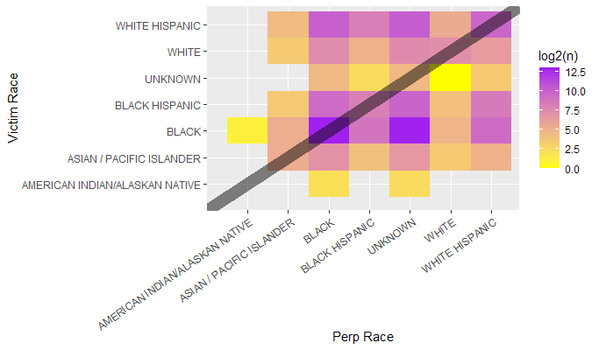

Slide 8
Filling in the Gaps
Can the data we have be used to resolve the racial identity of those 10097 unknown perpetrators?
Not reliably
Only one racial community is strongly predictive of perpetrator race

Slide 9
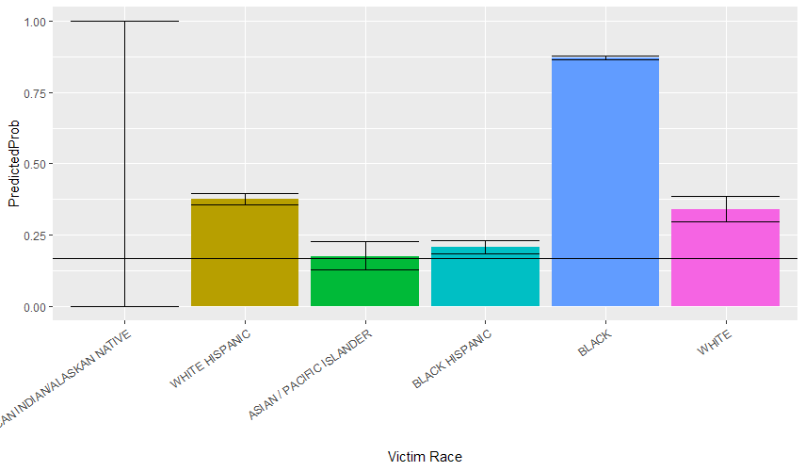

Slide 10
What DOESN’T the data say?
There are only 11 incidents listed involving Native Americans
Per the census, there are about 10 Native Americans for every 10,000 people
Where do the categorical decisions come from?
Are some perpetrator demographics based on witnesses?
Are victim demographics self-reported?
What counts as a shooting?

