Slide 1
Process Scheduler

Slide 2
01
02
Table of content
03
04
FCFS
MLFQ
First Come First Served
06
Multilevel Feedback Queue
SJF
Stride
Shortest Job First
07
Stride Scheduling
STCF
Shortest Time To Complete First
RR
Round Robin
Priority
05
Non Preemptive Priority

Slide 3
01
FCFS

Slide 4
Algorithm Description
FCFS
FCFS (First-Come-First-Serve) scheduling is a basic process management algorithm used in operating systems. It prioritizes processes based on their arrival time, with the first-arrived process being the first to be executed. Processes are placed in a ready queue, and the one at the front is selected for execution. After completion, a process is removed, and the next one in the queue is scheduled

Slide 5
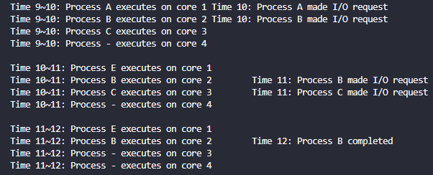
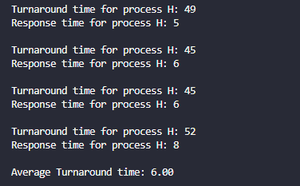
Simulator Output

Slide 6
02
SJF

Slide 7
Algorithm Description
SJF
SJF (Shortest Job First) is a scheduling algorithm where processes are executed based on their shortest burst time. The process with the shortest burst time is given priority, resulting in minimized waiting and turnaround times. While efficient, predicting exact burst times can be challenging.

Slide 8
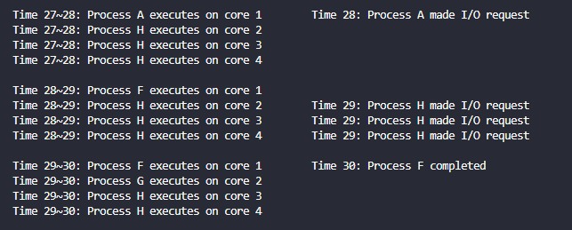
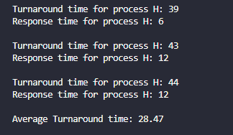
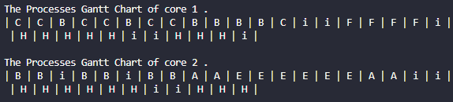
Simulator Output

Slide 9
03
STCF

Slide 10
Algorithm Description
STCF
The Preemptive version of Shortest Job First(SJF) scheduling is known as Shortest Remaining Time First (SRTF). With the help of the SRTF algorithm, the process having the smallest amount of time remaining until completion is selected first to execute

Slide 11
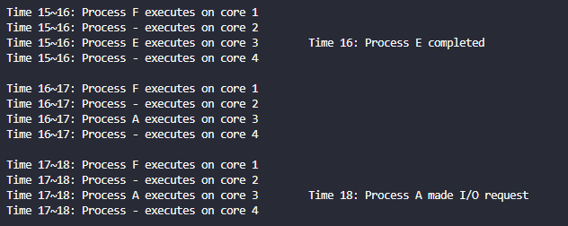
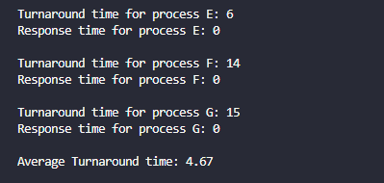
Simulator Output

Slide 12
04
RR

Slide 13
Algorithm Description
RR
Round Robin is a pre-emptive scheduling algorithm used in operating systems. It divides time into fixed intervals called time slices and assigns each process a turn to execute for a specified time. Processes are organized in a circular queue, and if a process's time slice expires, it is moved to the back of the queue, allowing the next process to run. This ensures fair distribution of CPU time among processes, making it suitable for time-sharing systems where responsiveness is crucial

Slide 14
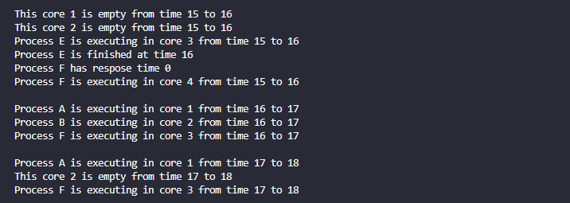
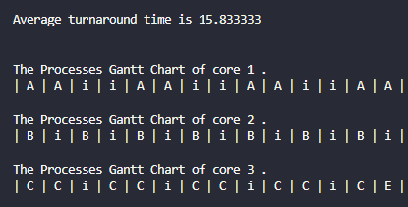
Simulator Output

Slide 15
05
Priority

Slide 16
Algorithm Description
Priority
Priority scheduling is a process scheduling algorithm where each task is assigned a priority, and the task with the highest priority is executed first

Slide 17
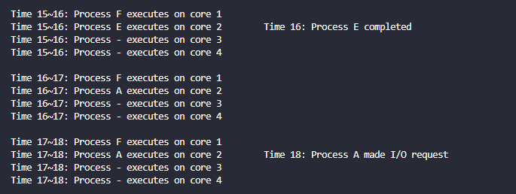
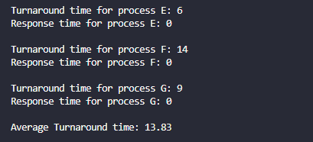
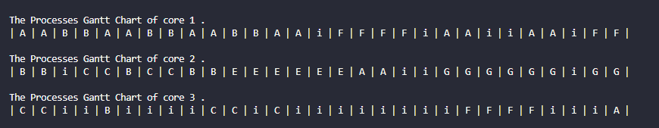
Simulator Output

Slide 18
06
MLFQ

Slide 19
Algorithm Description
MLFQ
Multi-Level Feedback Queue (MLFQ) is a dynamic scheduling algorithm used in operating systems. It manages processes by organizing them into multiple priority queues, with higher-priority queues having shorter time quanta. Processes start in the highest-priority queue and are adjusted dynamically based on their behavior. If a process uses its entire time quantum, it is demoted to a lower-priority queue.

Slide 20
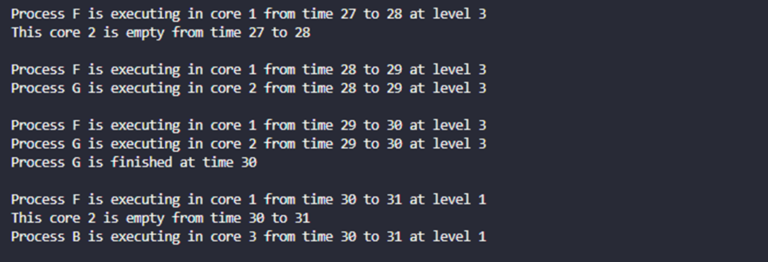
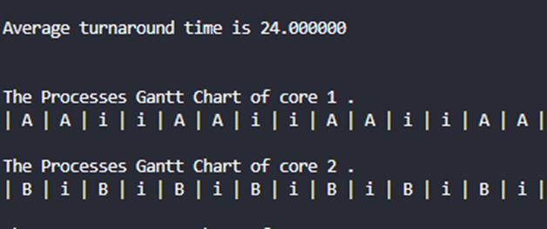
Simulator Output

Slide 21
07
Stride

Slide 22
Algorithm Description
Stride
The Stride Scheduling algorithm is a proportional-share scheduling approach in operating systems. It allocates CPU time among processes based on assigned "stride" values, where a lower stride indicates higher priority. Each process's stride is calculated using a formula that includes a pass value and a priority value. The scheduler selects the process with the smallest pass value, ensuring proportional fairness.

Slide 23
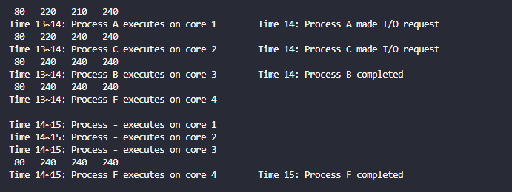
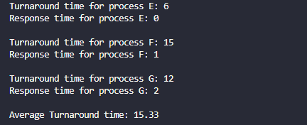
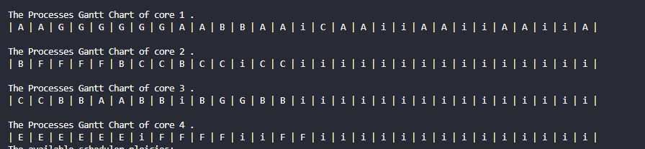
Simulator Output

Slide 24
Thanks!

