Slide 1

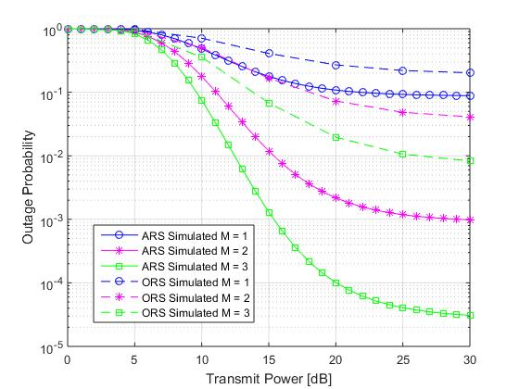
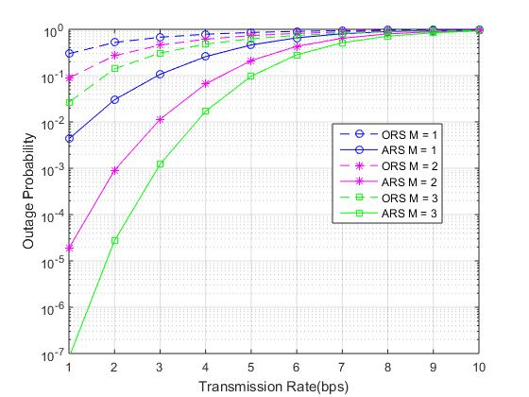
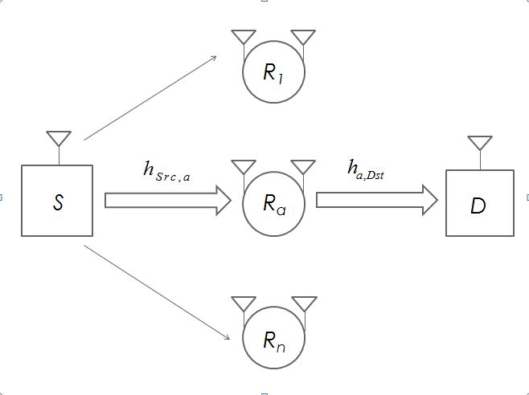
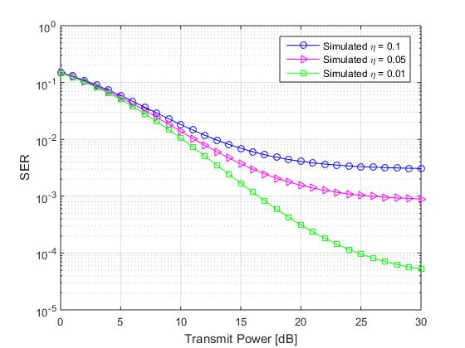

Outage Probability and SER Analysis of Joint Antenna and Relay Selection in Full Duplex AF Relay Networks
Rashmi Ravichandran| Prof. Rajesh R| SENSE
Motivation
Results
Full Duplex (FD) communication has been applied to relay networks, because it improve capacity in wireless communication. FD relay networks receive and transmit information in same time frame and frequency unlike the conventional half duplex method. As FD relaying improves throughput in hotspot areas and the cellular network edge, multiple relay systems have been considered in the proposed system model. Multiple relay FD systems employ relay selection schemes to achieve improved space diversity. Conventional multiple relay systems allowed for relay selection but, relay antenna for transmission and receiving was fixed hampering system performance. System throughput is improved in the proposed system model through means of joint antenna and relay selection scheme.
Scope
In order to achieve improved space diversity in comparison to conventional schemes, joint antenna and relay selection has been proposed in multiple FD relay systems. In such a relay network, there is one source, one destination and multiple FD Amplify and Forward (AF) relay nodes. Each FD node is equipped with one transmitter and one receiver antenna. According to the proposed system model, each relay first chooses transmit antenna and receive antenna on the basis of instantaneous channel state information. Out of multiple FD AF relay nodes which exist in the system, the best relay with the desired transmitter receiver configuration is chosen for end-to-end communication. An extra degree of freedom is added in case of the proposed system model which is an improvement to the conventional antenna selection scheme. Outage Probability and Symbol Error Rate (SER) analysis is carried out for the system to show its advantages.
Outage probability versus Transmit Power of ARS method for η = 0.05
System Model
Considering a multiple relay system, let the source node be (S), destination node be (D) and let M AF relay nodes participate in antenna and relay selection scheme.
Assuming the ath relay node, $R_{a}$ is chosen to forward the signal from the source to the destination node. The received signal is:
$$y_{a}\left[n\right]= h_{Src,a}x\left[n\right]+h_{LI,a}x_{a}\left[n\right]+n_{a}\left[n\right]$$
Similarly, the received signal at the destination is:
$$y_{Dst}\left[n\right]= h_{a,Dst}x_{a}\left[n\right]+ n_{Dst}[n]$$
From transmission power constrain equations, the final Signal Interference to Noise ratio (SINR)incorporating different channel links can be written as:
$$Υ= \frac{Υ_{Src, R_{a}}Υ_{R_{a},Dst}}{Υ_{Src,R_{a}}+(Υ_{R_{a},Dst}+1)(Υ_{R_{a}}+1)}$$
The process of selecting the best relay with the best transmitter receiver configuration can be described as:
$b_{a,AS}=arg⁡max⁡\{{ Υ}_{a,Ant1→Ant2},{ Υ}_{a,Ant2→Ant1,}$}
$Υ_{a,Ant1→Ant2}$ is the end-to-end SINR of the transmission system .This is likewise $for{ Υ}_{a,Ant2→Ant1}.$The outage probability can be obtained from the cumulative distribution function (CDF) $I\left(x\right)$ which has been derived as:
$$P_{out}{=[1− \frac{2}{1+ ηx}I\left(x\right)+\frac{1}{1+2ηx}I^{2}\left(x\right)]}^{M}$$
$I\left(x\right)=exp⁡(−\frac{2}{λ}x)\frac{2\sqrt{x^{2}+x}}{λ}K_{1}(\frac{2\sqrt{x^{2}+x}}{λ})$
The average SER is derived as:
$SER= \sum_{i=0}^{M}{\sum_{j=0}^{i}{\left({M \atop i}\right)}}\left({i \atop j}\right){−2}^{j}α$f_{i,j}
f_{n,m} = $\sum_{n=0}^{j}{\sum_{m=0}^{i−j}{\left({n \atop j}\right)}}\left({m \atop i−j}\right){(−2)}^{a−1}\sqrt{β}$η^{b}$\frac{\left(2b −1\right)‼}{{(β+2c)}^{(b+\frac{1}{2})}}$
Where,
$$a=n −2m −i−j$$
$$b=2\left(n −i −j\right)$$
$$c=(\frac{10}{3}n −\frac{5}{3}m −\frac{2}{3i}−\frac{4}{3}j)η+ \frac{4n −2m}{λ}$$
System Model of the proposed system comprises of source, destination and M relay nodes arranged as shown in the figure
Outage probability versus Transmission Rate of ARS method for η = 0.05
Average Symbol Error Rate versus Transmit Power of ARS method for N = 1 relays
Summary
A joint relay and antenna selection scheme was proposed for multiple FD relay networks with one source, one destination and M FD relays. Closed form expressions for outage probability and SER were derived and the performance of the system was evaluated and verified through MATLAB® simulation. The proposed system model achieves additional space diversity at the destination, thereby providing a better performance in comparison to the conventional relay selection scheme. The system model still suffers from self interference between the antennas of the relay and is not realisable at high SNR. Performance of the system can be improved by supressing self-interference.
Contact Details
rashmi.ravichandran2012@vit.ac.in
References
[1] M. Zhou, H. Cui, L. Song, and B. Jiao, "Transmit-receive antenna pair selection in full duplex systems, " IEEE Wireless Commun. Lett., pp. 1-4, Nov. 2013
[2] I. Krikidis, H.A. Suraweera, P.J. Smith, and C. Yuen, “Full-duplex relay
selection for amplify-and-forward cooperative networks,” IEEE Trans.
Wireless Commun., vol. 11, no. 12, pp. 4381–4393, Dec. 2012.

