Slide 1



Allali Mohammed Abdessettar
Presented by:
Mammogram Image Preprocessing for CAD Systems
The Role of Artificial Intelligence in
Modern Medicine Image Suggestion
Inspired by the methodology of Dr. Benshessin Nacer

Slide 2
Allali Mohammed Abdessettar
Presented by:
Mammogram Image Preprocessing for CAD Systems
Topic: Medical Image Preprocessing
Application: Breast Cancer Detection

Slide 3

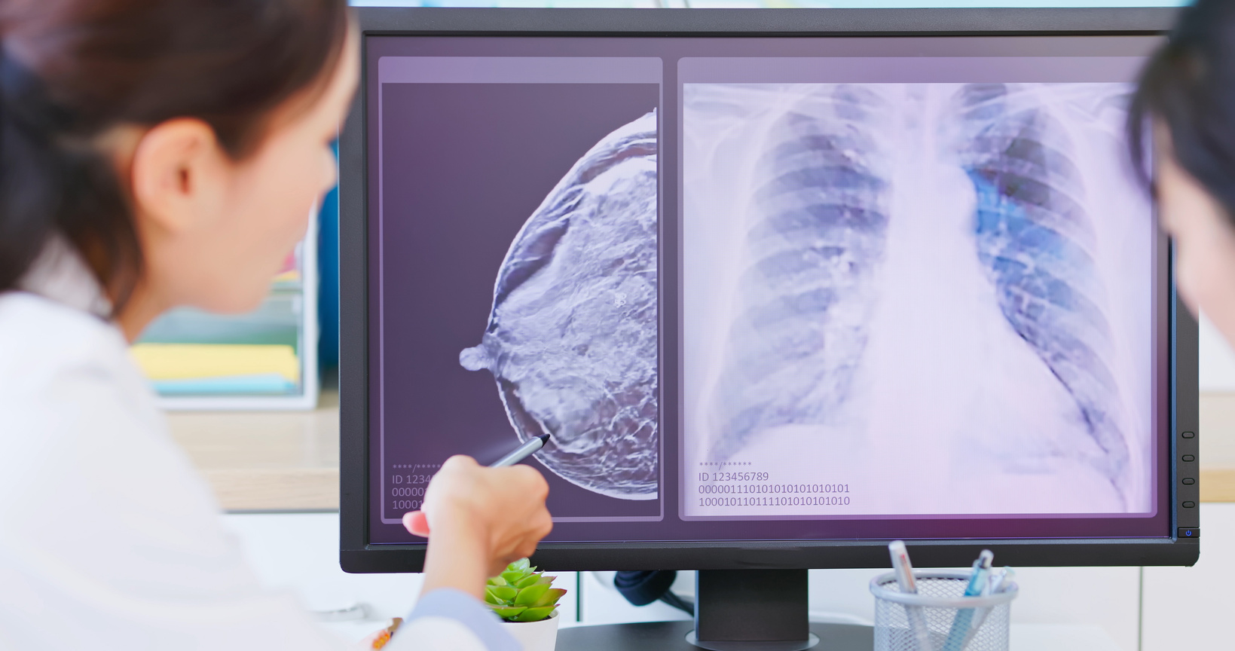

Motivation
Why Preprocessing Mammograms?
Raw mammograms contain:
Noise
Background
Labels and markers
Pectoral muscle
These elements:
Do not help diagnosis
Can confuse AI models
Preprocessing is mandatory before feature extraction or classification

Slide 4
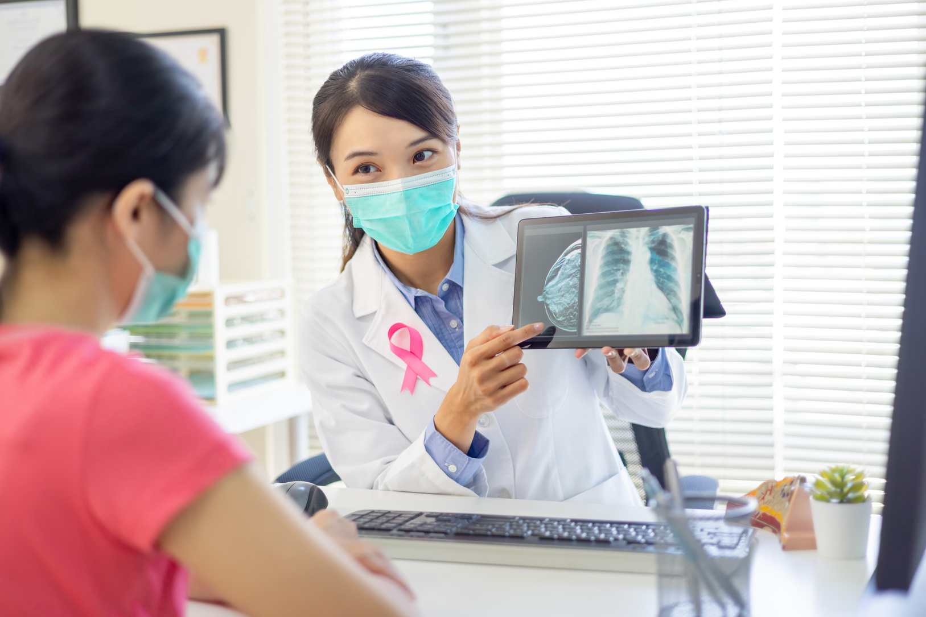
Main Idea of the Work
What Are We Doing?
We apply a step-by-step preprocessing pipeline to mammogram images in order to keep only the breast tissue. All irrelevant elements, such as noise, background, artifacts, and the pectoral muscle, are progressively removed.
Key Principle
The image is simplified while preserving only the medically relevant information needed for accurate analysis.

Slide 5

Global Preprocessing Pipeline
Main Steps
Noise removal
Artifact & background suppression
Pectoral muscle removal
ROI extraction and resizing
This pipeline is inspired by the report of Dr. Benshessin Nacer

Slide 6
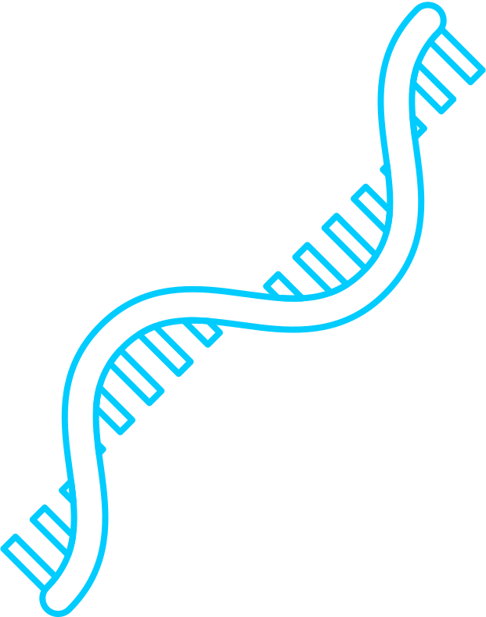
Step 1: Noise Removal
Objective
Method Used
Improve image quality
Preserve important edges
Removes impulsive and small Gaussian noise
Preserves edges better than linear filters
Method Used
Median filter (3×3)

Slide 7

Step 1: Noise Removal
Code Used (Noise Removal)
image = cv2.imread(image_path, cv2.IMREAD_GRAYSCALE)
denoised = cv2.medianBlur(image, 3)
Explanation
cv2.imread(..., IMREAD_GRAYSCALE)
Loads the mammogram as a grayscale image, which is required for medical image processing.
cv2.medianBlur(image, 3)
Applies a 3×3 median filter to remove noise while preserving edges.

Slide 8
Step 2: Artifact & Background Suppression
Objective
Techniques Used
Remove labels, markers, wedges, and background
Keep breast + artifacts first, then isolate breast
Global thresholding
Connected component labeling
Largest object selection

Slide 9

Step 2.1: Global Thresholding
Idea:
onvert grayscale image to binary
Threshold:
T=18
_, binary = cv2.threshold(image, 18, 255, cv2.THRESH_BINARY)
Explanation
Pixels ≥ 18 → white (foreground)
Pixels < 18 → black (background)

Slide 10

Step 2.2: Connected Component Labeling
Objective:
dentify each object separately
Code:
labels = measure.label(binary, connectivity=2)
Explanation
Each connected region gets a unique label
Breast, text, and markers are separated

Slide 11
Step 2.3: Largest Object Selection
Key Assumption
The breast is the largest object in the image
Code:
largest_region = max(regions, key=lambda r: r.area)
Explanation
Compute area of each component
Keep only the largest one

Slide 12
Step 2.4: Masking the Image
Objective
Remove artifacts and background completely
Code:
clean_image = cv2.bitwise_and(image, image, mask=breast_mask)
Explanation
Background pixels → 0
Breast pixels → unchanged

Slide 13
Step 3: Pectoral Muscle Removal
Why Is This Important?
The pectoral muscle appears with high intensity in mammogram images and has a visual appearance similar to dense breast tissue. If it is not removed, it can be incorrectly interpreted as an abnormal region, leading to false positives in automated analysis.

Slide 14

Step 3.1: Flip Right MLO Images
Objective
Standardize orientation
Code
image = cv2.flip(image, 1)
Explanation
Ensures pectoral muscle is always in the upper-left corner

Slide 15
Step 3.2: Quadrant Division
Idea
Pectoral muscle exists only in upper-left region
Code
quadrant = image[:h//2, :w//2]
Result
By isolating the breast region, the search area is significantly reduced, which leads to faster processing and improved accuracy in subsequent analysis.

Slide 16
Step 3.3: Triangular Localization (LTRPM)
Objective
Match anatomical shape of the pectoral muscle
Idea
Keep only upper-left triangular region
Benefit
Minimizes loss of breast tissue

Slide 17
Step 3.4: Seeded Region Growing (SRG)
Objective
Segment only the pectoral muscle
Code
muscle_mask = flood(image, seed_point, tolerance=0.15)
Explanation
The region growing process starts from a seed point selected as the brightest pixel. The region then expands by including neighboring pixels whose intensity values are similar, allowing accurate segmentation of the target area.

Slide 18
Step 3.5: Remove Muscle
Code
final_image = cv2.bitwise_and
(image, image, mask=~muscle_mask)
Result
The pectoral muscle is successfully removed while preserving the breast tissue for further analysis.

Slide 19
Step 3.6: ROI Cropping & Resizing
Objective
Keep only useful breast tissue
Standardize image size
Code
roi = image[y:y+h, x:x+w]
resized = resize(roi, (512, 512))

Slide 20

Final Result
Final Output
After preprocessing, the images are free from noise, background, artifacts, and the pectoral muscle. All images are standardized to the same size and are ready for feature extraction and use in AI-based models.

Slide 21

Summary
What We Did
We applied a structured and sequential preprocessing pipeline to mammogram images, including noise reduction, background suppression, artifact removal, and pectoral muscle elimination. The approach is guided by anatomical and radiological knowledge and follows the methodology proposed by Dr. Benshessin Nacer to ensure clinically meaningful image preparation.
Main Idea
The objective is to enhance the quality of mammographic data by isolating the breast region of interest (ROI) and suppressing irrelevant structures. This allows artificial intelligence models to focus exclusively on diagnostically significant breast tissue, thereby improving the reliability and accuracy of feature extraction and automated analysis.

