Slide 1
DEEPFAKE FACE DETECTION
Detecting & Classifying Facial Manipulation on FaceForensics++ with Lightweight, CPU-Only Models
Aya Said Abdallah Noah
Esraa Mohammed Elsayed
Abdelrahman Ibrahim Kamal Eldin
Deep Learning · Group 3 · Final Project Presentation
Notes:
[All three presenters on stage. Abdelrahman opens.] ABDELRAHMAN: Good morning everyone. We are Group 3 — I'm Abdelrahman, and with me are Esraa and Aya. Our project is about detecting deepfakes: given a face image, decide whether it is real or manipulated, and if manipulated, identify how. Everything we built runs on CPU only, so it is fully reproducible on an ordinary laptop. I'll start with the motivation, Esraa will cover the data and methods, Aya will present the results, and I'll close with limitations and future work.

Slide 2
01
Motivation & Problem
Why deepfake detection matters and what we set out to build
Presenter Abdelrahman
Notes:
ABDELRAHMAN: Let me begin with why this problem matters and exactly what we set out to do.

Slide 3
MOTIVATION
Deepfakes are now a real trust problem
Misinformation
Why a benchmark?
Fabricated videos of public figures spread faster than they can be debunked.
FaceForensics++ is the standard dataset for this research.
It pairs authentic videos with manipulated versions made by four methods:
Deepfakes, Face2Face, FaceSwap, NeuralTextures.
Impersonation & fraud
Face-swapped identities enable scams, fake KYC, and harassment.
Erosion of trust
If any video can be faked, real evidence also becomes deniable.
Speaker Abdelrahman
Notes:
ABDELRAHMAN: The reason this matters is trust in digital media. Modern face-manipulation methods are good enough to fool people, and that creates three concrete risks. First, misinformation — a convincing fake video of a politician or CEO can spread before anyone verifies it. Second, impersonation and fraud — face-swapping is already used in scams and identity attacks. And third, a subtler problem: once people know any video can be faked, they stop trusting even real footage. To study this rigorously you need a standard benchmark, and that is FaceForensics++. It gives us authentic videos alongside manipulated versions produced by four different techniques — Deepfakes, Face2Face, FaceSwap, and NeuralTextures — so we can train and evaluate fairly.

Slide 4
PROBLEM DEFINITION
Two questions, one hard constraint
Q1
Is this face real or fake?
Q2
Which manipulation was used?
Binary detection of any manipulation.
3-class typing: Deepfakes / Face2Face / FaceSwap.
The constraint: CPU-only
No GPU is used anywhere — training or inference. This was a deliberate choice so that the whole pipeline is reproducible on commodity hardware, and it shaped every decision: model size, batch size, and frame budget.
Speaker Abdelrahman
Notes:
ABDELRAHMAN: We framed the project around two questions. The first is binary detection — is a given face real or fake, regardless of how it was faked. The second is finer: given a fake, which manipulation family produced it — Deepfakes, Face2Face, or FaceSwap. And we imposed one hard constraint on ourselves: everything runs on CPU only — no GPU at any point. We did this on purpose so the work is reproducible by anyone on a normal laptop. But it's not free — it shaped every choice we made: which models we could afford, the batch size, and how many frames we sample per video. Keep that constraint in mind, because it explains a lot of our design.

Slide 5
OUR WORK
What we contribute, and today's roadmap
A stronger binary detector
Today
1
Scaled-up MobileNetV2 with class-weighted training, threshold tuning, and a 2-model ensemble.
1. Motivation & Problem
Abdelrahman
2. Data & Method
Esraa
3. Results & Analysis
Aya
4. Limitations & Future
Abdelrahman
A manipulation-type classifier
2
EfficientNet-B0 fused with an FFT frequency branch, regularized with MixUp.
A trustworthy protocol
3
Leakage-free pair-based splits, frame- and video-level metrics, and robustness analysis.
Speaker Abdelrahman
Notes:
ABDELRAHMAN: So what do we actually contribute? Three things. First, a stronger binary detector — we scaled up a MobileNetV2 baseline, added class-weighted training and threshold tuning, and combined two model variants into an ensemble. Second, a manipulation-type classifier that fuses a normal image network with a frequency-domain branch and is trained with MixUp. And third — which we think is the most important — a trustworthy evaluation protocol: leakage-free splits, both frame- and video-level metrics, and an honest robustness analysis. Here's the roadmap. I've covered motivation. Esraa will now take you through the data and the methods. [Hand over to Esraa.]

Slide 6
02
Data & Method
The dataset, the split that makes results trustworthy, preprocessing, and the two models
Presenter Esraa
Notes:
ESRAA: Thank you, Abdelrahman. I'm Esraa, and I'll cover the dataset, the split protocol — which is the single most important methodological point in our project — our preprocessing, and the two models we built.

Slide 7
DATA
FaceForensics++ — our benchmark
Deepfakes
Full face replaced by a deep-learning swap
Our subset
300
videos per class
Face2Face
Facial expressions transferred between people
20
frames per video
FaceSwap
Face region swapped by a graphics pipeline
c23
compression (high quality)
NeuralTextures
Face texture re-rendered, not fully replaced
~18k
face frames total
Speaker Esraa
Notes:
ESRAA: We use FaceForensics++, the standard benchmark. It contains authentic videos plus manipulated versions from four families, shown on the left. Deepfakes replaces the whole face with a learned swap; Face2Face transfers expressions from one person to another; FaceSwap swaps the face region using a graphics pipeline; and NeuralTextures re-renders the face texture rather than replacing it. These leave different traces, which becomes important later. On the right is the subset we actually used: 300 videos per class at the c23 high-quality compression level, sampling 20 frames per video, which gives us roughly eighteen thousand face frames in total. We deliberately chose c23 because it balances realism with file size, and it's the setting most likely to match real shared media.

Slide 8
DATA — KEY DECISION
The split that makes our results trustworthy
The trap: data leakage
The fix: official pair-based split
Fake videos are named target_source (e.g. 033_097).
A naive random split puts frames of the same identity in both train and test.
The model then memorizes faces, not manipulation — validation AUC even dropped below 0.5.
Use the official train / val / test JSON files at the pair level.
Fakes assigned by exact pair; reals by the identities in that split.
Verified zero overlap:
train ∩ val = 0 train ∩ test = 0 val ∩ test = 0
Speaker Esraa
Notes:
ESRAA: This is the slide I most want you to remember. When we first split the data randomly, we got suspiciously high scores — and then validation AUC actually fell below 0.5, which is worse than guessing. That's a classic symptom of data leakage. The cause is on the left: fake videos are named target_source — for example 033_097 means person 33's face on person 97's body. A naive random split scatters frames of the same identity across train and test, so the model just memorizes faces instead of learning manipulation artifacts. The fix, on the right, is to use the official FaceForensics++ split files at the pair level: fakes are assigned by their exact pair, and real videos by the identities appearing in each split. We then verified there is zero overlap between train, validation, and test. This one decision is what makes every number Aya shows you afterwards actually meaningful — without it, the accuracy would be a lie.

Slide 9
DATA — PREPROCESSING
From raw video to a clean face crop
1
2
3
4
›
›
›
Sample
Detect
Fallback
Normalize
20 frames per video, evenly spaced
Largest face via Haar cascade, 40% padding
Center crop if no face is found
Resize 224×224, ImageNet mean/std
Cropping to the face concentrates the model on manipulation artifacts, not the background.
Speaker Esraa
Notes:
ESRAA: Our models never see the full frame — they see a clean face crop. The pipeline has four steps. We sample 20 frames evenly across each video so they're not all from the same moment. For each frame we detect the largest face with an OpenCV Haar cascade and add 40% padding so we keep the jaw and hairline. If no face is detected, we fall back to a center crop so we never drop a frame. Finally we resize to 224 by 224 and normalize with the standard ImageNet statistics, because our backbones were pretrained on ImageNet. The reason we crop to the face is simple: manipulation artifacts live in the face, not the background, so this focuses the model where the signal actually is.

Slide 10
DATA — BALANCING
Handling 1 real : 4 fake imbalance
Weighted sampler
Tuned threshold
Each training batch sees roughly equal real and fake frames.
≈ 0.17
Class-weighted loss
Misclassifying a real frame costs 4× more (weights 4.0 : 1.0).
not 0.5
The model outputs low fake-probabilities, so a lower threshold is needed to catch them.
Threshold tuning
0.5 is wrong under imbalance — we search the validation set.
Speaker Esraa
Notes:
ESRAA: After fixing the split we hit a second problem: there are about four fake frames for every real one. Left untreated, the model just learns to say fake. We handle this three ways. A weighted random sampler balances every training batch so it sees roughly equal real and fake examples. A class-weighted loss makes a mistake on a real frame cost four times as much, which directly attacks our most common error. And we tune the decision threshold instead of assuming 0.5. That last point surprised us: the best threshold came out around 0.17, not 0.5. The model tends to output low fake-probabilities, so we have to lower the bar to actually catch fakes — and tuning it on validation raised accuracy substantially. The takeaway is that calibration matters as much as the model itself.

Slide 11
METHOD — MODEL 1
Binary detector: MobileNetV2 + ensemble
Two-stage transfer learning
Ensemble of two variants
Stage 1 — freeze backbone, train new head only
LR 1e-3, 5 epochs
Stage 2 — unfreeze last 4 blocks, fine-tune
LR 1e-5, early stopping
v1 — simple head
v2 — deeper head (ours)
Combined two ways:
• simple average of probabilities
• weighted by validation AUC
Why MobileNetV2? It is lightweight and fast on CPU — enough for the coarse real-vs-fake task.
Speaker Esraa
Notes:
ESRAA: Now the models. The binary detector is built on MobileNetV2, pretrained on ImageNet, with a new small classification head. We train it in two stages — this is transfer learning. In Stage 1 we freeze the whole backbone and train only the new head at a high learning rate, so the random head settles without disturbing the pretrained features. In Stage 2 we unfreeze the last four blocks and fine-tune gently at a much lower learning rate, with early stopping. We chose MobileNetV2 because it's light and fast on CPU, and real-versus-fake is a coarse task that doesn't need a heavy network. To squeeze out a bit more, we trained two head variants and combined them as an ensemble — both a simple average and a version weighted by each model's validation AUC.

Slide 12
METHOD — MODEL 2
Manipulation classifier: spatial + frequency
Spatial path
Why a frequency branch?
EfficientNet-B0
→ 1280-d features
Each generator leaves a distinct spectral fingerprint that the FFT exposes directly.
MixUp (α=0.3) blends images and labels → smoother boundaries between similar classes.
›
Fuse
1408-d
→ 3 classes
Frequency path
2-D FFT log-magnitude
→ small CNN → 128-d
3 classes only — NeuralTextures excluded (too similar); real frames excluded (no manipulation signal).
Speaker Esraa
Notes:
ESRAA: The manipulation classifier is more interesting. It has two paths. The spatial path is an EfficientNet-B0 — a bit stronger than MobileNet, which helps with the fine texture differences between forgery types. The second path is a frequency branch: we take the 2-D Fast Fourier Transform of the image, its log-magnitude, and pass that through a small CNN. We fuse both into a single 1408-dimensional descriptor and classify into three types. Why the frequency branch? Because each generator leaves a characteristic fingerprint in the frequency spectrum — periodic GAN patterns, blending edges — and the FFT exposes that directly, instead of hoping the spatial network learns it. We also train with MixUp, which blends pairs of images and their labels and forces smoother boundaries between Face2Face and FaceSwap, which look very alike. We kept this to three classes — we dropped NeuralTextures because it's too visually similar, and we excluded real frames since they carry no manipulation signal. That's the data and the models — Aya will now show what they actually do. [Hand over to Aya.]

Slide 13
03
Results & Analysis
How we evaluate, what both models achieve, robustness, and what the model looks at
Presenter Aya
Notes:
AYA: Thanks, Esraa. I'm Aya, and I'll present how we evaluate, the results for both models, how they hold up under degradation, and finally what the model actually attends to.

Slide 14
RESULTS — HOW WE MEASURE
Frame-level vs. video-level evaluation
Frame level
Video (group) level
Score every face crop independently. Strict, but a single hard frame can drag the score down.
Average the frame probabilities within each video, then decide once per clip.
Matches the pair-based dataset and how detection is used in practice — and it is consistently more reliable.
Metrics: Accuracy · Macro-F1 · ROC-AUC
Speaker Aya
Notes:
AYA: Before the numbers, two ways we measure. Frame level scores each face crop on its own — it's strict, but one bad frame can unfairly lower the result. Video level, or group level, averages the frame probabilities within a video and makes one decision per clip. This matches how the dataset is structured and how detection is actually used in the real world, where you judge a whole video, not a single frame. As you'll see, the video-level numbers are consistently better, because averaging cancels out per-frame noise. Throughout, we report three metrics: accuracy, Macro-F1, and ROC-AUC — Macro-F1 and AUC matter most under imbalance.

Slide 15
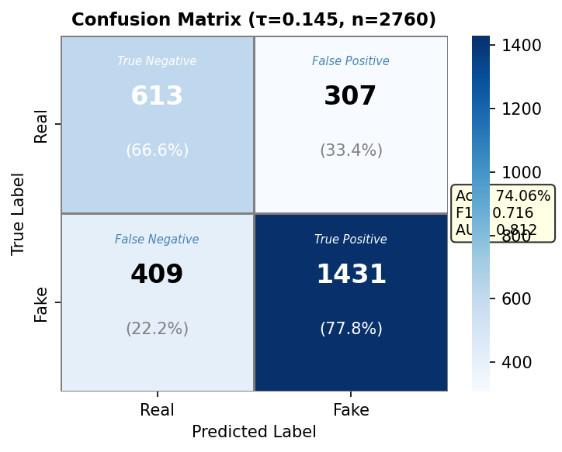
RESULTS — MODEL 1
Binary detection results
74.1%
0.899
Frame accuracy
Video-level AUC
Simple ensemble is best on accuracy (74.06%); v2 has the strongest ranking (AUC 0.812).
Video-level lifts accuracy to 75.4% and AUC from 0.812 → 0.899.
The minority real class is the harder one — lower recall than fake, under imbalance.
Speaker Aya
Notes:
AYA: Here are the binary results. On individual frames, the simple ensemble reaches about 74% accuracy — the best of our four configurations — and our v2 model has the strongest ranking ability with an AUC of 0.81. But the headline is the jump when we move to video level: accuracy rises to 75.4% and AUC climbs from 0.81 to 0.90. Averaging across frames removes a lot of noise. The confusion matrix on the right tells the error story: the minority real class is the harder one, with lower recall than fake — so the model still lets some fakes through and flags some real faces. That's expected, because real is the minority class, and it's exactly why we added class weighting and threshold tuning. It's the harder direction, and where the remaining headroom is.

Slide 16
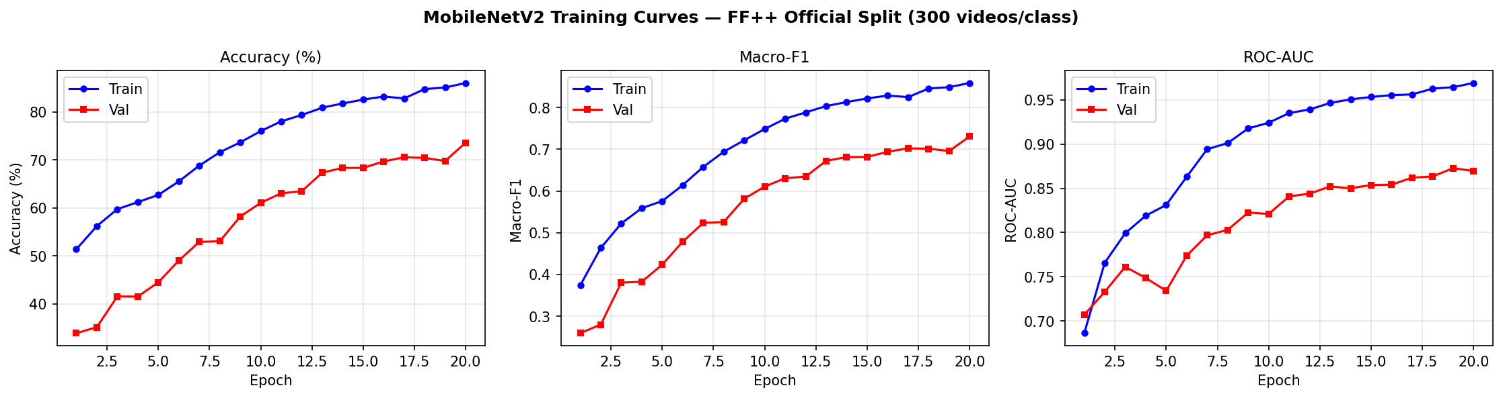
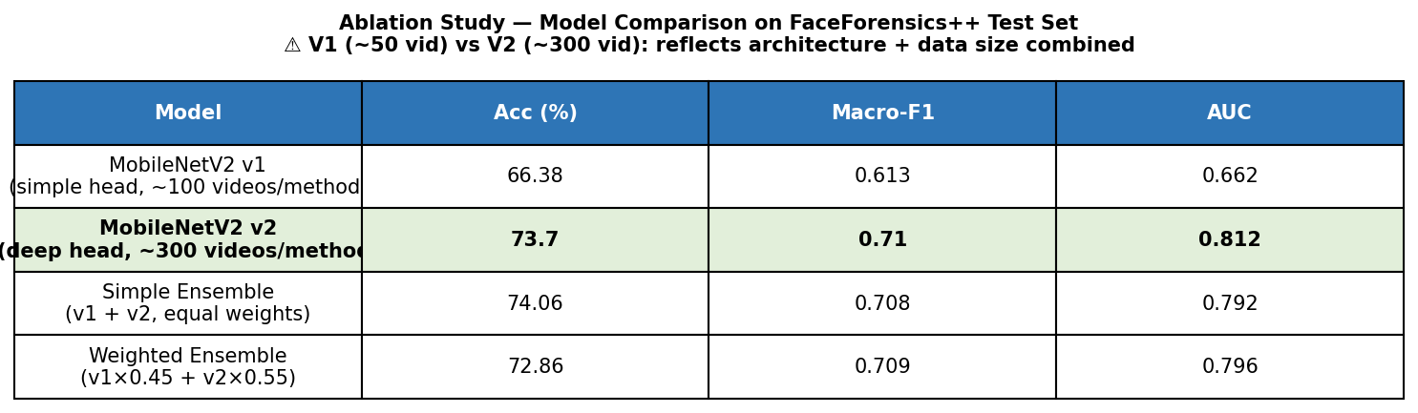
RESULTS — MODEL 1
How the binary detector was built up
Two-stage training
Ablation — architecture + data + ensemble
Most of the gain came from more data + a deeper head (v1 66% → v2 74%); the simple ensemble adds the final margin to 74.06%.
Speaker Aya
Notes:
AYA: Quickly, how we got to those numbers. On top are the two-stage training curves — accuracy, F1, and AUC climbing through Stage 1, the head-only warm-up, then jumping when we unfreeze the backbone in Stage 2. Below is our ablation: v1, the shallow head on less data, sits at 66%; v2, the deeper head on the full 300 videos, reaches about 74% — so most of our improvement came from more data and a deeper head together. The simple ensemble of the two then adds the final small margin to 74.06%, our best operating point. The weighted blend was slightly lower on accuracy, so we kept the simple one.

Slide 17
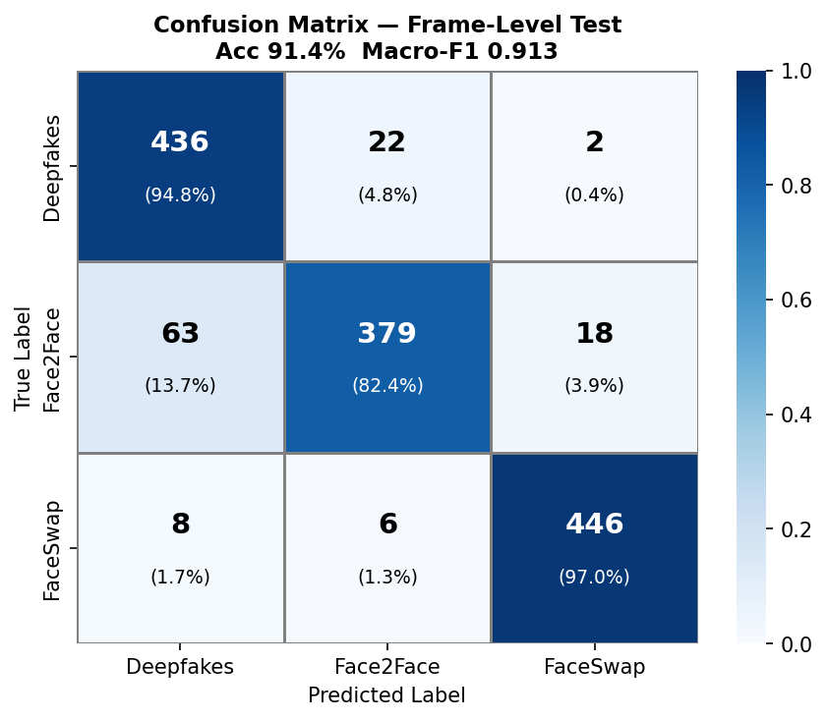
RESULTS — MODEL 2
Manipulation-type results
91.4%
97.1%
Frame accuracy
Video-level accuracy
Macro-F1 0.913 · Macro-AUC 0.984 at frame level.
FaceSwap is easiest (F1 0.96); Face2Face is hardest, sometimes confused with Deepfakes.
The frequency branch pays off — spectral fingerprints separate the forgery families cleanly.
Speaker Aya
Notes:
AYA: The manipulation classifier does much better, because telling the forgery types apart is actually easier than rejecting all of reality. At frame level it reaches 91.4% accuracy, Macro-F1 0.91, and AUC 0.98. At video level it jumps to 97.1% accuracy — nearly perfect. Looking at the confusion matrix, FaceSwap is the easiest family with an F1 of 0.96, while Face2Face is the hardest and occasionally gets confused with Deepfakes — which makes sense, since both involve learned facial changes. The big message here is that the frequency branch pays off: the spectral fingerprints Esraa described really do separate the families cleanly, far better than a spatial network alone would.

Slide 18
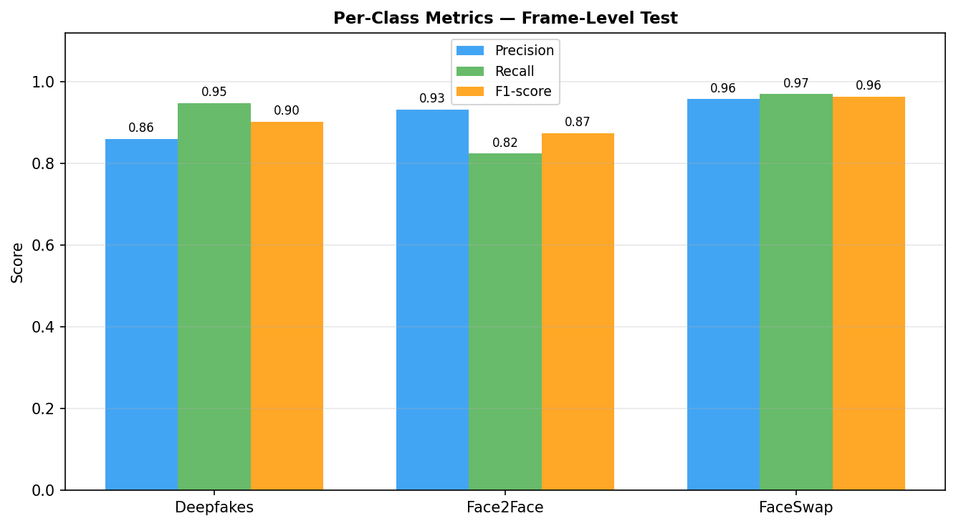
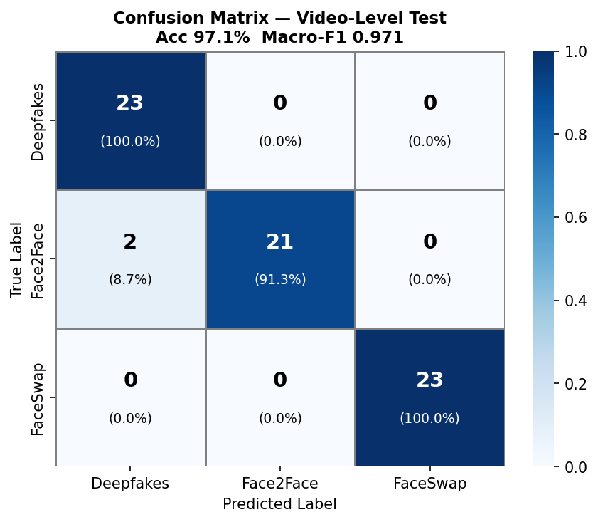
RESULTS — MODEL 2
Per-class & video-level performance
Per-class precision / recall / F1
Video-level confusion matrix
FaceSwap is perfectly separated; Face2Face is the only real source of confusion. At video level the matrix is almost diagonal — 97.1% accuracy.
Speaker Aya
Notes:
AYA: A closer look at the manipulation classifier. On the left, the per-class bars: FaceSwap is essentially perfect, Deepfakes is strong, and Face2Face is the weakest — it's the one the model occasionally mislabels. On the right is the video-level confusion matrix: once we aggregate frames per clip, it's almost perfectly diagonal, with only a couple of Face2Face videos misassigned, giving 97.1% accuracy. So the residual difficulty is entirely the Face2Face–Deepfakes pair, which we'd expect since both are learned facial reenactments.

Slide 19
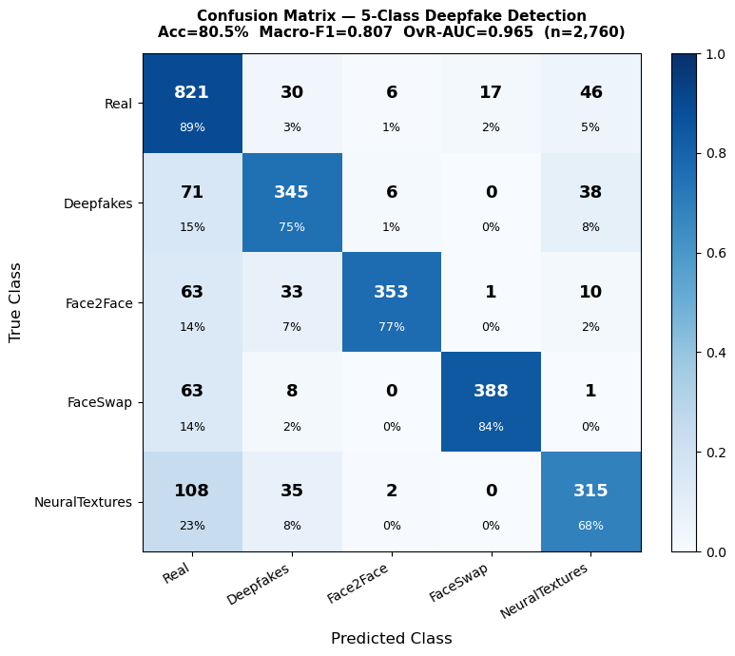
RESULTS — PRACTICAL EXTENSION
One model for all five classes
80.5%
0.807
Accuracy (TTA)
Macro-F1
A single MobileNetV2 that does detect + classify at once: Real + Deepfakes + Face2Face + FaceSwap + NeuralTextures.
3-stage fine-tuning + MixUp + test-time augmentation. Top-2 accuracy 94.0%; OvR-AUC 0.965.
Now includes NeuralTextures — the family the 3-class model had to drop.
FaceSwap & Face2Face cleanest; NeuralTextures hardest — the price of covering everything in one model.
Speaker Aya
Notes:
AYA: As a practical extension, we also built a single model that does both jobs at once — it classifies a face directly into five classes: real, plus all four manipulation families, including NeuralTextures, which our three-class model had to leave out. It's a MobileNetV2 trained in three stages with MixUp, and at test time we average over seven augmented views. That test-time augmentation alone lifted accuracy from 76% to 80.5%, with a Macro-F1 of 0.81 and a Top-2 accuracy of 94% — meaning the right answer is almost always in the model's top two guesses, which is exactly what you want for a triage tool. The confusion matrix shows FaceSwap and Face2Face are cleanest and NeuralTextures is the hardest. So this is one deployable model covering everything, at the cost of a little accuracy versus the specialized classifiers.

Slide 20
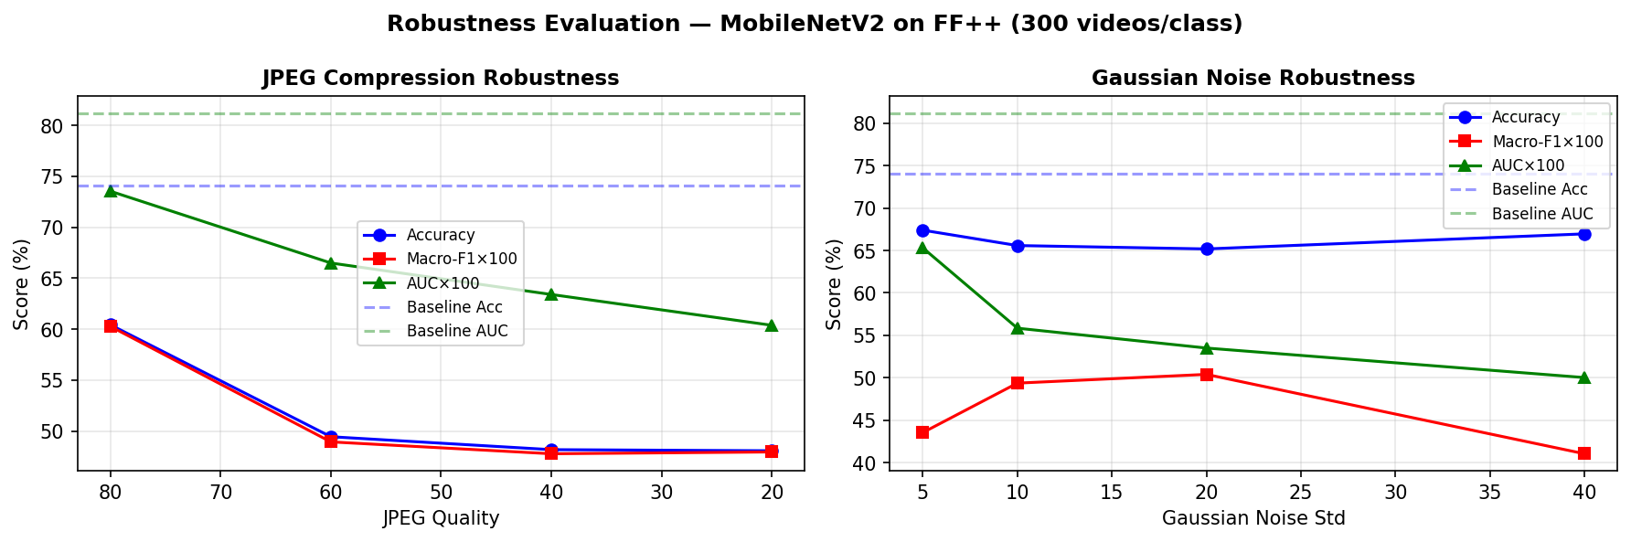
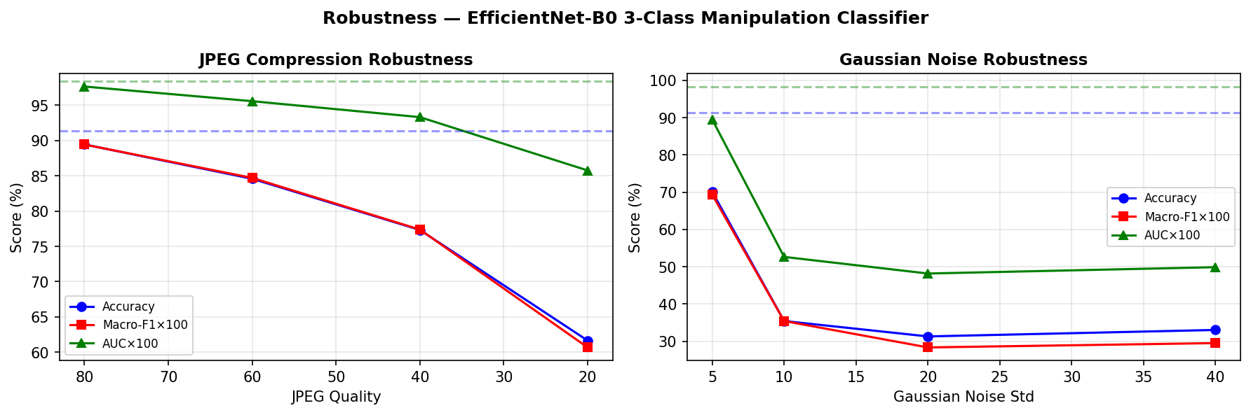
RESULTS — ROBUSTNESS
How well does it survive post-processing?
Binary detector
Manipulation classifier
JPEG: graceful
Gaussian noise: the weak spot
Both degrade slowly; the classifier still holds ~89% at quality 80 — and most shared media is lightly compressed.
Accuracy can look stable while F1 and AUC collapse — both models retreat to the majority class under heavy noise.
Speaker Aya
Notes:
AYA: Real media gets re-compressed and noisy, so we tested both models under JPEG recompression and Gaussian noise. Two clear findings. Under JPEG — the plots on the left of each pair — performance degrades gracefully. The manipulation classifier still holds about 89% accuracy at quality 80, and since most social-media content is only lightly compressed, that's encouraging. Under Gaussian noise — the right of each pair — there's a trap. Raw accuracy can look stable while Macro-F1 and AUC collapse. That's because under heavy corruption both models give up and just predict the majority class — so they look 'accurate' on the dominant class but have stopped discriminating. The manipulation classifier is hit hardest because noise destroys exactly the high-frequency cues its frequency branch depends on. The lesson: never trust accuracy alone — F1 and AUC reveal the real story.

Slide 21
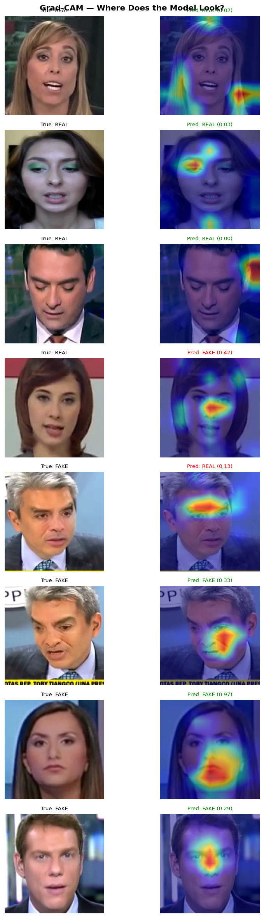
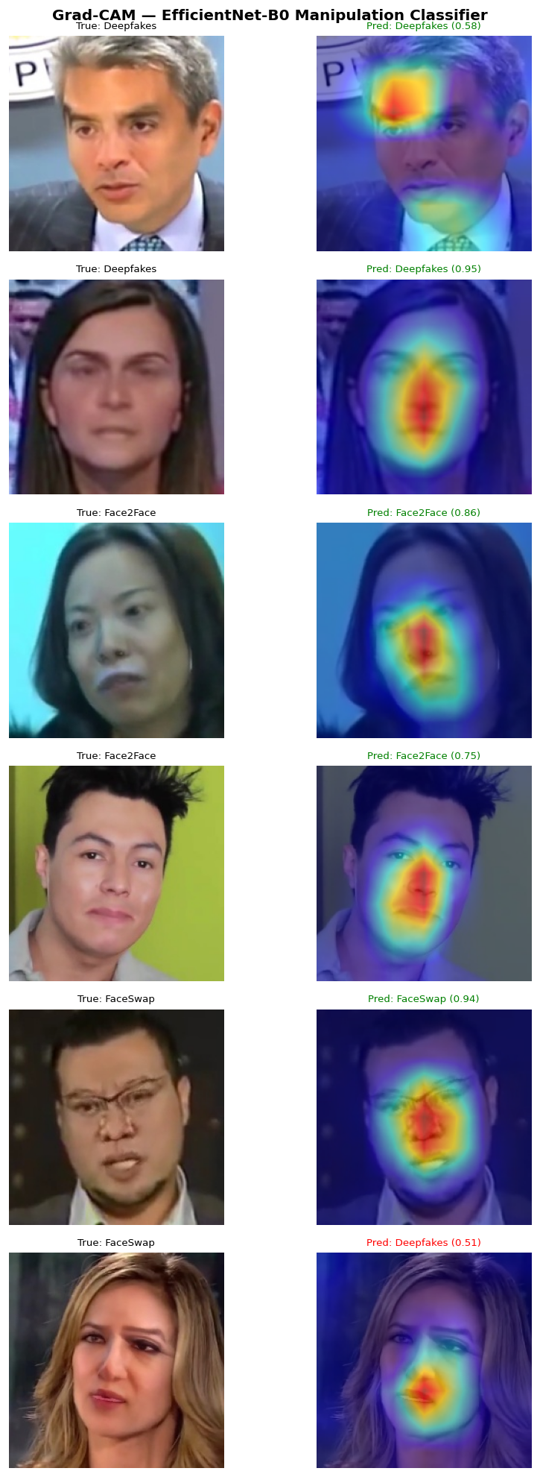
RESULTS — INTERPRETATION
What are the models actually looking at?
Focus on the face, not the background
Grad-CAM heatmaps for both models concentrate on central facial regions and blending boundaries — a sanity check that they use manipulation cues, not dataset shortcuts.
Why it matters
Interpretability builds trust: it shows the models learned the right thing, and points us to where errors come from.
Binary
Multiclass
Speaker Aya
Notes:
AYA: A sanity check with Grad-CAM, for both models — the heatmap strips on the right. Reassuringly, the attention lands on central facial regions and blending boundaries, exactly where manipulation artifacts appear, and not on the background. So the models learned the right thing rather than a dataset shortcut. This interpretability builds trust in the results and points us toward where the remaining errors come from.

Slide 22
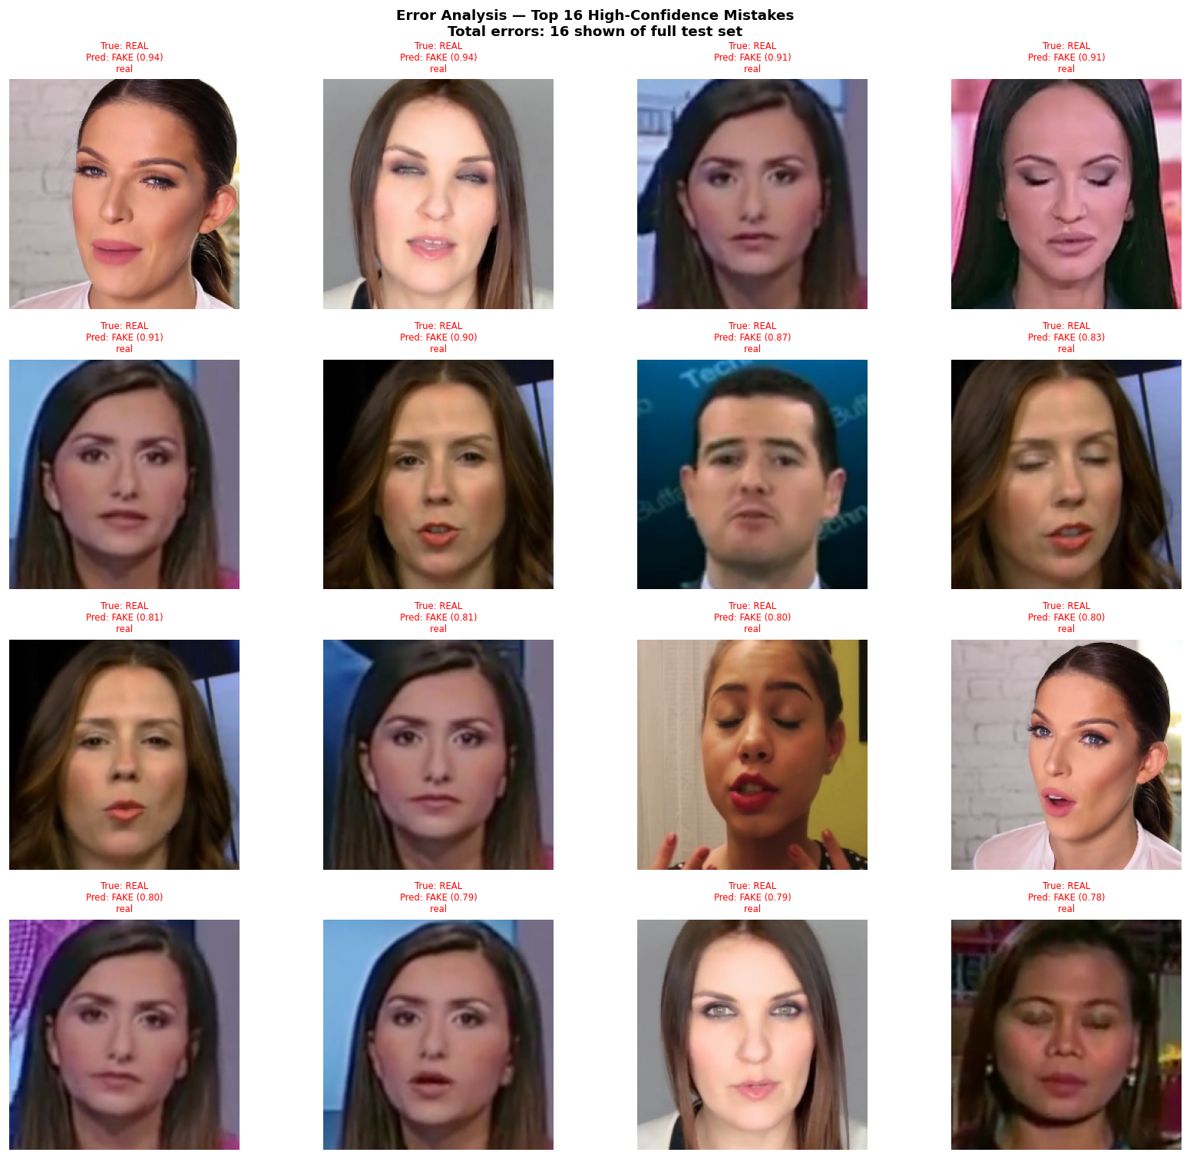
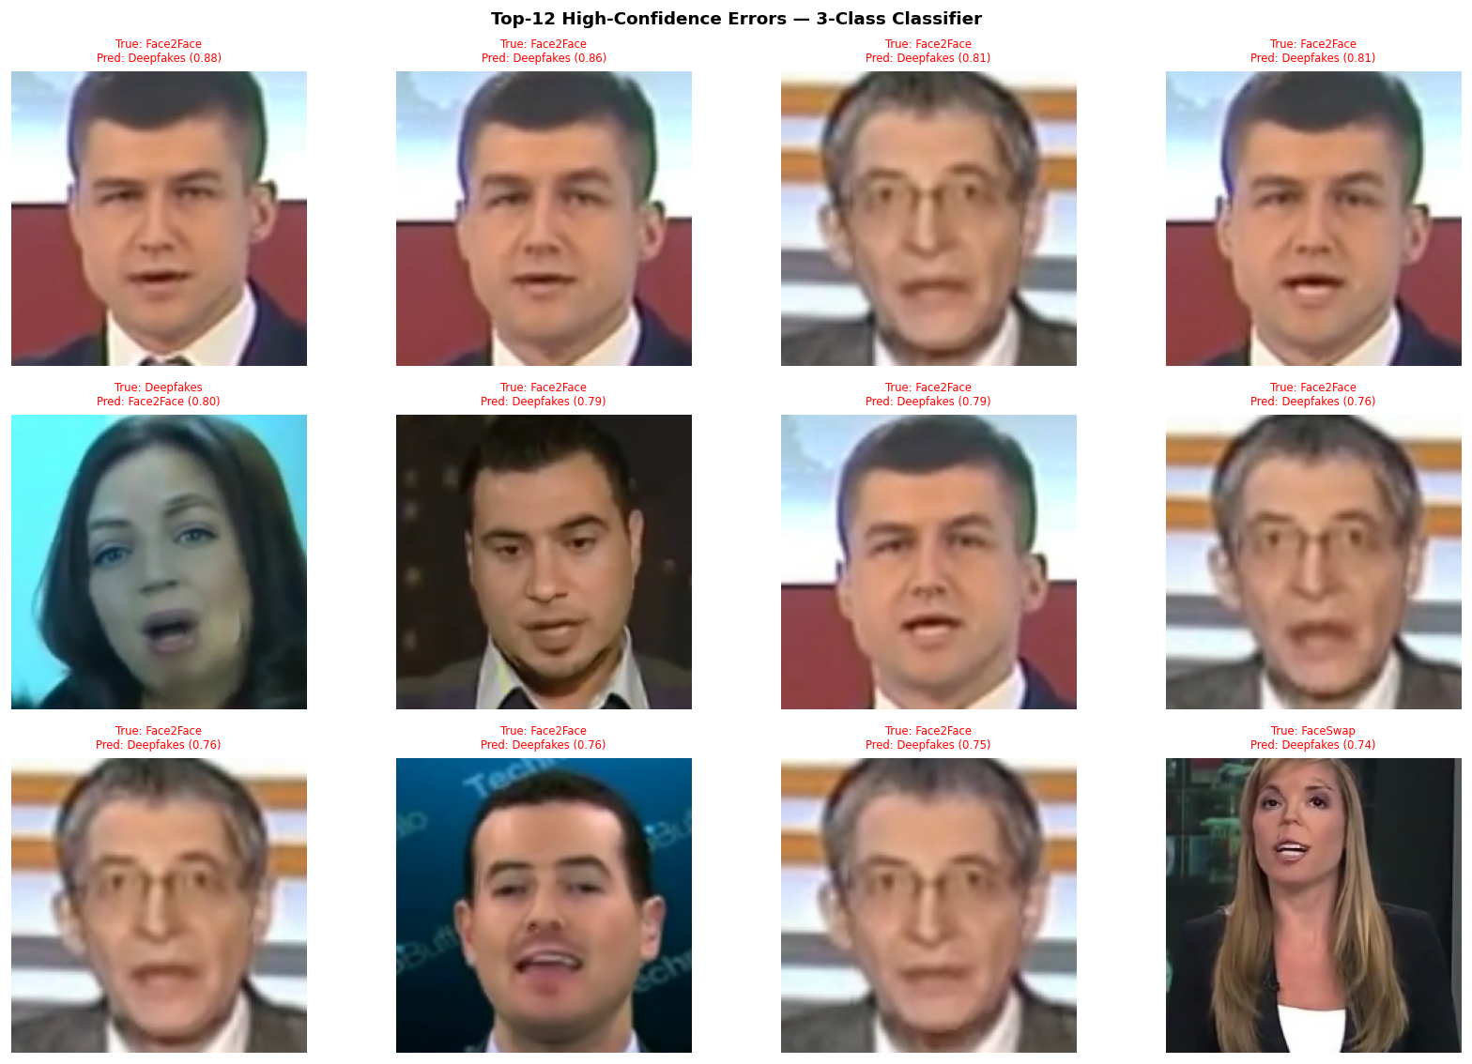
RESULTS — ERROR ANALYSIS
Where each model fails
Binary — confident mistakes
Manipulation — confident mistakes
Real faces in odd poses → flagged fake
Speaker Aya
Notes:
AYA: And honestly, where they fail. On the left, the binary detector's most confident mistakes are almost all real faces under unusual conditions — strong pose, blur, or occlusion — pushed over into 'fake'. On the right, the manipulation classifier's errors sit almost entirely on the Face2Face–Deepfakes boundary; several are low-detail or blurred frames where the frequency fingerprint is weakest. The good news is that nearly none of these frame-level slips survive video-level aggregation — which is exactly why the group accuracy reaches 97%. That wraps the results — Abdelrahman will close. [Hand back to Abdelrahman.]

Slide 23
04
Limitations & Future Work
An honest view of where this stands and where it goes
Presenter Abdelrahman
Notes:
ABDELRAHMAN: Thanks, Aya. Let me close honestly — what our system can't yet do, and where we'd take it next.

Slide 24
CLOSING
Limitations & future work
Limitations
Future work
300 videos/class, not the full benchmark
NeuralTextures excluded from the 3-class model
Evaluated on pre-extracted crops, not end-to-end video
Fragile under heavy noise (majority-class bias)
Add NeuralTextures → 4-class classifier
Corruption-aware training for robustness
End-to-end pipeline: detection → typing on raw video
Scale to the full FF++ dataset
Speaker Abdelrahman
Notes:
ABDELRAHMAN: We want to be honest about the limits. We trained on 300 videos per class, not the full thousand-video benchmark, so our numbers are indicative rather than state-of-the-art. The manipulation classifier leaves out NeuralTextures. We evaluate on pre-extracted face crops, not raw end-to-end video. And as Aya showed, both models are fragile under heavy noise, defaulting to the majority class. Each of those points directly to future work. We'd add NeuralTextures back to make it a four-class model, train with corruption augmentation so robustness improves, build a single end-to-end pipeline that goes from raw video to detection and then manipulation typing, and scale up to the full dataset.

Slide 25
CONCLUSION
Beyond accuracy: a correct, reproducible protocol
74.1%
0.899
91.4%
97.1%
binary frame acc
binary video AUC
type frame acc
type video acc
Leakage-free splits · calibrated thresholds · frame- and video-level metrics · robustness analysis.
That is what makes these results trustworthy — and a solid base to build on.
Thank you · Questions?
Notes:
ABDELRAHMAN: To conclude. We built two lightweight, CPU-only models on FaceForensics++: a binary detector that reaches about 74% at frame level and 0.90 video-level AUC, and a manipulation classifier that reaches 91% at frame level and 97% at video level. But the number we're proudest of isn't an accuracy — it's the protocol. Leakage-free splits, calibrated thresholds, both frame- and video-level reporting, and an honest robustness analysis. That's what makes these results trustworthy rather than just impressive, and it's a solid foundation for the future work we described. Thank you — we're happy to take your questions.

