Slide 1
Normal Distribution
Ansar Shahzadi
School of Electrical Engineering & Computer Science
National University of Science and Technology(NUST)

Slide 2
Normal Distribution
Continuous Distribution
Bell shaped curve
Uni-model single peak at the center, symmetrical
Normal distribution has two parameters mean and variance.
The total area under the curve is one.
The normal curve approaches, but never touches the x-axis.

Slide 3
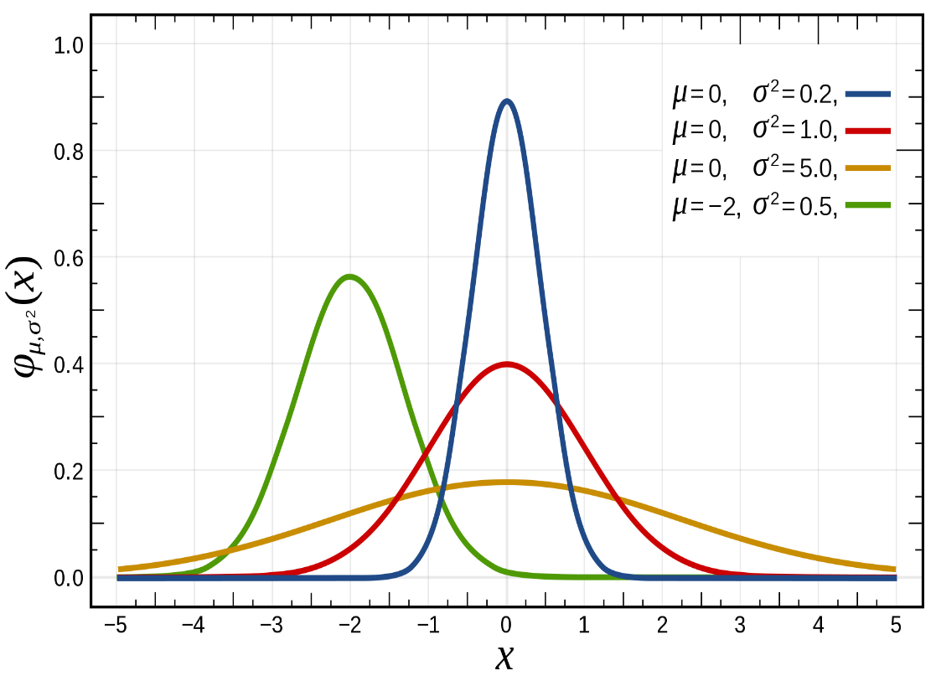

Normal Distribution
The p.d.f of normal distribution is
f(x)=$\frac{1}{σ\sqrt{2π}}e^{−\frac{1}{2}{\left(\frac{x−μ}{σ}\right)}^{2}}$ $for −∞≤x≤∞$
Here
Mean=µ
Standard deviation= $σ$
e=2.7281
$$π=3.14$$

Slide 4
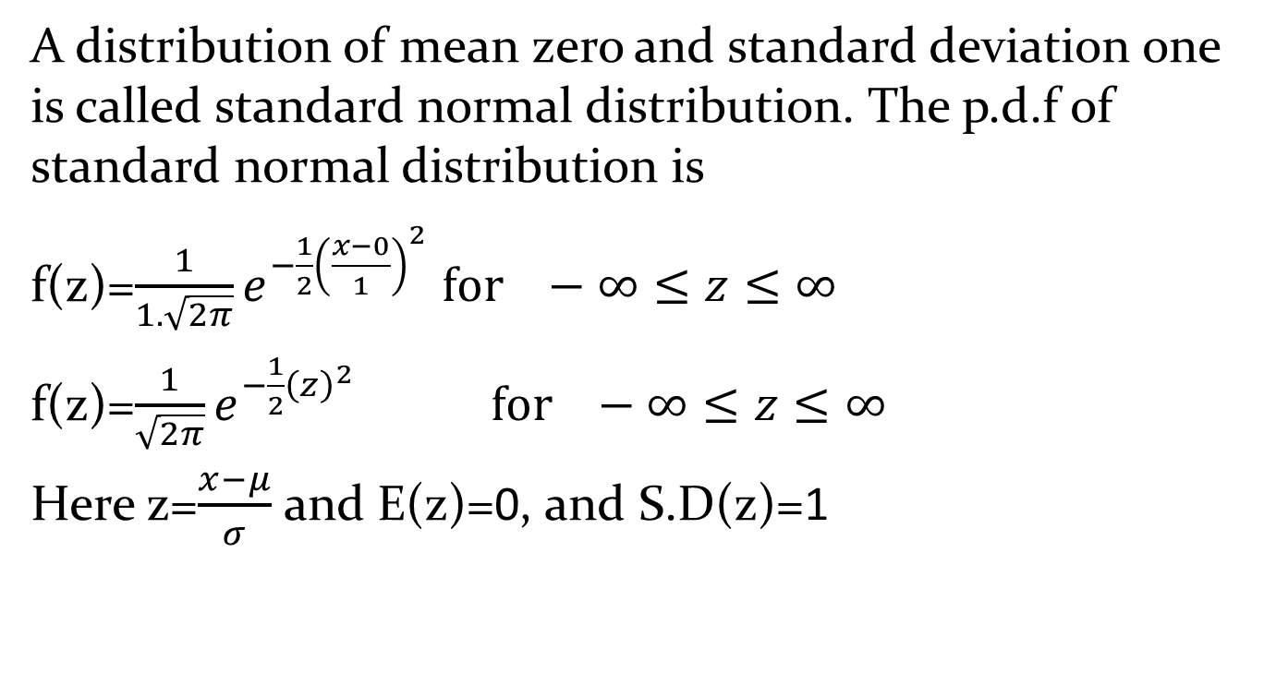
Standard Normal Distribution
A distribution of mean zero and standard deviation one is called standard normal distribution. The p.d.f of standard normal distribution is
f(z)=$\frac{1}{1.\sqrt{2π}}e^{−\frac{1}{2}{\left(\frac{x−0}{1}\right)}^{2}}$ $for −∞≤z≤∞$
f(z)=$\frac{1}{\sqrt{2π}}e^{−\frac{1}{2}{\left(z\right)}^{2}}$ $for −∞≤z≤∞$
Here z=$\frac{x−μ}{σ}$ and E(z)=0, and S.D(z)=1

Slide 5
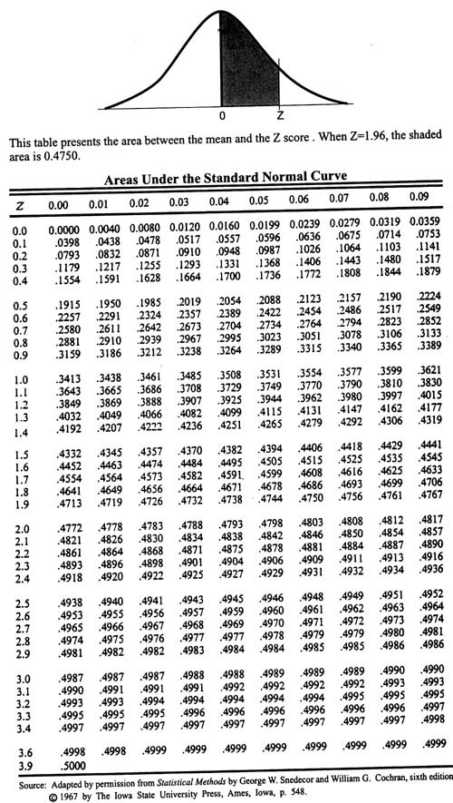

Slide 6
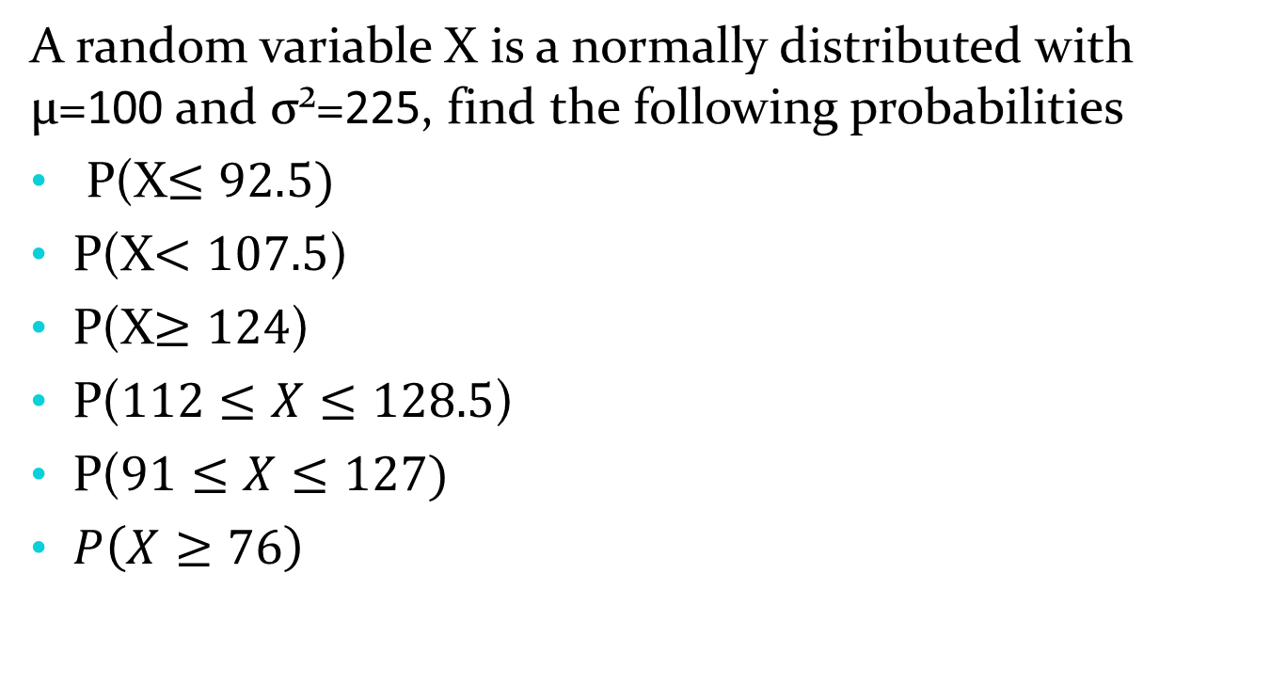
Normal Distribution
A random variable X is a normally distributed with µ=100 and σ²=225, find the following probabilities
P(X$≤92.5)$
P(X$<107.5$)
P(X$≥124$)
P($112≤X≤128.5$)
P($91≤X≤127)$
$P\left(X≥76\right)$

Slide 7

Normal Distribution
Let $Y=5X+10$ and X be normally distributed with a µ=10 and σ²=25, find the following probabilities
P(Y$≤54.5)$
P(Y$≥68$)
P($52≤Y≤67$)

Slide 8
Normal Distribution
The fill volume of an automated filling machine used for filling cans of carbonated beverage is normally distributed with a mean of 12.4 fluid ounces and a standard deviation of 0.1 fluid ounce.
What is the probability a fill volume is less than 12.1 fluid ounces?
If all cans less than 12.2 or greater than 12.5 ounces are scrapped, what proportion of cans is scrapped?
Determine specification that are symmetric about the mean include 95% of all cans.

Slide 9
Normal Distribution
A Man goes by car to his office, and the route through the city centers takes him, on the average, 27 minutes with a standard deviation of 5 minutes. With the opening of a new ring road, the man can bypass the congestion of the city center, but the journey now takes, on the average, 29 minutes with the standard deviation of 2 minutes. Assuming that both journey times are normally distributed, determine which route is the better one in the man has (i) 28 minutes, and (ii) 32 minutes to reach his office for an appointment

Slide 10
Normal Distribution
In a normal Distribution, 31% of the items are under 45 and 8% are over 64. Find the mean and standard deviation of the distribution.

Slide 11
Normal Distribution
An athlete finds that in a high jump he can clear a height of 1.68m once in five attempts and a height of 1.52m nine times out of ten attempts. Assuming the height he can clear in various jumps from a normal distribution, estimate the mean and standard deviation of the distribution.

Slide 12
Normal Distribution
Assuming that the number of marks scored by a candidate is normally distributed, find the mean and the standard deviation, if the number of first class students(60% or more marks) is 25, the number of failed students(less than 30%marks) is 90 and the total number of candidates appearing for the examination is 450.

Slide 13
Normal Approximation to the Binomial Distribution
The binomial distribution can be approximated by a normal distribution, when n is sufficiently large and neither p nor q is close to zero. Before you apply a normal approximation you have to check the following conditions np>5 or n(1−p)>5.

Slide 14
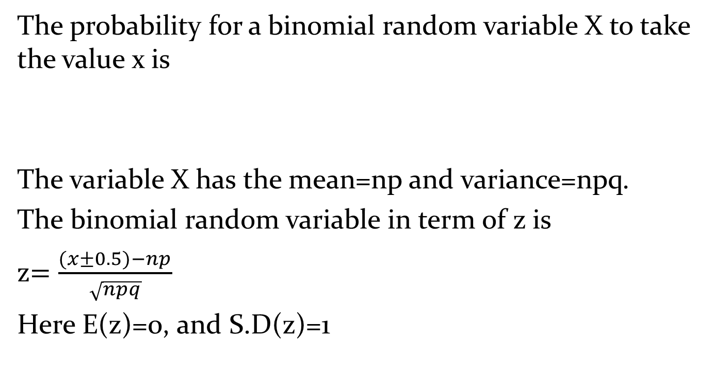
Normal Approximation to the Binomial Distribution
The probability for a binomial random variable X to take the value x is
The variable X has the mean=np and variance=npq.
The binomial random variable in term of z is
z$=\frac{(x±0.5)−np}{\sqrt{npq}}$
Here E(z)=0, and S.D(z)=1

Slide 15
Continuity Correction
We are approximating a discrete distribution with a continuous one, and so we must use a continuity correction. A discrete value x becomes the interval from x-0.5 to x+0.5; and this sort of adjustment is called continuity correction.
To do this,
Draw the diagram and shade the required area.
Use a broken line for the “boundary” if the probability is an inequality>, greater than or <, less than and a solid line otherwise ≥, greater than or equal to or≤, less than or equal to
Adjust any inequality by extending to the next “included” integer For example, >2 becomes ≥3, < 5 becomes ≤4
The shaded area is now extended by half a unit

Slide 16
Normal Approximation to the Binomial Distribution
So, continuing, the process is still:
Draw and label a diagram
Shade required area
Change raw score to standard (Z score):
Look up z value In tables
Adjust probability from table to required area

Slide 17
Normal Approximation to the Binomial Distribution
A pair of fair dice rolled 180 times. Use the normal approximation method to find the probability that a total of 7 occurs
At least 25 times
Between 33 and 34 times inclusive
Less than 27 times

Slide 18
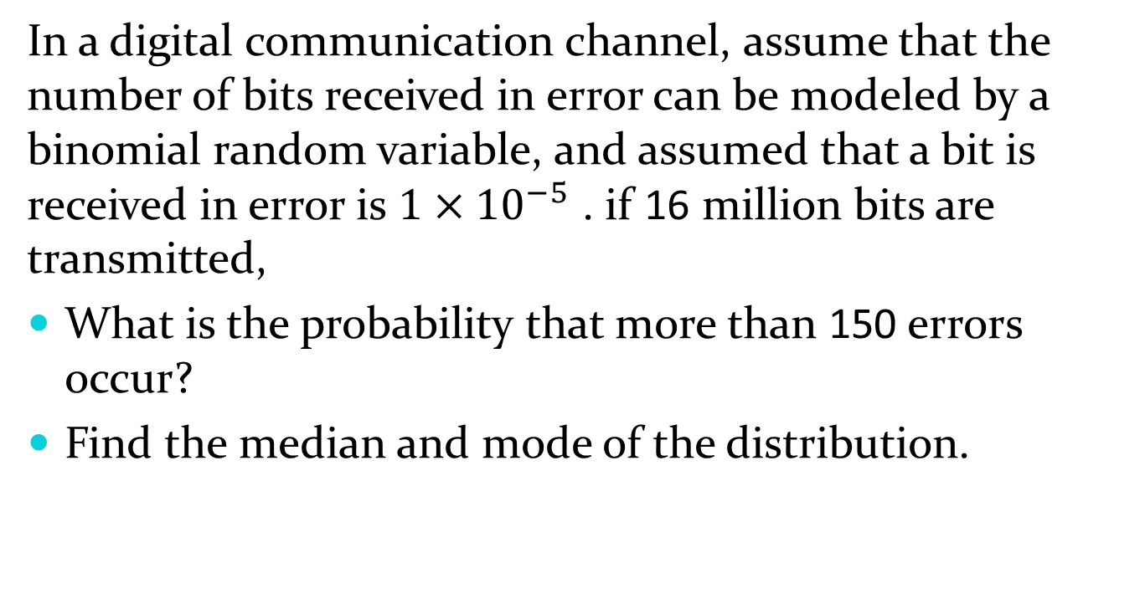
Normal Approximation to the Binomial Distribution
In a digital communication channel, assume that the number of bits received in error can be modeled by a binomial random variable, and assumed that a bit is received in error is $1×{10}^{−5}$ . if 16 million bits are transmitted,
What is the probability that more than 150 errors occur?
Find the median and mode of the distribution.

Slide 19
Normal Approximation to the Poisson Distribution
A telephone exchange receives, on average, 5 calls per minute. Find the probability that in a 20 minute period
No more than 102 calls are received
Exactly 90 calls are received

