Slide 1

CROP CONNECT
Abdul Rehman Memon (416585)
Faakhir Ul Hasan Zahid (410406)

Slide 2

TECH STACK
NEXT JS
NODE JS
MONGO DB
EXPRESS JS
TAILWIND CSS
SOCKET-IO

Slide 3

PRIOR KNOWLEDGE
HTML
CSS
JAVASCRIPT
BASIC PHP

Slide 4
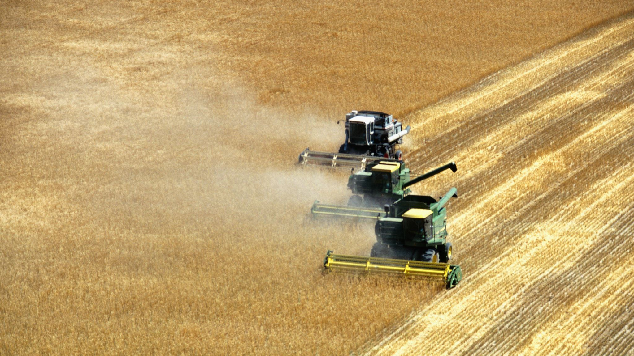
PURPOSE
Crop Connect serves as a centralized platform for individuals interested in gardening and farming activities. It aims to connect gardening enthusiasts about sustainable agriculture. This platform provides resources, tools and oppourtunities to support and promote farming projects

Slide 5

FUNCTIONAL REQUIREMENT
Every user will have their account
User can chat with any other user
User can create his own groups
Admin can monitor all things
User can visit marketplace and seek products of his/her interest
Users can list and see stories
Dashboard and homepage would provide overall insights
Chat would be real time by use of sockets

Slide 6

WEBSITE PORTALS
HOMEPAGE
USER DASHBOARD
COMMUNITY PAGE
MARKETPLACE

Slide 7
MAJOR MODULES
USER AUTHENTICATION AND PROFILES
COMMUNITY BUILDING TOOLS
EVENT MANAGEMMENT
MARKETPLACE
COMMUNITY CHAT

Slide 8
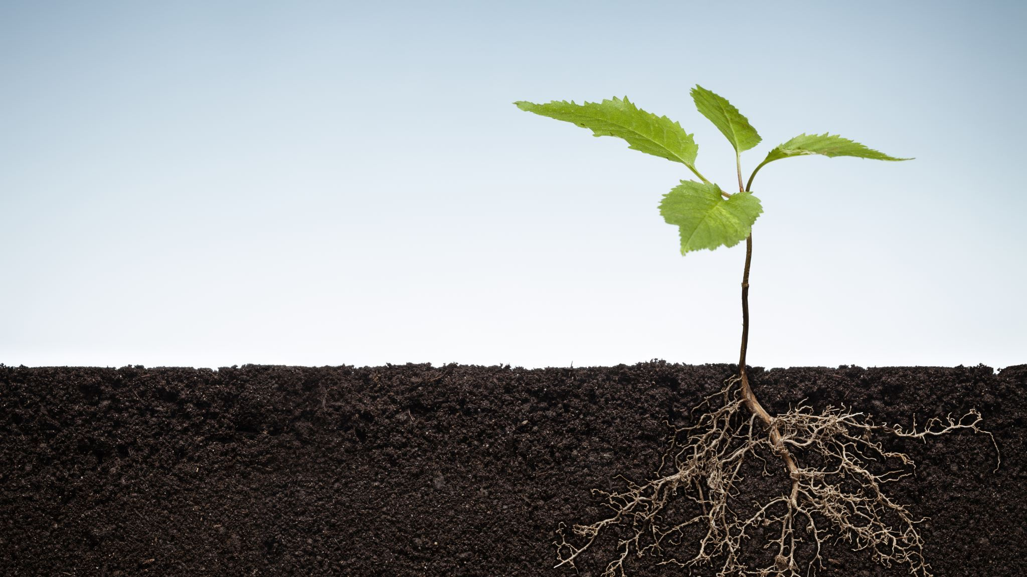
TARGET AUDIENCE
GARDENING ENTHUSIASTS
ENVIRONMENTAL ORGANIZATIONS
LOCAL COMMUNITIES AND ASSOCIATIONS

Slide 9

BENEFITS
Facilitates collaboration and knowledge sharing among gardening enthusiasts and farmers
Promotes sustainable agriculture in communities
Fosters sense of community and connection

Slide 10

THANKYOU !
Abdul Rehman Memon - 416585
Faakhir ul Hasan - 410406

