Slide 1
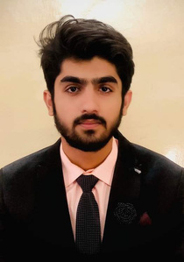


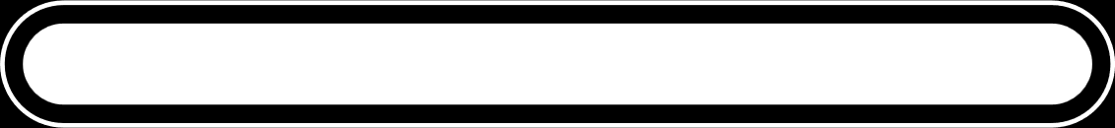
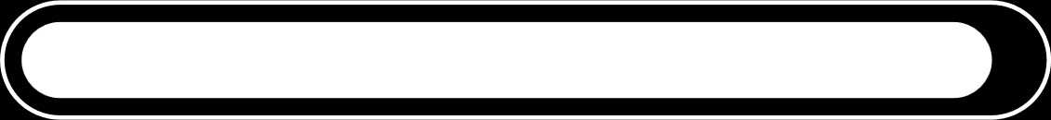
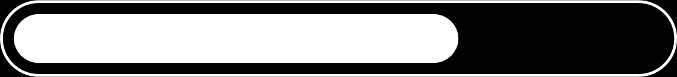
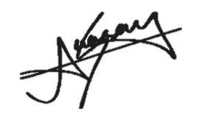
ABOUT ME
I am Abdul Wasay, a dedicated and passionate web developer with a strong foundation in programming languages and basic networking concepts. Currently pursuing my studies at COMSATS University, I am committed to continuous learning and professional growth. I enjoy building efficient, user-focused web solutions and actively seek opportunities to expand my skill set. Driven, motivated, and eager to excel, I am passionate about developing my career in the tech industry and contributing meaningfully to every project I work on.
ABDUL WASAY
PROJECTS
SCHOOL MANAGEMENT 2023
The School Management System (console based ) is a C LANGUAGE application that digitalizes and organizes student, teacher, and administrative records for efficient school management.
LINK: SCHOOL MANAGEMENT SYSTEM
CAR RENTAL 2024
The Car Rental System is a Java console application that manages vehicle availability, customer bookings, and rental records efficiently in a simple text-based interface.
LINK :CAR RENTAL SYSTEM
BANK MANAGEMENT SYSTEM 2024
The Bank Management System is a Java application that handles customer accounts, transactions, and record management to ensure secure and efficient banking operations.
LINK : BANK MANAGEMENT SYSTEM
Study Connect SYSTEM 2025
The Study Connect is an application in which there are several feature like white board and file upload to database and this project is practice project for .NET Win form.
LINK :Study Connect
ANTIVIRUS 2025
The Anti virus is WIN Form application for practicing .NET Framework in windows form. This application is cracking and checking all the viruses in the specific folder of personal computer.
LINK :ANTIVIRUS
Web Developer
Contact
0331-5789000
tahawasay1@gmail.com
Abbottabad, Pul Gulab street 1
Skills
Web dev
Figma Proto typing
Languages :
C#,C,Python,Java
Basic Networking
Education
COMSATS UNIVERSIRSITY ISLAMABAD, ABBOTTABAD CAMPUS
3.12 CGPA
Experience
Making of small projects on Web, Prototyping, made static websites

