Slide 1
Hashing

Slide 2
What is Hashing?
Hashing is another approach to storing and searching for values.
The technique, called hashing, has a worst case behavior that is linear for finding a target, but with some care, hashing can be dramatically fast in the average case.

Slide 3
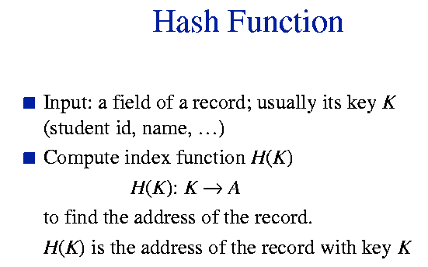

Slide 4
TABLES: Hashing
Hash functions balance the efficiency of direct access with better space efficiency. For example, hash function will take numbers in the domain of SSN’s, and map them into the range of 0 to 10,000.
546208102
f(x)
3482
1201
f(x)
541253562
Hash Function Map: The function f(x) will take SSNs and return indexes in a range
we can use for a practical array.

Slide 5
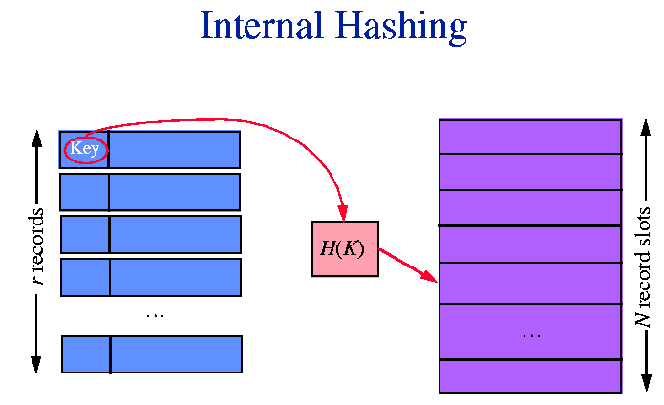

Slide 6
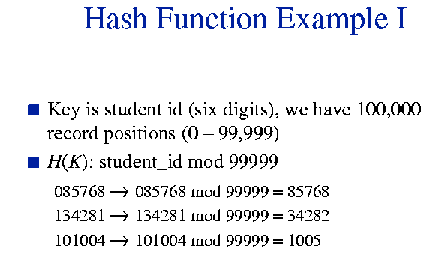

Slide 7
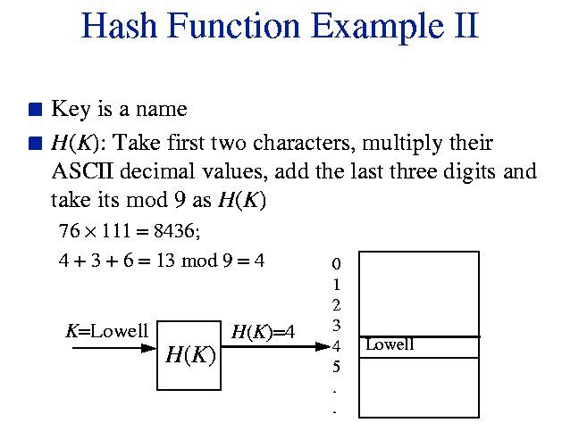

Slide 8
Where hashing is helpful?
Any where from schools to department stores or manufactures can use hashing method to simple and easy to insert and delete or search for a particular record.

Slide 9
Compare to Binary Search?
Hashing make it easy to add and delete elements from the collection that is being searched.
Providing an advantage over binary search.
Since binary search must ensure that the entire list stay sorted when elements are added or deleted.

Slide 10
How does hashing work?
Example: suppose, the Tractor company sell all kind of tractors with various stock numbers, prices, and other details. They want us to store information about each tractor in an inventory so that they can later retrieve information about any particular tractor simply by entering its stock number.

Slide 11
Suppose the information about each tractor is an object of the following form, with the stock number stored in the key field:
struct Tractor
{
int key; // The stock number
double cost; // The price, in dollar
int horsepower; // Size of engine
};

Slide 12
Suppose we have 50 different stock number and if the stock numbers have values ranging from 0 to 49, we could store the records in an array of the following type, placing stock number “j” in location data[ j ].
If the stock numbers ranging from 0 to 4999, we could use an array with 5000 components. But that seems wasteful since only a small fraction of array would be used.

Slide 13
It is bad to use an array with 5000 components to store and search for a particular elements among only 50 elements.
If we are clever, we can store the records in a relatively small array and yet retrieve particular stock numbers much faster than we would by serial search.

Slide 14
Suppose the stock numbers will be these: 0, 100, 200, 300, … 4800, 4900
In this case we can store the records in an array called data with only 50 components. The record with stock number “j” can be stored at this location:
data[ j / 100]
The record for stock number 4900 is stored in array component data[49]. This general technique is called HASHING.

Slide 15
Key & Hash function
In our example the key was the stock number that was stored in a member variable called key.
Hash function maps key values to array indexes. Suppose we name our hash function hash.
If a record has the key value of j then we will try to store the record at location data[hash(j)], hash(j) was this expression: j / 100

Slide 16
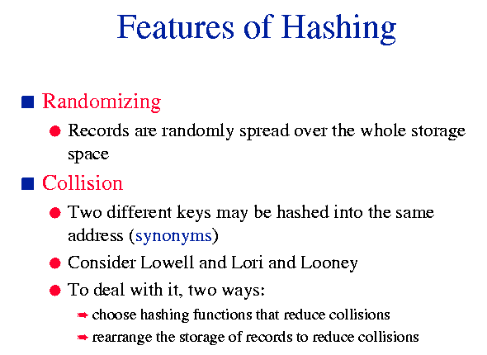

Slide 17
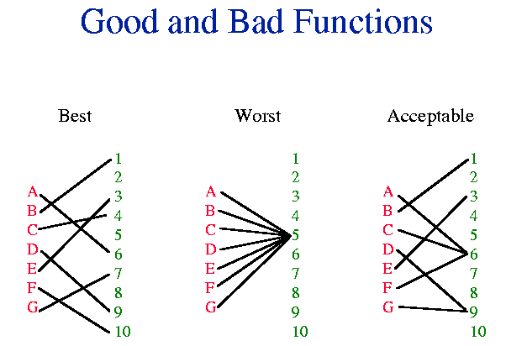

Slide 18
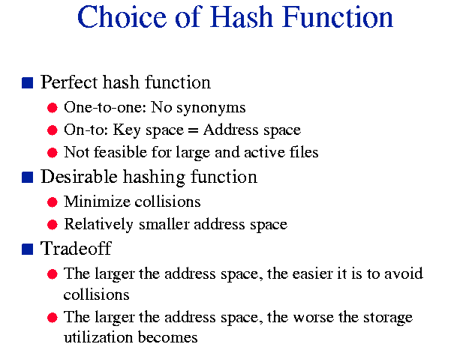

Slide 19
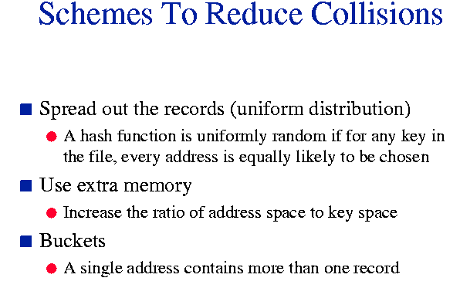

Slide 20
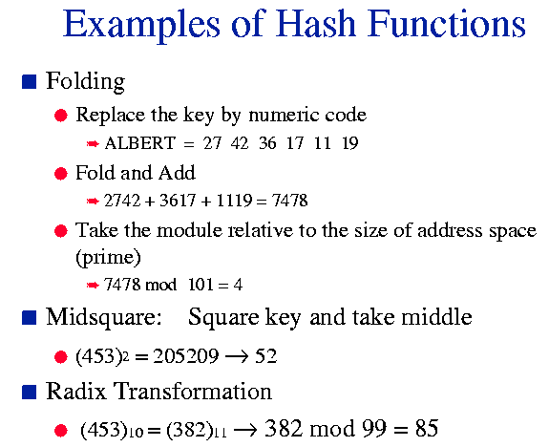

Slide 21
In our example, every key produced a different index value when it was hashed. That is a perfect hash function, but unfortunately a perfect hash function cannot always be found.
Suppose we have stock number 300 and 399. Stock number 300 will be place in data[300 / 100] and stock number 399 in data[399 / 100]. Both stock numbers 300 and 399 supposed to be place in data[3]. This situation is known as a COLLISION.

Slide 22
Algorithm to deal with collision
1. For a record with key value given by key, compute the index hash(key).
2. If data[hash(key)] does not already contain a record, then store the record in data[hash(key)] and end the storage algorithm. (Continue next slide)

Slide 23
3. If the location data[hash(key)] already contain a record, then try data[hash(key) + 1]. If that location already contain a record, try data[hash(key) + 2], and so forth until a vacant position is found. When the highest numbered array position is reached, simply go to the start of the array.
This storage algorithm is called:
Open Address Hashing

Slide 24
Hash functions to reduce collisions
1. Division hash function: key % table Size. With this function, certain table sizes are better than others at avoiding collisions.The good choice is a table size that is a prime number of the form 4k + 3. For example, 811 is a prime number equal to (4 * 202) + 3.
2. Mid-square hash function.
3. Multiple hash function.

Slide 25
Linear Probing
Hash( 89, 10) = 9
Hash( 18, 10) = 8
Hash( 49, 10) = 9
Hash( 58, 10) = 8
Hash( 9, 10 ) = 9
After
Insert 89
Insert 18
Insert 49
Insert 58
Insert 9
0
1
2
3
4
5
6
7
8
9
49
49
49
58
58
9
18
18
18
18
89
89
89
89
89
H + 1, H + 2, H + 3, H + 4,……..H + i

Slide 26
Problem with Linear Probing
When several different keys are hashed to the same location, the result is a small cluster of elements, one after another.
As the table approaches its capacity, these clusters tend to merge into larger and lager clusters.
Quadratic Probing is the most common technique to avoid clustering.

Slide 27
Quadratic Probing
Hash( 89, 10) = 9
Hash( 18, 10) = 8
Hash( 49, 10) = 9
Hash( 58, 10) = 8
Hash( 9, 10 ) = 9
H+1*1, H+2*2, H+3*3, ….H+i*i
After
Insert 89
Insert 18
Insert 49
Insert 58
Insert 9
0
1
2
3
4
5
6
7
8
9
49
49
49
58
58
9
18
18
18
18
89
89
89
89
89

Slide 28
Linear and Quadratic probing problems
In Linear Probing and quadratic Probing, a collision is handle by probing the array for an unused position.
Each array component can hold just one entry. When the array is full, no more items can be added to the table.
A better approach is to use a different collision resolution method called CHAINED HASHING

Slide 29
Chained Hashing
In Chained Hashing, each component of the hash table’s array can hold more than one entry.
Each component of the array could be a List. The most common structure for the array ‘s components is to have each data[j] be a head pointer for a linked list.

Slide 30
CHAIN HASHING
data
. . .
[0]
[1]
[2]
[3]
[4]
[5]
Record whose
key hashes
to 0
Record whose
key hashes
to 1
Record whose
key hashes
to 2
Another Record
key hashes
to 0
Another Record
key hashes
to 1
Another Record
key hashes
to 2
. . .
. . .
. . .

Slide 31
Time Analysis of Hashing
Worst-case occurs when every key gets hashed to the same array index. In this case we may end up searching through all the items to find one we are after ---
a linear operation, just like serial search.
The Average time for search of a hash table is dramatically fast.

Slide 32
Time analysis of Hashing
1. The Load factor of a hash table
2. Searching with Linear probing
3. Searching with Quadratic Probing
4. Searching with Chained Hashing

Slide 33
The load factor of a hash table
We call X is the load factor of a hash table:
X =
Number of occupied table locations
The Size of Table’s array

Slide 34
Searching with Linear Probing
In open address hashing with linear probing, a non full hash table, and no deletions, the average number of table elements examined in a successful search is approximately:
1
1
__
(
____
)
With X != 1
1
+
2
1-X

Slide 35
Searching with Quadratic probing
In open address hashing, a non full hash table, and no deletions, the average number of table elements examined in a successful search is approximately:
-l
n(1 - X)
With X != 1
__________
X

Slide 36
Searching with Chained Hashing
I open address hashing with Chained Hashing, the average number of table elements examined in a successful search is approximately:
X
1
+
__
2

Slide 37
Summary
Open addressing
Linear Probing
Quadratic hashing
Chained Hashing
Time Analysis of hashing

Slide 38
* Ex: h(k) = (k [0]+ k [1]) % n is not perfect since it is possible that two keys have same first two letters (assume k is an ascii string).
* If a function is not perfect, collisions occur. k1 and k2 collide when h2 (k1)= h2(k2).

Slide 39
A good hash function spreads items evenly through out the array.
A more complex function may not be perfect.
Ex :h2(k)= (k [0] + a1 * k[1]... + aj * k[j]) % n where j is strlen (k) -1; a1...aj are constant.

Slide 40
Example
-------
Consider birthdays of 23 people chosen randomly.
Probability that everyone of 23 people has distinct birthday
= (365x364x...x343)/(365^23 ) <= 0.5
Probability that some two of 23v people have the same birthday
>= 0.5
---> If you have a table with m=365 locations and only n=23
elements to be stored in the table (i.e., load factor
lambda=n/m=0.063), the probability of collision occurrence
is more than 50 %.

Slide 41
Methods to specify another location for z when h(z) is already occupied by a different element
(1) Chaining: h(z) contains a pointer to a list of elements mapped to the same location h(z).
o Separate Chaining
o Coalesced Chaining

Slide 42
2) Open Addressing
o Linear Probing: Look at the next location.
o Double Hashing: Look at the i-th location from h(z), where i is given by another hash function g(z).

Slide 43
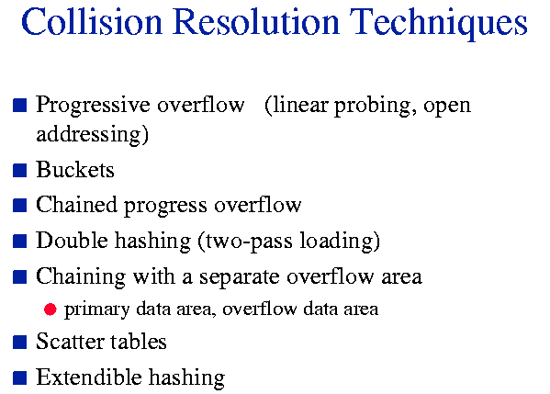

Slide 44
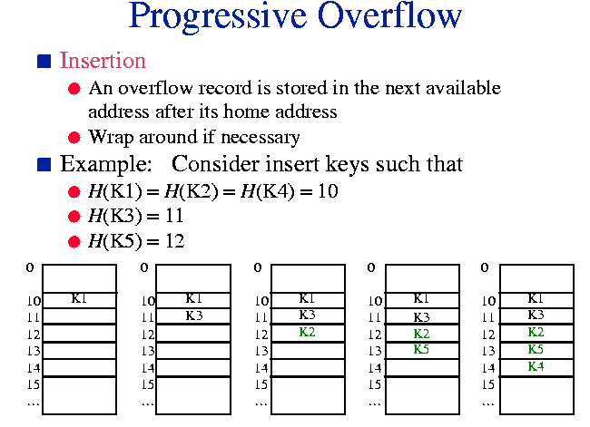

Slide 45
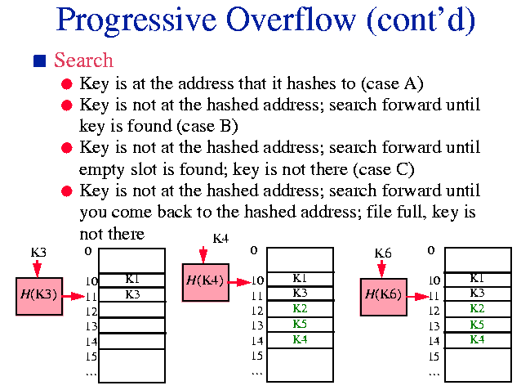

Slide 46
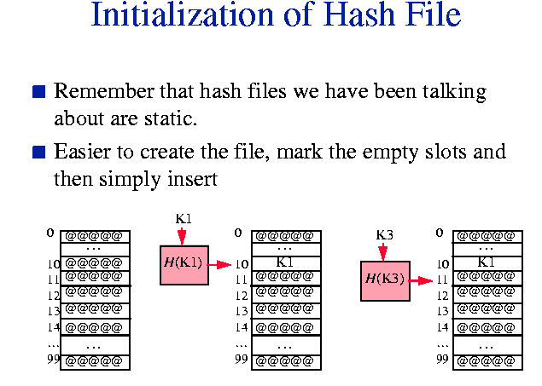

Slide 47
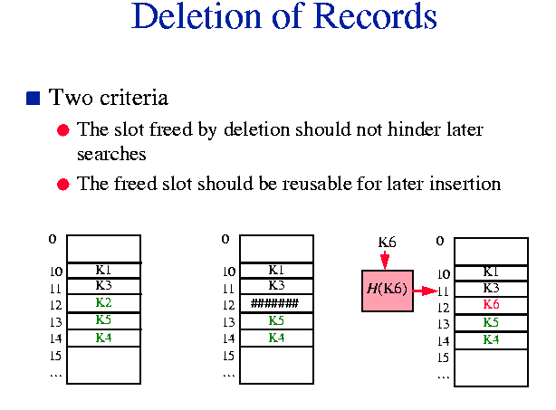

Slide 48
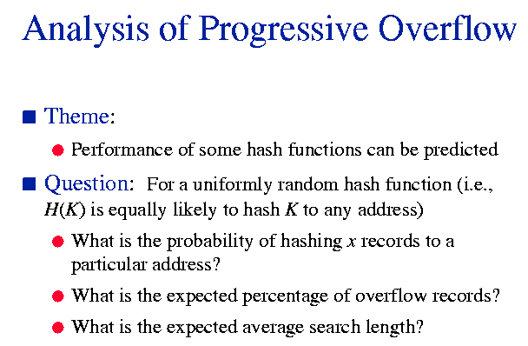

Slide 49
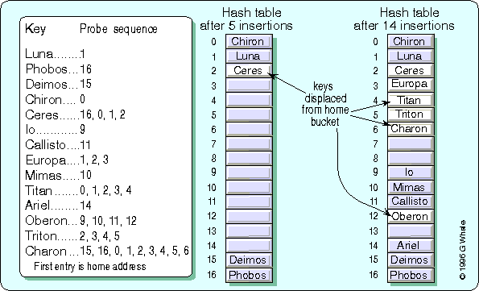

Slide 50
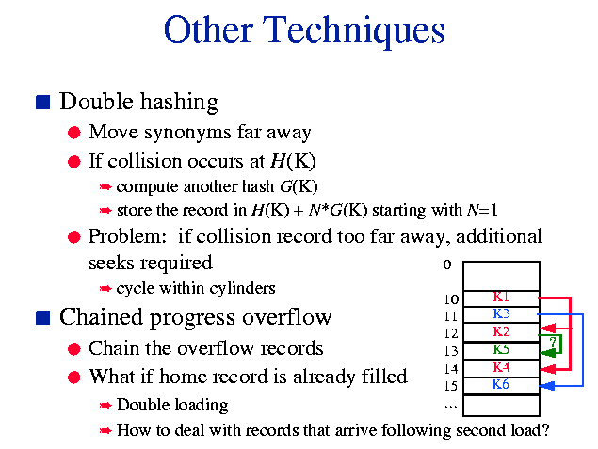

Slide 51
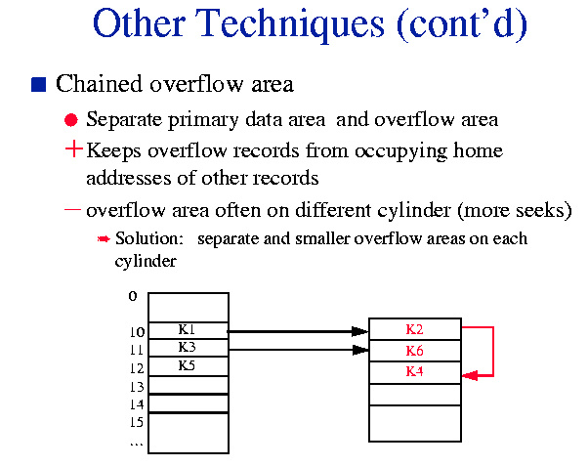

Slide 52
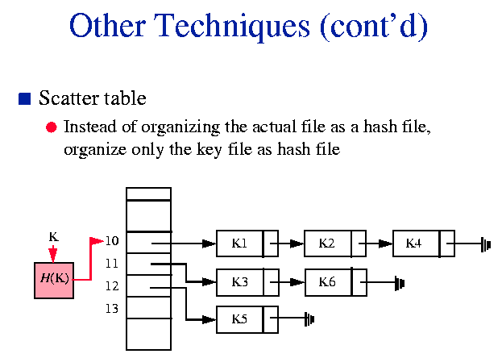

Slide 53
CHAINED HASHING
10
56
36
0
0
4
0
45
7
0
0
5
69
0

Slide 54
Secondary Clustering
- Tendency of two elements that have collided to follow the same sequence of locations in the resolution of the collision

Slide 55
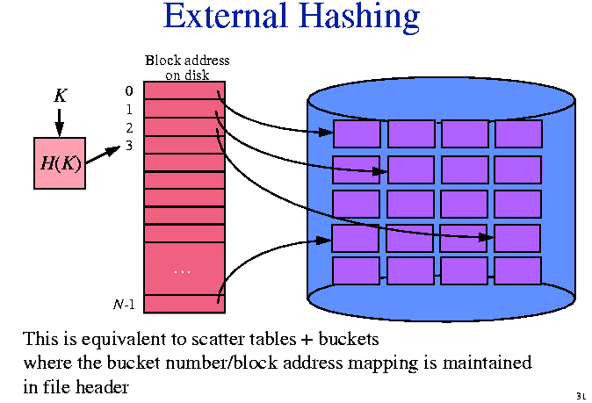

Slide 56
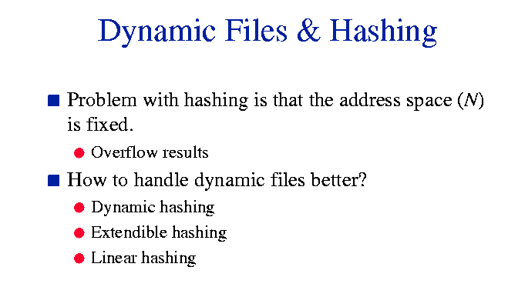

Slide 57
