Slide 1


OBJECT ORIENTED PROGRAMMING (WITH JAVA) Lecture 3 INTRODUCTION TO JAVA
DEPARTMENT OF COMPUTER SCIENCE
LAGOS STATE UNIVERSITY

Slide 2

Fundamentals of Programming
Decision Making
Loops
Numbers
Characters
Arrays
Strings
Functions
Basic Syntax
Programming Environment
Data Types
Variables
Keywords
Basic Operators
File I/O

Slide 3
Basic Syntax
Execute Sample Java (Syntax)
Number and String (characters)
Keywords
Java Variables
Operations

Slide 4

Operations in Java
Operators are used to perform operations on variables and values called operands.
Java divides the operators in the following groups:
Arithmetic operators
Assignment operators
Comparison operators
Logical operators

Slide 5
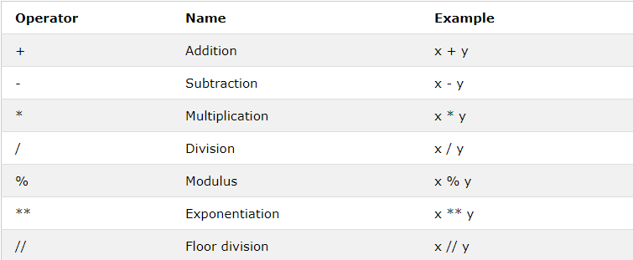
Arithmetic Operators

Slide 6
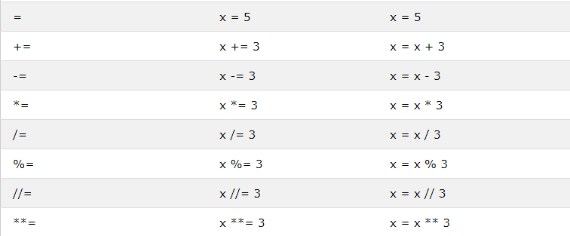
Assignment Operators

Slide 7
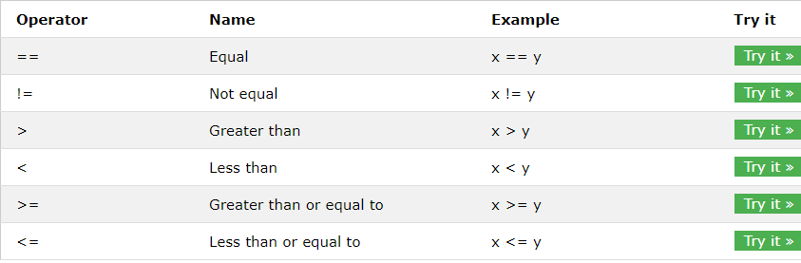
Comparison Operators

Slide 8
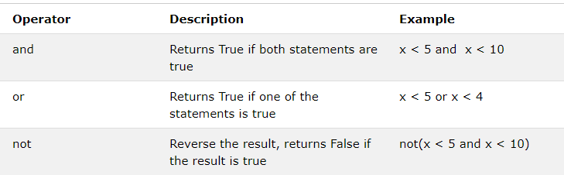
Logical Operators
&
X<5 &x <10
|
X<5|x<4
~
~(X<5 & x <10)

Slide 9

Decision Making (Control structure): Conditions and IF Statements
Java supports the usual logical conditions from mathematics:
Equals: a == b
Not Equals: a != b
Less than: a < b
Less than or equal to: a <= b
Greater than: a > b
Greater than or equal to: a >= b
An "if statement" is written by using the if keyword.
If
If… else if
If… else
If… else if… if

Slide 10
IF Statement
If (conditional statement ):
int a = 33; int b = 200; if (b > a){
System.out.println("b is greater than a")
}

Slide 11
ELSE IF Statement
Else if statement:
a = 33 b = 33 if (b > a){ print("b is greater than a")
} else if (a == b){ print("a and b are equal")
}

Slide 12
IF… ELSE IF … ELSE Statement
else statement:
a = 200 b = 33 if (b > a){ print("b is greater than a")
} else if (a == b){ print("a and b are equal")
} else{ print("a is greater than b")
}

Slide 13

Loops
Java has two primitive loop commands:
while loops
for loops

Slide 14
While Loops
With the while loop we can execute a set of statements as long as a condition is true.
i = 1 while (i < 6){ System.out.print(i); i += 1;}

Slide 15
Learn Java Online
https://www.w3schools.com/java/default.asp

Slide 16
Example
a = 5
b = 8
c = 9
if a + b == c:
print('a + b is greater than c')
else:
print('Unhandled exception')

Slide 17

~Cheers~

