Slide 1
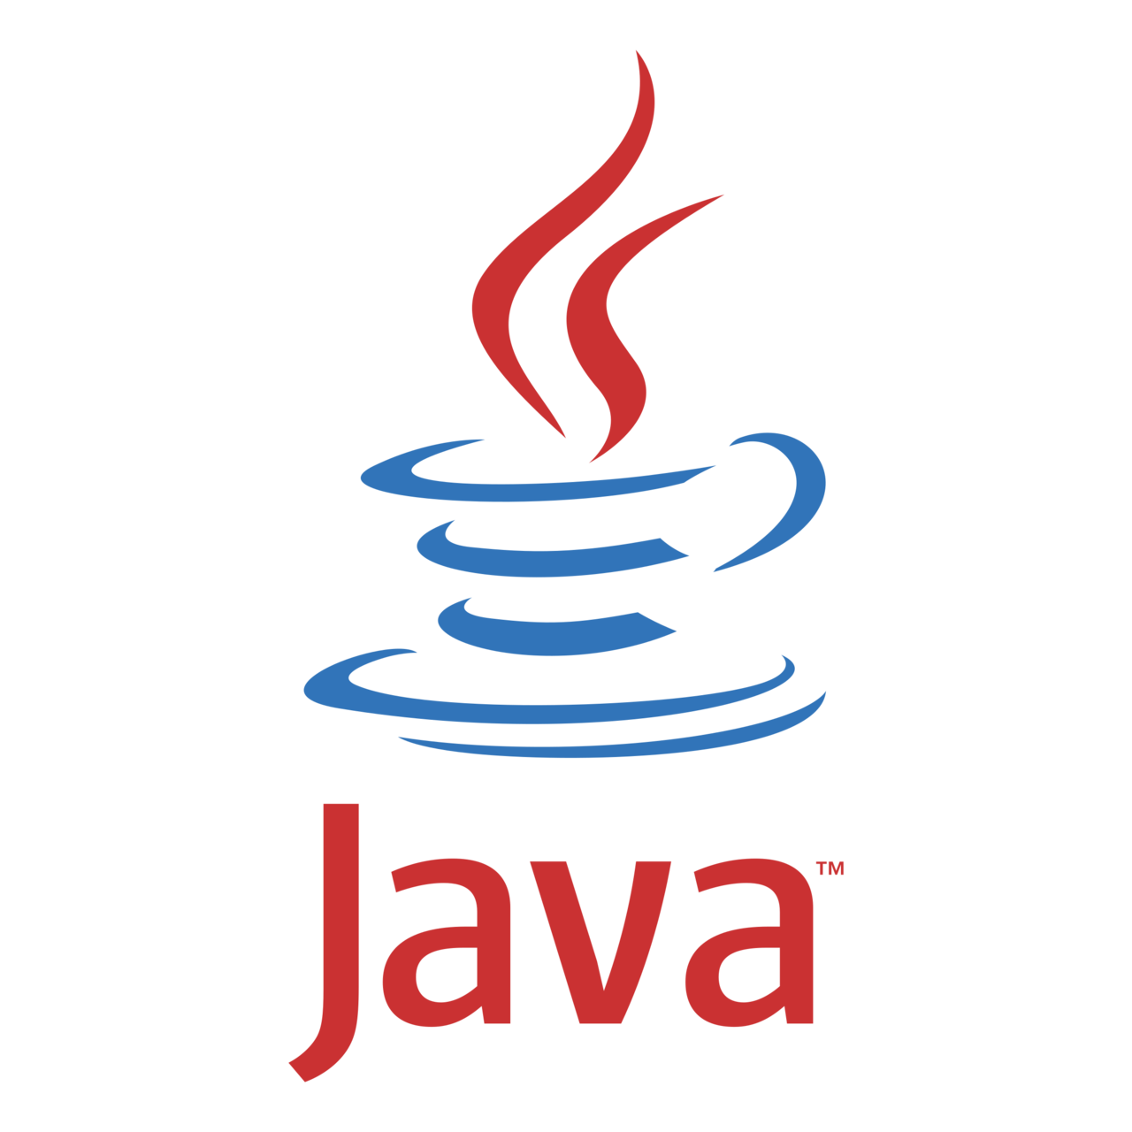

OBJECT ORIENTED PROGRAMMING (WITH JAVA) Lecture 2 INTRODUCTION TO JAVA
DEPARTMENT OF COMPUTER SCIENCE
LAGOS STATE UNIVERSITY

Slide 2
What is Java?
Java is a programming language and a platform.
Java is a high level, robust, secured and object- oriented programming language.
Platform: Any hardware or software environment in which a program runs, is known as a platform. Since Java has its own runtime environment (JRE) and API, it is called platform. Introduction to Java Programming Language
Notes:
Windows Runtime Environment – WinRT (C++)
Apple Runtime Enviroment - Swift

Slide 3
Introduction to Java programming language
Today Java programming language is one of the most popular programming language which is used in critical applications like stock market trading system on BSE, banking systems, android mobile application and many other areas.
Java was developed by James Gosling from Sun Microsystems in 1995 as an object-oriented language for general-purpose business applications and for interactive, Web-based Internet applications. The goal was to provide platform- independent alternative to C++.

Slide 4
Introduction to Java programming language
In other terms it is architecturally neutral, which means that you can use Java to write a program that will run on any platform or device (operating system).
Java program can run on a wide variety of computers because it does not execute instructions on a computer directly. Instead, Java runs on a Java Virtual Machine (JVM).

Slide 5
Benefit of Java
Java has been tested, refined, extended, and proven by a dedicated community of Java developers, architects and enthusiasts.
Simple Grammar – Java has a very simple grammar familiar to anyone with experience in C and C++.
Portability – These days Java really does run well on all the popular platforms
Speed – The latest JIT compilers for Suns JVM approach the speed of C/C++ code, and in some memory allocation intensive circumstances, exceed it.
Garbage Collection – the programmer doesn’t have to worry about memory (most of the time).
Huge library and developer community support available on Internet.

Slide 6
Where it is used?
According to Sun, 3 billion devices run java.
There are many devices where java is currently used. Some of them are as follows:
Desktop Applications such as acrobat reader, media player, antivirus etc.
Web Applications such as irctc.co.in, javatpoint.com etc.
Enterprise Applications such as banking applications.
Mobile
Embedded System
Smart Card
Robotics
Games … etc

Slide 7
Where it is used?
According to Sun, 3 billion devices run java.
There are many devices where java is currently used. Some of them are as follows:
Desktop Applications such as acrobat reader, media player, antivirus etc.
Web Applications such as irctc.co.in, javatpoint.com etc.
Enterprise Applications such as banking applications.
Mobile
Embedded System
Smart Card
Robotics
Games … etc

Slide 8
FEATURES OF JAVA
Simple
Dynamic
Secured
Robust
Object Oriented
Distributed
Architectural Neutral
Platform Independent
Multi-threading
High performance
Interpreted
Simple
Dynamic
Secured
Robust
Object Oriented
Distributed
Architectural Neutral
Platform Independent
Multi-threading
High performance
Interpreted
Figure 1: Java Features

Slide 9
Features of Java - Simple
According to Sun, Java language is simple because:
Syntax is based on C++ (so easier for programmers to learn it after C++).
Removed many confusing and/or rarely-used features e.g., explicit pointers, operator overloading etc.
No need to remove unreferenced objects because there is Automatic Garbage Collection in java.
And also removed many other confusing and/or rarely used features like explicit pointer, operator overloading etc.

Slide 10
Features of Java - OOP
Object-oriented means we organize our software as a combination of different types of objects that incorporates both data and behavior.
Object-oriented programming(OOPs) is a methodology that simplify software development and maintenance by providing some rules. • Basic concepts of OOPs are:
• Object • Class • Inheritance • Polymorphism • Abstraction… and others.

Slide 11
Features of Java – Platform Independent
A platform is the hardware or software environment in which a program runs.
There are two types of platforms software-based and hardware-based. Java provides software-based platform.
The Java platform differs from most other platforms in the sense that it is a software-based platform that runs on the top of other hardware-based platforms. It has two components:
Runtime Environment
API(Application Programming Interface) .

Slide 12
Features of Java – Platform Independent
Java code can be run on multiple platforms e.g. Windows, Linux, Sun Solaris, Mac/OS etc. Java code is compiled by the compiler and converted into bytecode.
This bytecode is a platform-independent code because it can be run on multiple platforms i.e. Write Once and Run Anywhere(WORA).
Java solves the problem of platform-independence by using byte code. The Java compiler does not produce native executable code for a particular machine like a C compiler does. Instead it produces a special format called byte code. Java byte code written in hexadecimal, byte by byte, looks like this:
CA FE BA BE 00 03 00 2D 00 3E 08 00 3B 08 00 01 08 00 20

Slide 13
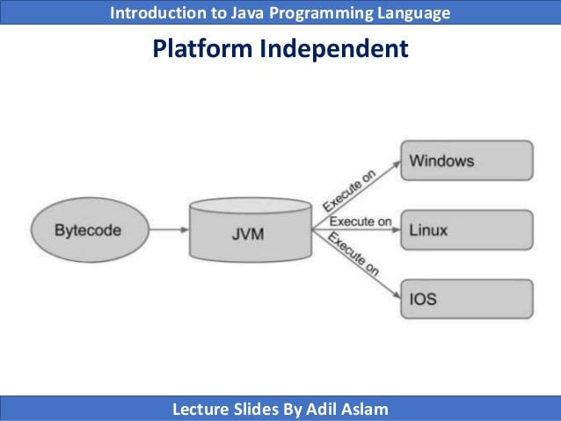
Features of Java – Platform Independent
Figure 2 Java Platform Independence

Slide 14
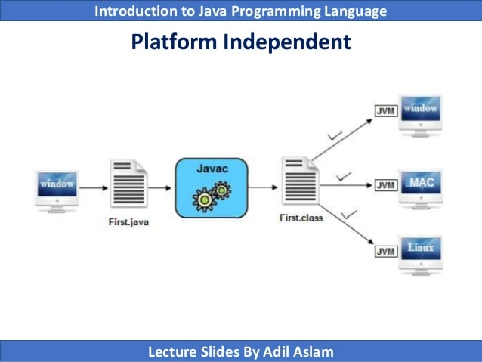
Features of Java – Platform Independent
Figure 4: Platform independence

Slide 15

Assignment
Write short notes on the following Features of Java:
Robust
Distributed
Architectural Neutral
Multi-threading
High performance
Interpreted
Dynamic
Write short notes on the History of Java

Slide 16

~Cheers~

