Slide 1

Mudaris web site plateform
Developd by Abdulaziz Alshehri

Slide 2
Problems
- Did not find suitable private teacher.
- There is no certified platform for private teachers.
- The course or subject is difficult.
- Young or children students have learning difficult.

Slide 3

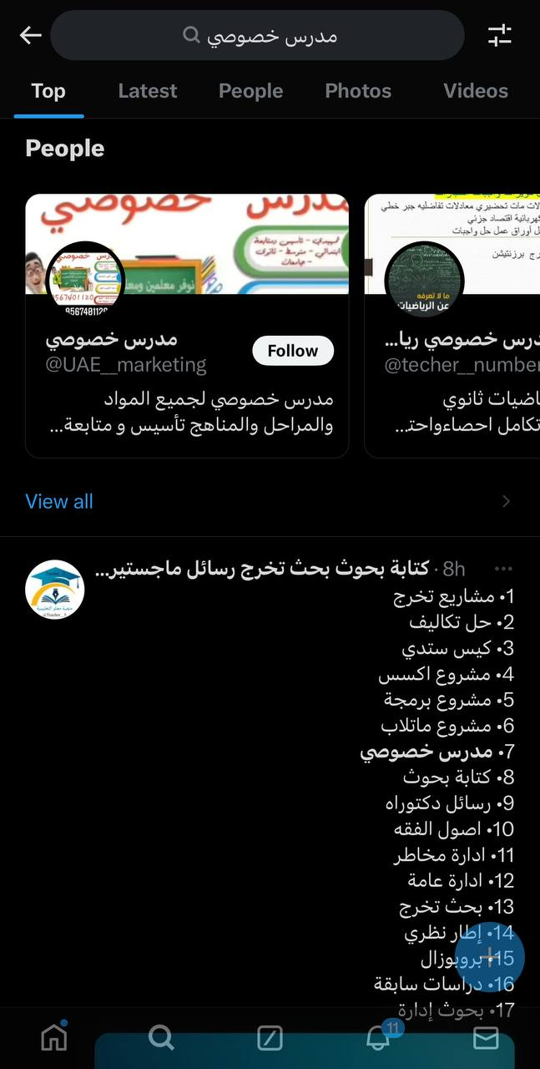
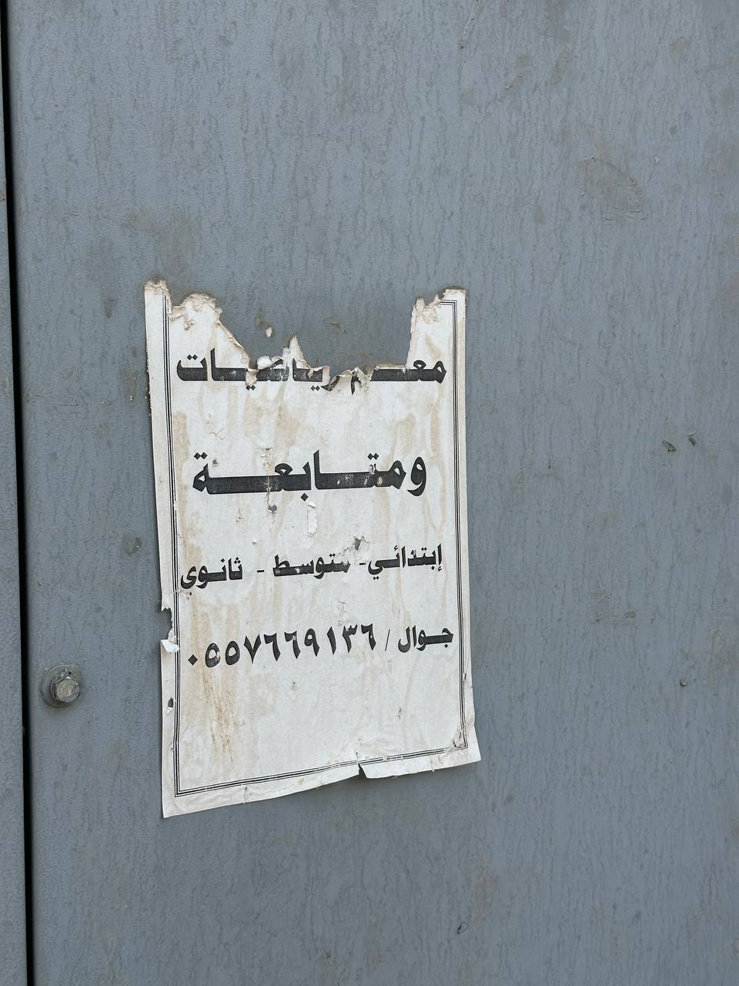
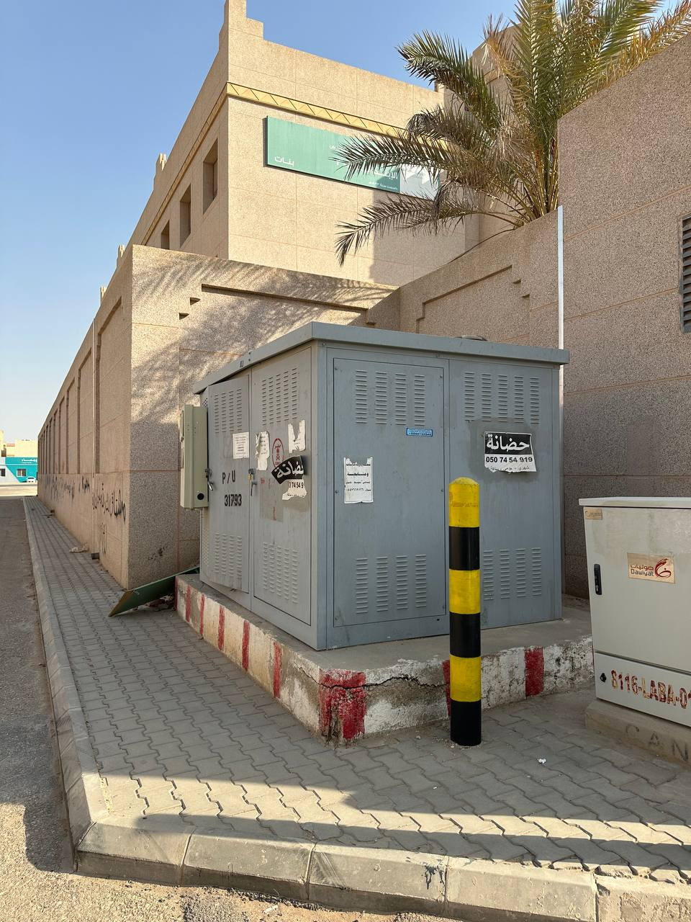
Problems description

Slide 4
Solution
- Mudaris Platform can provide:
Students can find multiple private teachers.
Students can find many and different courses.
Private teachers can publish and provide they’re course content and teaching offers.
Private teachers will have financial return from they’re courses.
Student can rate private teacher after take the course or offer.
Student can write comments in the published applications or offers.

Slide 5
Conclusion!

