Slide 1
بِسْمِ ٱللَّهِ ٱلرَّحْمَـٰنِ ٱلرَّحِيمِ

Slide 2
RAIN DETECTION CIRCUIT WITH ALARM AND AUTOMATIC RAIN SENSING WIPERS
GROUP MEMBERS :
Hamna Baig Fa20-bee-030
Arbab Fatima Fa20-bee-036
Areeba Abid Fa20-bee-004

Slide 3
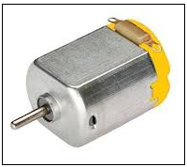
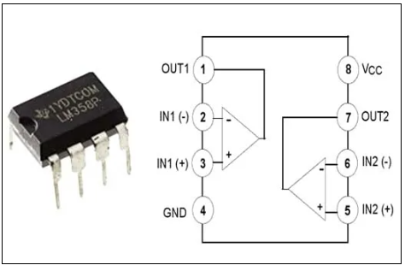
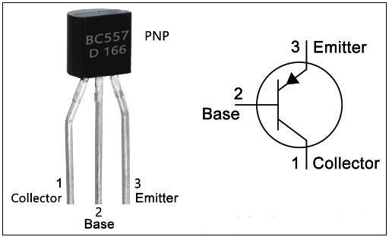
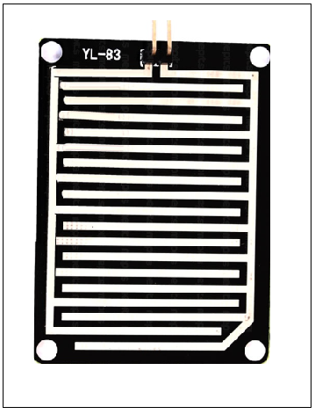
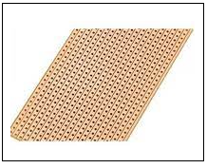
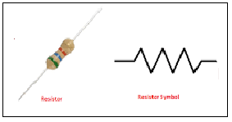
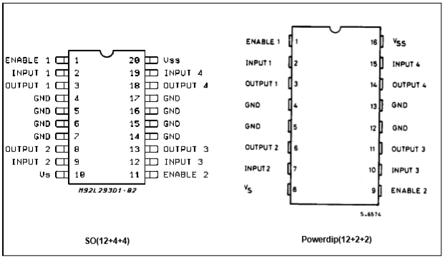
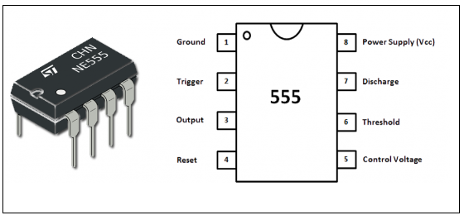
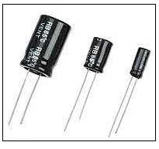
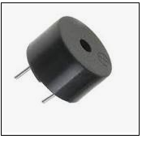
COMPONENTS USED
555 Timer IC
L293D IC
IC LM358
Transistor BC557
Resistors (1k, 10k, 2.2M)
Capacitors (0.01uF, 0.47uF)
DC Motor
Rain Sensor
Power supply (9V)
Soldering wire
Vero Board
Soldering Iron
Buzzer

Slide 4

FLOW CHART
Rain Sensor
Transistor BC557
Supply
Comparator LM358 IC
Timer
LED
LED
Buzzer
Motor drive L293D IC
DC motor
9V Supply

Slide 5
CIRCUIT EXPLANATION
This Automatic Rain Sensing with buzzer and wiper Control Circuit can be divided into five parts.
First part includes 555 IC in Astable Mode. For Astable Multi-vibrator, we have used a 555 Timer IC for generating pulse in every 1-2 seconds (depends on C1 capacitor value), means 555 Timer IC is configured in Astable mode.
Second part includes Comparator LM358. Output of Astable Multivibrator is directly connected to inverting pin of Comparator LM358. Comparator LM358 IC is used here for comparing 555 timer IC’s output voltage and reference voltage across comparator’s non inverting terminal, set by using Voltage Divider Circuit (R3 and R4).
Third part has Motor Driver circuitry using L293D. Output from 555 timer IC is connected to Pin No 7 and also the output of comparator is directly connected at pin 2 of Motor Driver L293D.
Forth part is Rain Sensor. Output of Rain sensor is connected to base terminal of PNP transistor.
Fifth part consist of Buzzer and motor which activates when rain is detected and it get switched off when there is no water(rain) on windscreen.
Also indication for the circuit is included in fifth part. Led are used for this purpose. One is placed at output of 555 timer and one at the output of comparator.

Slide 6
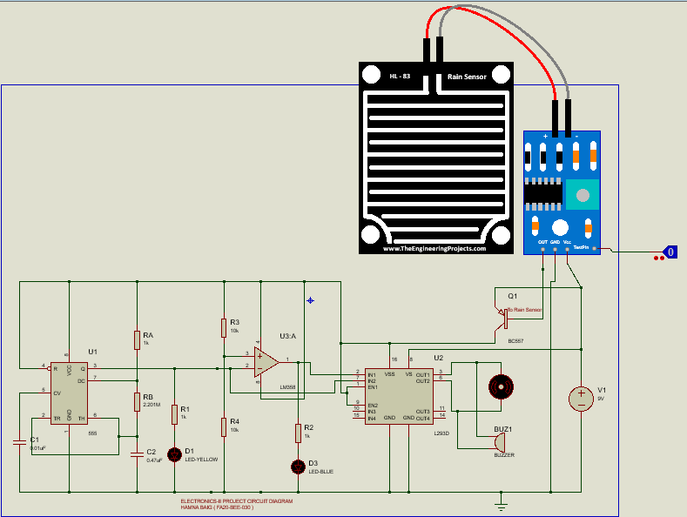
CIRCUIT DIAGRAM ON PROTEUS

Slide 7
WORKING EXPLANATION
When water drops of rain falls over the Rain Sensor then it will trigger the PNP transistor BC557 and PNP transistor turns ON the power supply of whole circuit
PNP transistor here works as a switch for the circuit .Output from emitter side of PNP transistor is used as source of the circuit. Base of PNP transistor is connected to Rain Sensor Output.
When the output of 555 Timer IC goes HIGH then the comparator LM358 gives LOW output and when the output of 555 IC goes LOW then the Comparator’s output goes HIGH.
By using these two outputs DC motor turns clock wise and anticlockwise and wiper attached to it turns right to left and left to right, through Motor Driver IC L293D
LED connected at output of 555 Timer glows when its output is high.
LED connected at output of LM358 comparator glows when its output is high.
Buzzer alarms when rain is detected and is also connected at the output of L293D Motor Driver IC.
Wipers are connected with the Dc motor.

Slide 8
THANKYOU FOR YOUR ATTENTION AND TIME !

