Slide 1
Historical changes in health condition
and its relation to government expenditure
Yanying Yu, Shufan Ming
IS597 Final Project

Slide 2
Finding patterns in changes:
“It is important to know why people die to improve how people live.”
“assess the effectiveness of our health systems help allocate resources based on needs”
Data curation:
deaths and causes of death; data on disability, disaggregated by age, sex and geographic location
Project purposes
Notes:
Why do we want to study this topic?
Public health is important. Here I directly quote a sentence online ”It is important to know why people die to improve how people live.“
In this project, we
Pointed out the most common health issues
Discover the patterns like cause of death and health outcomes in each region/country. How it has been changed over the years.
Those assessments of people’s health conditions help to allocate government resources based on needs.
We got our data mainly from the WHO official website, which contains detailed information on death statistics, cause of death, across countries and years.

Slide 3
Previous work
1.Global and regional causes of death
Dataset: World Health Organization
Research topic: global-, regional- and country-level estimates of mortality for a comprehensive set of causes (communicable, non-communicable, injuries) in 2004 (Mathers et al., 2009).
Finding 1: The contribution patterns of three death categories non-communicable dominant the cause of death
Finding 2: There is a growing importance of non-communicable diseases in most low- and middle-income countries since 2004
Finding 3: Cardiovascular diseases are the most killer in the world, Infectious and parasitic diseases are the next leading cause, followed by cancers in 2004
2. The Impact of Health Expenditures on Health Outcomes in Sub-Saharan Africa.
Dataset: annual data on 46 sub-Saharan African countries covering the period 2000–2015
Research topic: the effect of health expenditures on selected critical health outcomes in sub-Saharan Africa (Amponsah, 2019).
Main Finding: steady increases in health expenditures over time have the tendency to improve health outcomes in SSA
Notes:
We relied on two papers to conduct our analysis
The first is about
The mortality rate due to various reasons across countries.
They disaggregated data from the perspective of income group, year, to find out dominant diseases and estimations afterwards.
The second focused on the measurement of crucial three health outcomes in one particular region sub-saharan africa and how that changes over years related to health expenditure.

Slide 4
Our work
Paper 1:
Data outdated
No program code and not mention data preprocessing steps
-> potentially biased picture of the patterns of global mortality.
Paper 2:
sub-Saharan Africa only
No program code and not mention data preprocessing steps
-> would the conclusions hold for other countries.
Notes:
Those two papers have more or less limitations: data is outdated. No clear data pre-processing explanations,
So one of our purpose is to replicate the analysis in the paper to see whether we reach an agreement on their conclusions;
and also whether the finding for one region, that patterns can be generalised to other regions as well

Slide 5
Data collection and cleaning
1. Global cause of death
API: https://www.who.int/data/gho/data/themes/mortality-and-global-health-estimates/ghe-leading-causes-of-death
Columns: country, Year, Population, Age_group (all age), Sex(Both_sex), Cause_code, Cause_title, Death_rateper100K, Death_number, etc.
2. Health expenditure:
API:GHO OData API
Columns: Life expectancy Maternal Mortality Ratio; Current health expenditure;
3.Country income group, Country Region, Mortality categories,
World Bank Country and Lending Groups
Global health estimates: Leading causes of death
https://datatopics.worldbank.org/world-development-indicators/the-world-by-income-and-region.html
Useful columns: country_code, country_name, Income group data for calendar year, country_region, disease_code, disease_categories, disease_name
Notes:
As we mentioned before, two main data streams are WHO API and world bank database.
We requested JSON format data from their API. and filtered the columns we need based on their documentation.

Slide 6
Data set explanation
How many countries? 164 countries
Time span? 2000 - 2019
Seven regions — Provided by The World Bank
East Asia & Pacific; Europe & Central Asia; Latin America & Caribbean; Middle East & North Africa; Middle East & North Africa; South Asia; Sub-Saharan Africa
Four income group — Provided by The World Bank
1.High 2.Upper-middle 3.Lower-middle 4.Low
Three types of Mortality — Provided by World Health Organization (WHO)
1.communicable 2.noncommunicable 3.injuries.
Nearly 91 causes-of-death diseases —provided by WHO Global Health Estimates (GHE)
3 selected critical Health outcomes - under 5 mortality, maternal mortality, life expectancy
Notes:
Just a little overview of the data, and dimensions
Note that income group can be changed over time as the country developed. And we also take that into account.

Slide 7





Idea of analysis
Worldwide
Income group/ Region
Mortality type /Age/ Sex
Specific disease
Notes:
Our idea is to go deeper into the issues step by step. From the Global perspective, then go down to the income group, then Mortality type and finally in the Specific disease perspective.

Slide 8
Hypothesis 1
Do the Global patterns of mortality by income group all over the world aligned with the previous work?
Patterns : i.e., Trend of mortality
Cause Distribution
leading cause of death
Notes:
For the first paper, we made the first hypothesis: Do the Global patterns of mortality by income group all over the world aligned with the previous work?
The patterns here mean the trend pattern, the distribution pattern and Ranking pattern.

Slide 9
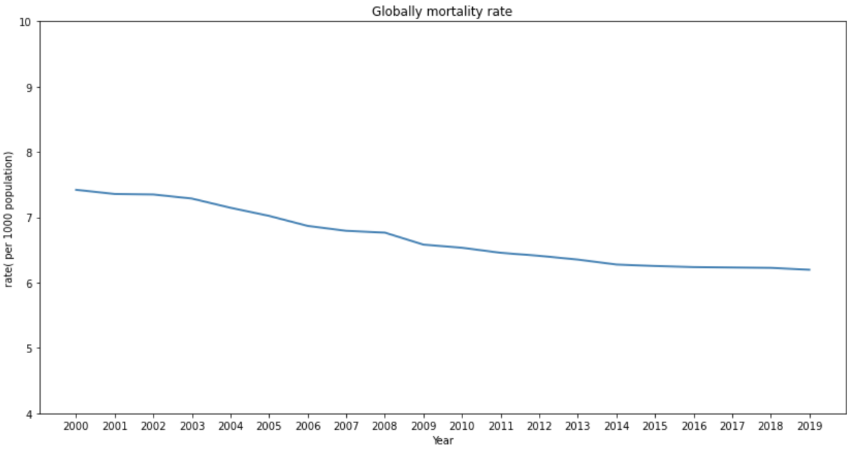
Globally death rate trend during 2000-2019
What led to this reduction?
Notes:
Now, lets look at the global death trend.
We calculate the total number of death, then divided by population，so for each year, we use the number of death per 1000 people to represent the death rate.
We can clearly see the reduction of death rate within these years. From 7.5 people to 6.5 people.
So the question is, what led to this reduction?

Slide 10
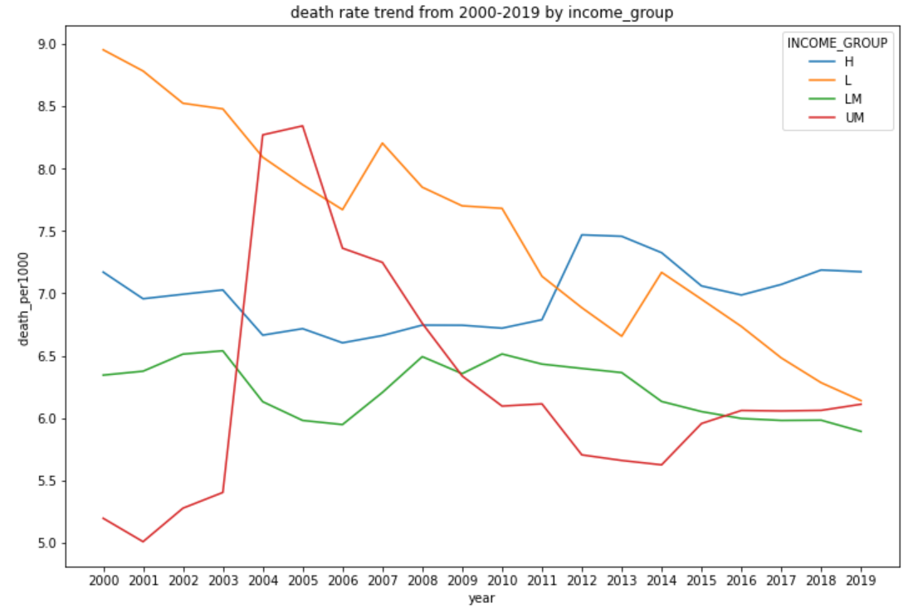
Four income group
1:High 2:Upper middle 3:Lower middle 4:Low
Findings:
1.Low income group declined significantly
2. Something happened in Upper-middle countries during 2004-2005
3.Two peaks in Low income group around
2007 and 2014
Notes:
From the income group perspective
This is the death rate of four income group. It is obvious the death rate has declined in the low income group, so this might be one reason to led the global reduction.
We had some other findings. Although the general trend of Low income group is a decline, but there are two peaks around 2007 and 2014
The red line which represent the upper middle group, there is peak around 2004, must be something happened, maybe a pandemic? We will discuss later.

Slide 11
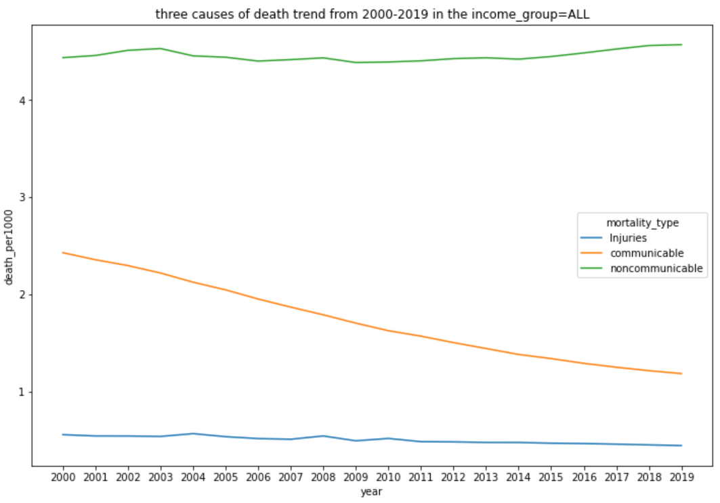
Three mortality type:
1. Communicable 2:Noncommunicable. 3. Injuries
Test:
1.growing importance of noncommunicable diseases
2.The contribution of three type cause-of-death in 2004 globally
2004 globally | Article | Test
Non-Communicable | 60% | 62.4%
communicable | 30% | 29.7%
Injuries | 10% | 7.9%
Notes:
From the Mortality type perspective,
The line chart show the death rate of three mortality types. We can see the Non-communicable, and Injuries, they remained stable these years, but the communicable disease are getting lower..
So the decreasing rate of communicable Mortality is the another one to explain the globally decreasing.
Besides, for one of the article's conclusion， noncommunicable diseases are growing important among theses three types, it is true
Also, the article analyzed the contribution of three Mortality type in 2004, we can see 60% deaths caused by non-communicable disease, 30% by communicable, and 10% by Injuries. We tested again, the results is quite similar.
So another question shows up, is it the same distribution within each income group? Like 6-3-1

Slide 12
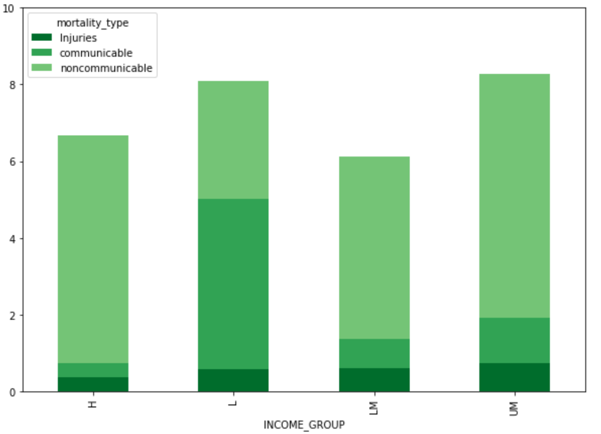
Same pattern of cause-of-death type in different income group?
the distribution of Mortality type in different income group in 2004
Test:
communicable diseases remain an important cause of death in low income countries in 2004
Notes:
To be specific, we used the Bar Chart to analyze the distribution of mortality type in each income group in 2004, we can say except the Low income countries, non communicable disease is the most killer, but in the Low income countries, the communicable disease is the leading cause of death. Different income group show the different proportions. So in the article, it is true to say communicable diseases remain an important cause of death in low income countries in 2004.
So is these proportion remain stable after 2004? are the countries in low income group getting better in terms of the death caused by communicable disease?

Slide 13
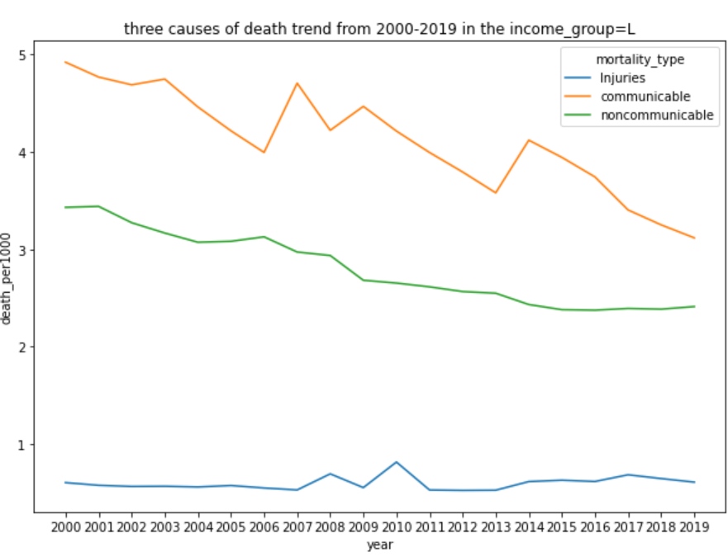
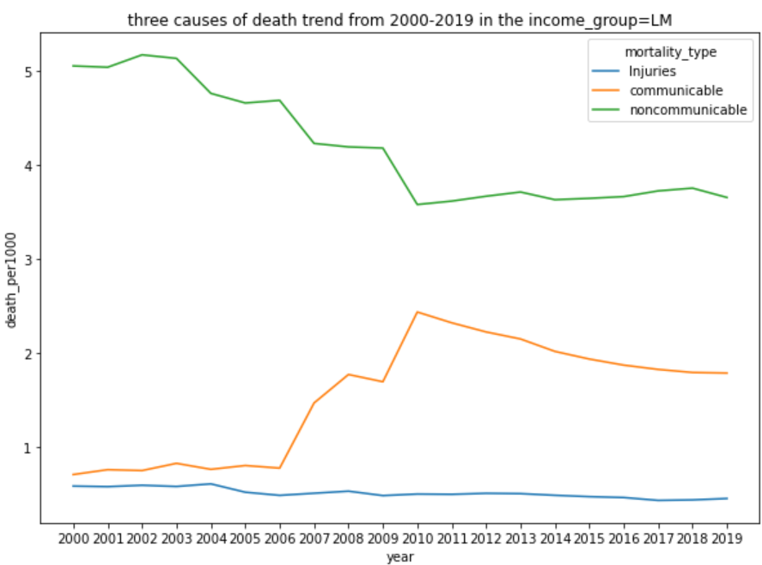
How the cause-of-death type changed in low and low-middle income group?
TEST:
Estimation: growing importance of noncommunicable diseases in most low- and middle-income countries since 2004
Low income group:True
LM: During 2004-2010, non-communicable are getting less important(more communicable). But after 2010, the trend match the conclusion of the paper.
Notes:
So this is the death rate trend of three mortality type. We can say from the line chart that the proportion are changing all the time.
In low income countries, the non communicable and communicable are getting better, but the the decline of communicable is even greater. So the conclusion in the article that growing importance of noncommunicable diseases in most low- and middle-income countries since 2004, for low income group, it is correct to some extents. But in the lower middle group, it is not true. Because Years after 2004, the trend was the opposite

Slide 14
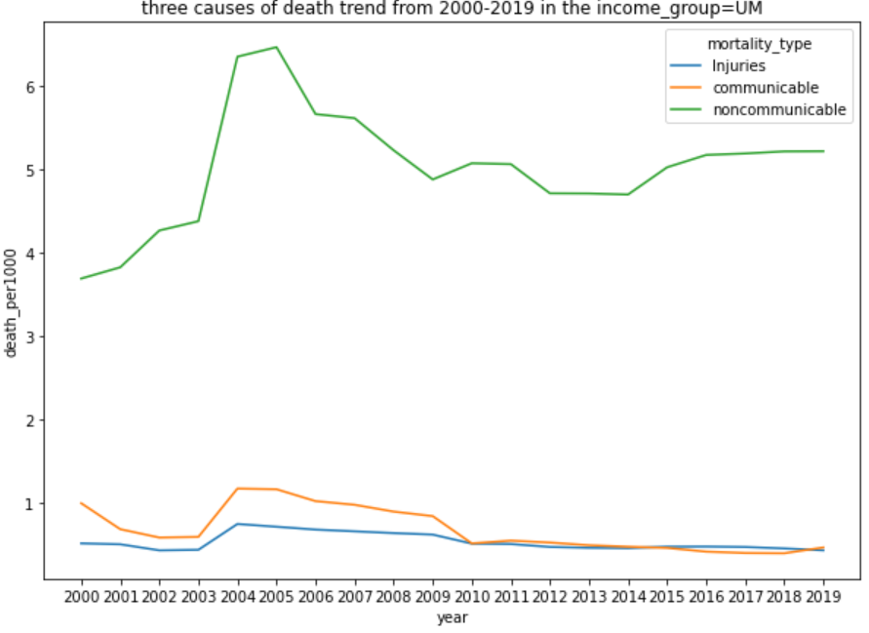
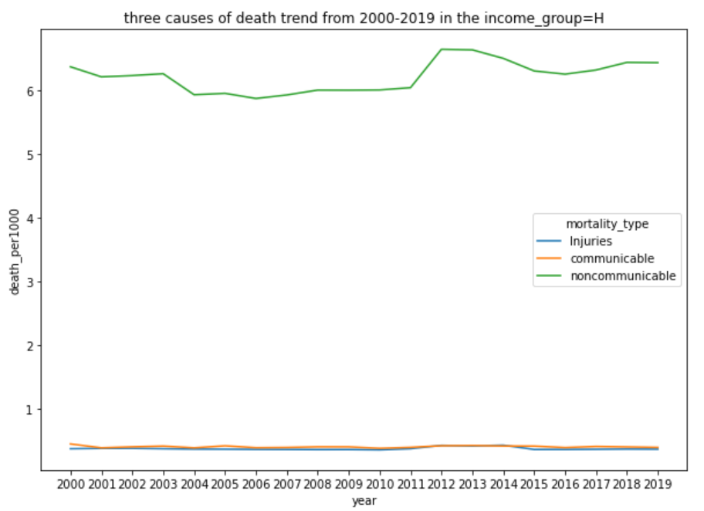
How the cause-of-death type changed in High and Upper-middle income group?
TEST:
Estimation: growing importance of noncommunicable diseases in most low- and middle-income countries after 2004
UM: 2004-2010, non-communicable are getting less, after that , the portion keep the same level.
Notes:
On the right side, High income group, there even not a fluctuations so the countries with high income are more powerful to withstand every coming pandemic.
Turn to the upper middle income, the estimation is not correct, because after 2004, the ratio of non communicable are getting less, so How the paper draw this wrong estimation?
From this Upper-middle income line chart, there is a non communicable disease surge around 2004, so the authors, they might thought the death rate of non communicable would go up as before, but unfortunately, those countries did a great job to solve the pandemic, so the death rate go down after 2004.
So what specific disease occur around 2004? Now we can discuss in the context of specific diseases.

Slide 15
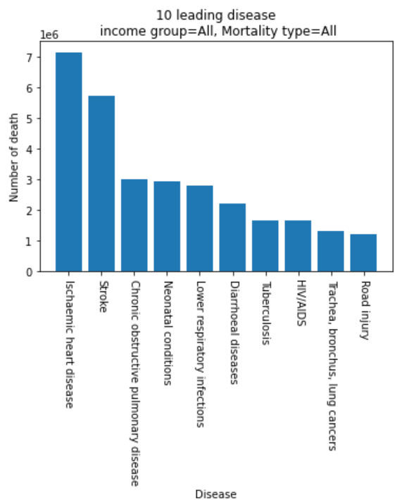
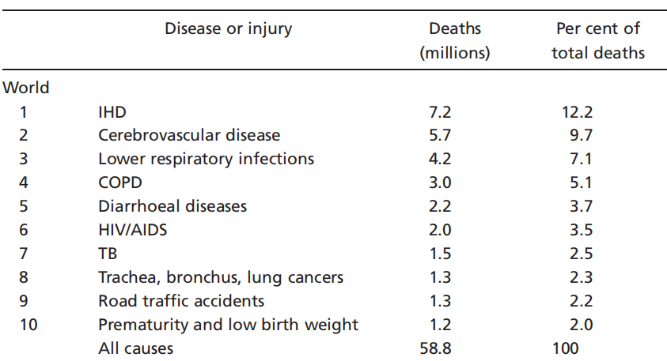
Global leading cause-of-death disease in 2004
Article’s conclusion
-
-
-
Test:
Cardiovascular diseases are the leading cause of death
Infectious and parasitic diseases are the next leading cause,
followed by cancers
Notes:
Before that, Take a look at the leading disease all over the world. The article and us analyze the top 10 Mortality disease by their death rate. The bar chart is our result.
Although some kinds of diseases changed their Academic Name, they are still the same.
We have the same disease in the Top 10, the difference only shows on the rank. So we can see the arrows here, Up means the disease became more serious.
Overall, we can say as the article did，Cardiovascular diseases are the leading cause of death in the world, then the Infectious disease, and then the cancer.
1.Heart disease,
2.cerebrovascular,脑血管疾病
3.lower respiratory,下呼吸道感染
4.chronic obstructive pulmonary disease慢性肺,
5.diarrhoeal diseases.
6.AIDS 获得性免疫缺陷综合征hiv
1.Ischaemic heart disease
2.Stroke中风
3.Chronic obstructive pulmonary disease慢性肺
4. Neonatal conditions新生儿疾病
5.Lower respiratory infections下呼吸道感染
6.Diarrhoeal diseases腹泻病

Slide 16
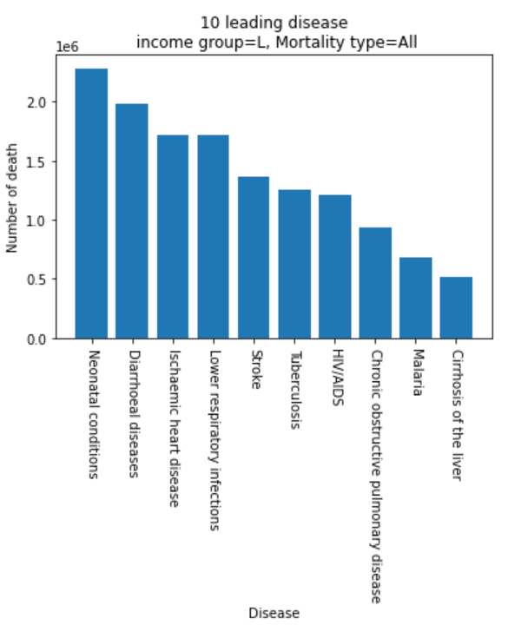
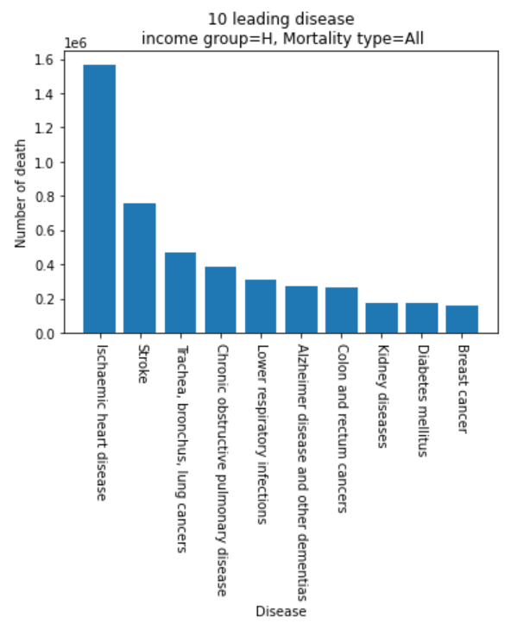
Compare leading disease between High and Low income group in 2004
Notes:
We also tried to analyze the leading causes of death in each income group.
Lets compare between high and low income countries
IHD and stroke were the leading causes of death in high-income countries, and also in the top five causes in low-income countries.
In low-income countries, the main causes are neonatal and infectious disease
So there are major differences in the ranking of causes between high- and low-income countries

Slide 17
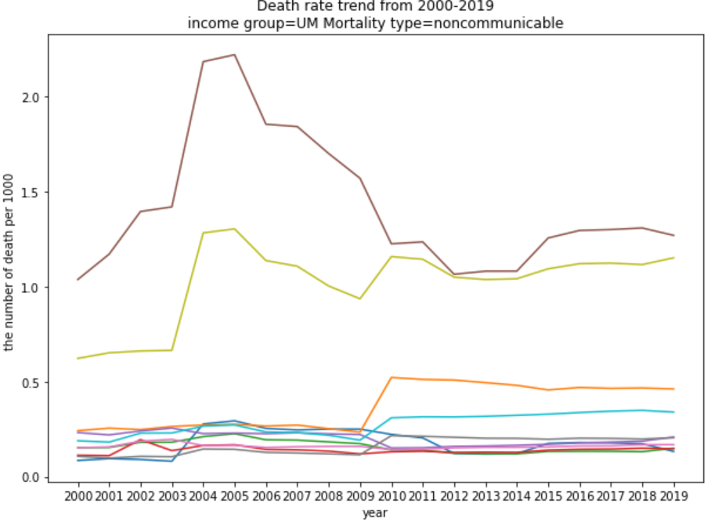
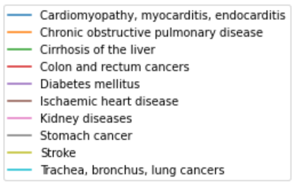
The trend of Leading non-communicable mortality diseases(2005)
in Upper-middle income countries
Recap
What led to the peak?
Notes:
Now we try to recap the findings few minutes ago, There is a surge of non communicable disease in upper middle countries. So we used the Top 10 leading disease then see their trend..
It is easy to know the surge caused by increasing IHD and Stroke. I don’t know what happened in 2004 around those upper middle income countries, but there is a huge increasing number of people killed by these two kinds of disease.

Slide 18
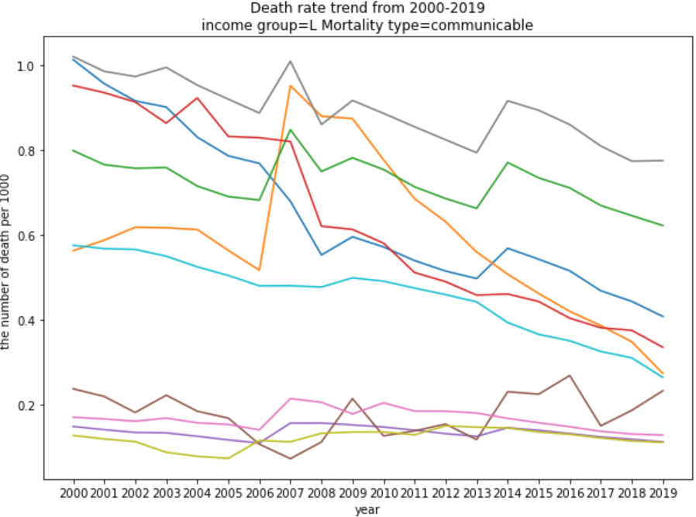
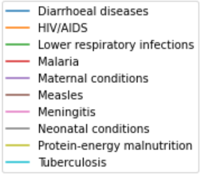
The trend of Leading communicable mortality diseases in Low income countries
Recap
What led to two peaks?
Notes:
Also there are two peaks in the low income group, we did the same job, and the results shows that the first surge mainly mainly caused by the increasing HIV.
And for the second peak, the increasing of Neonatal conditions, lower respiratory infections, diarrhoeal disease and the Measles contributed to this peak together.

Slide 20

Findings
Do the Global patterns of mortality by income group all over the world aligned with the previous work?
Patterns : i.e., Trend of mortality Cause Distribution leading cause of death
1 Low income countries did a great job on communicable disease issue.
2. There are major differences in the ranking of causes between high- and low-income countries
3. An HIV pandemic occurred in 2007 in low-income countries with 7 years to come back to the normal level.
4. IHD and Stroke cases surged in 2004 in upper-middle countries, leading to a mortality spike in the whole Upper-middle income countries
Notes:
To sum up, the hypothesis is mostly right except the trend of mortality.
Besides, there are many findings related to the difference among the income group, the pandemic occurred in the early year.
So the question is , for a country, what they do can lower the death rate, that lead us to turn to the next paper

Slide 21
Hypothesis 2
As in Sub-Saharan Africa, we expect health expenditure to exert a positive and significant impact on all three health outcomes (life expectancy, under-five mortality, and maternal mortality), for other regions globally. (1996-2015)
Tested Correlation: health expenditure and under-five mortality, maternal mortality, life expectancy.
Notes:
A little bit recap on this hypothesis.
Previous work concluded that in sub-saharan africa, the three selected health outcomes improved with more government investments before 2015.
We did the same analysis to see if our results aligned with their conclusion.

Slide 22
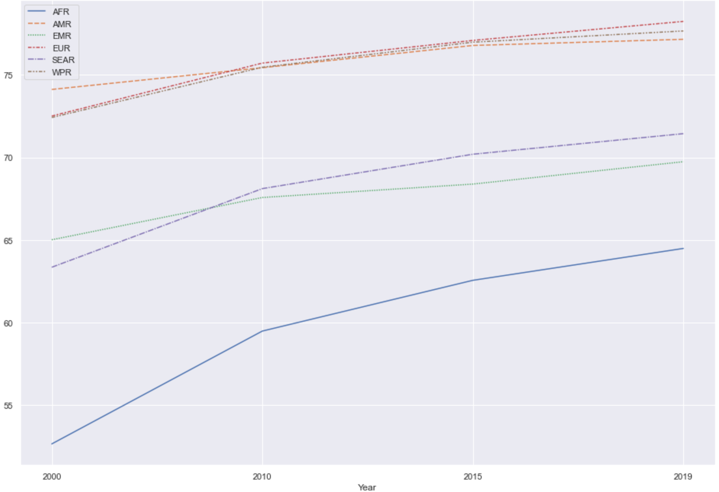
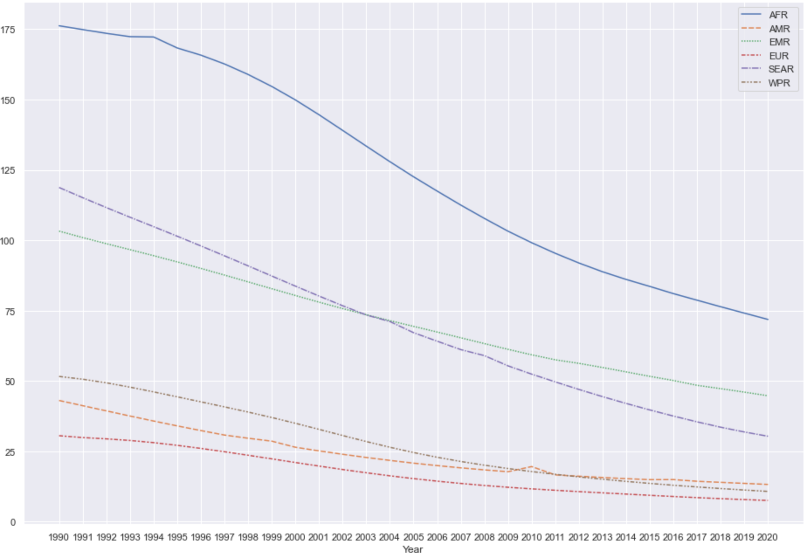
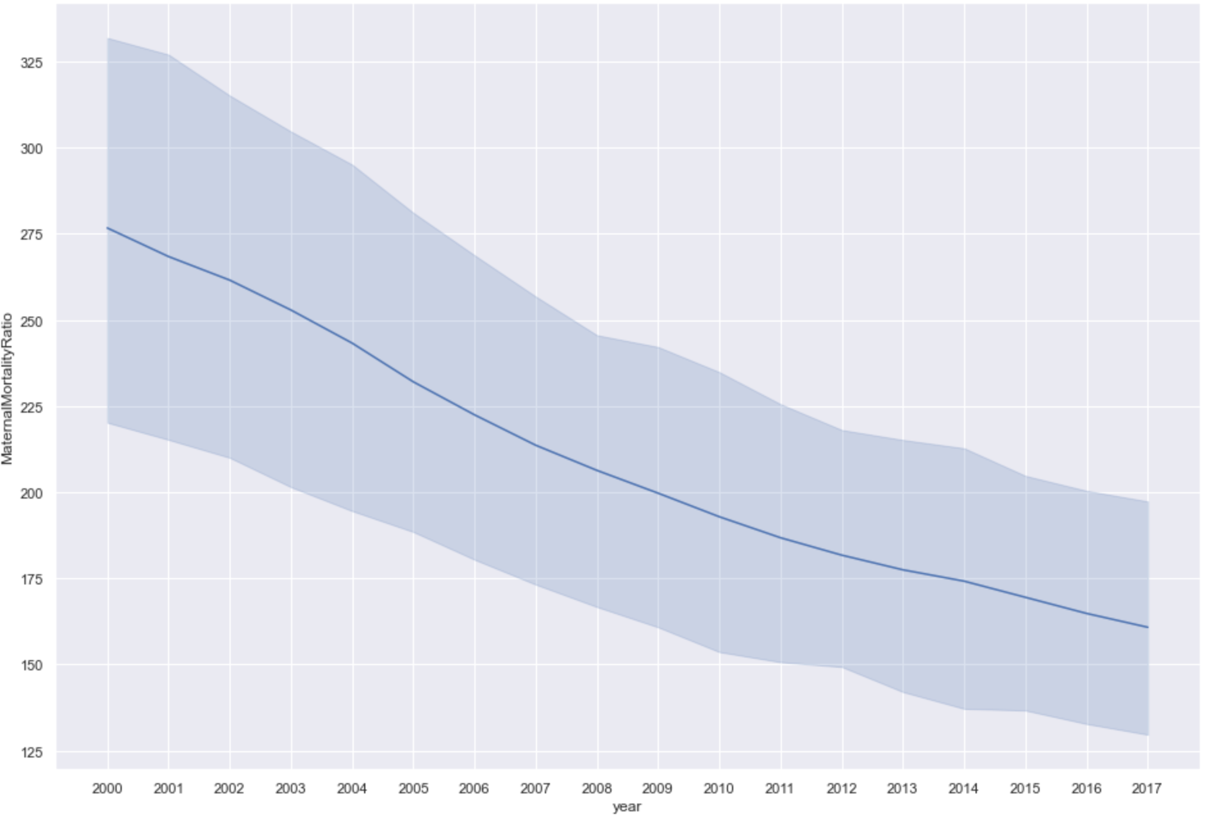
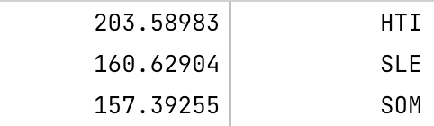
Overview of health outcome over the years
Under 5 mortality (deaths per 1000 live births)
Life expectancy
Maternal mortality (per 100 000 live births)
Notes:
The big picture of how those three outcomes changed over years.
Noted that life expectancy data only updated every five years
But we can still see the positive trend in all three factors:
Except for the region AMR - a peak point in 2010 in the case of “under 5 mortality” rate
Zoomed into the next level of guaualiry on the country basis, we found that Haidi, experienced the most severe earthquake in 2010.

Slide 23
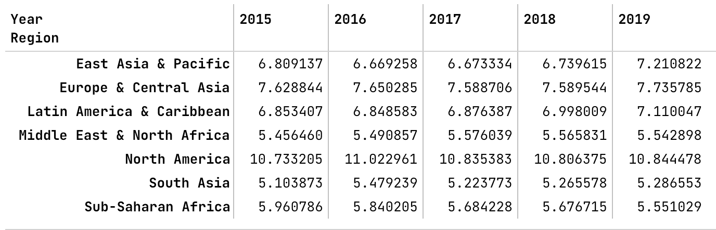
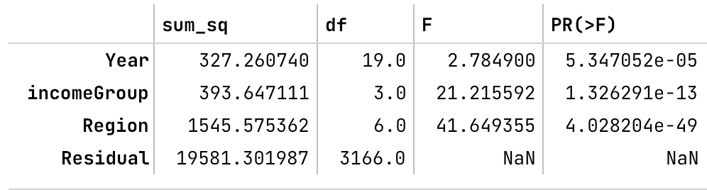
Overview of health expenditure 2015 - 2019
Health expenditure per region per year
There are significant differences in health expenditure across Year, Income Group, Region.
Notes:
In another line of research, we see great discrepancies exist across years, income groups, and regions in regards to health expenditure.
We further investigated the extent to which dimension of categorization can be mirrored on the health expenditure?
We did an ANOVA test: which factor is correlated with health expenditure? - all are related

Slide 24
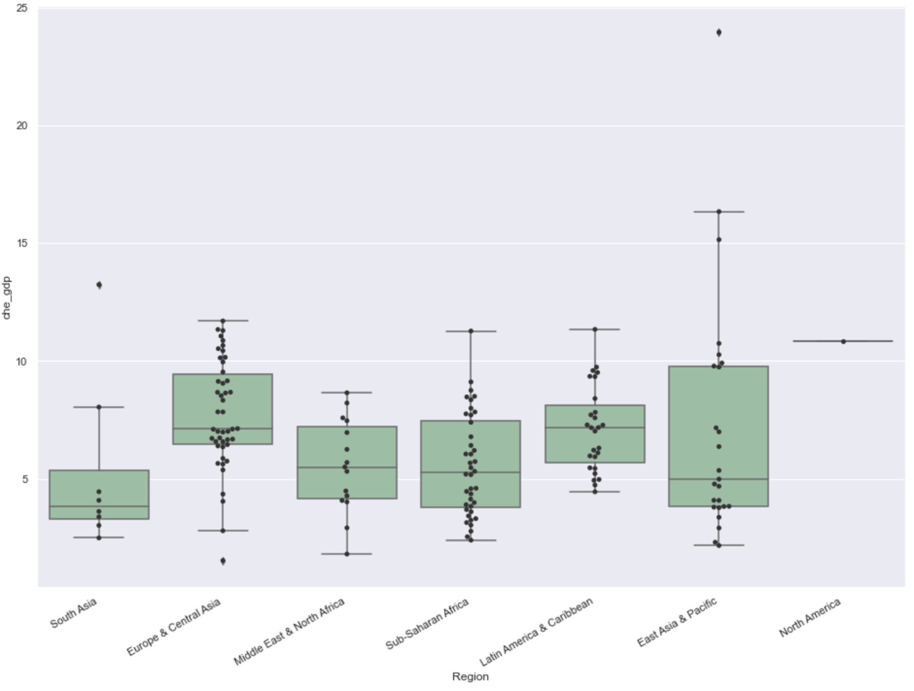
Health expenditure in 2019
Notes:
A box plot shows how the health expenditure is distributed over the world.
The y-axis is the percentage of gdp which is an indication of how resources were allocated to health compared to other sectors.
The point represents a country in that region. Outliers in east asia & pacific. Health expenditure accounts for more than 20% of GDP. on average is between 5 to 10 percent
Number of countries were different in each region, Canada is the only country in North America

Slide 25
Effect of Health Expenditure on Selected Health Outcomes
Before 2015, a 1% increase in health expenditure resulted in a 0.5 percent reduction in under-five mortality in sub-saharan Africa; 9% reduction in North America. this happens to all other regions except for East Asia & Pacific
After 2015, the correlation between health expenditure and under-five mortality remains.
Except for South Asia, East Asia & Pacific
Pearson correlation test:
The results suggest that steady increases in health expenditures over time have the tendency to improve health outcomes in most regions/countries.
Notes:
The findings in previous work conducted in Sub-saharan Africa can be generalised into other regions.
With some exceptions (east asia
Health expenditure can exert a positive influence on health outcomes.

Slide 26
Reference
Mathers, C. D., Boerma, T., & Ma Fat, D. (2009, September 22). Global and regional causes of death. OUP Academic. Retrieved April 26, 2022, from https://academic.oup.com/bmb/article/92/1/7/332071?login=false
Amponsah, E. N. (2019). The impact of health expenditures on Health Outcomes in ... Retrieved April 27, 2022, from https://journals.sagepub.com/doi/full/10.1177/0169796X19826759

Slide 27
Thank you

Slide 28
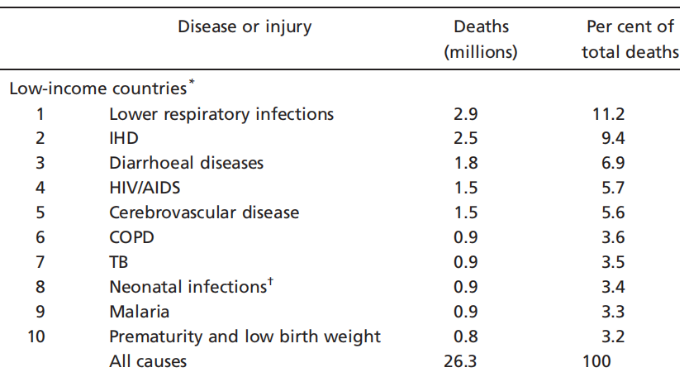
Leading cause-of-death disease in Low income group in 2004
Article’s conclusion
-
-
Notes:
Also we can analyze the leading causes of death in each income group.
The author mentioned the data limitations like the newborn data, so this might be the reason why these two results look so different.

Slide 29
Limitations and Future work
Empty record & NULL value
Data inspection: correlation test: outlier data
Unified income group categorization
Notes:
2.Because some countries didn’t provide the death registration data to WHO, we need to have a better way to solve the empty record and null value.
2. Come up with a better way to solve the Null value or empty record.
1.Optimize program code to have a better usability and efficiency.

Slide 30

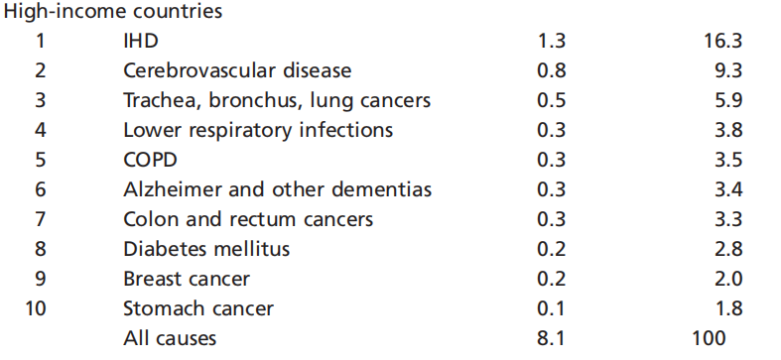
Leading cause-of-death disease in High income group in 2004
Article’s conclusion
Notes:
The leading disease are quite similar in the high income countries, The Big difference is we had a Kidney disease at 8 th, so maybe this is another data limitation that the article mentioned.

