Slide 1
SMS Sending Flow using AT Commands
Prepared by Abel Joy

Slide 2
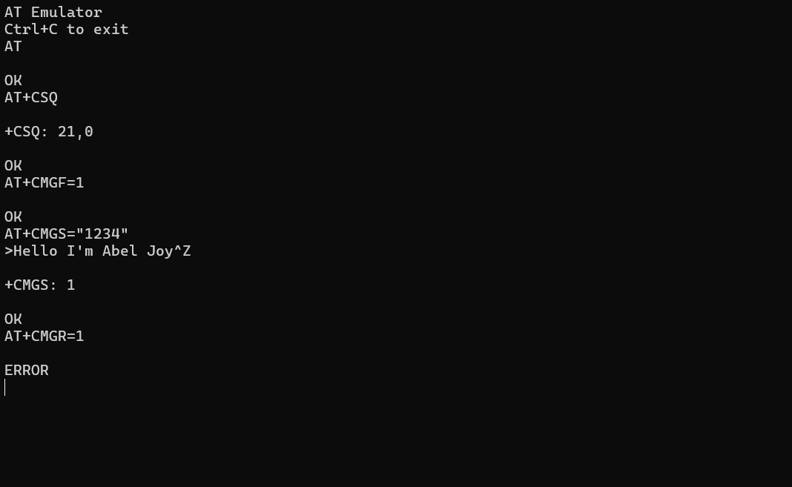
Step-by-Step Flow Screenshot

Slide 3
AT Command Flow Explanation
1. AT – Checks if module is responsive
2. AT+CSQ – Gets signal strength (21,0 means good signal)
3. AT+CMGF=1 – Sets SMS mode to text
4. AT+CMGS="1234" – Prepares to send SMS to number 1234
5. Message entered: Hello I'm Abel Joy, then Ctrl+Z
6. +CMGS: 1 confirms message sent
7. AT+CMGR=1 – Tried to read message from slot 1 but got ERROR
It is showing error because it is not supported in celersms.

