Slide 1

Wing Drag and Stability Optimization
By Ayden Bennett

Slide 2
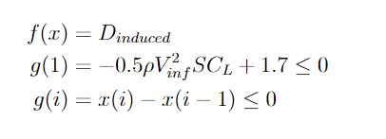
Drag Reduction Problem Statement
Create a wing capable of the following features: 8.0 meter wingspan, angle of attack of 5 degrees, 1.7 Newtons of lift at 1 m/s.
Minimize drag as much as possible and accomplish constraints by modifying chord lengths.
Constraints: Chords must be aligned at the quarter length and they must decrease in length moving towards the wingtip.

Slide 3
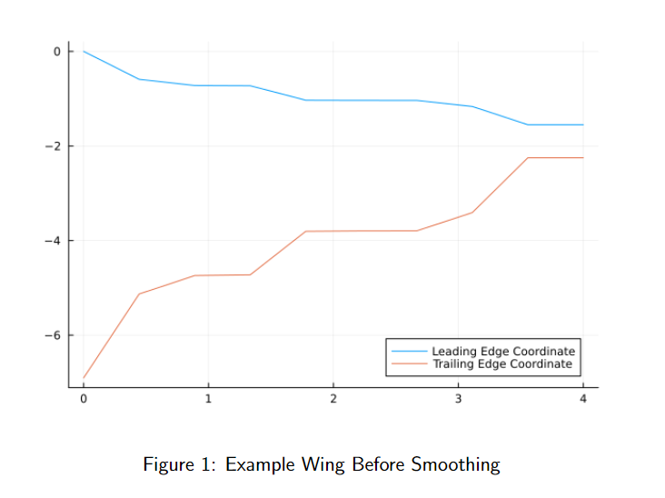
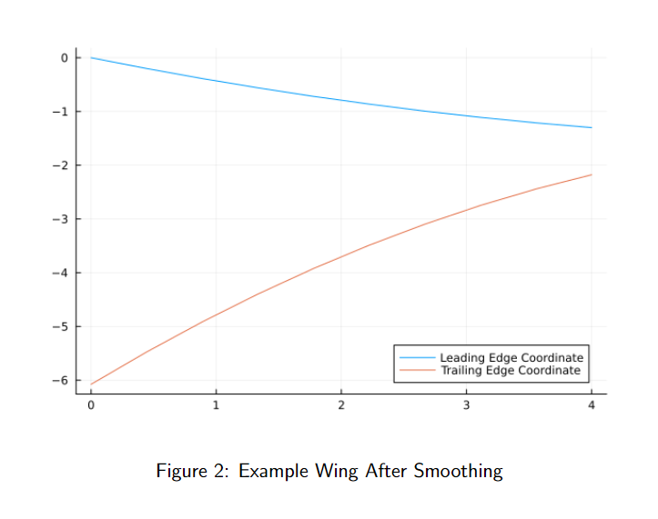
Methods
Use SNOW.jl in Julia to modify chord lengths and satisfy constraints using a general non-linear solver.
Output a vector of chord lengths and smooth using a second order regression fit.

Slide 4
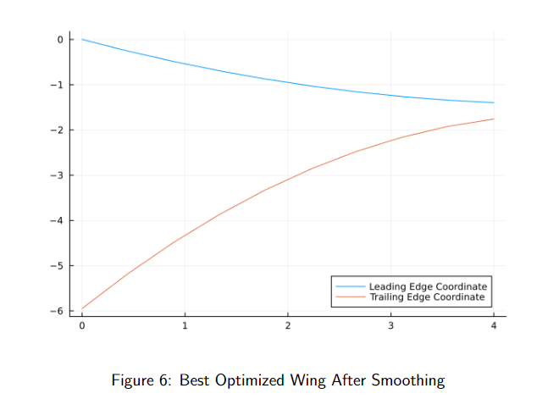
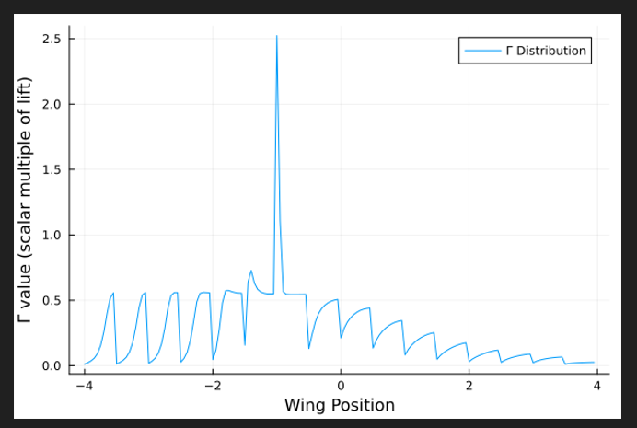
Results
Cdrag starting = 0.0104
Cdrag ending (after smoothing) = 0.00785

Slide 5
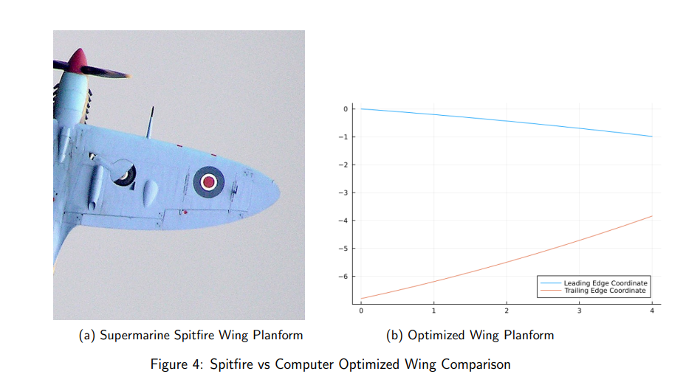
Results

Slide 6

Uh oh

Slide 7
Introducing the Stabilizer’er!!!
This program allows you to input an initial aircraft design with all sorts of variables and it will output a new stabilized wing!
The idea is that it predicts and optimizes pitch stability in two forms: static stability and trim stability. It will output a feasible wing even if the initial design is not within the feasible region!

Slide 8
How does it work?
Uses SNOW.jl and VortexLattice.jl in conjunction to create the ideal wing through 600+ lines of code in Julia compartmentalized into functions.
Variables that the optimizer changes:
Leading Edge Distribution, Chord Distribution, Wing/Tail Distance from CG, Twist Distribution, and wingspan/tail-span.
Constants (user specified):
Air/wing/tail density, airspeed, fuselage CG.
Constraints:
Lift constraint as well as tail/wing placement (avoids placing them on top of each other)
Computes new CG, mean aerodynamic chord, etc then throws everything into a VLM analysis to get the coefficient of moment about CG to determine trim stability! Also computes static stability from the stability derivatives to make things safe!

Slide 9
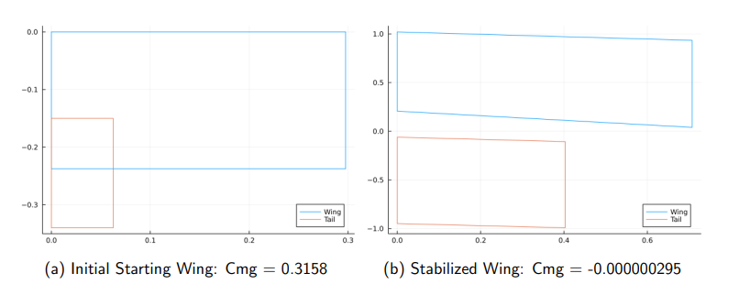
Results
7 Orders of Magnitude Better!

Slide 10
