Slide 1

Wing Drag and Stability Optimization
By Ayden Bennett

Slide 2
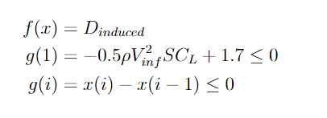
Drag Reduction Problem Statement
Create a wing capable of the following features: 8.0 meter wingspan, angle of attack of 5 degrees, 1.7 Newtons of lift at 1 m/s.
Minimize drag as much as possible and accomplish constraints by modifying chord lengths.
Constraints: Chords must be aligned at the quarter length and they must decrease in length moving towards the wingtip.

Slide 3
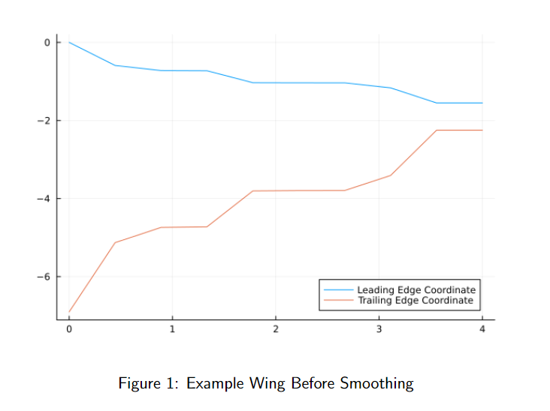
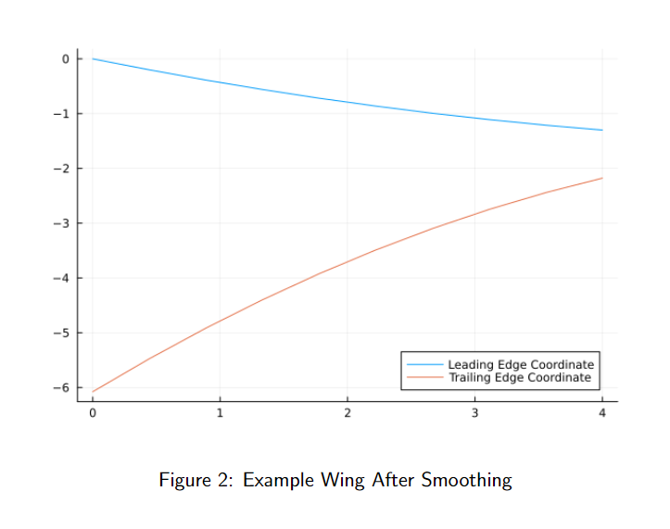
Methods
Use SNOW.jl in Julia to modify chord lengths and satisfy constraints using a general non-linear solver.
Output a vector of chord lengths and smooth using a second order regression fit.

Slide 4
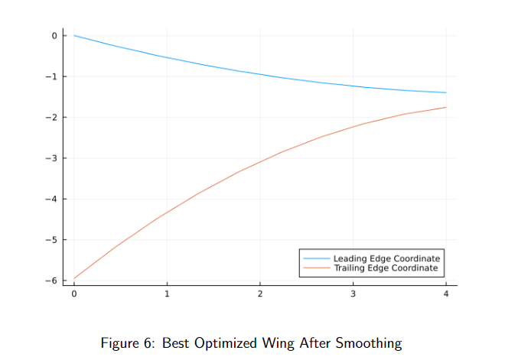
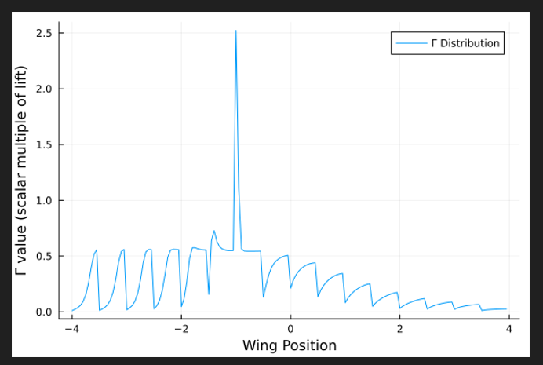
Results
Cdrag starting = 0.0104
Cdrag ending (after smoothing) = 0.00785

Slide 5
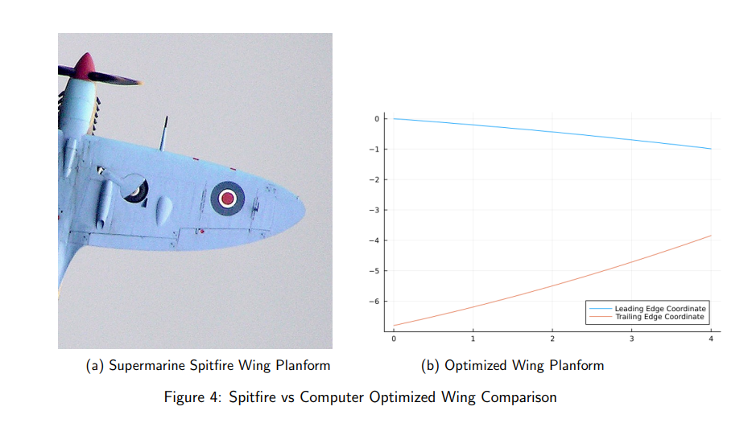
Results

Slide 6

Uh oh

Slide 7
Introducing the Stabilizer’er!!!
This program allows you to input an initial aircraft design with all sorts of variables and it will output a new stabilized wing!
The idea is that it predicts and optimizes pitch stability in two forms: static stability and trim stability. It will output a feasible wing even if the initial design is not within the feasible region!

Slide 8
How does it work?
Uses SNOW.jl and VortexLattice.jl in conjunction to create the ideal wing through 600+ lines of code in Julia compartmentalized into functions.
Variables that the optimizer changes:
Leading Edge Distribution, Chord Distribution, Wing/Tail Distance from CG, Twist Distribution, and wingspan/tail-span.
Constants (user specified):
Air/wing/tail density, airspeed, fuselage CG.
Constraints:
Lift constraint as well as tail/wing placement (avoids placing them on top of each other)
Computes new CG, mean aerodynamic chord, etc then throws everything into a VLM analysis to get the coefficient of moment about CG to determine trim stability! Also computes static stability from the stability derivatives to make things safe!

Slide 9
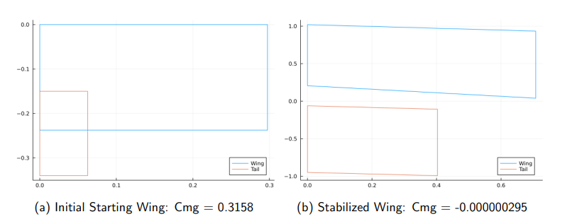
Results
7 Orders of Magnitude Better!

Slide 10
Future Research
Improved Wing Analysis
The idea is that I will get a better lift and drag coefficient by using VLM to get the induced angle of attack for small sections of the wing. These angles of attack will then be referenced to the airfoil polars with the induced angle of attack to figure out lift and drag coefficients.
Issue is that I’m having trouble getting an accurate angle of attack for each wing section. Once that is resolved I can combine this with the Lift Stabilizer’er.

Slide 11
