Slide 1
Climate App Explorer and Climate Forecast for Downtown Montreal
By
Anna-Belle Filion

Slide 2
Project steps
1- Data collection
2- Data Pre-processing
3- Data Analysis
4- Model building (training + validation + deployment)
5. App creation

Slide 3
Data
- Daily climate data of Montreal (McTavish/McGill)
- Carbon dioxide (CO2) mean global concentration yearly
- Methane (CH4) mean global concentration yearly
- Montreal’s population

Slide 4
Data – Climate data
The weather station McTavish/McGill provides data since 1871.
For visualization - maximum temperature
- minimum temperature
- precipitation.
For model - maximum temperature
- minimum temperature
Pre-processing :
- Weather stations over Montreal's Island were used to replace any missing daily weather reports
Results :
- Consecutive daily weather reports from 1892 to 2024.

Slide 5
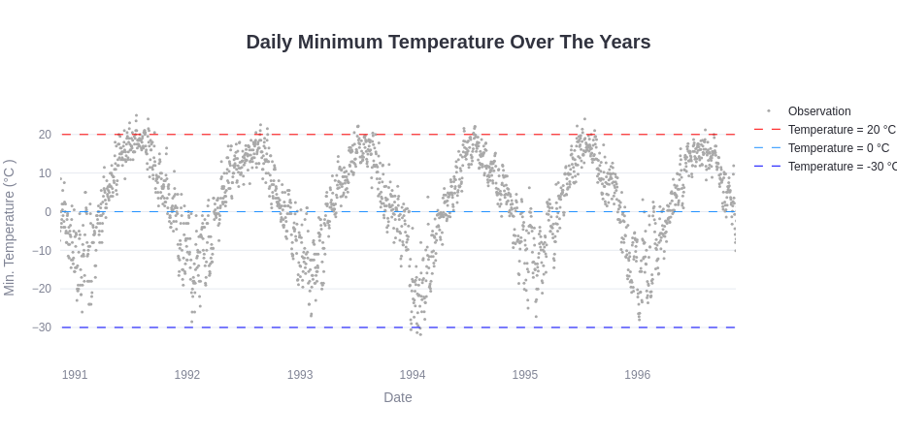

Slide 6
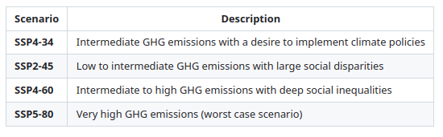
Data – Greenhouses Gases (GHG)
Various dataset covering different periods and the frequency of availability varied.
The data were interpolated with a polynomial (second degree and third degree) method giving :
- Yearly data
- No discontinuities between the various dataset.
The observations and the prediction yearly for every Shared Socioeconomic Pathways (SSP) scenario from 1850 to 2099
Goal with model:
- Esthablish connections between GHG and temperature increase due to climate change.

Slide 7
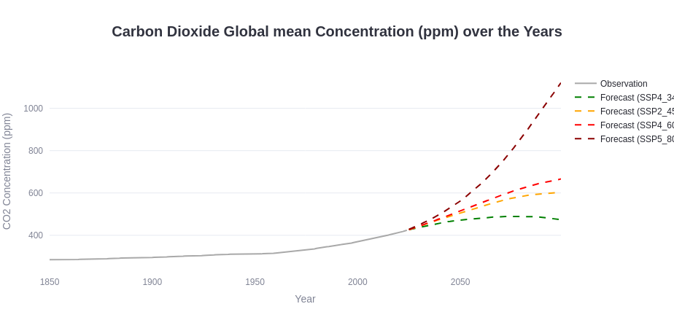
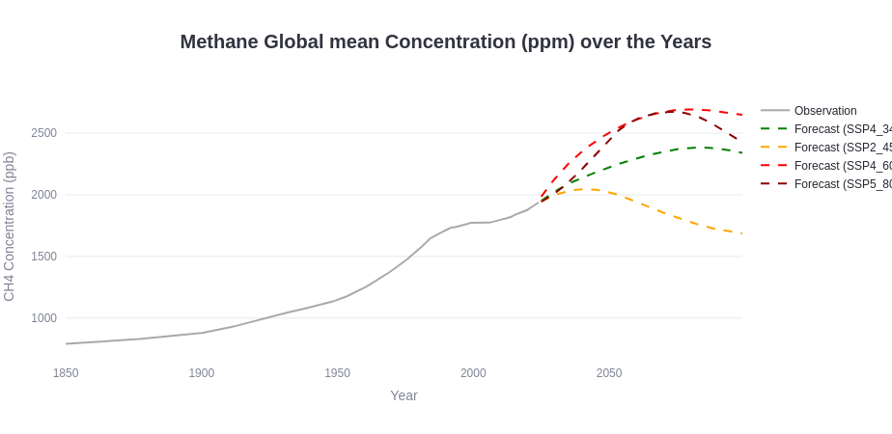

Slide 8
Data – Population
Population density significantly impact the land surface of a city.
Impacting:
- Heat storage capacity
- Albedo
- Ability of retain moisture
Creating
- Urban Heat Island
Goal with model:
- To establish the connection between the population curve and the temperature (Urban Heat Island).

Slide 9
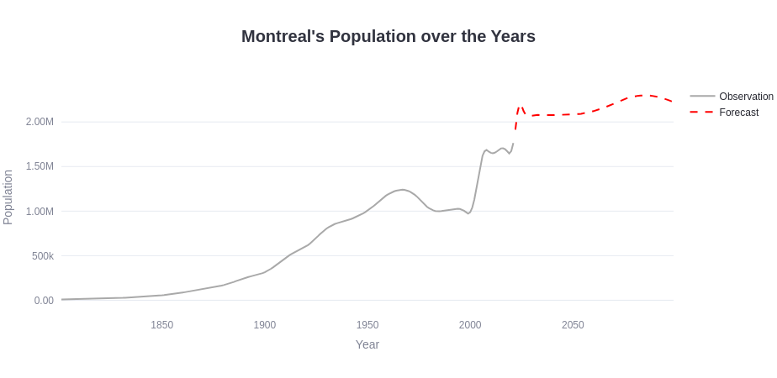

Slide 10
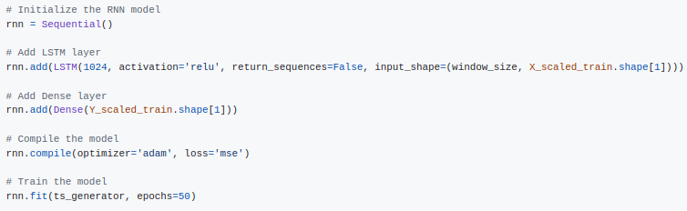
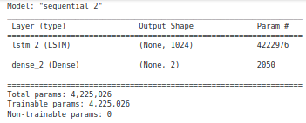
Recurrent Neural Network model
The goal was to build an RNN model that would forecast the daily, seasonal and annual variability of maximum/minimum temperatures and its variation caused by climate change for Downtown Montreal.
My RNN model :
- Simple 1 layer Long-Short Term Memory (LSTM) RNN model
- 31 days window from TimeseriesGenerator
- trained with the daily data from 1892 to 2020

Slide 11
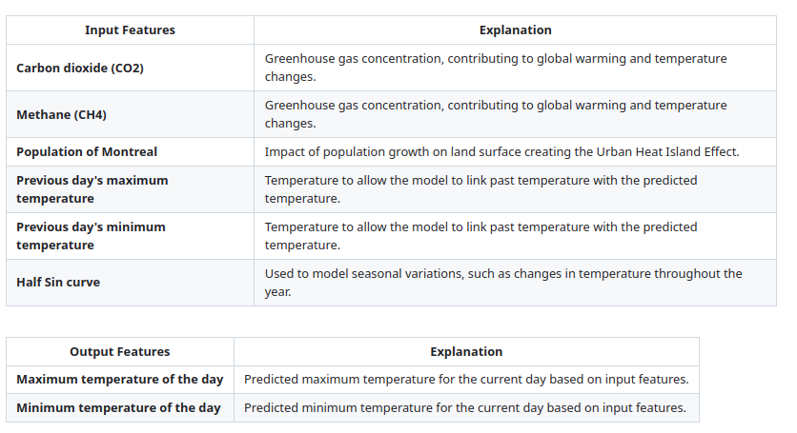
RNN model

Slide 12
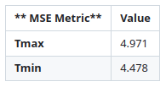
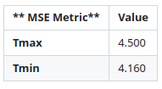
RNN model validation
Train/test/validation split method was used
Metric : Mean Squared Error (MSE)
A moving window approach was used:
1 - A fixed-size window of 31 days of input feature is used.
2 - The model is used to predict Tmax and Tmin.
3 - This window then slides forward by one day.
4 - The forecasted Tmax and Tmin is used to replace the last entry of the Previous day's maximum/minimum temperature.
5 - The model is used to predict Tmax and Tmin.
6 - Repeat steps 4 and 5 until the entire forecasty period is covered.
Testing dataset comprised daily data from 2021 to 2022
Validation dataset constituted of daily data from 2023 to 2024

Slide 13
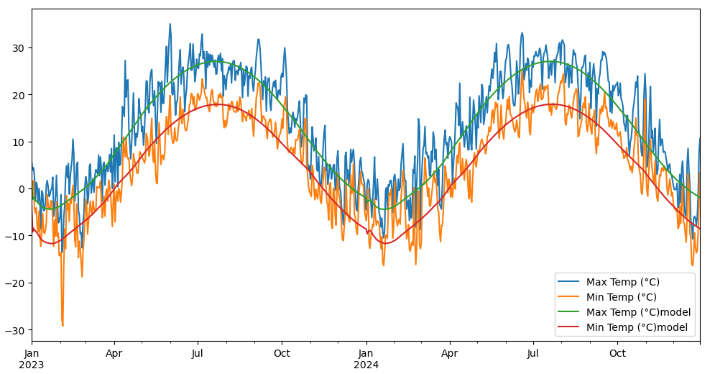
RNN model validation

Slide 14
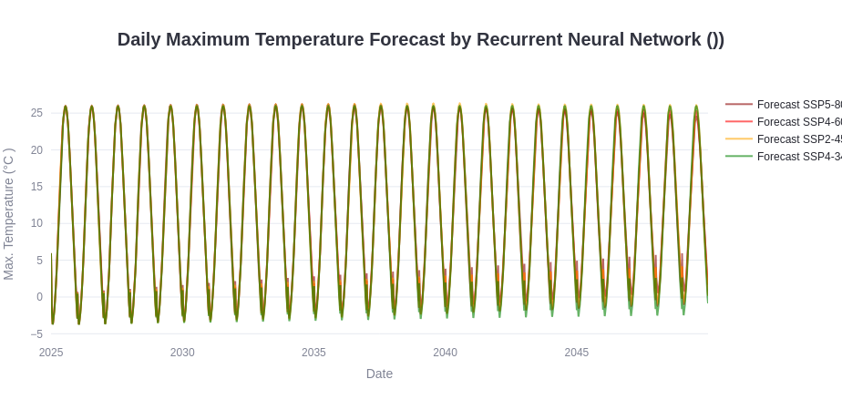
RNN model results
A prediction was made from 2025 up to 2050
We can see that the model see clearly the annual cycle of temperatures.

Slide 15
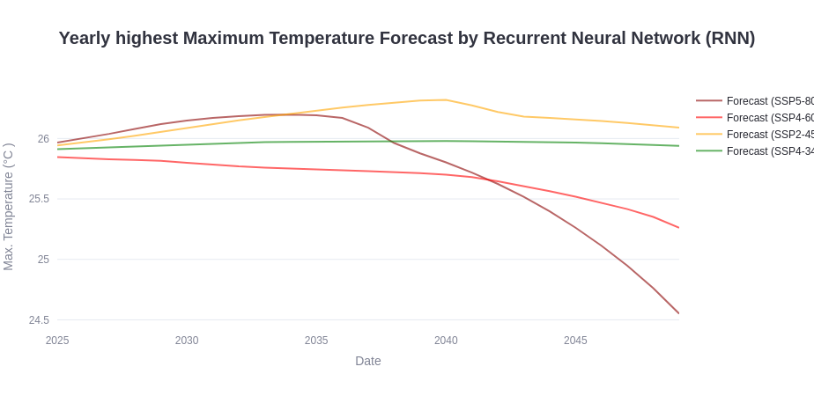
RNN model results
Here are some graph that focus on the summer portion of the annual cycle to see the trend in summer maximum temperature to expect with climate change based on our RNN model.

Slide 16
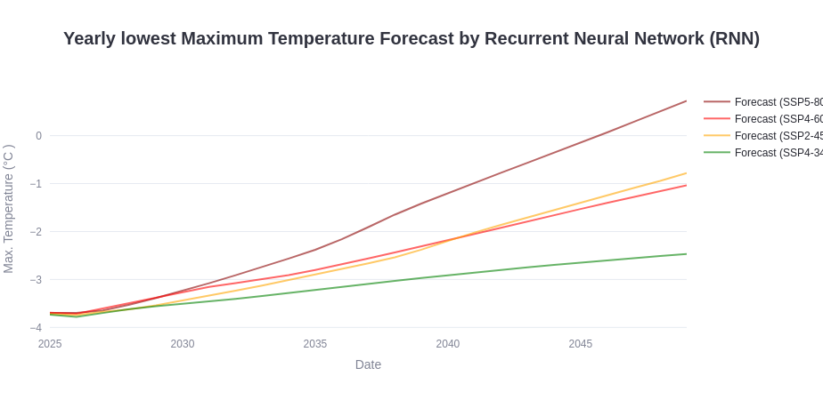
RNN model results
Here are some graph that focus on the winter portion of the annual cycle to see the trend in winter maximum temperature to expect with climate change based on our RNN model.

Slide 18
RNN model results
We see some unexpected drops in temperature with global warming scenario that should results in an increased trend.
For example, there is a sharp drop at 2040 in the SSP2-45 scenario.
- Seems to be related to the drop in methane emissions.
For the significant drop in the SSP5-80,
- Seems to be related to a weak inflection point in the population at 2036.
This leads me to believe that there is some instabilities in my model that are triggered, propagated and amplified with time when there is an inflection point in the input features.

Slide 19
Climate App
Our Climate Application was developed to visualize the weather's evolution over the last century for Montreal (McTavish/McGill).
Easy navigation through historic data for
- maximum temperature
- minimum temperature
- precipitation.
Allows visualization of frequency of severe events trough time.
- # of days per year with daily precipitation greater than 75 mm.
Climate forecast visualizer for different global warming scenarios produced from our RNN model.
Demo coming shortly after the presentation

Slide 20
Conclusion
Our Climate App
- Will be launched shortly.
Our RNN model
- Needs more work to resolve the instability issue.
- Needs adjustments to capture daily cycles (daily sin curve).
- Artificially add weights to GHG
(Methane contribute 30 times more to climate change than Carbon Dioxide)
- Tests without the population in the input features

Slide 21

Thank you
By Anna-Belle Filion

