Slide 1

Residential Housing Rental Adds Analysis across Canada
By Anna-Belle Filion

Slide 2
Wrong turns along the road
Too much data cleaning
  Cleaned irrelevant columns
Using only latitudes and longitudes
  Regression analysis has no geo-spatial component
Working with the skewed original dataset
Tried to resolve the skewed dataset by building provincial models
  Too much to do in too little time!

Slide 3
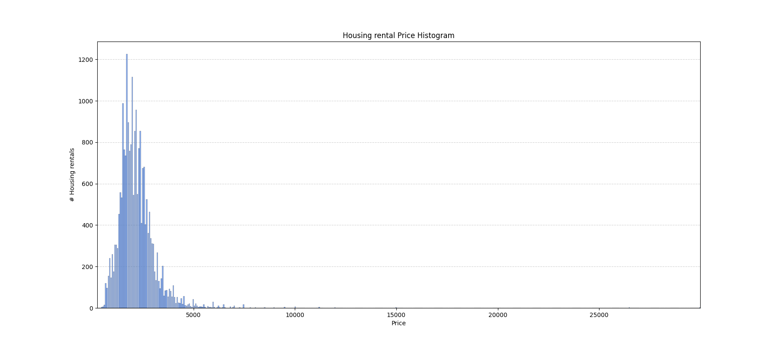
Data Analysis
Cannot build a decent model with a dataset contaminated by outliers

Slide 4
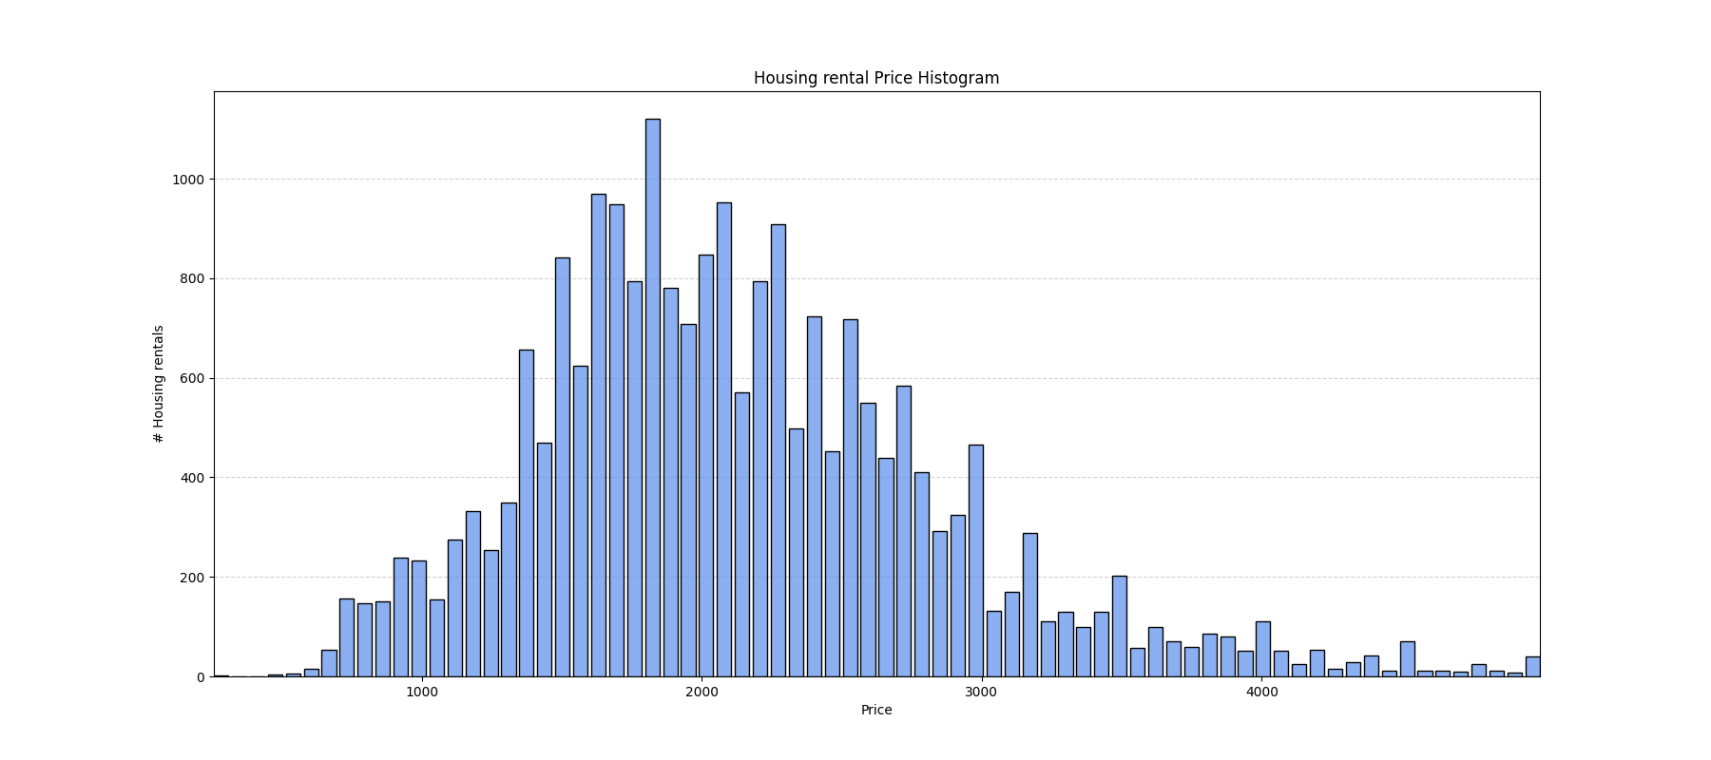
Data Analysis
By removing about 1.2% of the data (price> 5000$),
I was able to get a near normal distribution.

Slide 5
Finding best model
Tested 6 different sets of best features 2*(15,20,30)
Tested 3 different models
  Linear Regression
  Polynomial Regression
  Ordinary Least Square
Cross-Validation method
  Train-Test Split

Slide 6
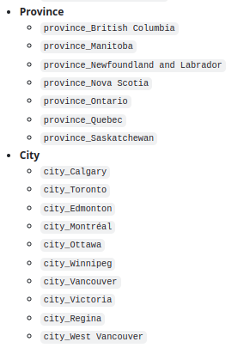
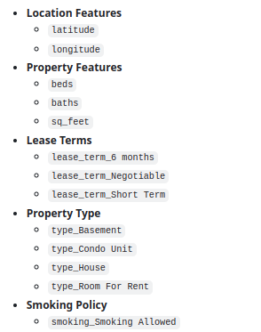
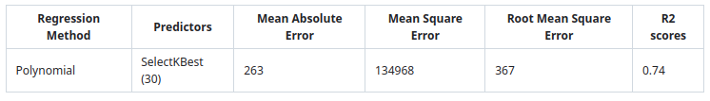
Best model
30 features found with SelectKBest
Polynomial of 2nd degree Regression

Slide 7
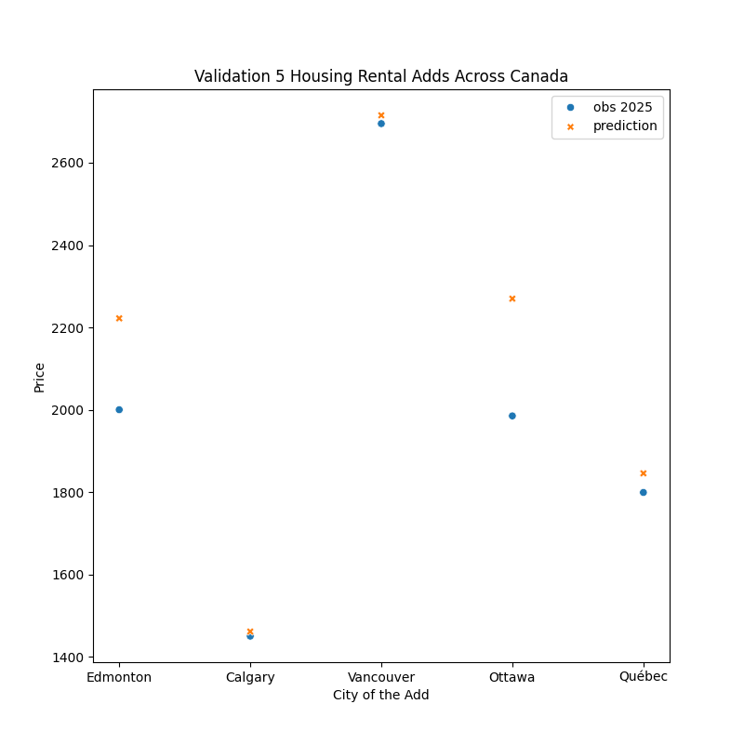
Validation with 2025 data
Best model tested with 5 adds across Canada
  Edmonton
  Calgary
  Vancouver
  Ottawa
  Quebec city
RSME = 163
Overall, exceed expectation!

Slide 8
Thanks!

