Slide 1

PHP Course
Lecture 4
Temuri Takalandze
@ABGEO

Slide 2
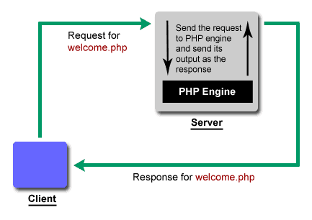
Run PHP in Web environment

Slide 3
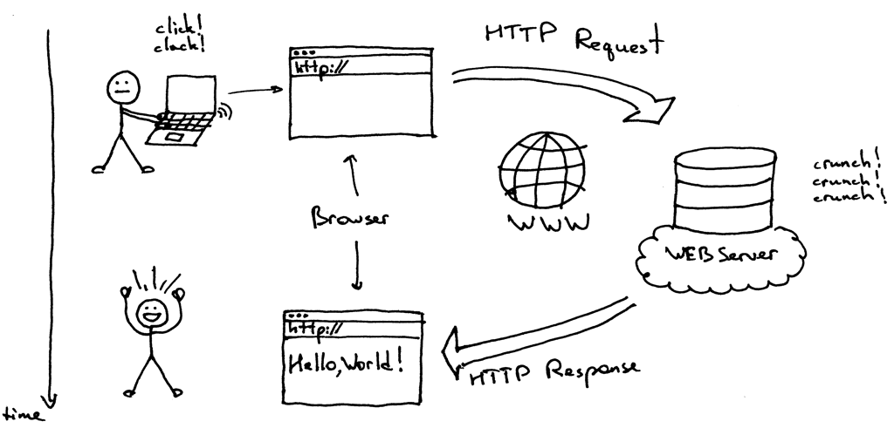
Request & Response

Slide 4
Basic HTTP methods
Method | Description
GET | Retrieve representation of a resource
POST | Create a new resource
PUT | Overwrite an existing resource or create new if it doesn’t exists
PATCH | Partially update a resource
DELETE | Delete a new resource
https://developer.mozilla.org/en-US/docs/Web/HTTP/Methods

Slide 5
HTTP response status codes
Range | Description | Example
100–199 | Informational responses | 102 Processing - This code indicates that the server has received and is processing the request, but no response is available yet.
200–299 | Successful responses | 200 OK - The request has succeeded
300–399 | Redirects | 301 Moved Permanently - The URL of the requested resource has been changed permanently.
400–499 | Client errors | 404 Not Found - The server can not find the requested resource
500–599 | Server errors | 500 Internal Server Error - The server has encountered a situation it doesn't know how to handle.
https://developer.mozilla.org/en-US/docs/Web/HTTP/Status

Slide 6
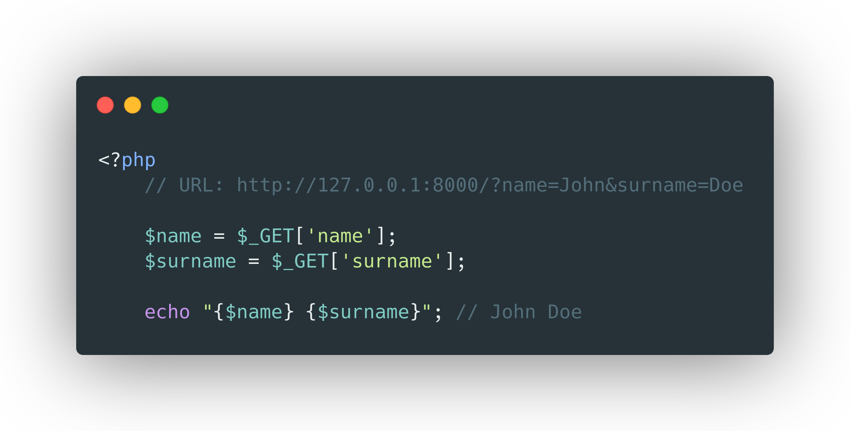
GET Super Global

Slide 7
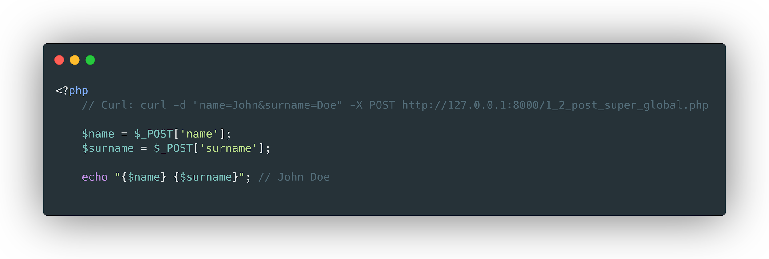
POST Super Global

Slide 8
Other Request/Server Super Globals
$_REQUEST
$_SERVER

Slide 9
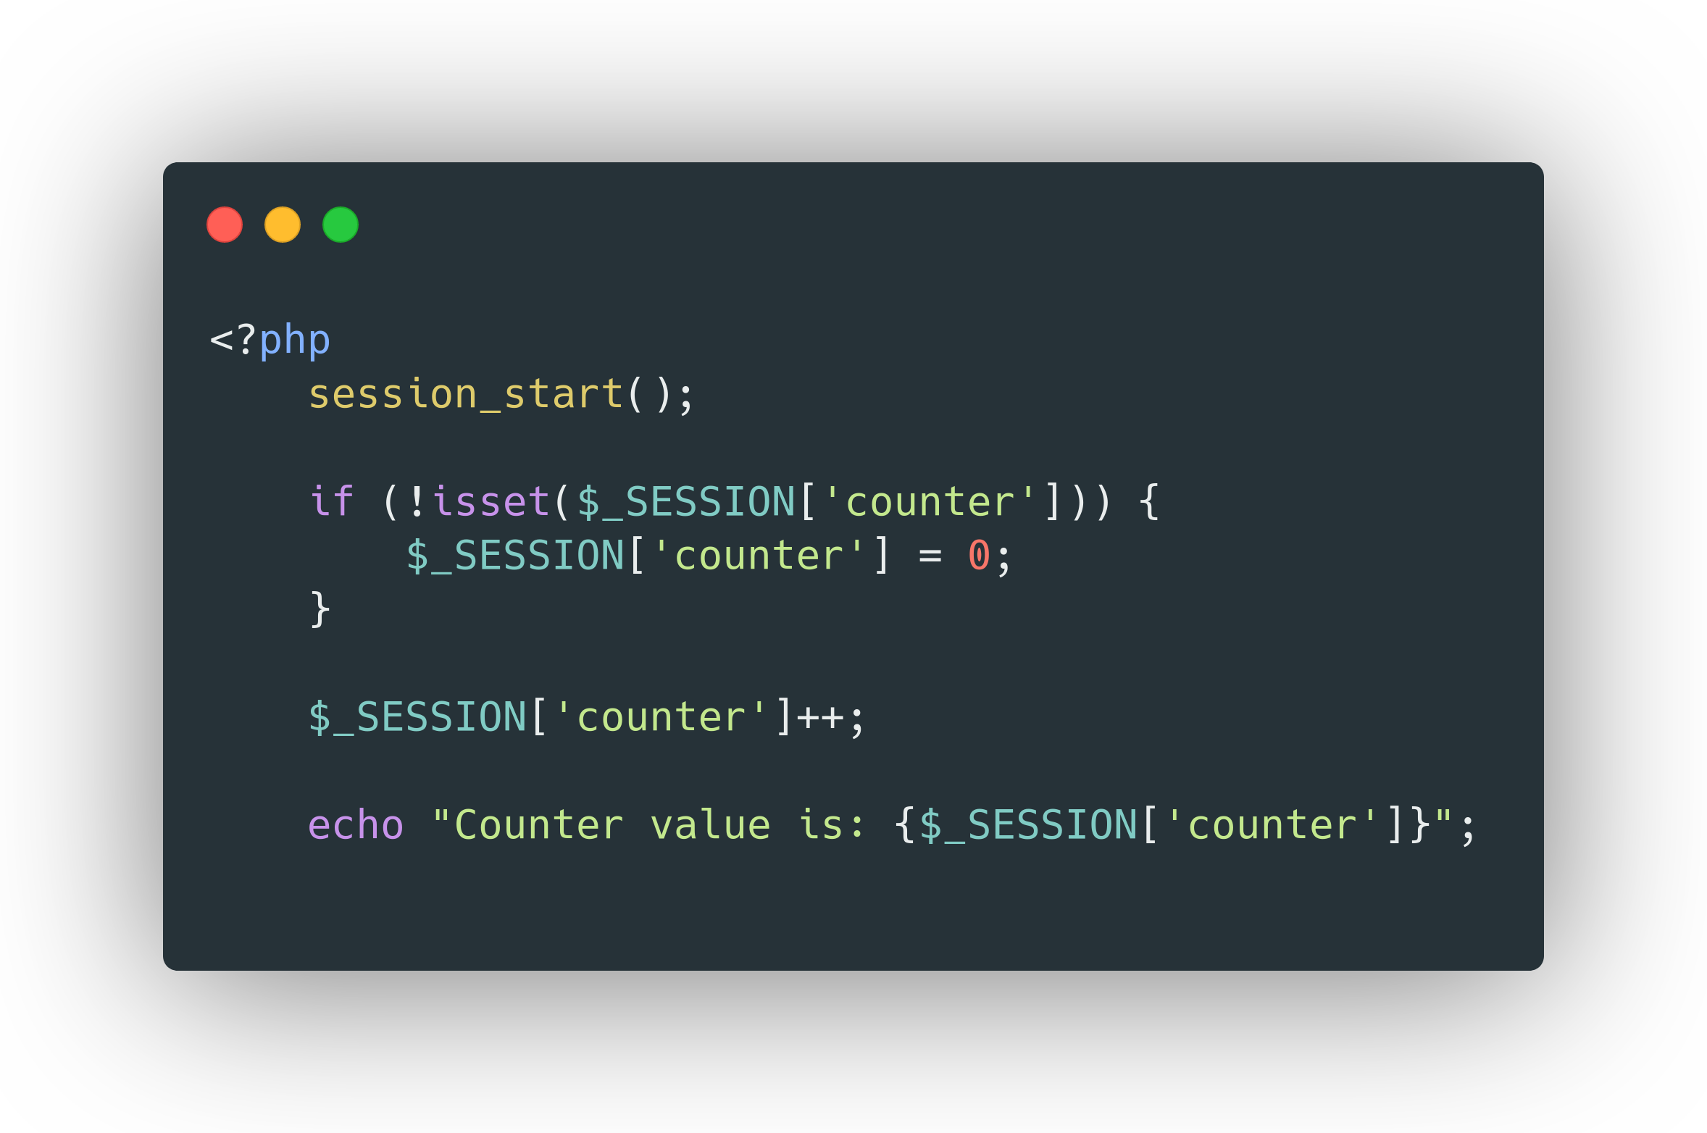
Session

Slide 10
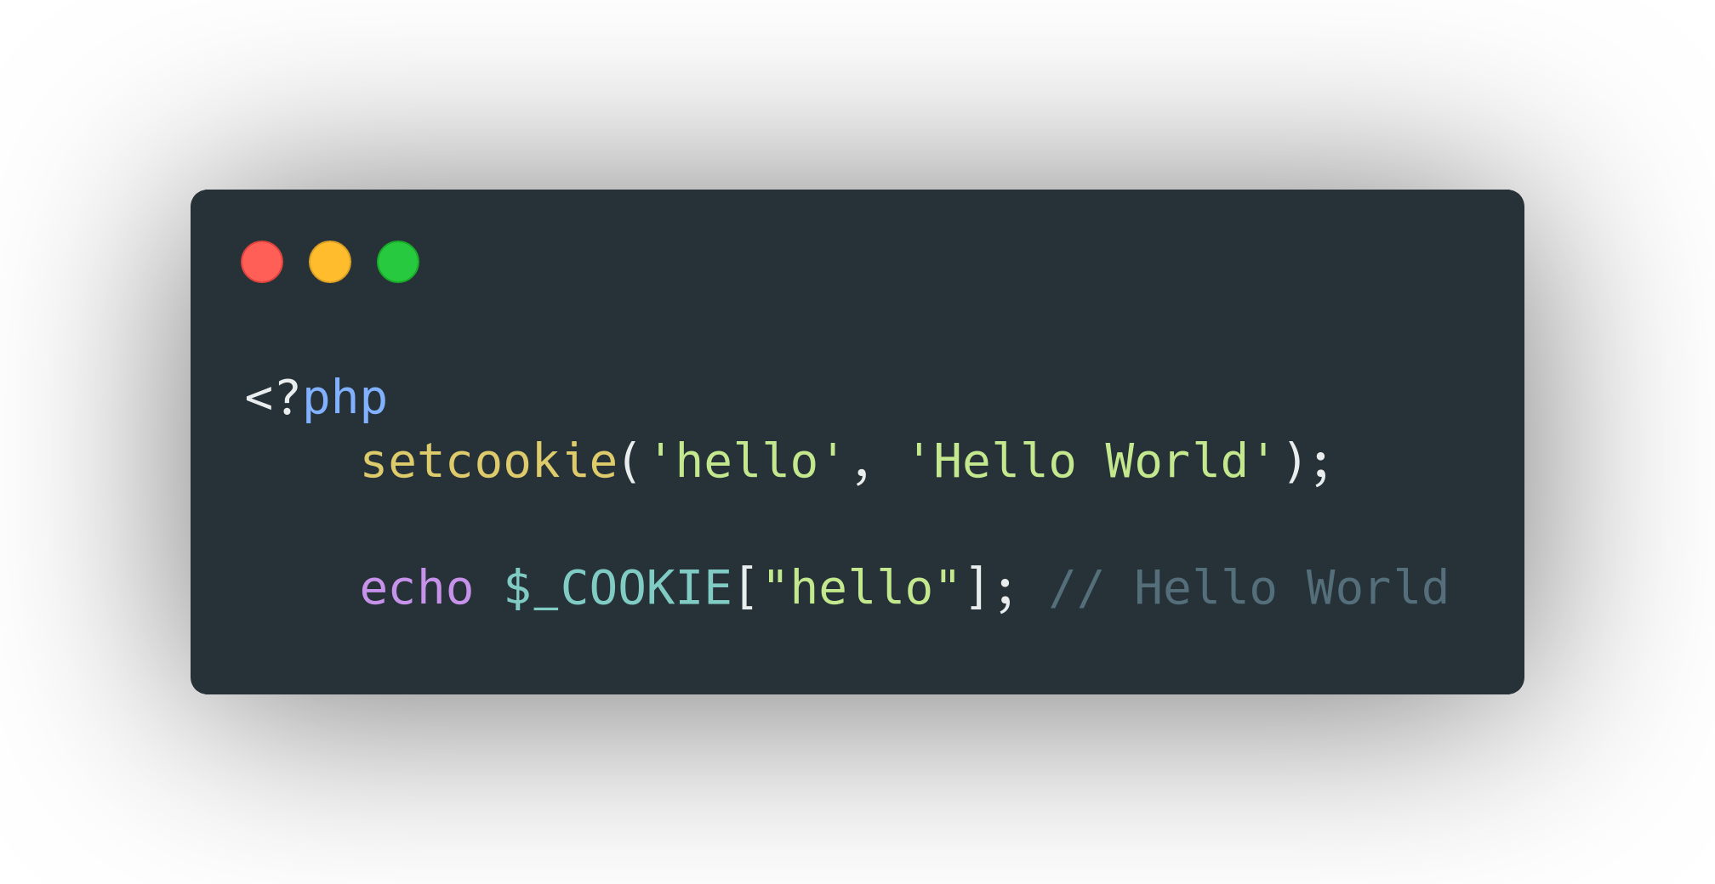
Cookies

Slide 11
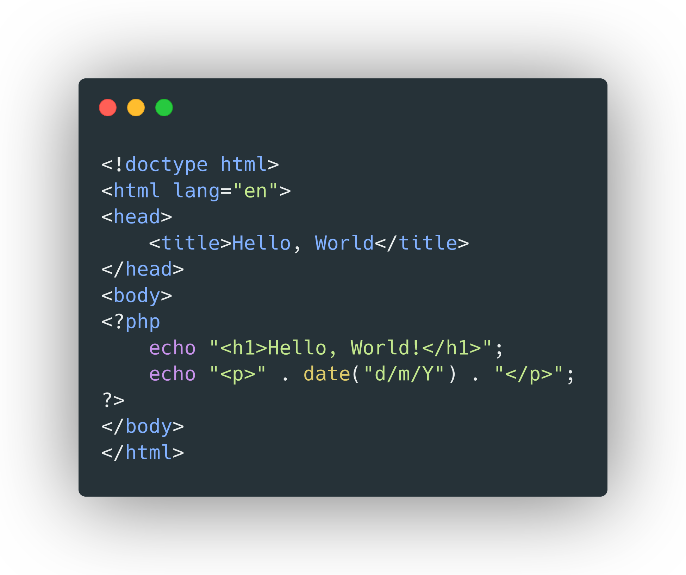
Templating

Slide 12
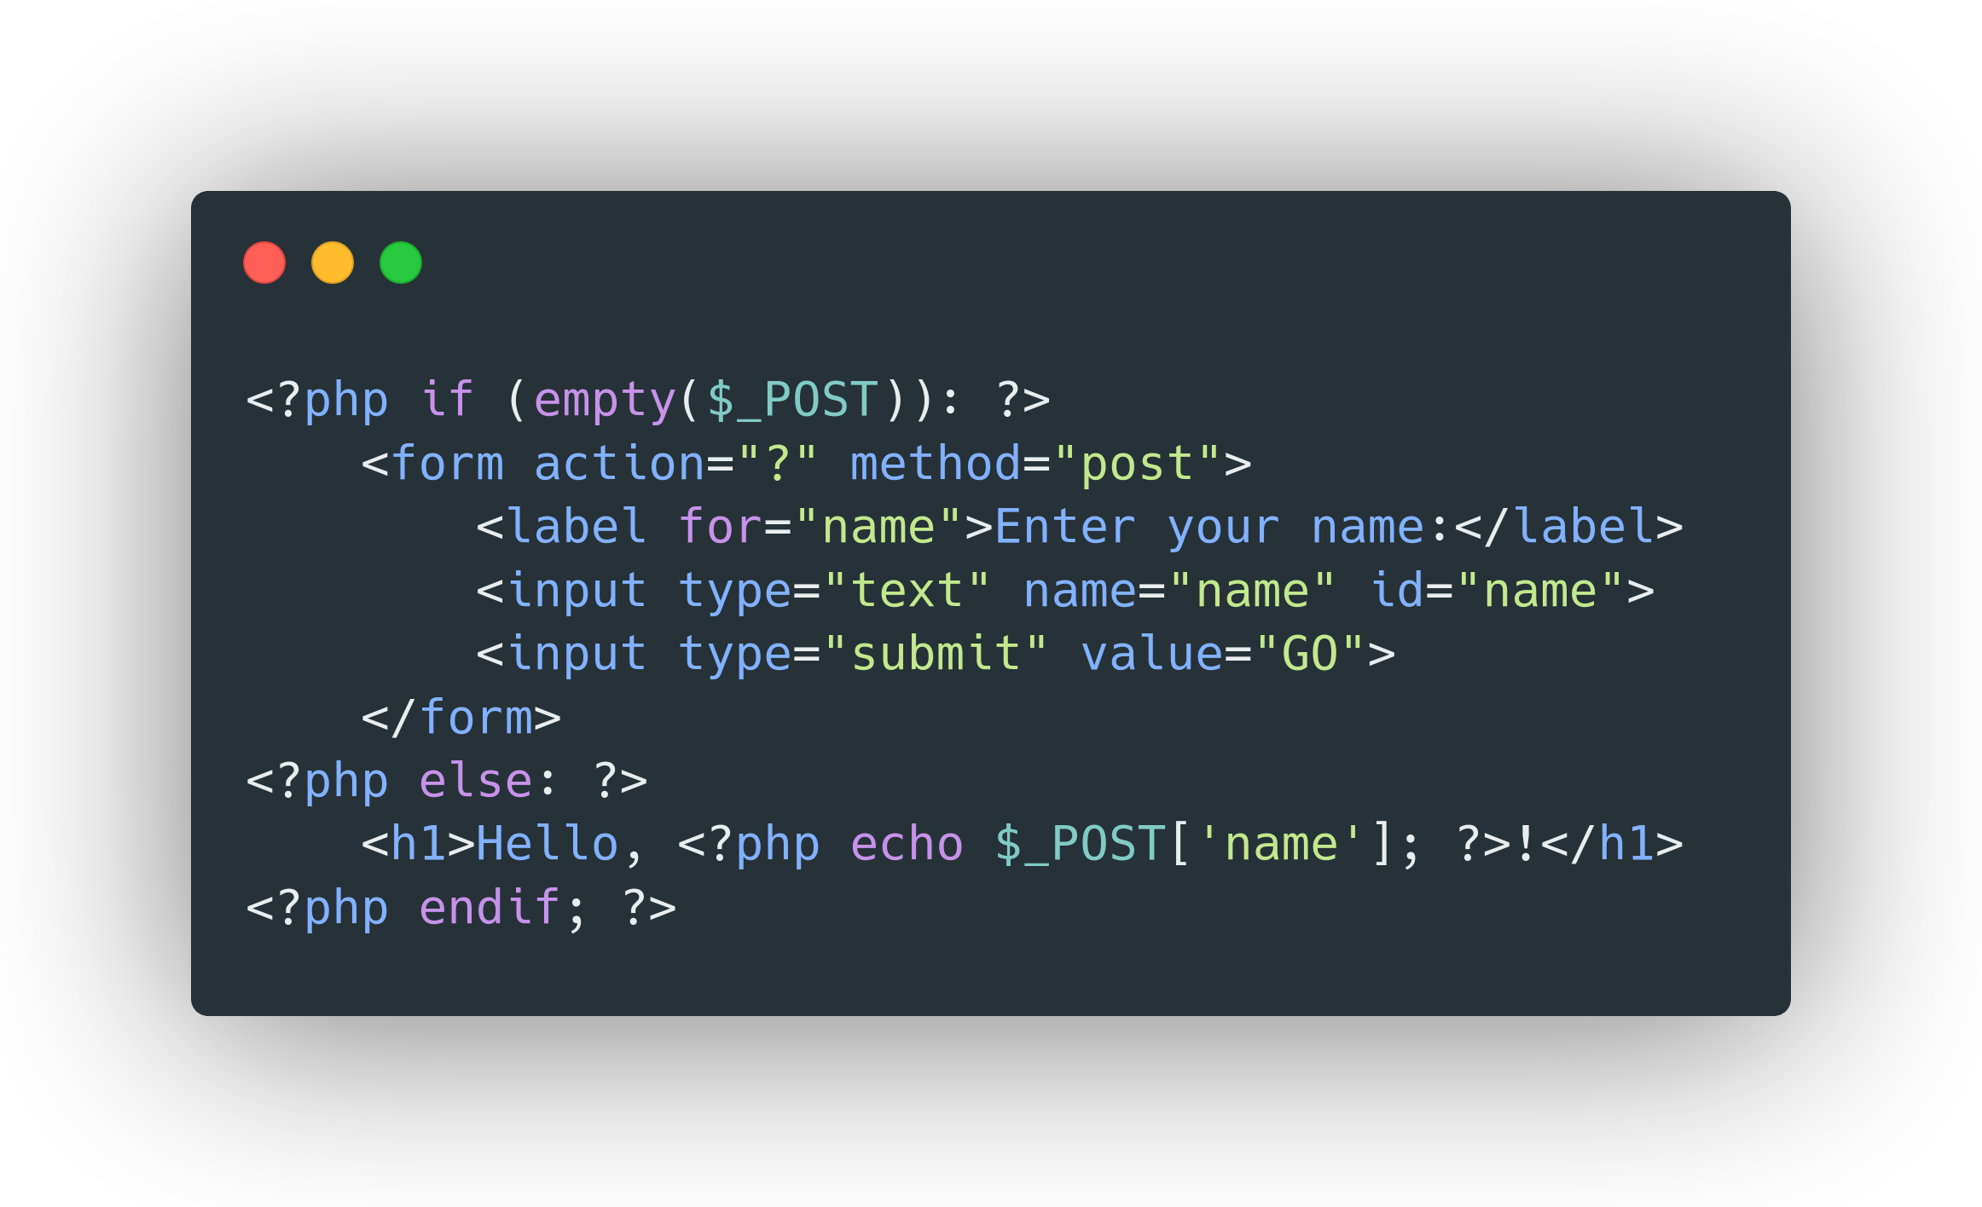
Form Handling

