Slide 1

PHP Course
Lecture 2
Temuri Takalandze
@ABGEO

Slide 2
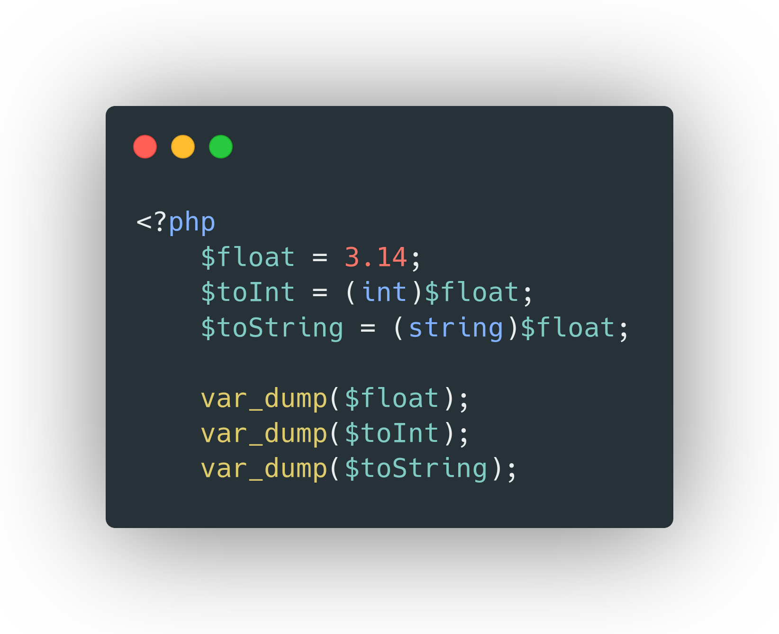
Type Casting

Slide 3
Operators
Assignment Operators
Math Operators
Increment/Decrement Operators
Comparison Operators
Logical Operators

Slide 4
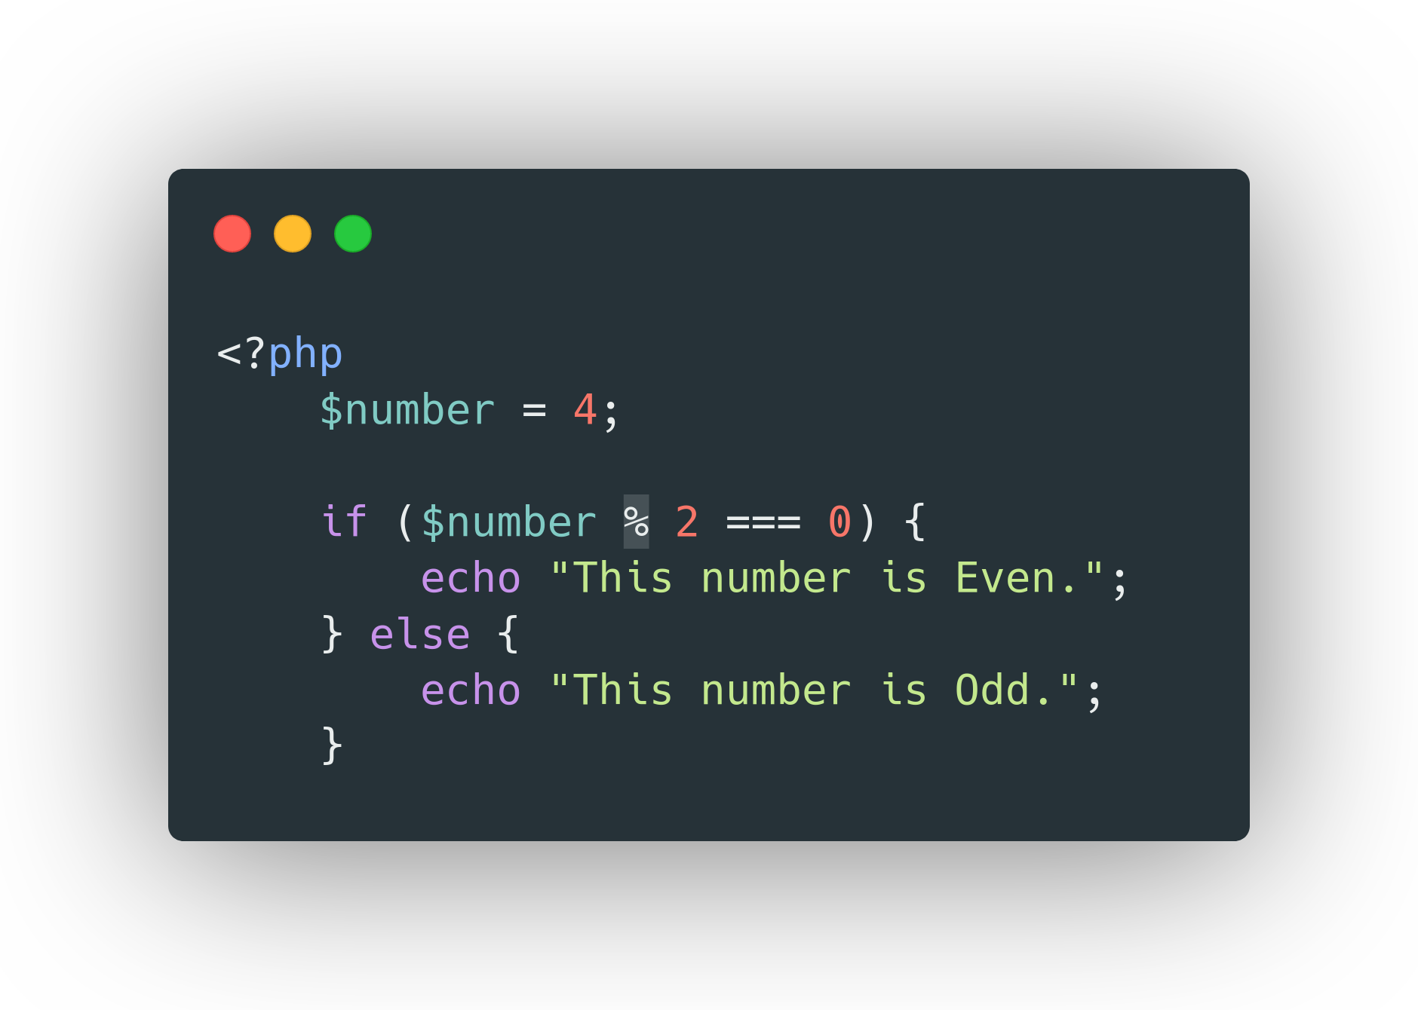
If-Else Statements

Slide 5
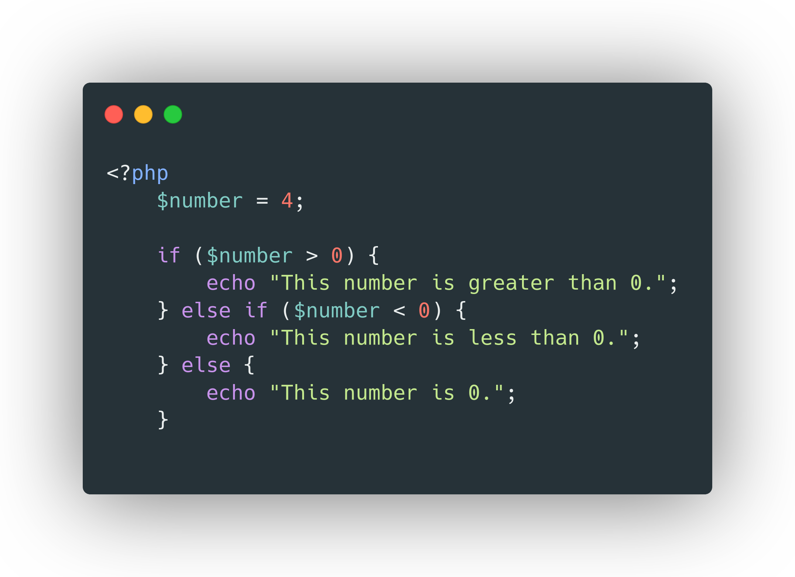
Elseif Statements

Slide 6
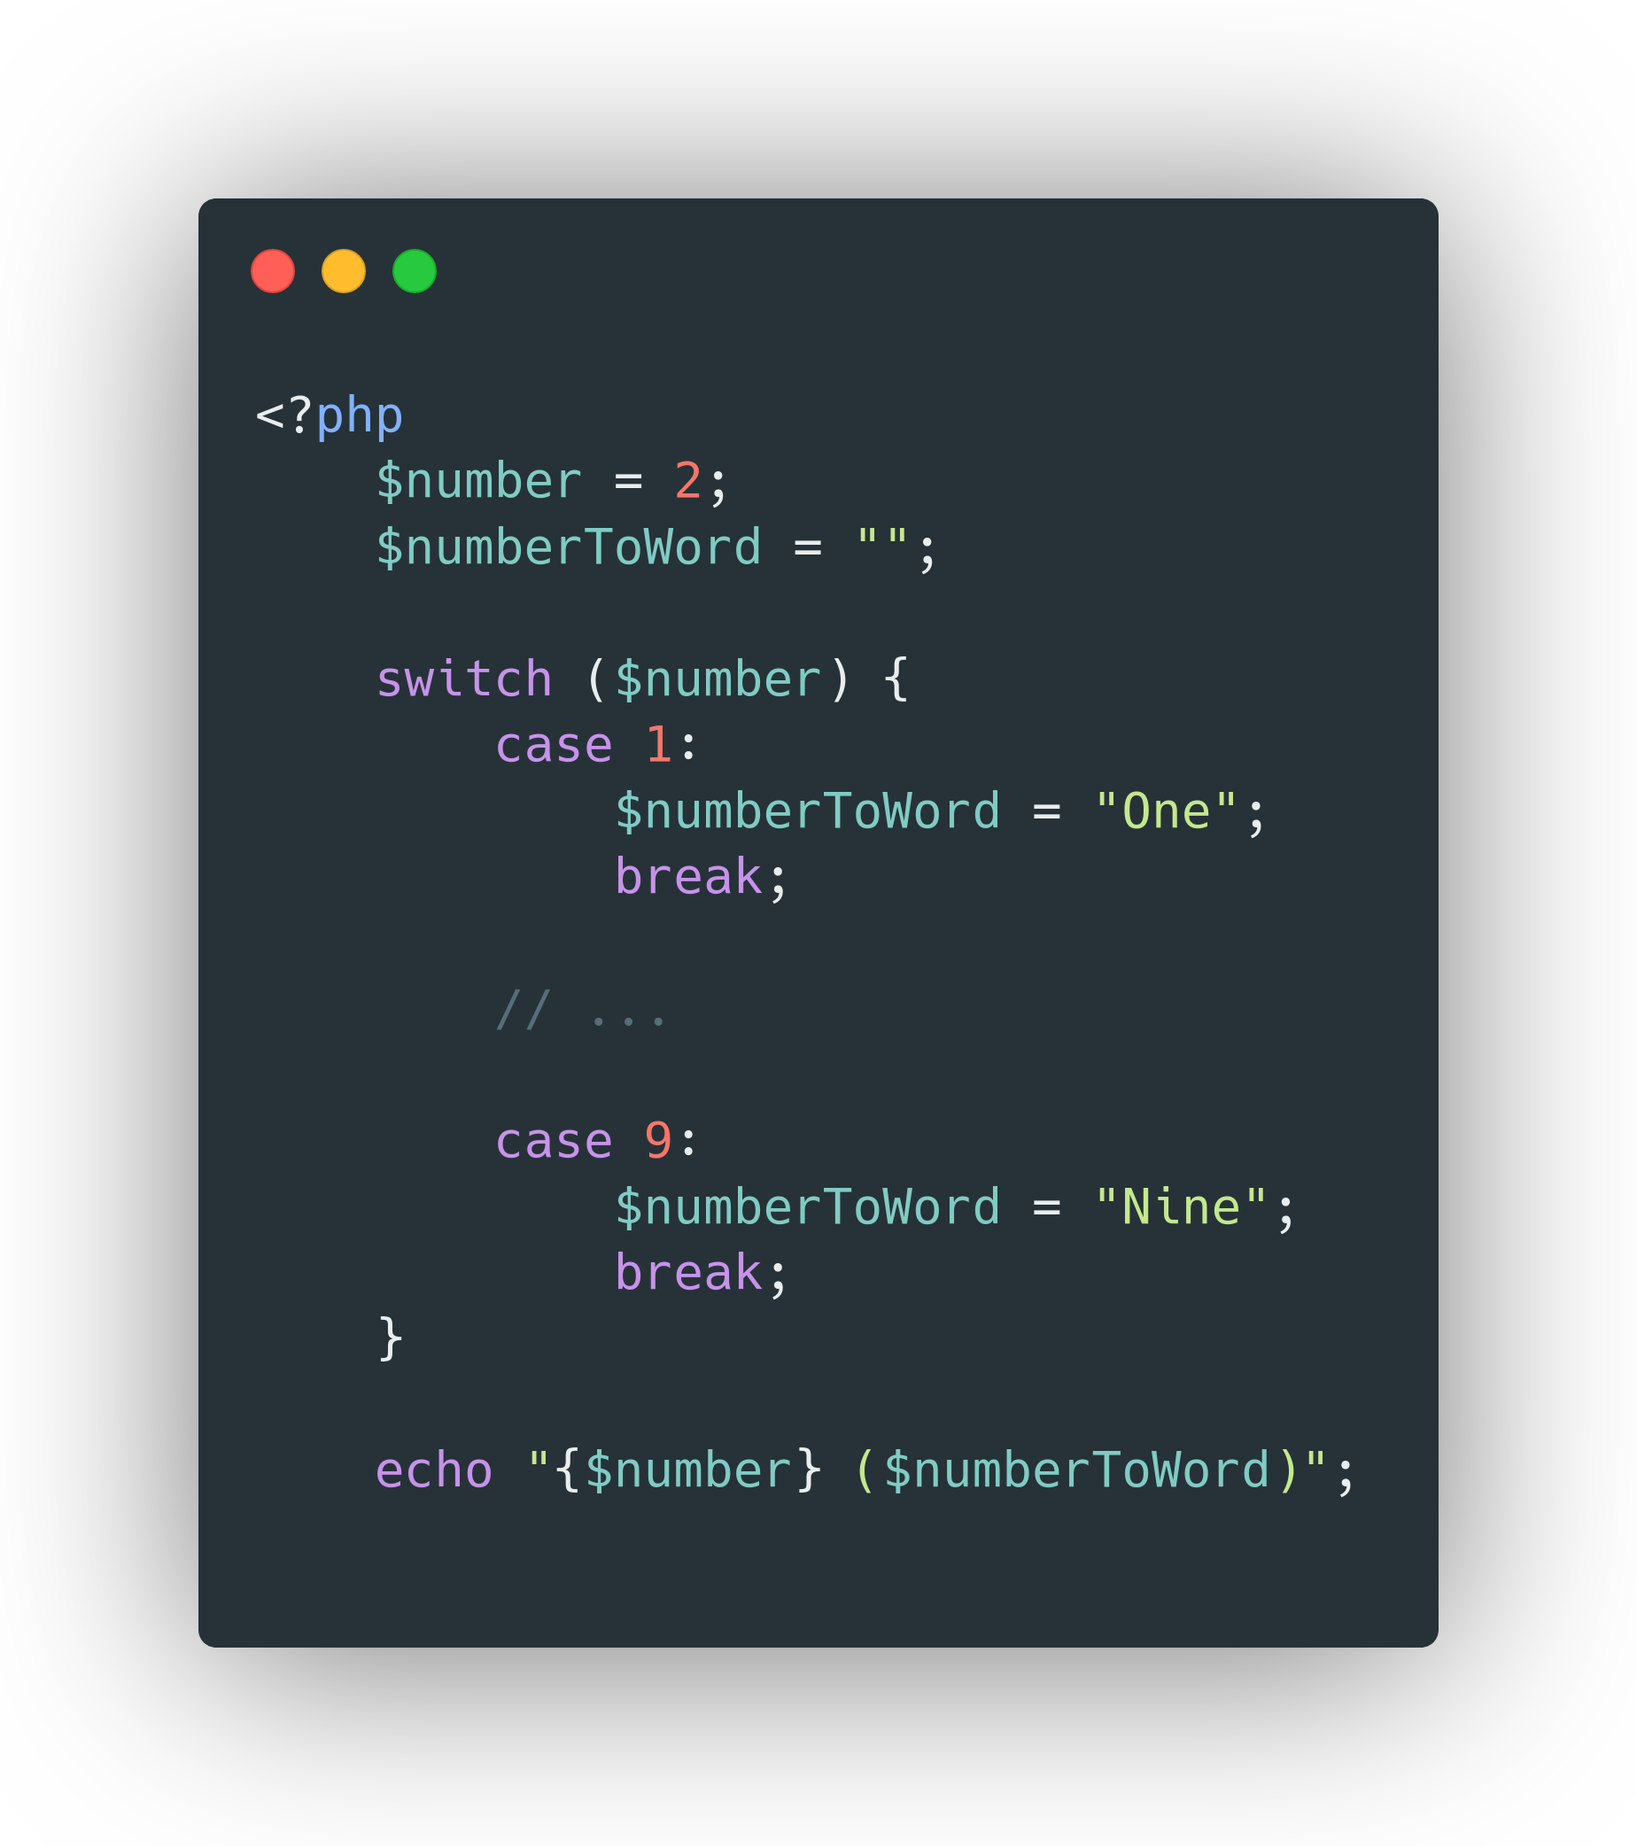
Switch-Case Statement

Slide 7
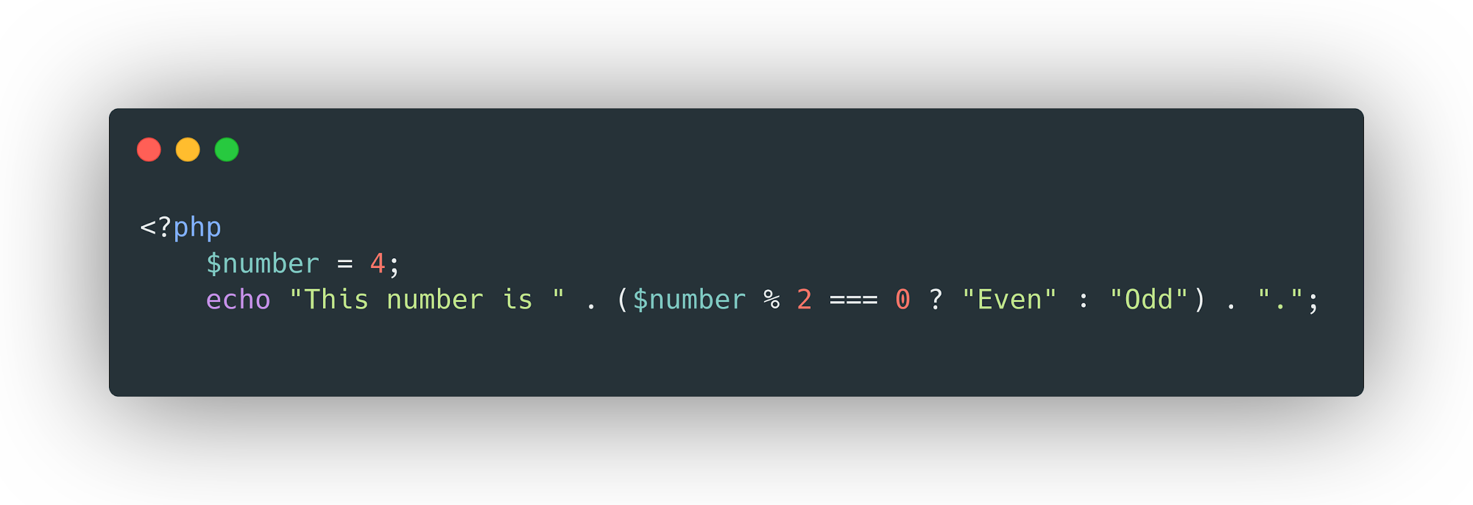
Ternary Operator

Slide 8
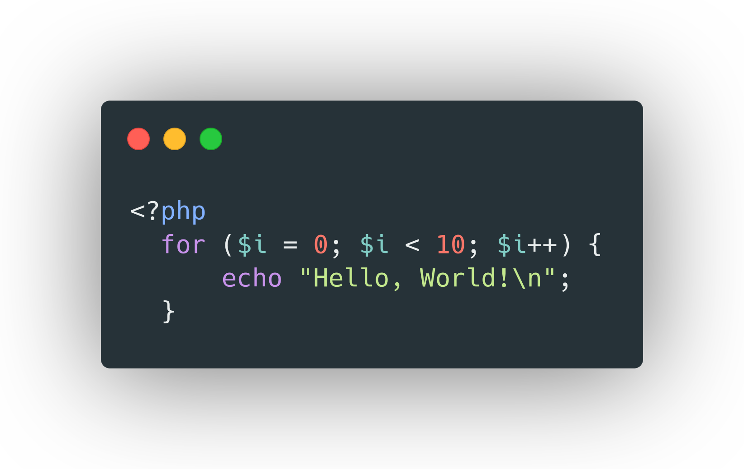
Loops

Slide 9
Loops
While
Do-While
For
Foreach

Slide 10
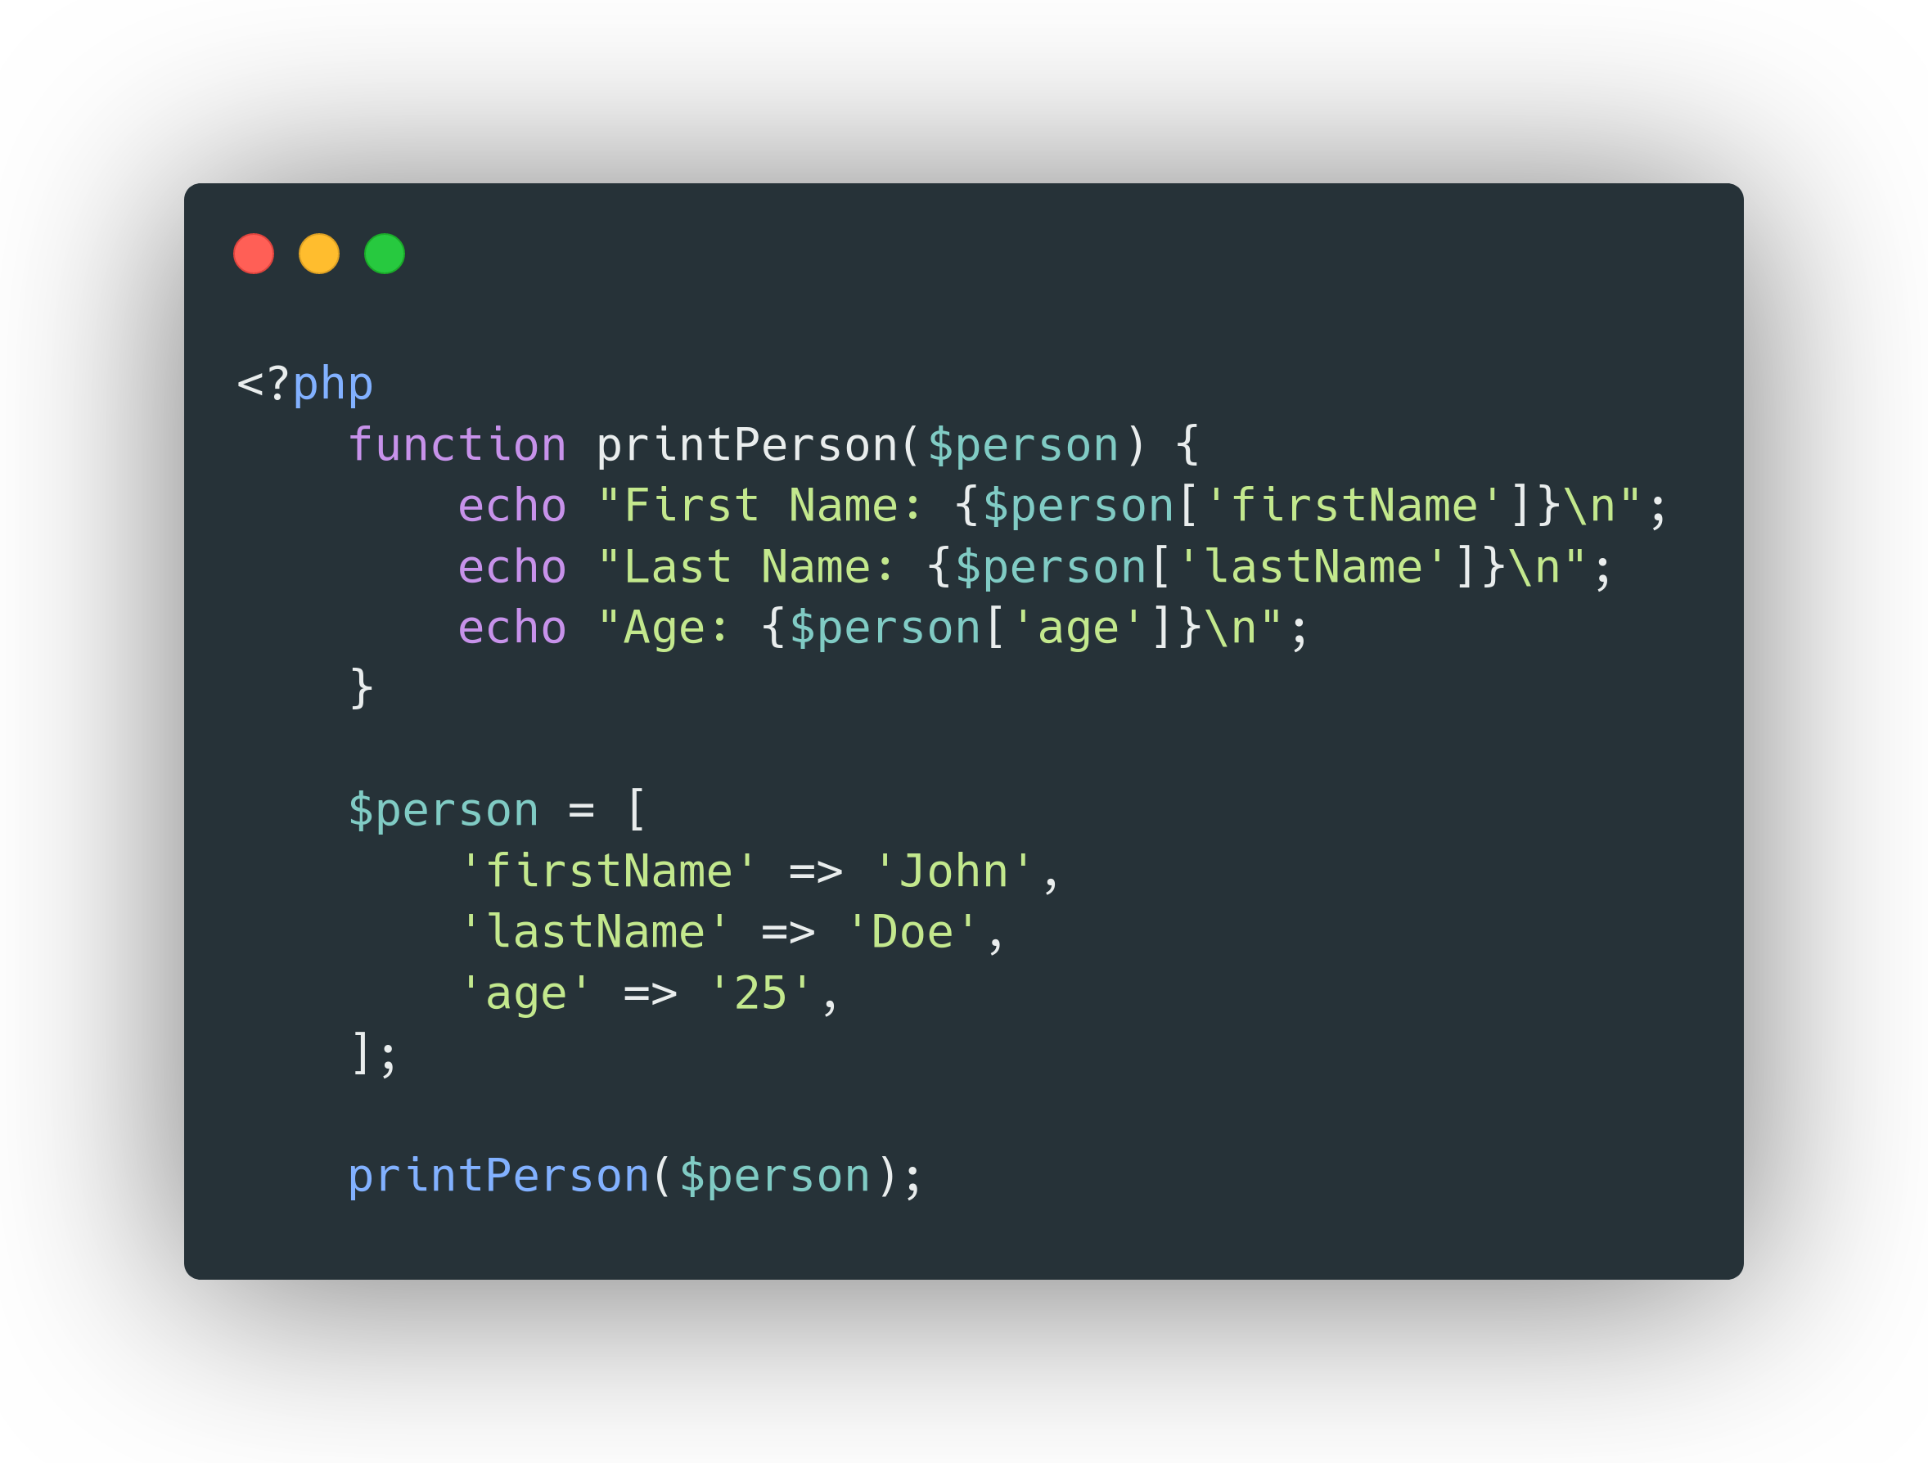
Functions

Slide 11
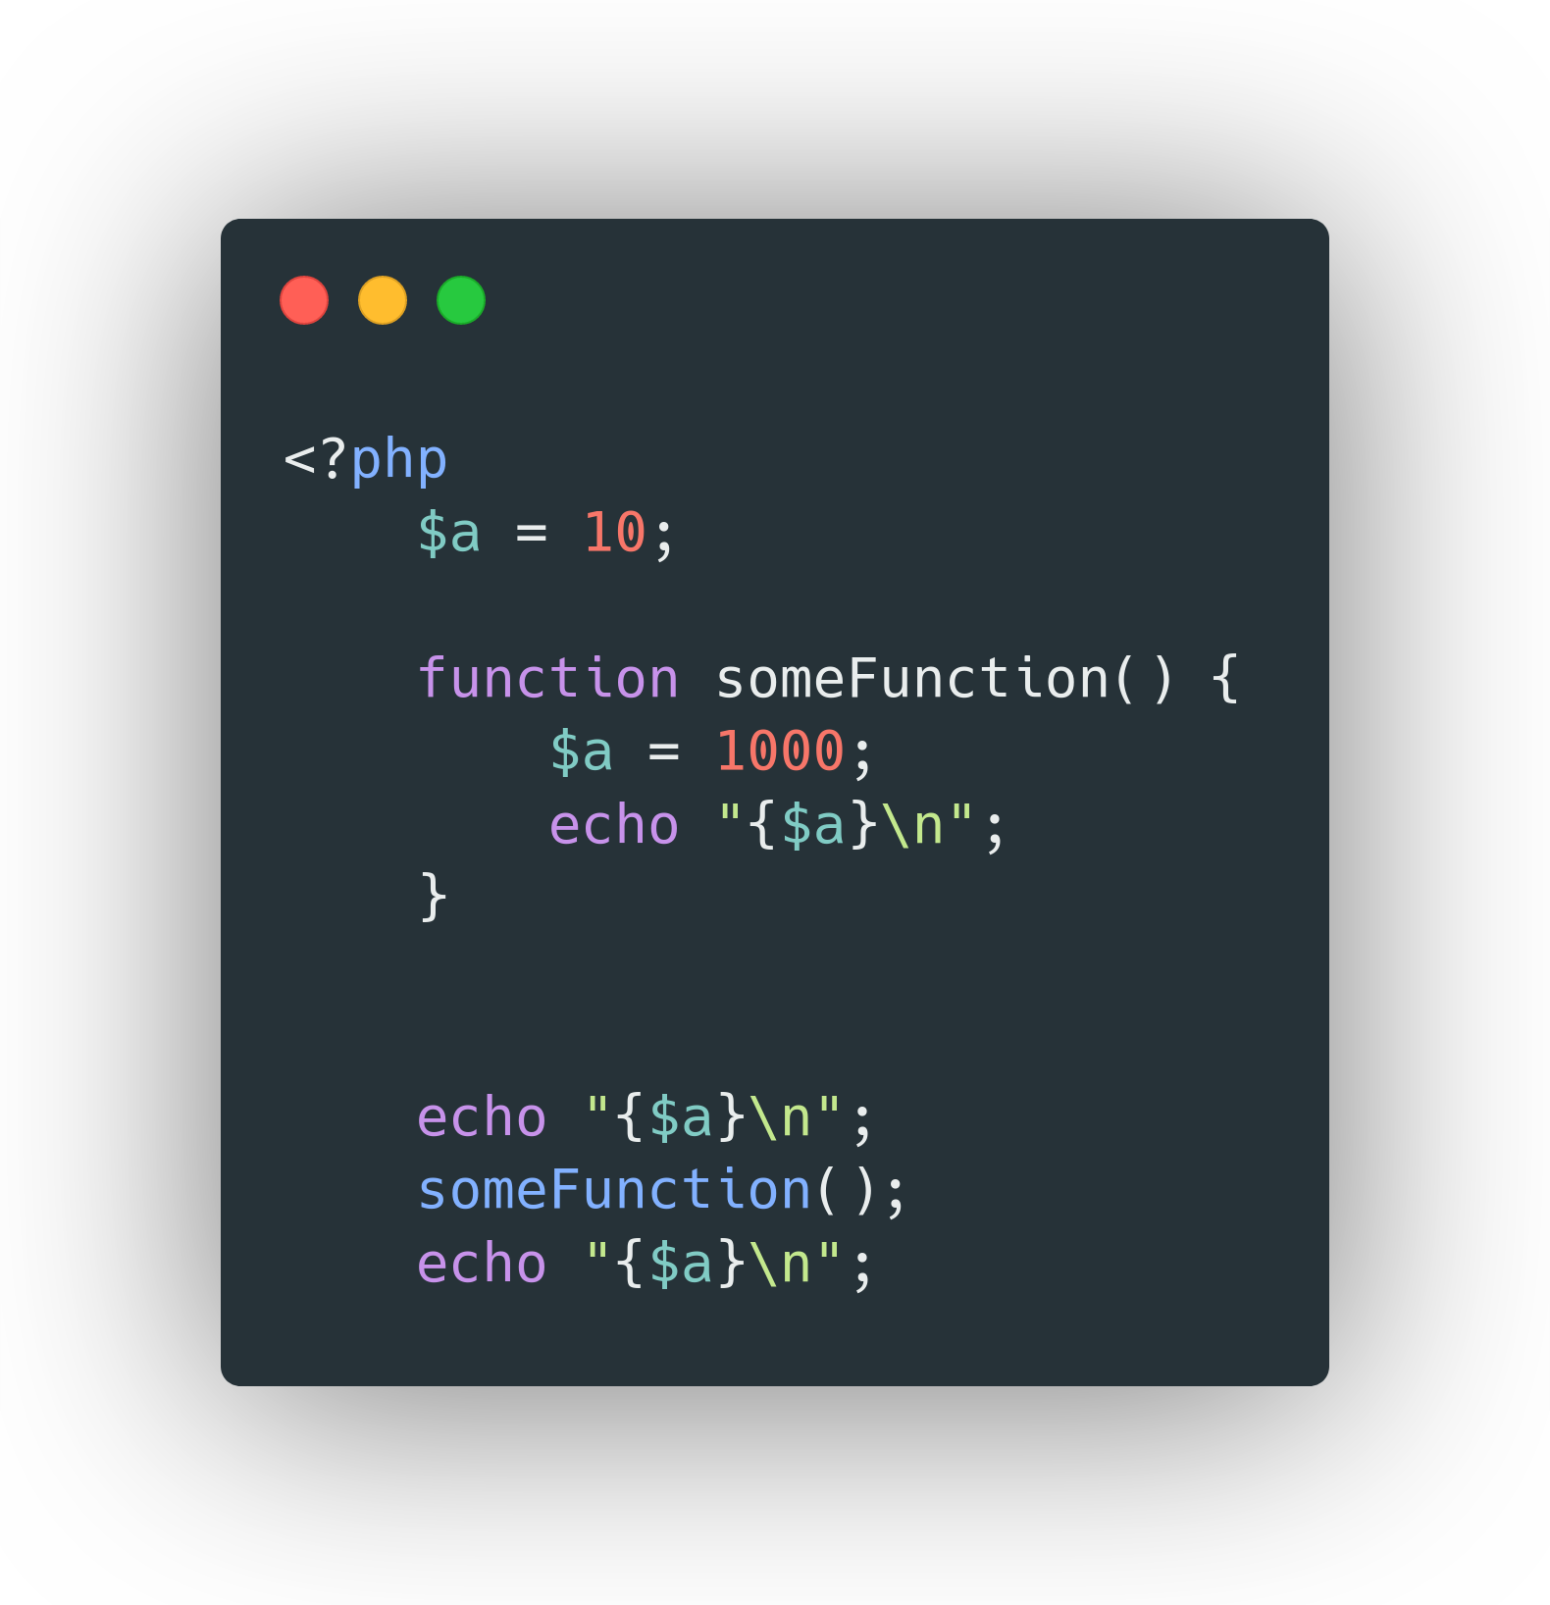
Scopes

Slide 12
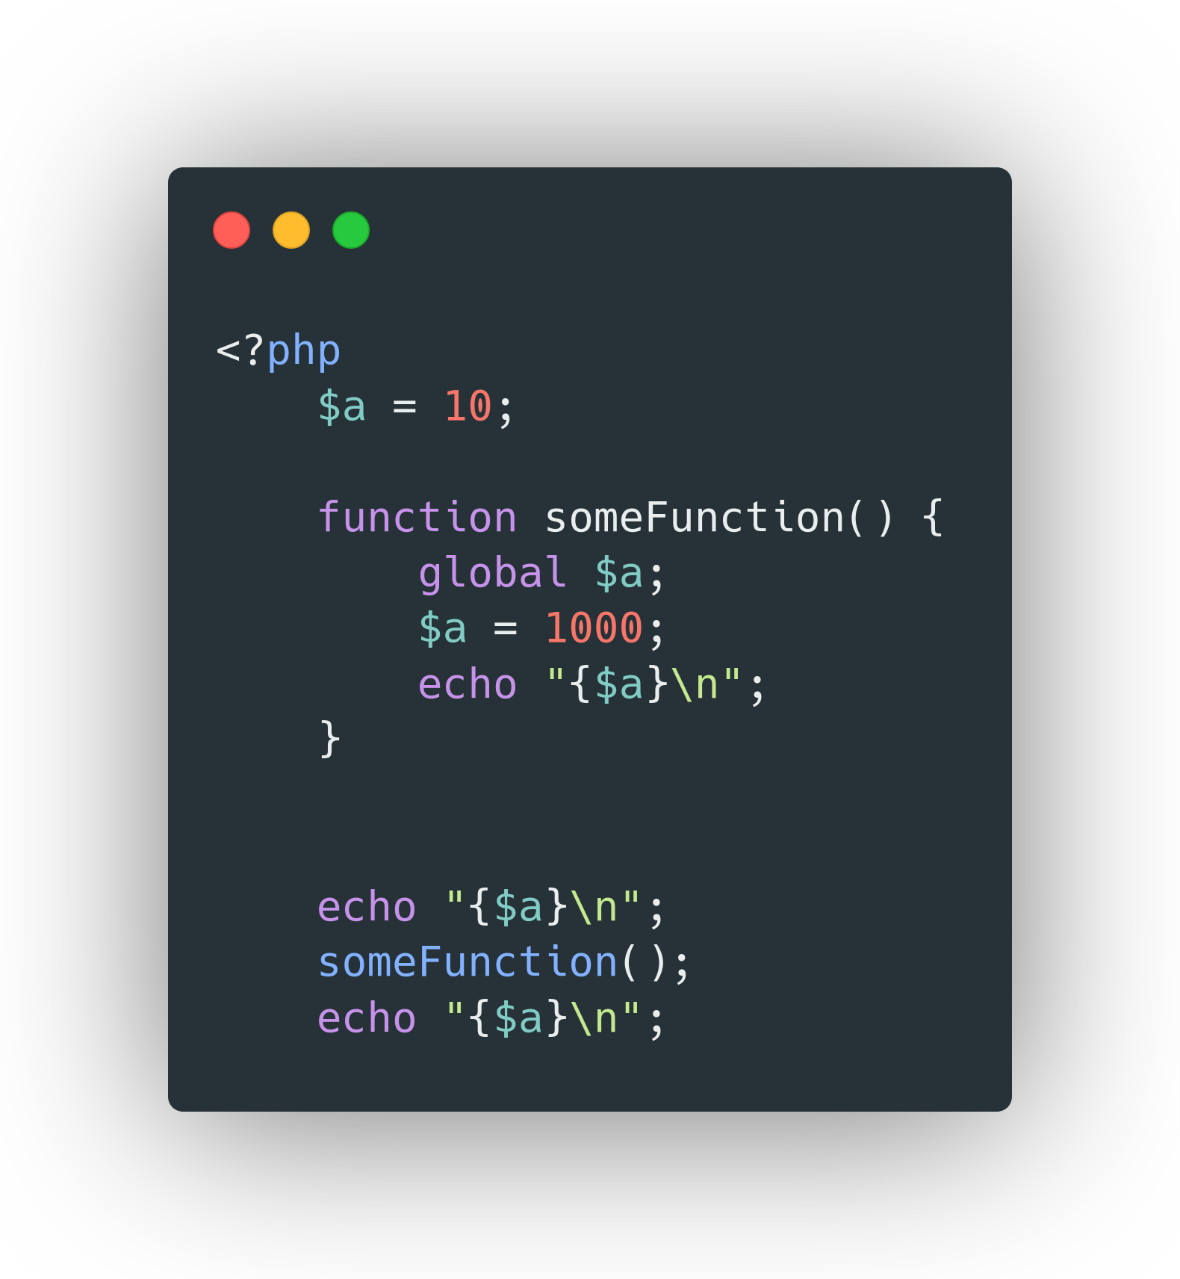
Global Variables

Slide 13
Basic Built in PHP functions
Date & Time Functions
getdate() - Returns date/time information of a timestamp or the current local date/time
date() - Formats a local date and time.
time() - Returns current Unix timestamp;
date_parse() - Returns an associative array with detailed info about a specified date
...
String Manipulation Functions
str_repeat() - Repeats a string a specified number of times
str_replace() - Replaces some characters in a string
strlen() - Returns the length of a string
strpos() - Returns the position of the first occurrence of a string inside another string
strtolower() - Converts a string to lowercase letters
strtoupper() - Converts a string to uppercase letters
substr() - Returns a part of a string
ucfirst() - Converts the first character of a string to uppercase
ucwords() - Converts the first character of each word in a string to uppercase
...

Slide 14
Basic Built in PHP functions
Math Functions
abs() - Returns the absolute (positive) value of a number
max() - Returns the highest value in an array, or the highest value of several specified values
min() - Returns the lowest value in an array, or the highest value of several specified values
pi() - Returns the value of PI
pow() - Returns x raised to the power of y
rand() - Generates a random integer
...

