Slide 1

PHP Course
Lecture 5
Temuri Takalandze
@ABGEO

Slide 2
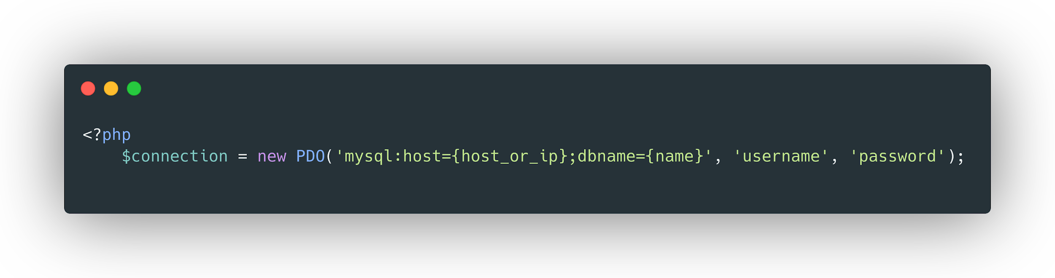
Connect to MySQL Database

Slide 3
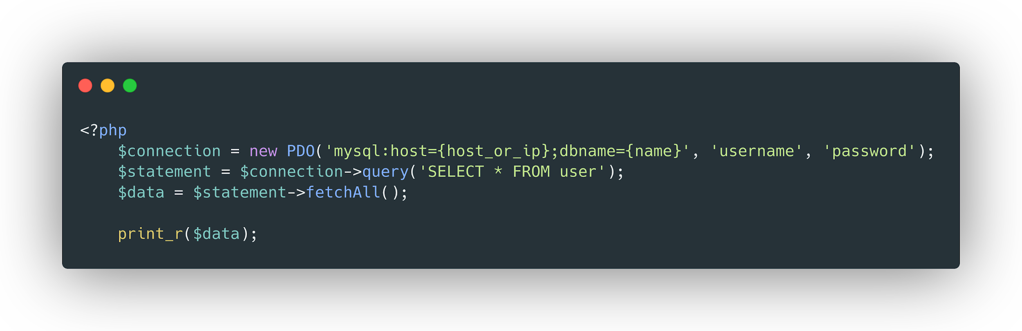
Select data from Database

Slide 4
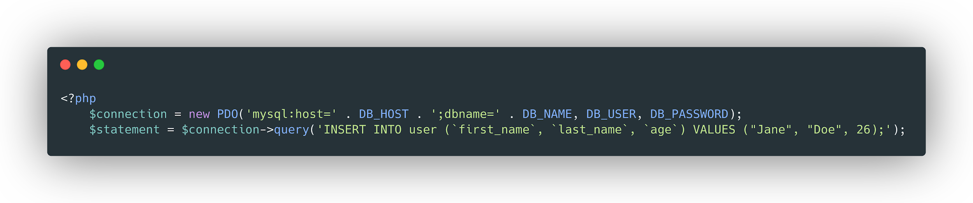
Insert data into Database

Slide 5
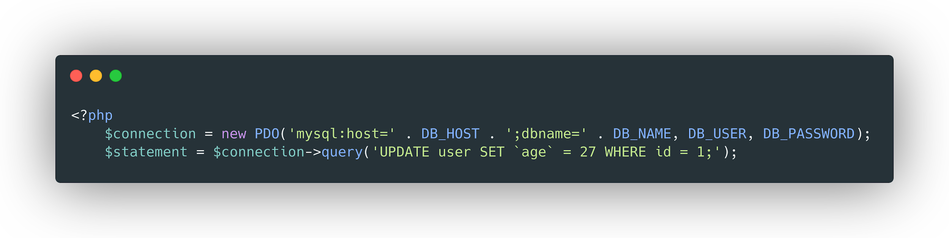
Update data in Database

Slide 6
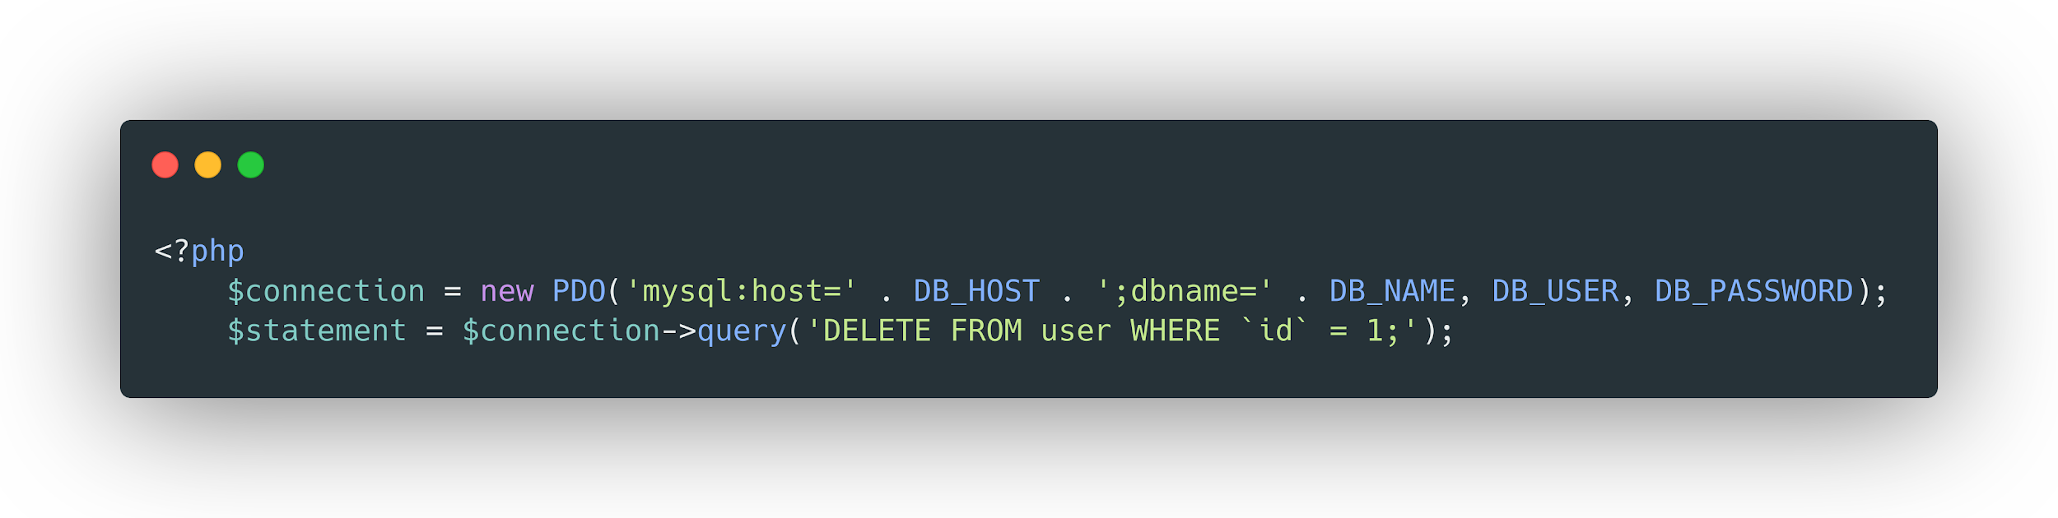
Remove data from Database

Slide 7
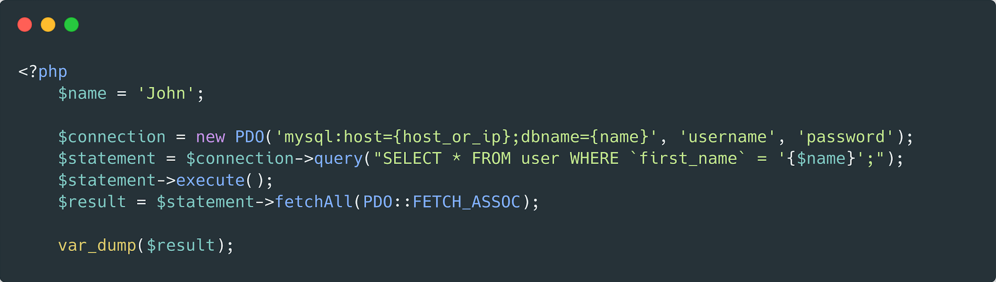
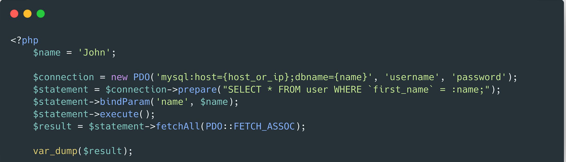
SQL Injection protection

