Slide 1

PHP Course
Lecture 1
Temuri Takalandze
@ABGEO

Slide 2

Introduction
Rasmus Lerdorf

Slide 3
Release history
Version | Release date | Supported until
1.0 | 8 June 1995
...
5.6 | 28 August 2014 | 31 December 2018
6.x | Not released
7.0 | 3 December 2015 | 3 December 2018
...
7.4 | 28 November 2019 | 28 November 2022
8.0 | December 2020 | December 2023

Slide 4
Basic Structure and Syntax
<?php
// PHP code goes here
?>
;
$
*.php

Slide 5
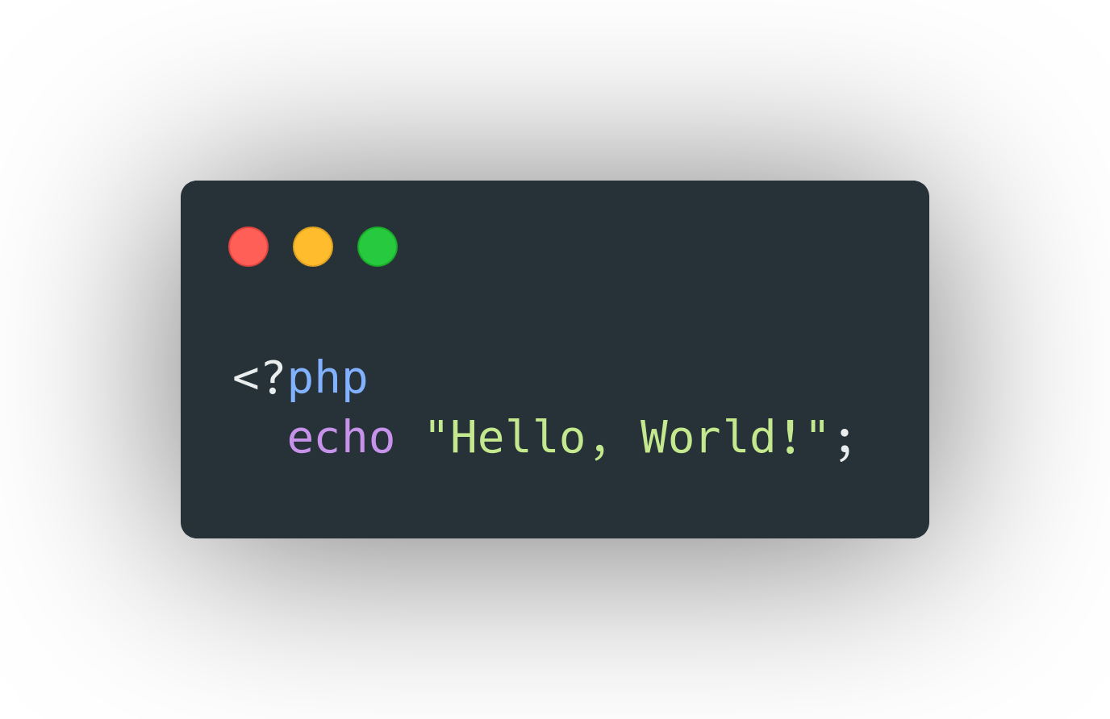
Hello World

Slide 6
Comments in PHP
// This is a one-line c++ style comment
# This is a one-line shell-style comment
/* This is a multi line comment
yet another line of comment */

Slide 7
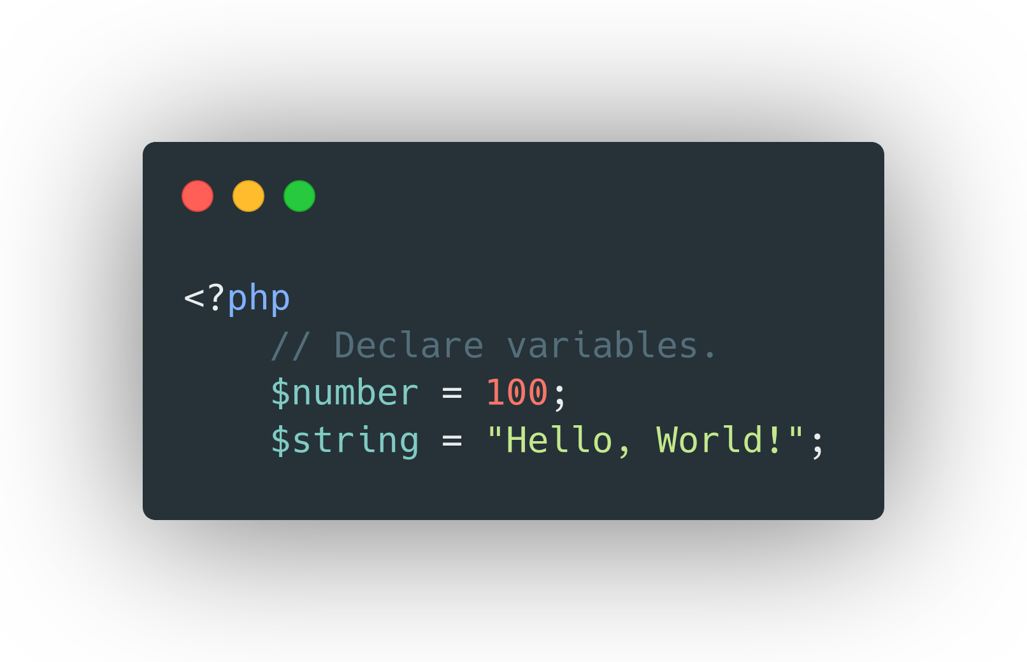
Variables

Slide 8
Data Types
Type | Value | Example
String | A sequence of characters | $a = “Hello, World!”;
Integer | The number between -2³¹ and 2³¹ | $a = -100; $b = 500;
Float | A number with a decimal point or a number in exponential form. | $a = -1.52; $b = 2.3;
Boolean | TRUE or FALSE | $a = true; $b = false;
Array | An array stores multiple values in one single variable. | $a = [];
Object

Slide 9
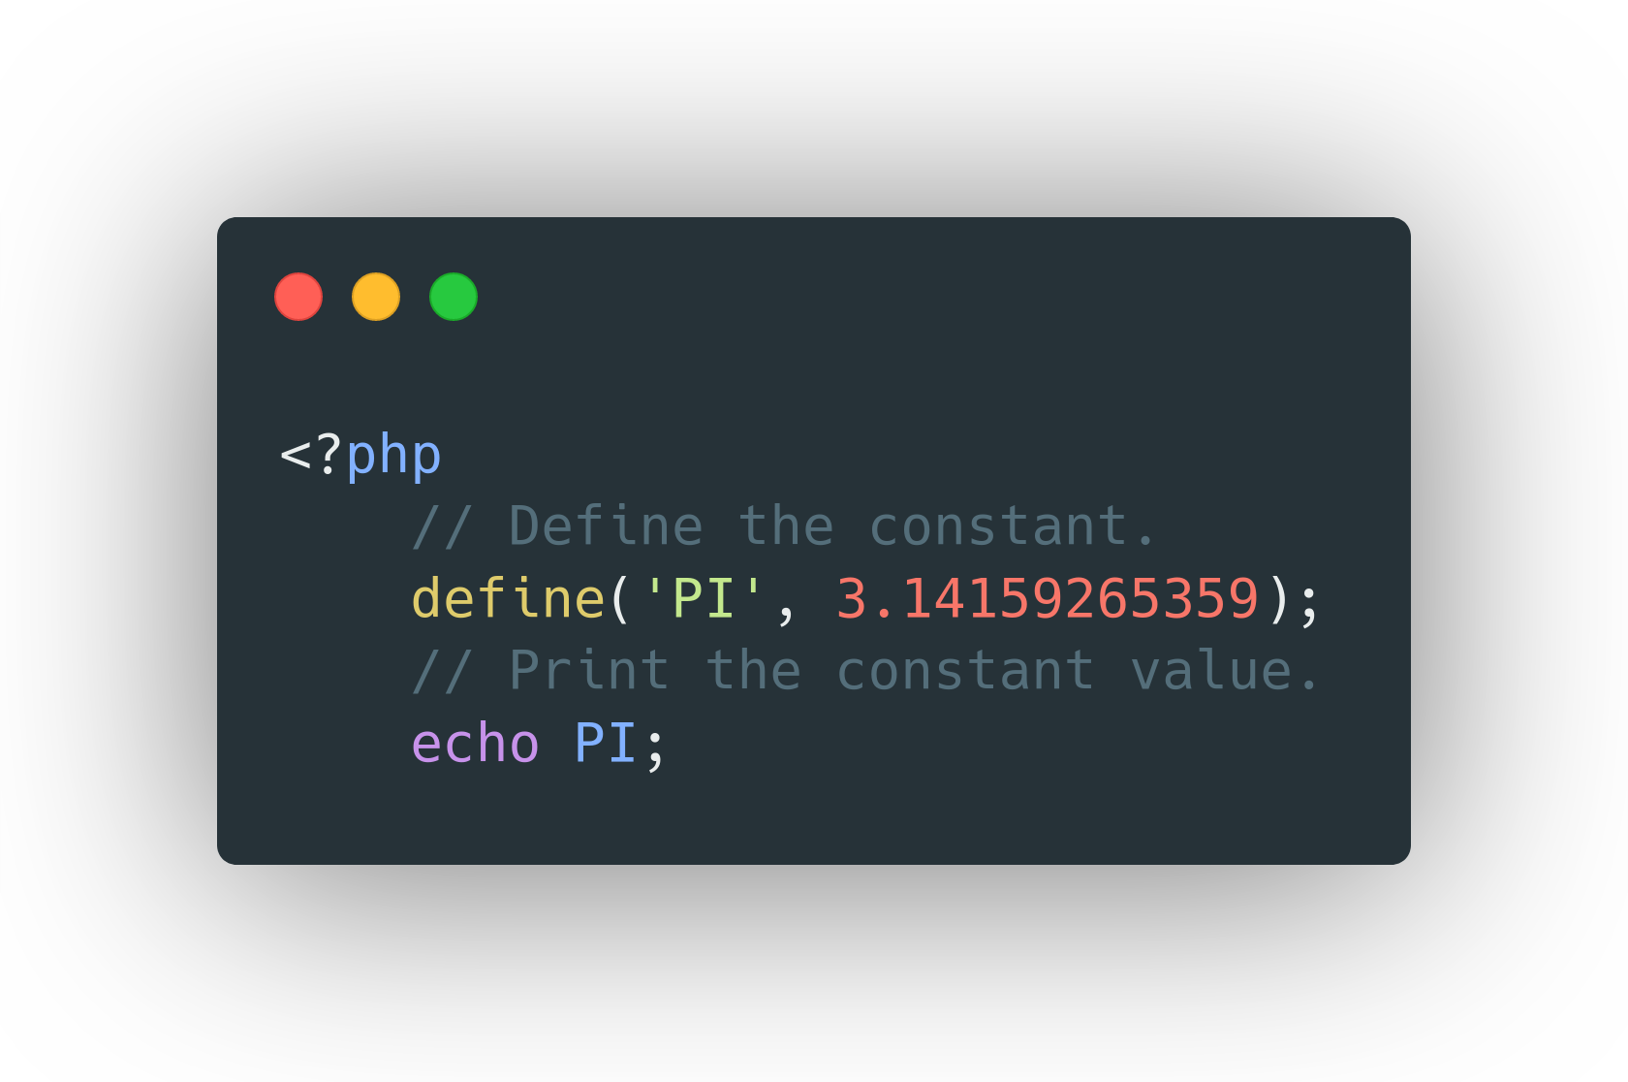
Constants
A mathematical constant is a number whose value is fixed by an unambiguous definition, often referred to by a symbol or by mathematicians' names to facilitate using it across multiple mathematical problems.
- Wikipedia

Slide 10
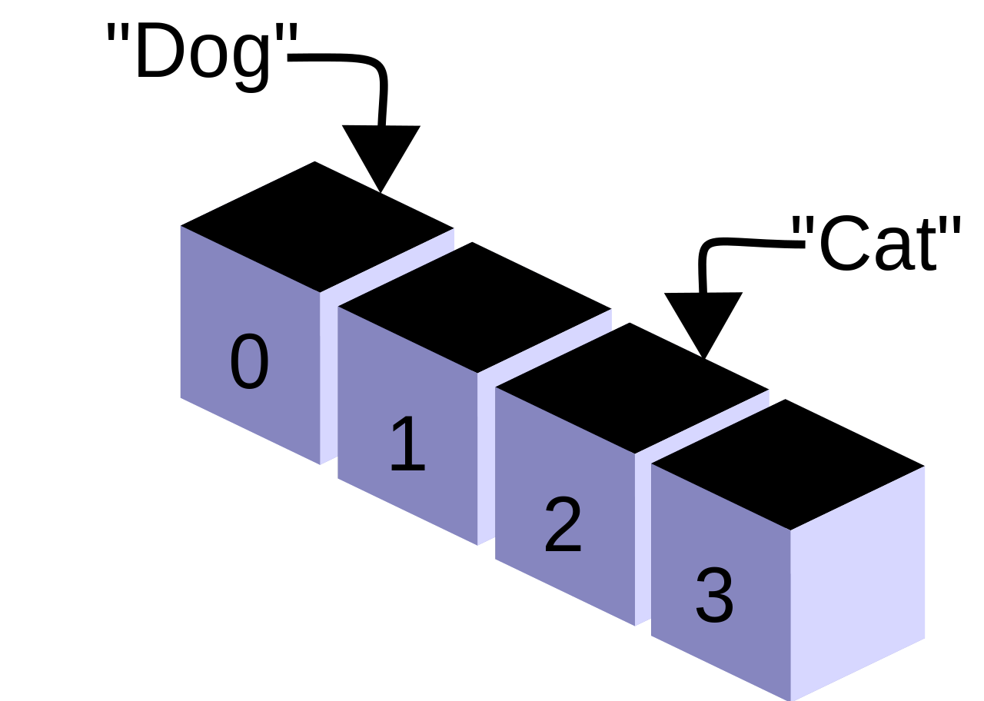
Arrays

Slide 11
Arrays
Numeric Arrays
Associative Arrays
Multidimensional Arrays

Slide 12
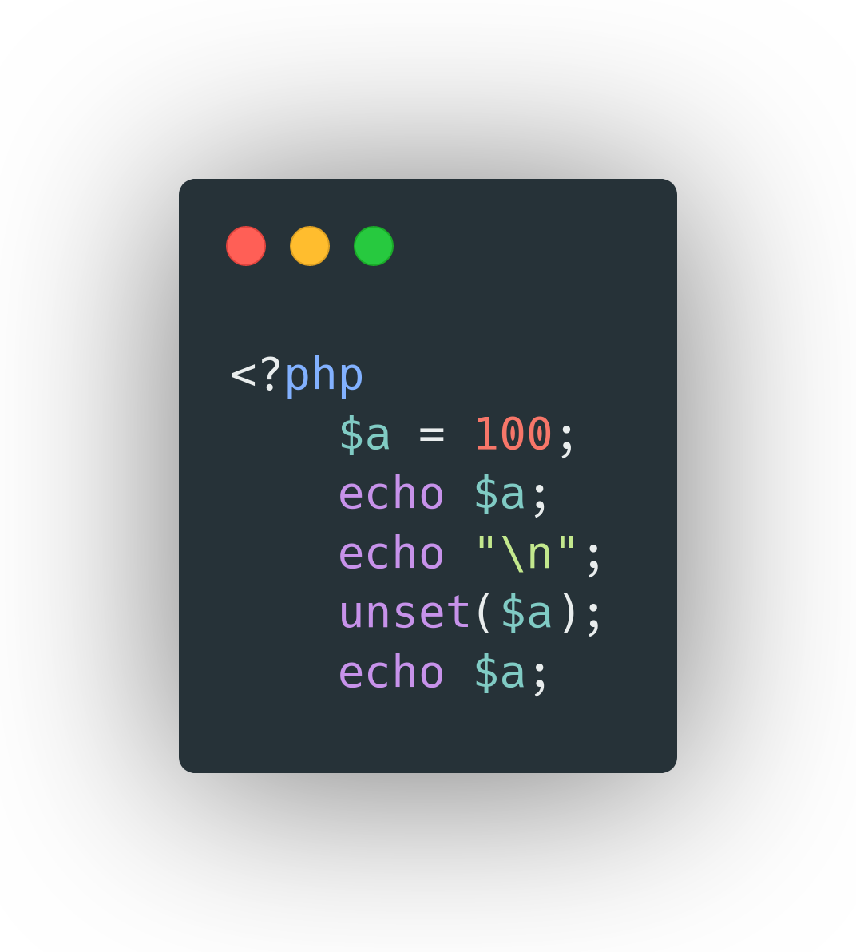
Unset

Slide 13
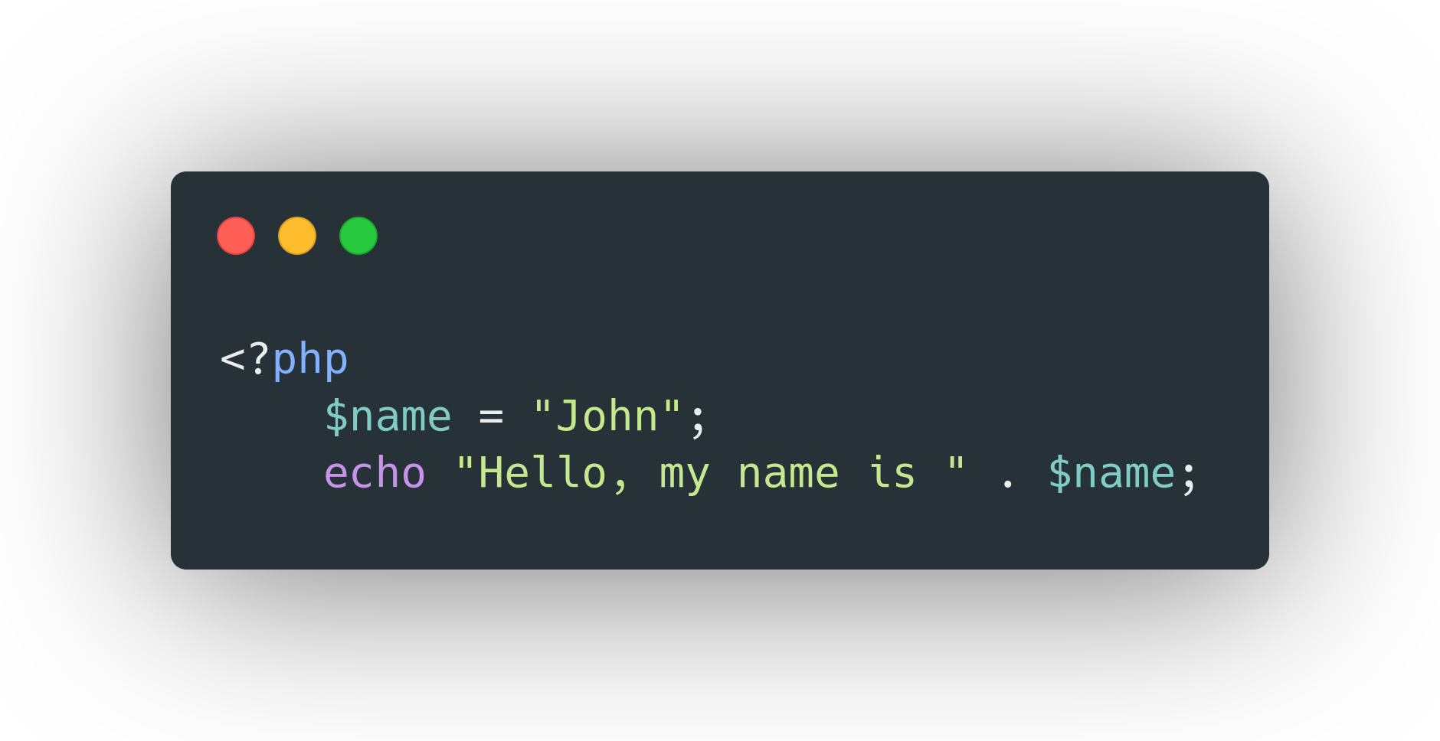
String Concatenation

Slide 14
Type checking functions
is_bool - to find out whether a variable is a boolean;
is_int - to find out whether a variable is an integer;
is_float - to find out whether a variable is a float;
is_null - to find out whether a variable is null;
is_string - to find out whether a variable is a string;

