Slide 1

PHP Course
Lecture 3
Temuri Takalandze
@ABGEO

Slide 2
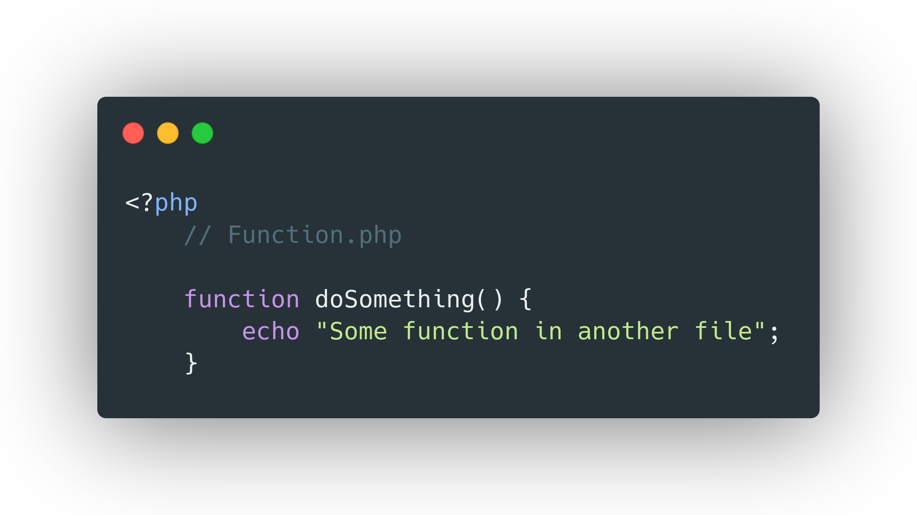
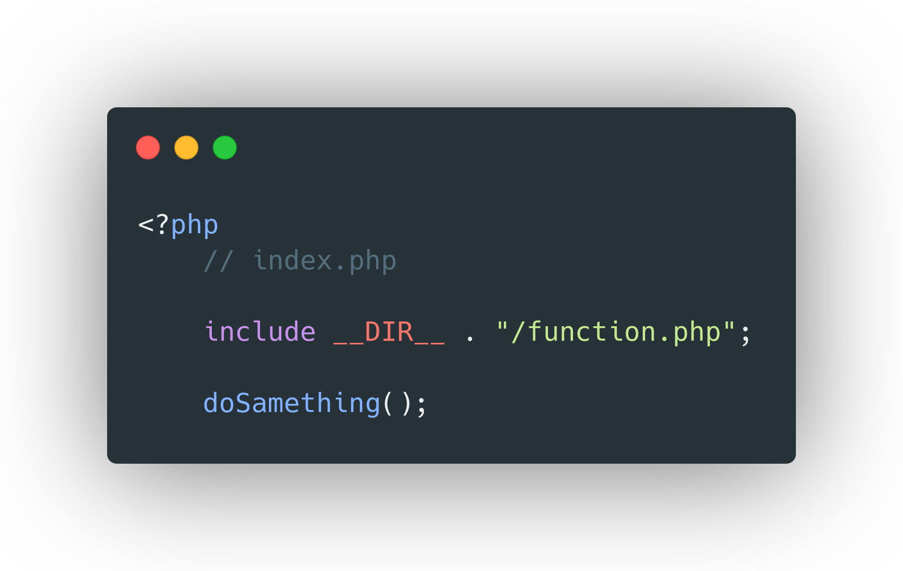
File Inclusion

Slide 3
File Inclusion
include()
require()
include_once()
require_once()

Slide 4
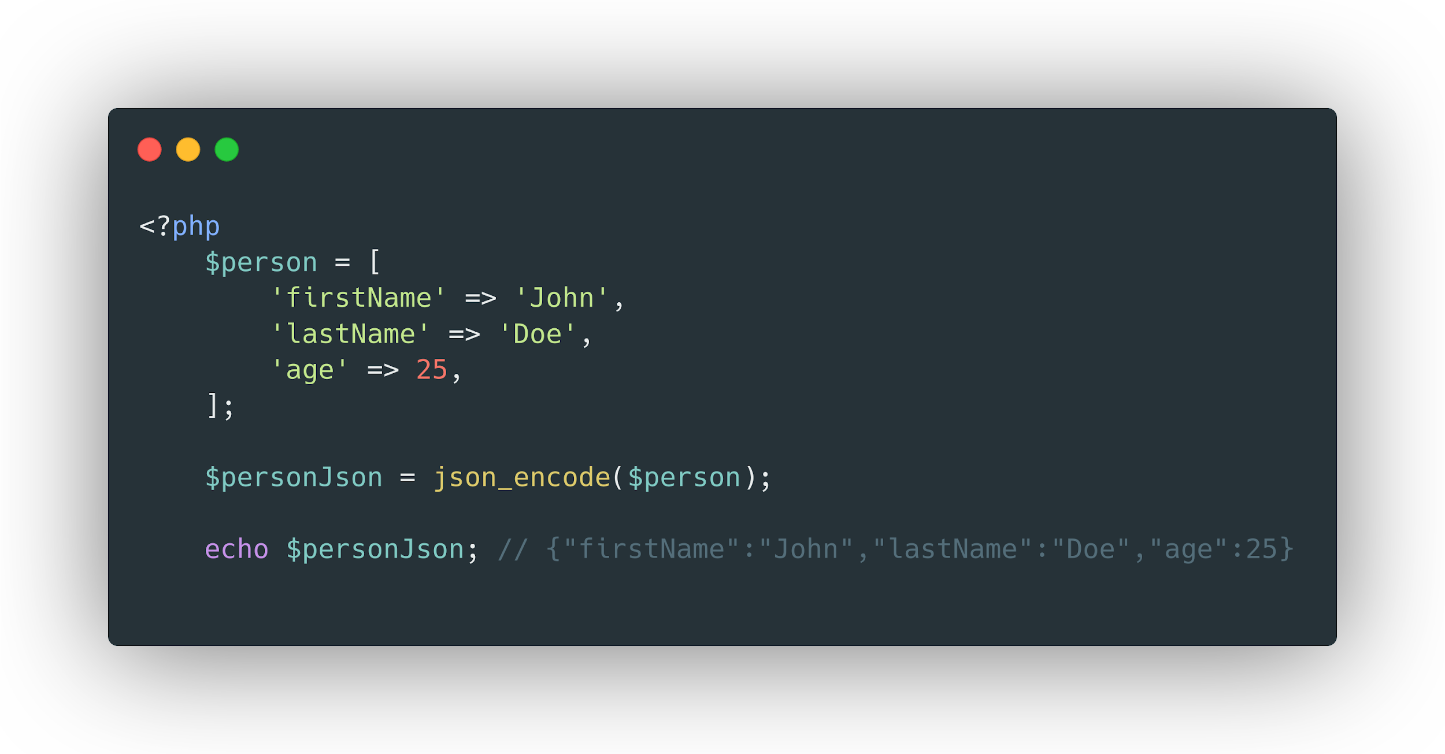
JSON Encode

Slide 5
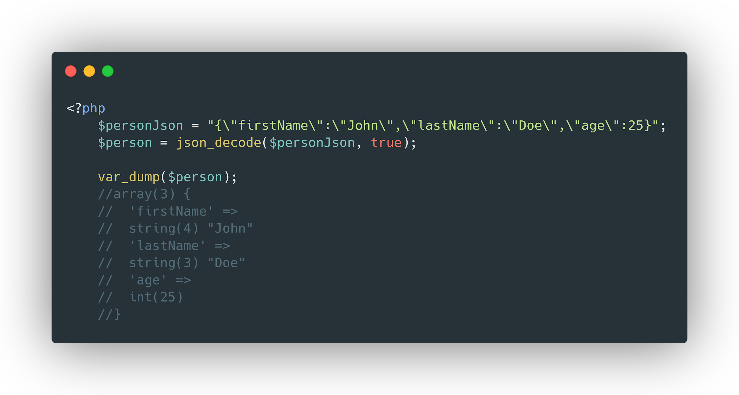
JSON Decode

Slide 6
Object Oriented Programming (OOP)

Slide 7
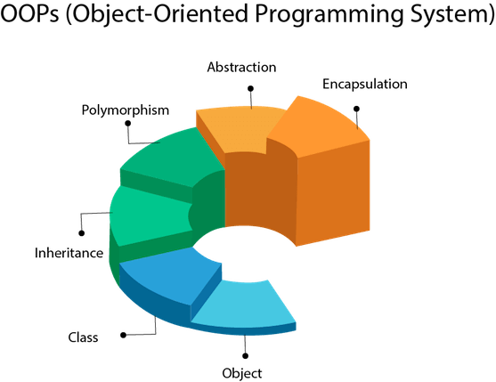
What is Object Oriented Programming?

Slide 8
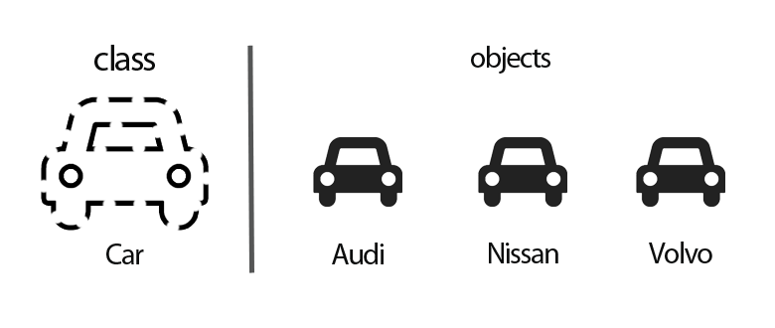
Classes and Objects

Slide 9
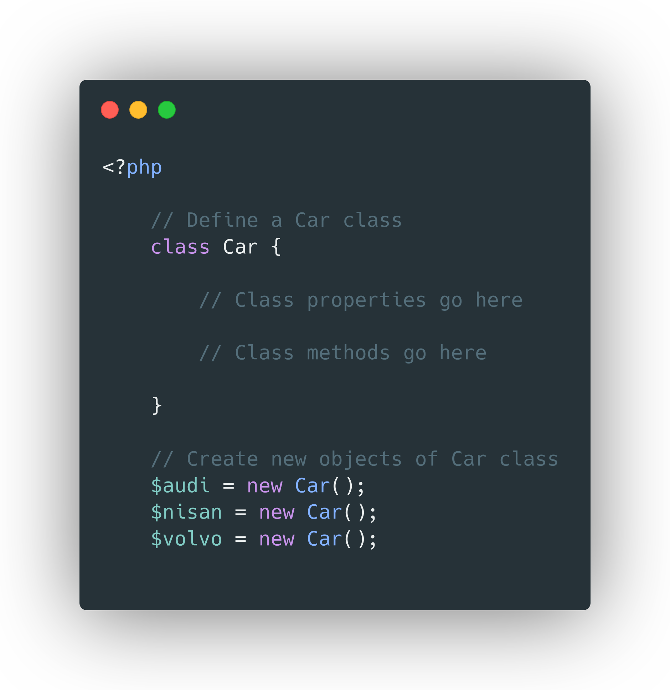
Classes and Objects

Slide 10
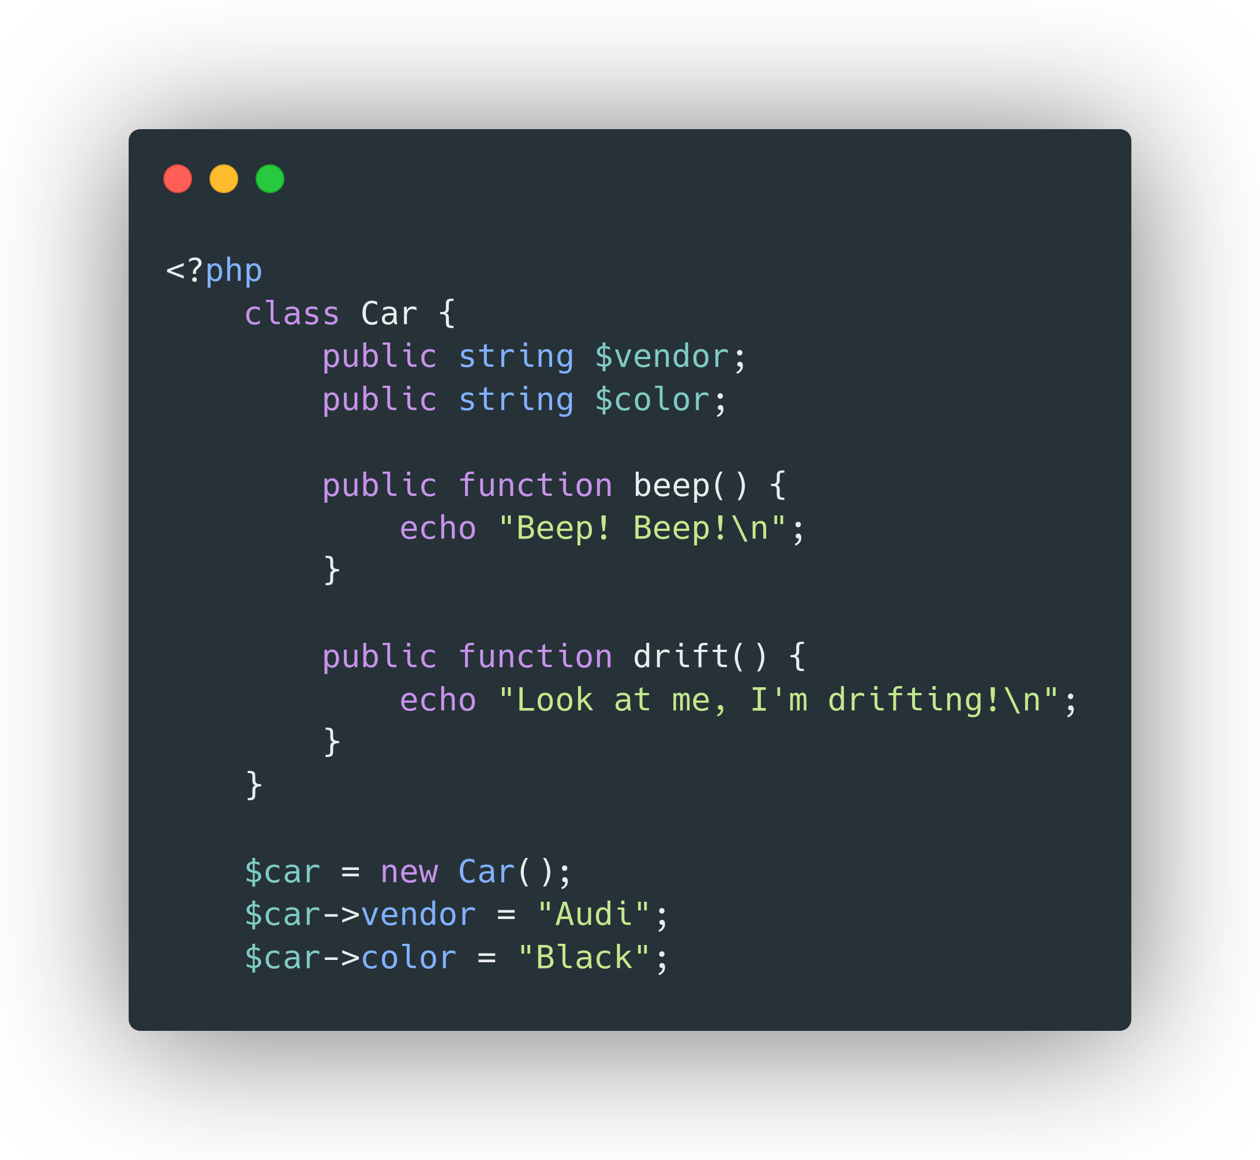
Class Fields and Methods

Slide 11

Access Modifiers

Slide 12
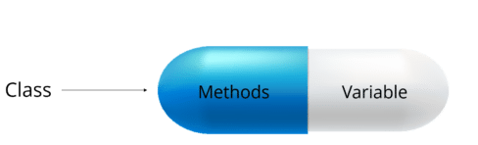
Encapsulation

Slide 13
Inheritance

Slide 14
Polymorphism
beep()
beep()
beep()

Slide 15


Interfaces
move();

