Slide 1

WASTE FOOD DONATION MANAGEMENT SYSTEM
Made By:
Abhang Karode.

Slide 2
Contents:
Introduction
Problem Statements
Objectives
Work Flow
Implementation
Benefits
Conclusion

Slide 3
Introduction:
Waste Food Donation Management System Project is a mission to end hunger and no wasting of food to make a hungry-free world.
Using a Python , we streamline the donation process, making it easy for donors to list food and matching them with nearby recipients efficiently.
The focus of this project is to reduce the amount leftover food being used to the needy people

Slide 4
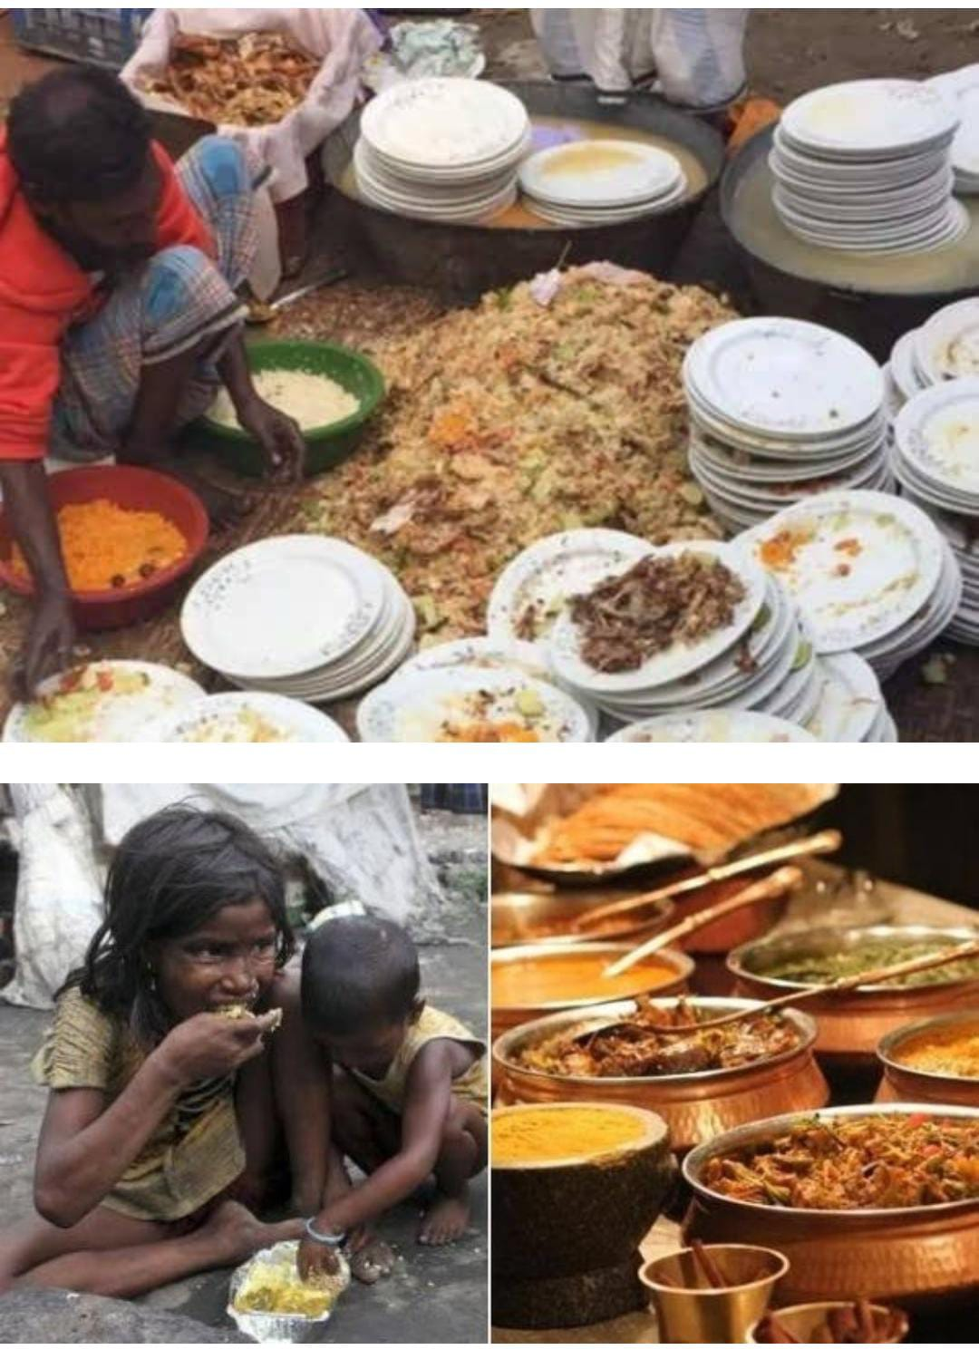
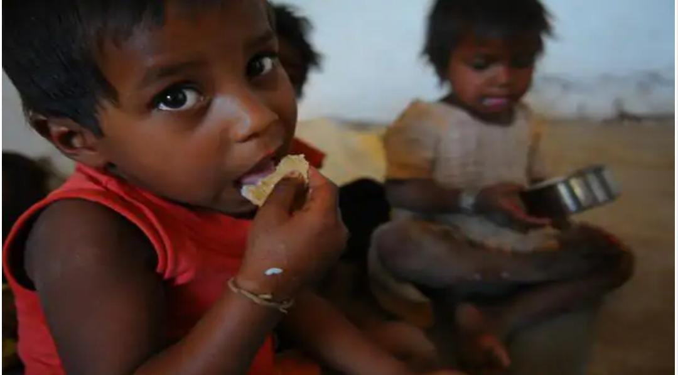
DID YOU KNOW HOW MUCH FOOD IS WASTED IN INDIA ?

Slide 5
68.7 Million Tonnes per year in INDIA.

Slide 6
Problem Statements:
Challenge
India wastes 30-40% of food, translating to massive economic losses & environmental damage.
Millions suffer hunger while food goes to waste due to:
Lack of donor awareness & recipient access.
Concerns about food quality & donation reliability.
Our Python-powered solution: Bridge the gap, connect donors & recipients, reduce food waste, and fight hunger.

Slide 7
Objectives:
Enable easy interaction between donor and volunteer.
Easy and fastest record of Donar finding technique.
It is very easy to use.

Slide 8
Work Flow:
Reg
Donor
Receiver
Name Contact Details and Address
Details of Donor
Pickup location
Accept
Food Items:
Received
Cancel

Slide 9
Implementation
Main File : Displaying the main menu options based on the user's choice, calling the corresponding methods from the other modules.
Registration Module : Implementing a class or function to handle new user registrations. Prompting the user to input their details such as name, email, and password.
Donar Login Module : Implementing a class to handle donor login functionality. Allowing donors to make donations by Inputting their contact details, address, pickup location, and food items. Providing feedback to the donor after making a donation, and prompt them if they want to cancel the donation if it's not picked up Receiver
Login Module : Implementing a class or function to handle receiver login functionality. Allowing receivers to view available donations and choose to accept or decline them.

Slide 10
Step 1: User can register using personal details.
Step2: User can login in his personal account using id and password.
Step 3: Create a new food Item with details of quantity, location, address contact,
Step 4: Add multiple food items to cart for Donating.
Step 5: Donar can wait or cancel the Donation after receiver not able to receive the donation.
Donor Side

Slide 11
Receiver side
Step 1: User can register using personal details.
Step 2: User can login in his personal account using id and
password. Step 3: List of donar Available Today
Step 4: After accepting the request from donor side
Step 5:After accepting the food volunteer .
Step 6: Volunteer can logout the system.

Slide 12
Benefits
Reduced food wastage.
Positive environmental impact.
Strength community bonds.

Slide 13
Conclusion
The Waste Food Donation System is a beginner-friendly Python project designed to address the critical issue of food waste by creating a simple, effective platform for connecting food donors with those in need.

Slide 14
Thank you

