Slide 1



Student Admission Management System

Slide 2
Name : Solanki Abhay Hakmabhai Branch : IT Enrollment No. :- 23002170210122 Div : C5 Roll No. : 154
Prepare By :-

Slide 3
Content :-
Introduction
Functionalities
Technologies Used
Merits & De-merits
Future scope

Slide 4

Introduction :-
A Student Admission Management System Is A Python Based Project Which Can Manage The Student By It's Past Percentage And Enroll It To Branch According To Their Percentage.

Slide 5
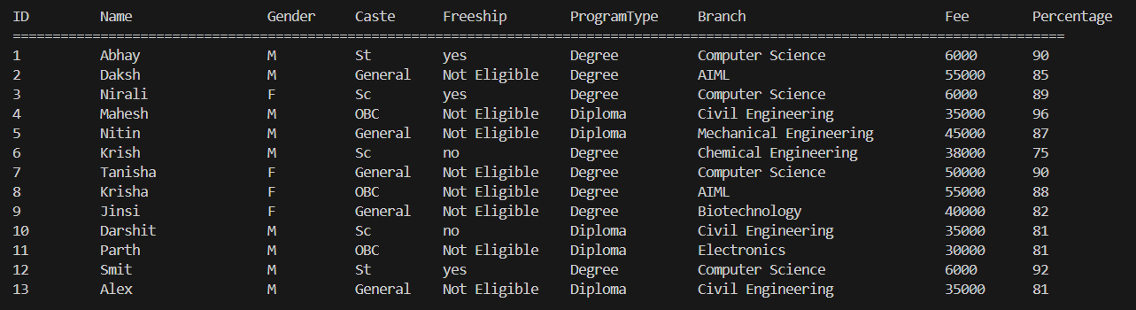
Functionalities :-
Admin Authentication
Student Data Management
Different Branch Selection
Validations
Data Store

Slide 6

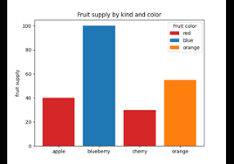


Technologies Used :-
Python
Matplotlib
Library
Array
Dictionary
ETC :
File Handling
Exception handling
For Storing Data
For Graphical Representation

Slide 7
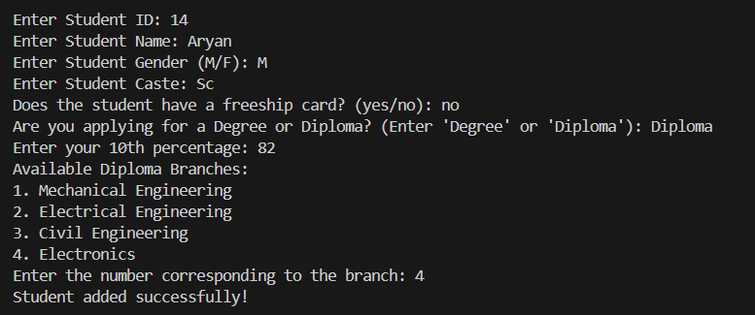
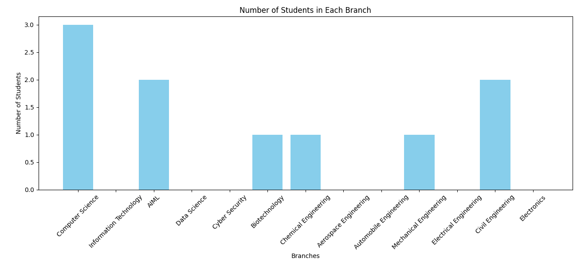
Merits :-
Automated Eligibility Checking – Validates student marks
against the required minimum criteria for different branches.
Admin Authentication – Ensures secure access to student records through admin login credentials.
Dynamic Data Updates – Enables easy student record modification and updates.
Interactive Console Interface – Provides step-by-step guidance for student admission.
Graphical Data Representation – Displays student distribution across branches using graphs.

Slide 8
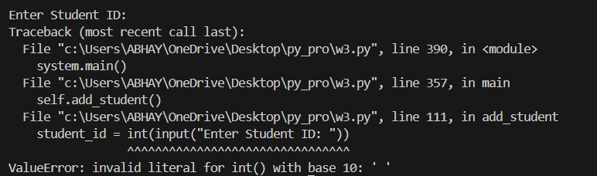
Demerits :-
Limited Scalability – Uses JSON files for storage, which is not ideal for handling a large number of students.
No Multi-User Support – Only one admin can log in and manage the system at a time.
Manual Data Entry – Requires manual
input, which may lead to human errors.
Lack of Real-Time Updates – Does not support live updates or concurrent modifications.

Slide 9



Future Scope :-
Enhanced Security Features – Implementing multi-factor authentication and encryption for better data protection.
Cloud-Based Data Storage – Storing student records on the cloud for real-time access and scalability.
Mobile Application Support – Developing a mobile app for students to apply, check admission status, and receive notifications.

Slide 10
Thank You

