Slide 1
Task-2
Report
Critical Vulnerability in webappsecurity.com

Slide 2
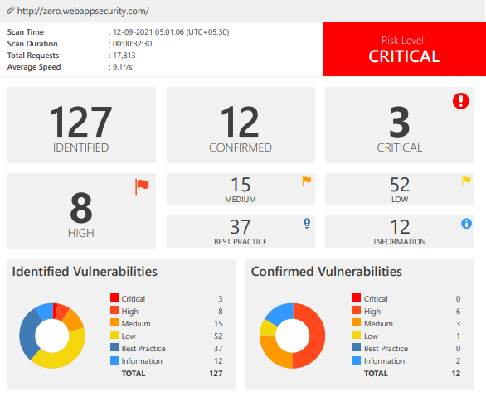
Automatic Scan Report:
Report pdf in git repo.

Slide 3
Basic Information
Title: Out-of-date Version (Apache)
Domain: webappsecurity.com
Subdomain: zero.webappsecurity.com
The website is using an out-of-date version of Apache, which make it vulnerable to attacks.
Host: https://zero.webappsecurity.com/
Identified Version: 2.2.6
Latest Version: 2.4.48 (in this branch)

Slide 4
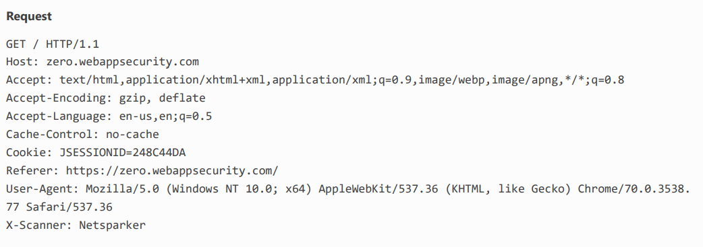
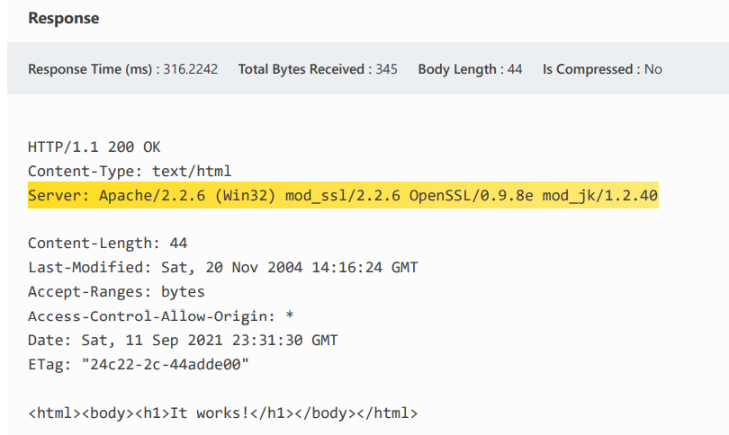

Slide 5
Impacts:
Since the website is using an older of Apache, which was updated as bugs were found in it or any software advancement was given in update, the website is
Unable to use the advanced technologies provided in new versions.
Vulnerable to attacks as the bugs in an older version is already known to the hacker who using the bugs of Apache will try to get access in website.
As Apache is responsible for accepting directory (HTTP) requests from Internet users and sending them their desired information in the form of files and Web pages, the hacker will get all the requests and responses resulting in leaking out of all bank data, including pins, passwords, etc.

Slide 6
Mitigation:
To remove the vulnerability, update Apache to latest version.
Doing this will save your website from all the vulnerabilities in older version of Apache.
For Updating you can use the link given:
https://httpd.apache.org/download.cgi

