Slide 1


DIY
LOW-RANK APPROX. TECHNIQUE FOR NEURAL SIGNAL DENOISING
VIA SVD
BY ABHINAV RAJ
2311006

Slide 2

SVD ?

Slide 3
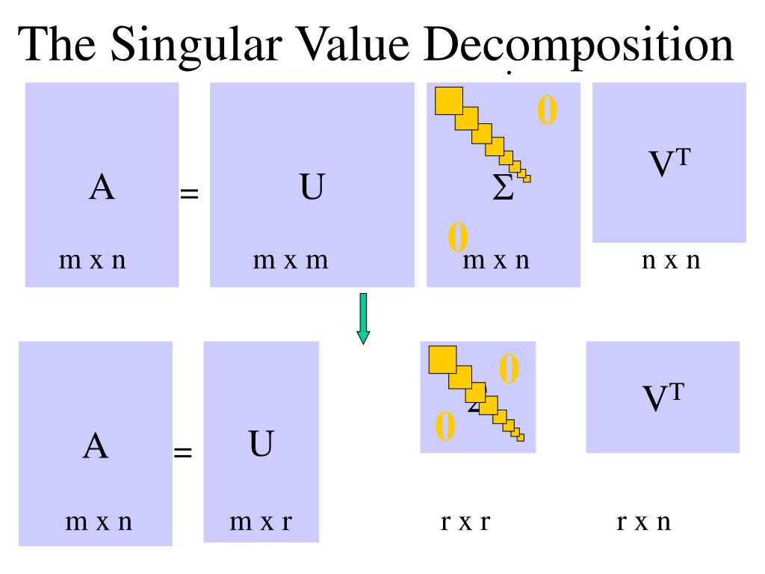
A=UΣV
T
SVD ?

Slide 4
MOTIVATION FOR DENOISING
  Real neural activity lies in correlated low-dimensional subspaces
(few dominant components).
  Noise is often high-dimensional and uncorrelated across channels or time.
  SVD separates them because noise contributes to smaller singular values.
By reconstructing only the top k components,
  Retain large-scale neural structures (e.g., oscillations, slow potentials),
  Remove random noise and micro-fluctuations.

Slide 5
DECRYPTING CODE

Slide 6
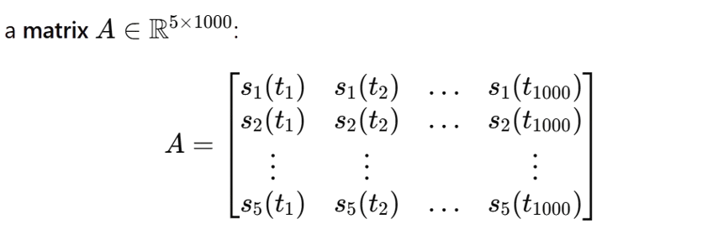
SAMPLE INPUT SIGNAL
DECRYPTING CODE

Slide 7
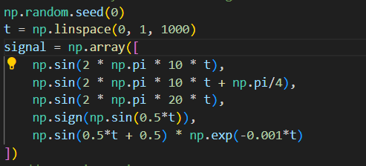
SAMPLE INPUT SIGNAL
DECRYPTING CODE

Slide 8


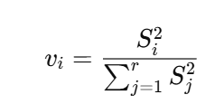

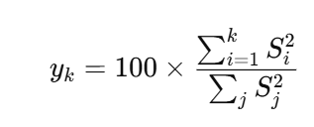
VARIANCE
,

Slide 9
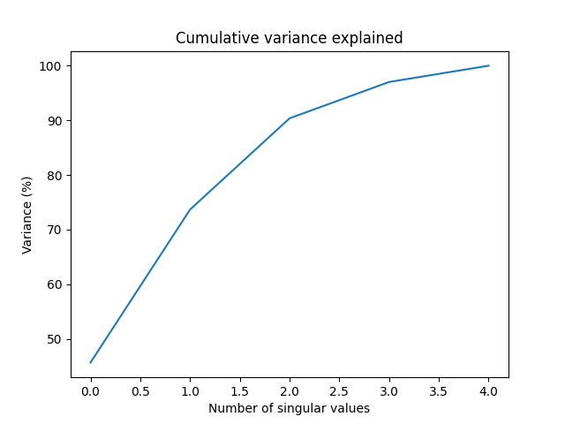
VARIANCE
,
computing the variance of singular values helps to:
  Quantify how much of the “signal structure” each component carries.
  Choose how many components to keep (rank selection).
  Assess the effectiveness of the denoising process.

Slide 10
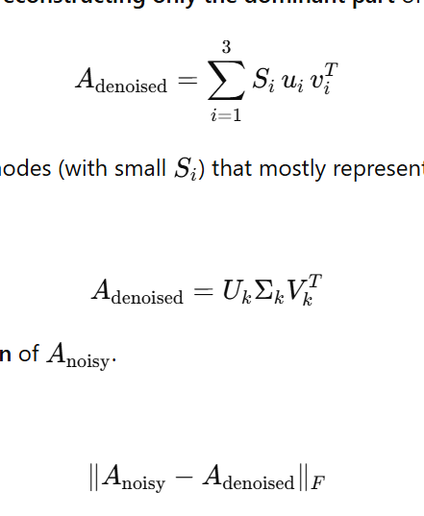
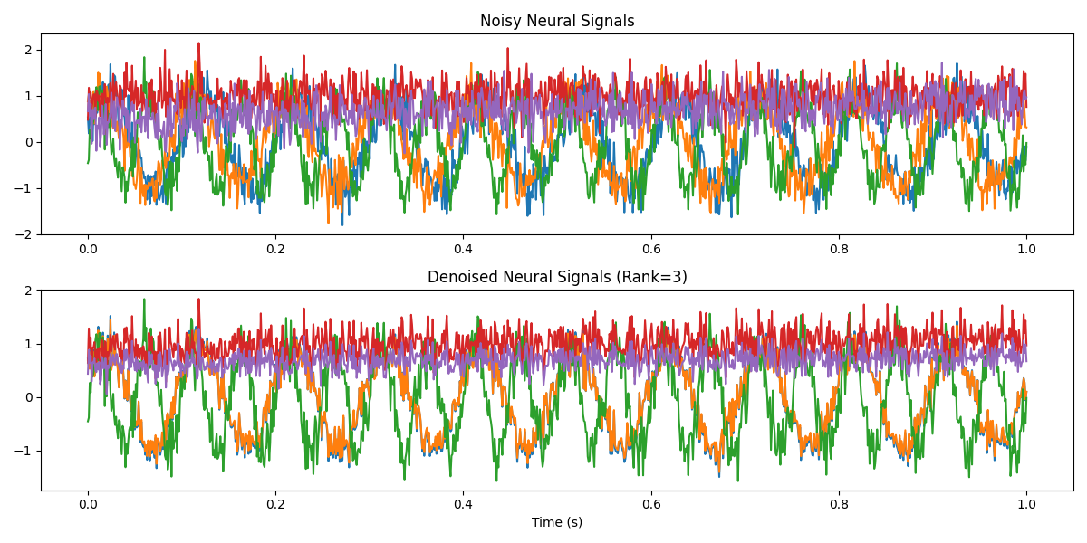
DENOISING

Slide 11
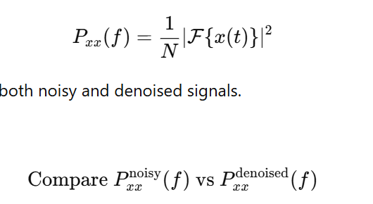
DENOISING
VERIFICATION
WELCH’S METHOD TO ESTIMATE THE POWER SPECTRAL DENSITY (PSD):

Slide 12
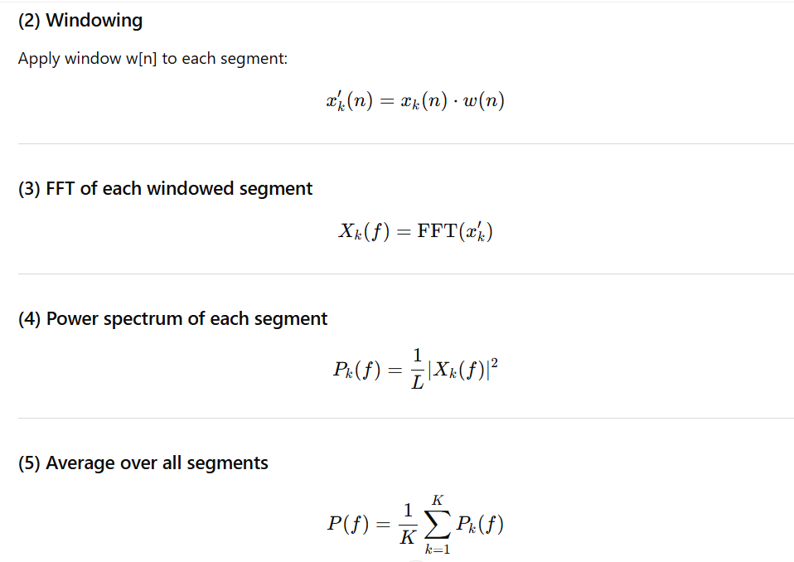
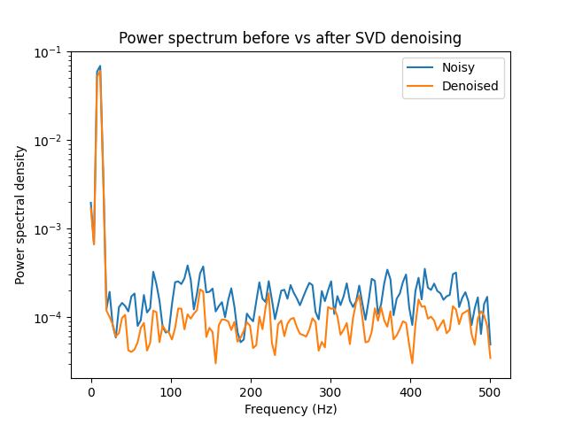

Slide 13
MIND MAP
OF
MY PROJECT

Slide 14

SAMPLE INPUT SIGNAL
ADDED RANDOM NOISE
MIND MAP
OF
MY PROJECT
DENOISED USING SVD
VERIFYING BY PLOT OF
POWER SPECTRUM

Slide 15
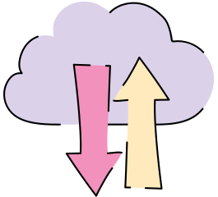
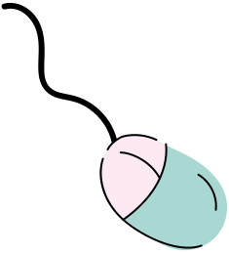
Thank You

