Slide 2





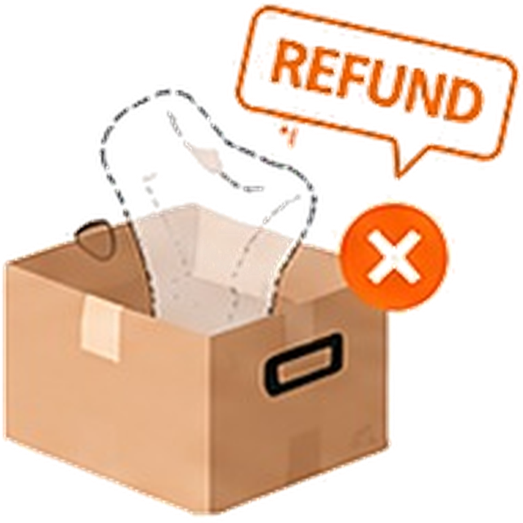
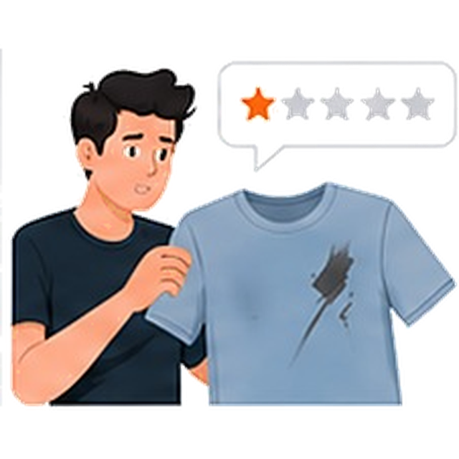
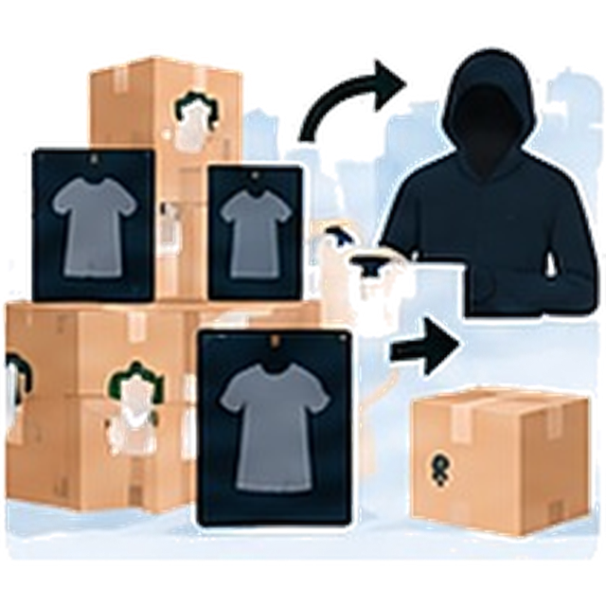
































Northfield Retail | The Returns Integrity Challenge
How do we protect a growth-driving free-returns promise while stopping evolving abuse patterns and reducing losses?
1
COMPANY CONTEXT: NORTHFIELD RETAIL
Fast-growing online fashion & lifestyle retailer
2
A GROWING ABUSE REALITY
Returns grew 3× faster than orders in two years; a costly share is not genuine
THIS POWERS
22M
active shoppers
Higher conversion
Industry-leading NPS
Free, no-questions-asked returns drive higher conversion
Stronger repeat purchases
Wardrobing
Refund without return
Serial “not as described” claims
Organized reseller rings
NPS and repeat purchase rate beat category benchmarks
Free & easy returns brand promise
Wearing an item once and returning it as new.
Claiming a refund for items that are never sent back.
Repeated “not as described” or “damaged” claims.
Groups abusing returns at scale, often to resell.
Returns have been a deliberate growth lever since day one
3
WHY TODAY’S APPROACH FAILS
Manual, reactive and siloed — abuse is caught only after it repeats
4
TECHNICAL CONTEXT: FRAGMENTED SIGNALS
Signals exist, but are not joined
Limited coverage
Late detection
Reactive and outdated
Order management
Payments
Customer support
Carrier tracking
12-person
Trust & Safety team
An abusive account typically completes 6 full return cycles before anything flags it — each one a fully absorbed loss.
Static rules catch last month’s patterns; abusers adapt within weeks.
Order history
Items, behaviour
Return history
Refunds
Payment methods
Chargebacks
Chat transcripts
Complaints
Claim patterns
Shipment status
Return scans
Delivery exceptions
Only ~4% reviewed
of all returns,
close to at random
A stricter rule can’t tell a wardrobing ring from an unlucky first-time shopper.
96% / 4%
Cycle 1
Cycle 2
Cycle 3
Cycle 4
Cycle 5
Cycle 6
No correlation across systems
Emerging patterns go unseen in real time
Loss
Loss
Loss
Loss
Loss
Loss
5
ROOT CAUSES
Why abuse is increasing and hard to catch
6
COSTS & IMPACT
Direct financial losses plus customer and brand costs
Impact on the business
Impact on honest customers
Multiple, evolving abuse patterns
Siloed data
Static rules get outdated quickly
False positives carry brand cost
Compliance and explainability
2.3% of shoppers drive ~38% of losses from items never returned
6 loss-making return cycles per abusive account before it is flagged
Wrongful bans — loss of access despite genuine behaviour
Wardrobing, no-return refunds, serial disputes and reseller rings each leave different signals.
Signals are scattered across orders, payments, support chats and carrier tracking.
Once abusers notice a detection heuristic, they adapt within weeks.
Wrongly flagging genuine customers hurts trust and repeat purchases.
Must avoid bias, withstand scrutiny and give analysts explainable actions.
Poor experience — refund delays from manual reviews
Unquantified losses across refunds, reverse logistics and operations
Rising escalations as wrongful bans and abuse threaten the promise
Erosion of trust — undermines the promise that drives growth
THE CORE PROBLEM
Northfield needs a system that continuously spots emerging abuse patterns and recommends an action — a hold, a review or a policy nudge —
before serial abuse compounds, without penalizing honest customers.
Notes:
Northfield Retail — the returns integrity challenge: company context, abuse patterns, why today’s approach fails, fragmented signals, root causes, and costs & impact.

Slide 3



































Northfield Retail | Returns Integrity Ecosystem
A connected view of people, workflows and systems to detect returns abuse early and protect the free-returns promise.
1
END-TO-END RETURNS JOURNEY
Many teams and systems are involved — gaps in visibility and disconnected data let abuse slip through
1
Purchase
Customer buys an item
2
Return request
Customer starts a return
3
Shipment & tracking
Item shipped via carrier
4
Receipt & verification
Item received and checked
5
Refund decision
Refund, hold or review
6
Post-return monitoring
Watch for emerging patterns
2
KEY PERSONAS, WORKFLOWS, FRICTIONS AND OUTCOMES
Connected across the journey
PERSONA
DAY-TO-DAY WORKFLOW
FRICTION TODAY
OUTCOME (AFTER RESOLVING)
Customer
Honest shopper & potential abuser
Buys, returns and keeps shopping
!
Some users exploit easy returns
Genuine customers face delays or wrongful holds
Little visibility on return status
Smoother, faster returns for genuine users
High-risk users flagged early
More trust in the free-returns promise
Shop
Raise return request
Ship item
Track status
Receive refund
Trust & Safety Analyst
Investigates flagged returns and decides the action
!
Reviews only ~4% of returns
Data scattered across systems
Patterns visible only after many cycles
Early detection of emerging abuse
One consolidated customer view
Explainable recommendations
Review alerts
Check customer & order history
Analyse signals across systems
Recommend action
Warehouse / Operations
Receives and verifies returned items
!
Missing or inconsistent item data
Used or missing items hard to spot
Not linked to customer or order history
Clear checks for high-risk returns
Fewer fraudulent refunds
Accurate, real-time item status
Receive package
Scan item
Check condition
Update system
VP, Trust & Safety
Owns risk, customer trust and policy
!
Rising losses from refund fraud
PR escalations from wrongful bans
Static rules soon become ineffective
Lower preventable losses
Fewer complaints and PR issues
Adaptive, data-driven policies
Monitor trends
Review escalations
Assess impact
Set policy & safeguards
3
KEY TECHNICAL SYSTEMS (CURRENT STATE)
Signals exist, but are not joined today
4
VALUE UNLOCKED
One system that unifies data, detects abuse early and enables action
Order management
Orders, items, return history
Payments
Refund events, chargebacks
Customer support
Chat transcripts, complaints
Carrier tracking
Shipment status, return scans
Unify data
across all systems
Detect
abuse patterns in real time
Generate
explainable recommendations
Enable action
hold, review or ban
Monitor & adapt
to new patterns
Disconnected data silos → no real-time view of customer behaviour or emerging patterns
Notes:
Returns integrity ecosystem: end-to-end returns journey, key personas with their workflows, frictions and outcomes, current technical systems, and the value unlocked by a unified system.

Slide 4










































ReturnLens | Production Readiness & Governance
Production-ready, secure and responsibly governed to protect the free-returns promise.
1
PRODUCTION READINESS & SCALABILITY
Built to handle peak volumes, stay reliable and reach production with minimal risk
Scales for real-world demand
End-to-end observability
Reliable & fail-safe by design
Path to production
Handles everyday traffic and 10× sale peaks without slowing refunds.
Live dashboards across service, data, model and AI agent.
Clear fallbacks, so customers never pay for a failure.
Gated rollout with validation and rollback.
5–10×
~600K
Service health
Data quality
SCENARIO
SYSTEM RESPONSE
DEV & UNIT TEST
Scoring service slow or down
Refund proceeds as today (fail open)
Build and unit test
Synthetic / masked data
Latency, error rate, throughput, availability
Freshness and completeness of all five feeds
STAGING
A data feed is late
Low-confidence score; no auto hold
End-to-end testing
UAT with analysts
~60K
Model performance
AI agent monitoring
LIMITED LAUNCH
99%
Valid
Fallback
Small % of traffic
Monitored closely
Normal day
refunds / day
Sale peak
up to 10× normal
Planned capacity
pre-scaled
Failed
Bad model or rules release
One-click rollback to the last approved version
Score distribution, precision, drift, fairness
Response time, tool usage and success rate
RAMP UP
Traffic 25% → 50%
Track performance and impact
KEY TARGETS
AI agent unavailable or invalid output
Non-AI flow takes over; refunds unaffected
Auto-scaling across regions
In-memory feature store < 10 ms
Real-time scoring < 150 ms
AI summaries on 1–2% of refunds
99.95%
≥ 90%
< 0.2
0.80–1.25
FULL ROLLOUT
monthly uptime
audited precision
PSI drift
fairness ratio
100% with ongoing monitoring
Rollback in minutes if needed
2
SECURITY, COMPLIANCE, RESPONSIBLE AI AND GOVERNANCE
Protect customer data, meet regulation and keep every decision fair and explainable
Security
Compliance
Responsible AI
Governance once live
Keep customer and transaction data safe.
Meets regulatory and industry requirements.
Fair, explainable and contestable by design.
Clear ownership, oversight and monitoring.
Encrypted in transit and at rest
India DPDP Act and GDPR: purpose limits, notice, right to contest
Named owner for each model and prompt
Tokenised card data; no raw customer IDs
No solely automated significant decisions
Behaviour signals only; no sensitive attributes
Monthly fairness testing across groups
Human-readable reason for every action
Human review for serious cases; customers can appeal
Monthly model risk committee
Least-privilege access and SSO
PCI DSS for card data
No change without registry approval
NEVER USED IN THE SCORE
Quarterly independent audit
LLM gateway: zero data retention, prompt-injection defences
Full audit log of every decision
Name
Gender
Age
Location
Language
Device
Payment type
Kill switch owned by VP, Trust & Safety
Notes:
ReturnLens: production readiness and scalability (demand, observability, fail-safe design, phased rollout), then security, compliance, responsible AI and governance.

Slide 5








































ReturnLens | MVP-First Roadmap
From a single return to enterprise-wide impact — detect abuse, reduce losses and protect genuine customers.
1
PHASED ROADMAP
Start focused with the MVP, then scale to more abuse patterns and categories
MONTHS 0–2
MONTHS 2–5
MONTHS 6–9
MONTHS 10–15
Foundations
MVP (live)
Version 2
Version 3
Connect 6 systems
Orders, payments, carrier, warehouse, accounts, support chat
Refund without return
Items never came back
ReturnLens
Held
Wardrobing
Worn, then returned as new
Wardrobing
More product categories
Apparel, footwear, accessories
Orders
Payments
Carrier
Reseller rings
Linked accounts, shared addresses
Ankle boots
$129 refund
95
Automated pattern discovery
New patterns found from fresh data
High risk
Damaged-on-arrival claims
Marked “damaged” or “not as described”
Build golden dataset
Label real and abusive cases
Data Hub
✓
Items never came back
+30
Review Console
Score, reasons and AI summary
✓
Missing in last 60 days
+25
✓
Repeat returns
Legal and policy sign-off
Define guardrails and approval rules
✓
Links to known abusers
+30
Warehouse grading
Condition-based assessment
✓
Similar items
Real-time customer experience
Instant refunds for trusted users
Warehouse
Accounts
Support
Evidence Agent
Citations and clear explanations
✓
New account
+5
✓
Kept briefly
✓
Keeps items briefly
+5
2
BUSINESS CASE
Fewer abusive refunds, less analyst effort, better experience
3
SUCCESS METRICS
Measurable gains for the business and customers
WHY THERE IS VALUE
Estimated financial impact (illustrative, prototype metrics)
KEY ASSUMPTIONS
Metric
Today
With ReturnLens
Why it matters
Abusive refunds cost money
Items never return or feed reseller rings.
Fewer abusive refunds + less analyst effort
Scale to more patterns and categories
Full rollout with automated detection
Abusive refund cycles cut from 6 to 3 on targeted cases
Abusive refund cycles before loss stops
6
3
Stops repeat abuse earlier
Team of ~12, plus cloud and tools
Analysts work manually
They review many low-value cases today.
$37M
AI evidence summaries cost < $10K a year (1–2% of refunds)
Analyst reviews that find real abuse
10%
50%
Analysts focus on real cases
40
$10M
$26M
Escalations from wrongly flagged customers
Baseline
50% lower
Better for honest customers
Genuine customers pay
Abuse brings stricter rules, slower refunds.
20
~4 months
payback period
0
Year 1
Year 2
Year 3
Precision of cases sent to a person
Baseline
≥ 90%
Only high-quality cases reach analysts
4
HOW WE TEST AND VALIDATE
Quality, reliability and fairness before and after launch
5
TECHNICAL KPIS & GUARDRAILS
Fast, reliable and fair
1
Backtesting
on golden dataset
2
Shadow mode
6–8 weeks
3
AI evaluation
quality checks
4
Canary rollout
safe launch
5
Monitoring
ongoing, after launch
< 150 ms
99.95%
< 20 min
< 0.2
0.80–1.25
< 24 hrs
scoring latency (p95)
monthly availability
data feed freshness
model drift (PSI)
fairness ratio
oldest analyst case
Test scoring logic
Check precision, recall and AI explanations
Runs in parallel, no action
Exit only at ≥ 90% precision with fairness passed
Review 300 AI summaries
Check format, citations, bias
Red-team testing
5% traffic + 5% control
Monitor performance
Ramp 25% → 50% → 100%
Track key KPIs
Drift detection (PSI < 0.2)
Quarterly independent audit
GUARDRAILS (ALWAYS ON)
Human review of serious cases
Agent prepares evidence only
One-click rollback and kill switch
No sensitive traits scored
Customers can appeal
Notes:
ReturnLens MVP-first roadmap: phased roadmap from foundations to Version 3, business case, success metrics, how we test and validate, and technical KPIs and guardrails.

Slide 6




























ReturnLens | Solution at a Glance
AI-powered decision support for returns integrity at Northfield Retail — from data to an explainable, human-owned decision.
1
WHAT IS RETURNLENS?
2
END-TO-END ARCHITECTURE
From Northfield’s data to a decision, with an AI decision-support layer
An AI decision-support layer that detects abusive returns, helps analysts decide faster and fits Northfield’s existing systems.
Existing systems
Data Hub
AI intelligence layer
Decision layer
Applications
Order management
Event stream & change capture
Risk Score model
Explains each score with key signals
Policy engine
Business rules & thresholds
Returns platform
Refund / hold / ban
Payments
Review Console
Score and AI summary
Detects abuse early
Helps analysts decide faster
Built for Northfield’s stack
Carrier tracking
Data unification
Learning Engine
Learns from analyst decisions
Orchestrator
Routes every return
Finds refund-without-return, reseller rings, wardrobing and damaged claims.
A clear score, reasons and an AI evidence summary with citations.
Uses current data, rules and returns platform; no change for customers.
Warehouse
Quality checks
Support app
Customer support view
Customer accounts
Entity resolution
Evidence Agent
Cites records and counter-evidence. Never decides.
Model registry
Versioning and monitoring
Support chat
Feature store
Audit log
Every decision logged
3
INSIDE THE EVIDENCE AGENT
Only for held cases (1–2% of refunds): a reliable, explainable loop
4
ENGINEERING FEASIBILITY & TRADE-OFFS
Build vs buy vs extend for Northfield
1
Fixed prompt
Version-controlled system prompt
Example output (shortened)
Build
from scratch
Buy
third-party product
Extend platform
recommended
6
2
{
"summary": "3 items never
came back; address shared
with 2 flagged accounts",
"pattern": "reseller_ring",
"confidence": "high",
"evidence": [{…}],
"counter_evidence": [{…}],
"suggested_next_step":
"escalate_linked_accounts"
}
Time to MVP
9–12 months
3–6 months
~5 months
Analyst reviews
Sees score, reasons and summary, then decides
Read-only lookups
Up to 4: orders, carrier, warehouse, accounts
Year 1 cost (est.)
~$8–12M
~$3–6M
~$4M
~12 people + cloud
Evidence
Agent
Customisation
Full control
Limited
fixed features
High
built for Northfield
5
Retry once
If still invalid, use template fallback
3
Assemble evidence
Cite record IDs; list innocent explanations
Fit with systems
Low
rebuild connectors
Medium
integration needed
High
uses current stack
(read-only)
Ongoing cost
High
High
per transaction
Lower
4
Validate output
Check JSON, citations and guardrails
Key trade-offs
Full flexibility
Slow and expensive
Higher delivery risk
Faster rollout
May not fit our rules
Harder to explain
Best fit for Northfield
Faster time to value
Lower effort and cost
Citations
Innocent explanations
No sensitive traits
5
PERFORMANCE & SCALABILITY
6
DEPLOYMENT PLAN
7
RUN IT RELIABLY IN PRODUCTION
< 150 ms
< 20 sec
99.95%
10×
1–2%
0–2 months
Set up
2–5 months
MVP (live)
6–9 months
Expand
10–15 months
Scale
24/7 on-call with runbooks
Risk score latency (p95)
Evidence Agent time
Monthly availability
Peak sale traffic handled
Refunds sent to the AI agent
Weekly model monitoring and drift checks
✓
Integrate 6 systems
✓
Risk score model
Wardrobing & damaged claims
More categories
Quarterly independent audits
Peak sale traffic
(e.g. Black Friday)
✓
Feature store & registry
✓
Evidence Agent
More features
Automated pattern discovery
One-click rollback / kill switch
✓
Monitoring and rules
✓
Review Console
Private LLM access (no PII, full logging)
Notes:
ReturnLens overview: what it is, end-to-end architecture, inside the Evidence Agent, engineering trade-offs (build, buy, extend), performance, deployment plan and running it reliably in production.

Slide 7
Thank You

