Slide 1
DEV HACK
Developer Student Club
INTRODUCING TEAM ENIAC
Kalinga Institute of Industrial Technology

Slide 2
OUR AWESOME TEAM
MEET THE TEAM ENIAC
Aayush Vats
Abhishek Sharma
Rohit Kumar
Someshwar Tripathi
TEAM ENIAC
KIIT UNIVERSITY

Slide 3
THEME DOMAIN
PROBLEM STATEMENT
Environment
Design a smart waste collection system that allows citizens to segregate the various types of solid waste they want to dispose and the municipal authorities to efficiently collect the same. .

Slide 4
Smart solid waste collection strategy
Household waste management is one of the major challenges of municipalities in developing countries.At present in India, there is no automated waste segregated approach at household level and a compact, low cost and user friendly segregation system for urban household to streamline the waste management process is the need of the hour. Along with urbanization, booming economic activity and increased living standards, urban households have increased their consumption. Our smart waste collection system will be highly beneficial in monitoring the generation of waste by the urban households as well as the people living in the small towns.This will help us in Protecting cities and their neighborhoods from waste-related hazards and in improving environment.Our system includes the strategies to reduce the levels of waste, improve waste-management and improve waste collection services.
The purpose of this system is to propose a method of identification that performs detection using images to identify the different types of waste containers.The main goal is to be able to successfully identify and classify waste containers in a reliable manner.
Municipal authorities in developing countries face severe resource constraints and hence services are not provided.The waste-management cost could be as high as fifty percent of the total budget for some municipalities in developing countries. In our system the municipalities will charge fee to collect household waste. Hence, they may rely on private contractors to provide waste-management services and collect waste from households for a fee. A reliable set of revenue sources is an absolutely necessary condition for the sustainability of these solutions which will be collected from the households.

Slide 5
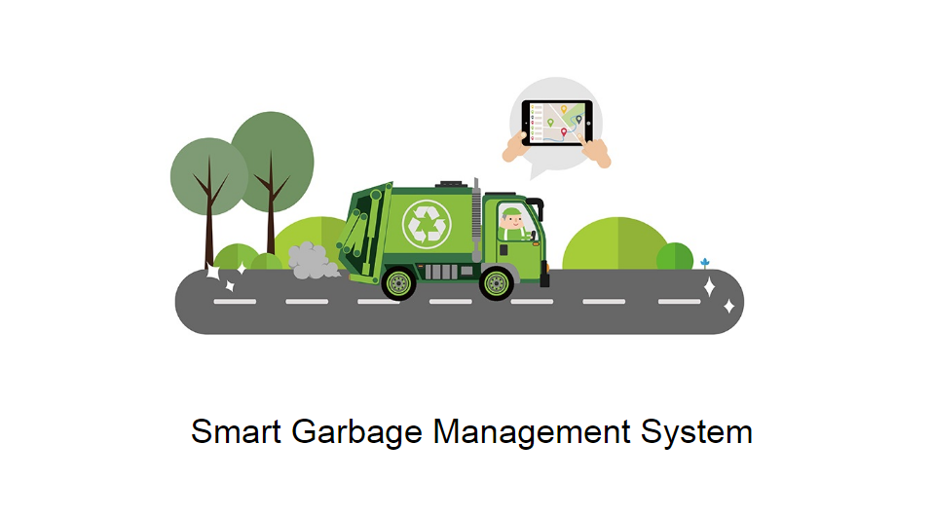
Waste Segregation using Deep Learning Algorithm
I.DEEP LEARNING ALGORITHM
The subset of Artificial Intelligence is Deep Learning algorithm. CNN is the most appropriate image classification method in the last years.Important python libraries used are Tensorflow, Numpy, Matplotlib, Opencv, etc. In that,libraries are helpful to detect and classify waste object.
II.METHODOLOGY
The methodology of waste segregation using deep learning algorithm are given below.
a.Library Installation
b.Model Preparation
c.Frozen inference graph
d.Process of displaying image
e.Classify waste of image

Slide 6
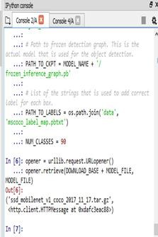
A.Library Installation
The installation of python libraries are numpy, matplotlib, tensorflow, utils, opencv, tarfile, os.
The Numpy is an important python library helpful to realize convolution neural network algorithm. Using Numpy, image is converted into matrix. The matrix form of image using CNN is used for interpretation and analysis.Matplotlib supports plotting functions for python programming language. In this proposed system, Matplotlib is used to draw bounding box. The bounding box is used to display object image name with score range. The Matplotlib provides object oriented application programming interface.
OS is an import library of python. It uses a way of operating system dependent functionality. It is used for path manipulation Sys is one of the import library of python. It uses a particular task of system operation and it is same as os.path. Os.path is specifies the path to access and sys.path is uses the path defined for system operation. Tarfile is used to read and write large amount of data representation in specific task.
Tensorflow is one of the main concepts in this proposed system. The python library of tensorflow is an open source software library. Tensorflow is used to create frozen graph. The frozen graph is helpful to detect and segregate object in real-time using webcam. It supports graphical representation of data and includes lot of file libraries such as protobuf, util, framework, graph etc.
Utils is a collection of function and classes. The utils is one of python library file and its concept supports the implementation of CNN. In this proposed system, utils library is installed from Tensorflow library.
B.Model Preparation
Model preparation is one of the main concept of training dataset in deep learning algorithm. The training dataset has multiple of image in form array.The model preparation process is used to download SSD mobilenet COCO dataset. In that, mobilenet is one of the fastest RCNN and hence used in the training dataset for this proposed system. The library file utils with tarfile downloads dataset via os.path and then sys.path. Advantage of SSD mobilenet is the detection of object from an image at a faster rate.

Slide 7
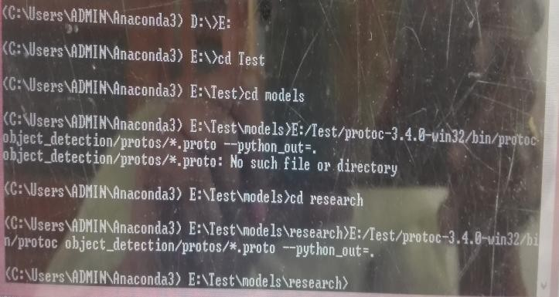
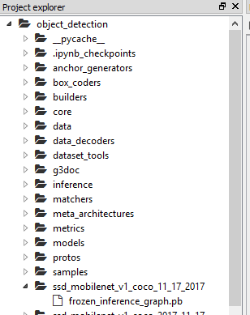
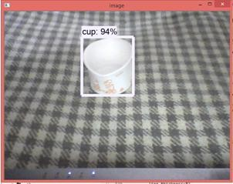
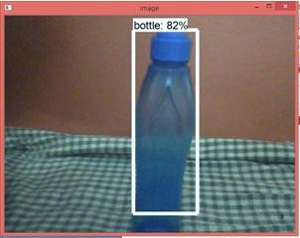
C.Frozen Interference Graph
Protocol Buffer is widely used by google for storing and interchanging all kinds of structured information. The protocol buffer is important in the frozen graph. The protocol buffer installation command is “protoc object_detection/protos/*.proto–python_out”. After installation of protobuf, tensorflow library of pb2 file is automatically installed. The frozen detection graph of the pb file is through object path detection and then it’s convolution neural network concept. The command path_to_ckpt is used to predict a specific object detection from image or video. After running of the command path_to_ckpt, and automatically create frozen graph in SSD mobilenet.
D.Process of display image convert RGB
Already the code for conversion of specific image to RGB base on the image size. The input of image size may or may not be of different size. Whatever is the size of object be, the detected image will be converted to the specific size (32X32). The python index library of numpy is used to create the array information of the image. Os.path and Sys.path is used to detect images and are are identified as biodegradable or not.

Slide 8

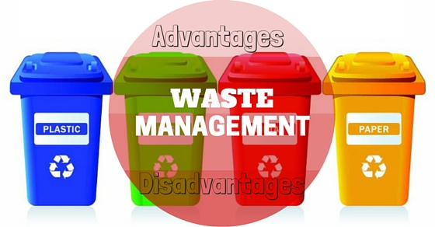
Why the citizens will agree to be a part of our waste collection system?
The frequency of collecting waste will be four times a month(weekly).
The distance between home and waste collection point will probably be not more than 10 minutes(if possible). The municipal vehicle will stop at the given point and all neighbouring households are required to bring their waste in the given point. This can be decided by municipality later.
One time subsidy will be provided by the municipality to buy dustbin. The dustbin will be distributed through the Municipality.
Waste collection fee will be paid to municipality per month.
Advantages of this smart waste collection system:
This system may encourage households for recycling or reuse of the products.
Households produce mainly six types of wastes.Out of the total household wastes generated a high percentage is of organic waste.In order to reduce the waste collection fee the households can feed such waste to the animals.
A small number of households will start practicing composting of organic waste which will reduce the volume of waste.
A municipal waste collection can be viable when household fee recovers the cost of management.

Slide 9
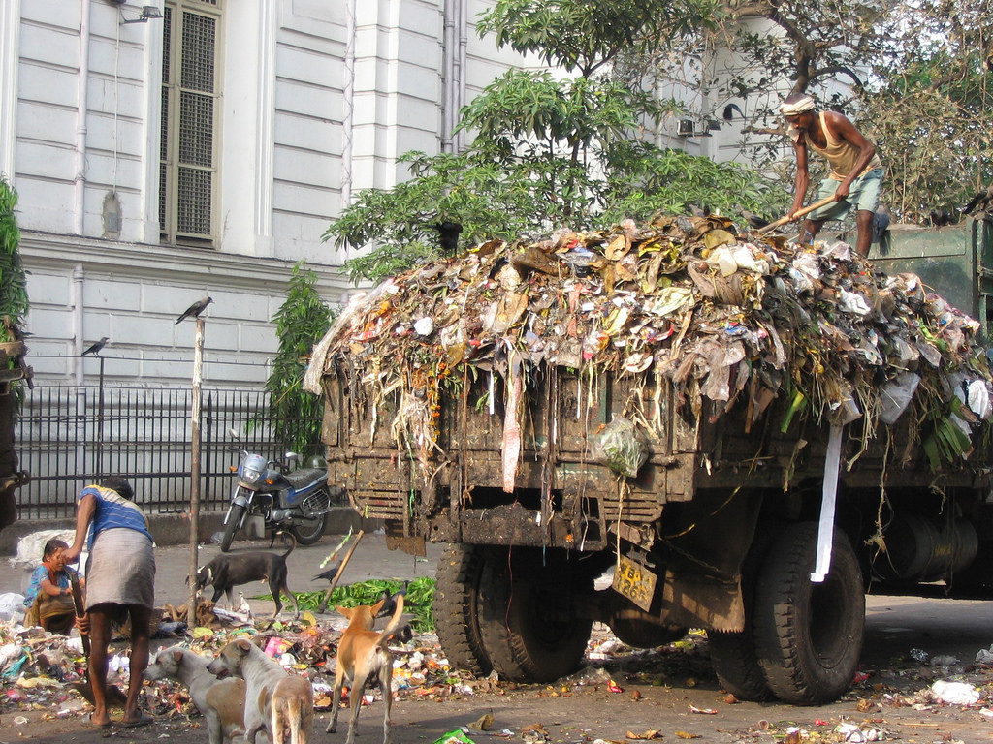
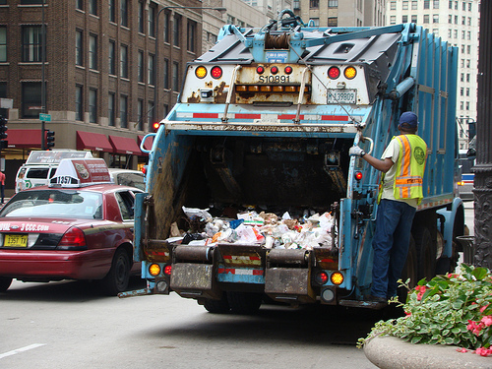
Conclusion
With the advent of deep network architectures,this system proposes the idea of fully automated waste segregation using deep learning. Hence to implement it, the system works with a huge data set, pattern predictions for object detection and training algorithms. Thus this system, aids in reducing air pollution levels as the people will stop burning plastic and paper waste and in the long run focuses on the development of universal waste segregation framework.

Slide 10
THANKS FOR FOR
WATCHING

