Slide 1


PLEDGE TO PROGRESS Sustainability Hackathon
Sponsored By
Your Team Name : srapid
Your team bio : Abhijat Sarari (Team Leader)
Date : 27-04-2023

Slide 2
Problem Statement?
One reason could be the urgent need to transition to sustainable energy sources and reduce our carbon footprint to combat climate change. With the rising awareness of environmental issues and the increasing demand for renewable energy, there is a significant opportunity for innovation in the energy sector.
Another reason could be the potential benefits of a peer-to-peer trading system for renewable energy. By enabling users to sell their excess green energy to others on a decentralized network, it can promote a more efficient and cost-effective use of energy, reduce dependence on traditional energy providers, and create a more resilient and reliable energy system.
Lastly, blockchain technology has shown potential in various industries, including finance and healthcare, and has the potential to revolutionize the energy sector as well. By leveraging the security, transparency, and efficiency of blockchain technology, a peer-to-peer trading system for renewable energy can bring significant benefits to both consumers and producers.

Slide 3
User Segment & Pain Points
The early adopters of a blockchain-based solution for peer-to-peer trading of renewable energy could be individuals or businesses who are interested in sustainability, have the resources to invest in renewable energy infrastructure, and are looking for more control over their energy consumption and production.
Specifically, the early adopter user segment could include:
Homeowners with solar panels or other renewable energy sources who want to sell their excess energy to other consumers on a decentralized network.
Small businesses that have invested in renewable energy sources and want to reduce their energy costs and earn extra revenue by selling their excess energy.
Eco-conscious consumers who want to support renewable energy and reduce their carbon footprint by purchasing energy from renewable sources on a peer-to-peer network.
Community-based organizations that are interested in promoting sustainability and resilience by supporting local renewable energy production and consumption.
The pain points that these early adopters might be facing include:
Limited access to renewable energy infrastructure and distribution networks.
High costs associated with installing renewable energy infrastructure and complying with regulatory requirements.
Limited control over energy production and consumption, which can result in wasted energy and higher costs.
Lack of transparency and efficiency in the energy market, which can make it difficult to track energy usage and pricing.

Slide 4
Pre-Requisite
There are several existing alternatives and competitive products in the renewable energy market that could potentially serve as alternatives to a blockchain-based solution for peer-to-peer trading of renewable energy. Here are a few examples:
Traditional energy providers: Consumers can continue to rely on traditional energy providers to supply their energy needs, but this may not provide the same level of control over energy production and consumption as a decentralized peer-to-peer network.
Renewable energy certificates (RECs): RECs are a tradable commodity that represent the environmental attributes of one megawatt-hour of renewable energy generation. RECs are typically purchased by individuals or businesses to offset their carbon footprint or meet regulatory requirements, but they do not provide the same level of direct control over energy production and consumption as a peer-to-peer network.
Virtual power plants (VPPs): VPPs are cloud-based systems that allow energy producers to aggregate their energy resources and sell them as a single unit to energy consumers. VPPs can help to balance the grid and reduce energy costs, but they still rely on centralized control and do not provide the same level of decentralization as a peer-to-peer network.
Green energy retail providers: Green energy retail providers offer consumers the option to purchase renewable energy directly from the provider, but this does not provide the same level of control over energy production and consumption as a peer-to-peer network.
While these alternatives may provide some benefits, they often rely on centralized control, lack transparency, and may not provide the same level of cost-effectiveness or environmental benefits as a decentralized peer-to-peer network. A blockchain-based solution for peer-to-peer trading of renewable energy can offer a more efficient, transparent, and sustainable alternative to these existing alternatives.

Slide 5
Tools or resources
Azure Blockchain Service: Azure Blockchain Service is a fully managed blockchain service that enables users to deploy and manage blockchain networks quickly and easily. It supports various blockchain protocols, including Ethereum, Hyperledger Fabric, and Corda, making it an excellent choice for developing blockchain-based solutions. Azure Cosmos DB: Azure Cosmos DB is a globally distributed, multi-model database service that supports various NoSQL data models, including document, key-value, graph, and column-family. It provides high throughput, low latency, and automatic scaling, making it an excellent choice for storing and querying data in a blockchain network. Azure Functions: Azure Functions is a serverless compute service that enables users to run event-driven code in response to various triggers, such as HTTP requests, messages, and timers. It supports various programming languages, including C#, Java, JavaScript, and Python, making it an excellent choice for developing serverless functions to handle blockchain events and transactions. Azure Key Vault: Azure Key Vault is a cloud service that enables users to store and manage cryptographic keys, certificates, and secrets. It provides a secure and centralized location for managing the cryptographic keys and certificates needed for secure blockchain transactions. Azure DevOps: Azure DevOps is a set of cloud services that enable users to plan, build, and deploy applications quickly and efficiently. It includes various tools and services, such as Azure Boards, Azure Repos, Azure Pipelines, and Azure Artifacts, making it an excellent choice for managing the development and deployment of a blockchain-based solution. These are just a few examples of the Azure tools and resources that could be used for developing a prototype for a blockchain-based solution for peer-to-peer trading of renewable energy.

Slide 6
Any Supporting Functional Documents
Solution Overview: Our solution aims to enable peer-to-peer trading of renewable energy through a decentralized blockchain-based network. The solution will allow users to generate, store, and sell their own green energy to other users on the network, providing a more efficient, transparent, and sustainable alternative to traditional energy providers.
Methodology: To develop the solution, we will follow an agile methodology that emphasizes iterative development, continuous feedback, and rapid prototyping.
Architecture: The architecture of our solution will be based on a permissioned blockchain network, using Hyperledger Fabric or Ethereum as the underlying blockchain protocol. The solution will also include a web-based user interface that allows users to interact with the blockchain network, monitor their energy production and consumption, and initiate energy transactions. The user interface will be built using modern web technologies such as Angular or React and will integrate with the blockchain network using APIs provided by the blockchain platform.
Scalability: To ensure scalability and performance, the solution will use cloud-based infrastructure provided by Microsoft Azure. We will leverage Azure Kubernetes Service (AKS) for container orchestration, allowing us to easily scale our solution as demand grows. We will also use Azure Cosmos DB for data storage and management, providing a globally distributed and highly scalable NoSQL database solution. Additionally, we will use Azure Functions for serverless compute, enabling us to run event-driven code in response to blockchain events and transactions.

Slide 7
Key Differentiators & Adoption Plan
Key Differentiators: Our solution has several key differentiators that set it apart from alternative solutions. First, our solution leverages blockchain technology to provide a decentralized and transparent platform for peer-to-peer energy trading, which is more efficient and cost-effective than traditional energy providers. Finally, our solution provides incentives and rewards for users to participate in the green energy market, encouraging them to reduce their carbon footprint and contribute to a more sustainable future.
Adoption Plan: To build adoption for our solution, we will follow a multi-pronged approach that focuses on both user acquisition and engagement.
User Acquisition: We will focus on acquiring users in the early stages by partnering with local renewable energy providers and conducting targeted marketing campaigns
User Engagement: To keep users engaged and active on the platform, we will provide incentives and rewards for participating in the green energy market
Strategic Partnerships: We will establish strategic partnerships with renewable energy providers, local governments, and other organizations to build credibility and trust in our solution. We will also work with these partners to promote our solution and expand its reach.
Continuous Improvement: We will continuously seek feedback from our users and stakeholders to identify areas for improvement and refine our solution iteratively. We will also stay up-to-date with the latest blockchain and energy technologies to ensure that our solution remains cutting-edge and competitive.

Slide 8
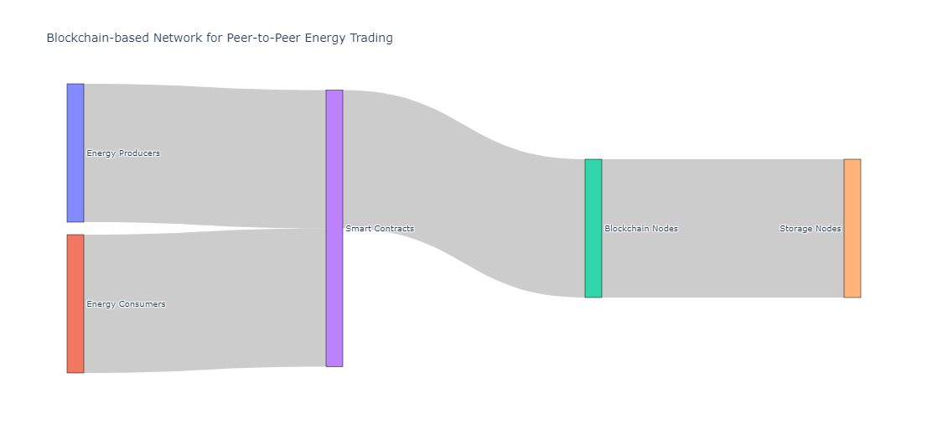
GitHub Repository Link & supporting diagrams, screenshots, if any
GITHUB

Slide 9
Thank You
Team member names: Abhijat Sarari

