Slide 1

Real Estate price prediction
Abhijeet p. Selukar

Slide 2
Your best quote that reflects your approach… “It’s one small step for man, one giant leap for mankind.”
- Neil Armstrong

Slide 3
Introduction
Predicting real estate prices accurately is crucial for buyers, sellers, and investors.
Importance of accurate price prediction in real estate transactions.
Using historical real estate data and machine learning algorithms to predict future property prices.

Slide 4
Data Collection and Preprocessing
Source of data
Features collected (e.g., location, size, number of bedrooms/bathrooms, amenities), and size of the dataset.
Data preprocessing Handling missing values, feature scaling, encoding categorical variables, and splitting the data into training and testing sets.
Feature Selection

Slide 5
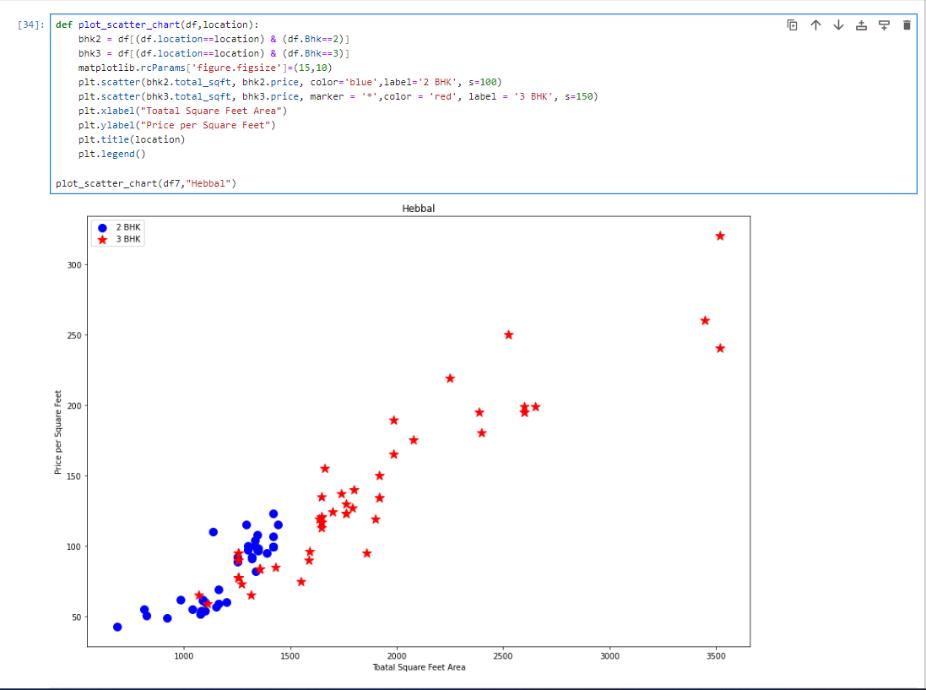
Outlier Detection

Slide 6
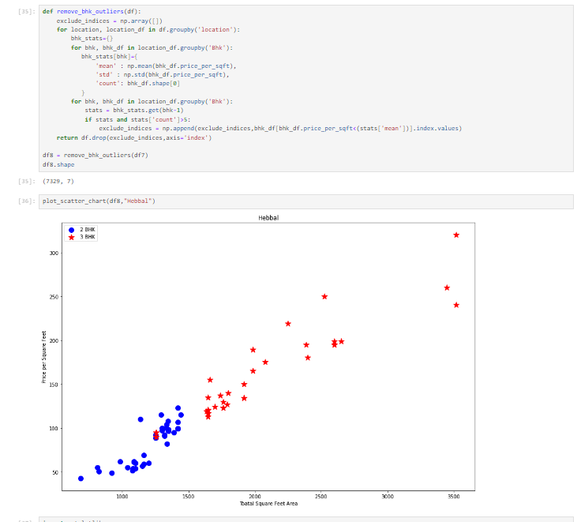
Outlier Handling

Slide 7
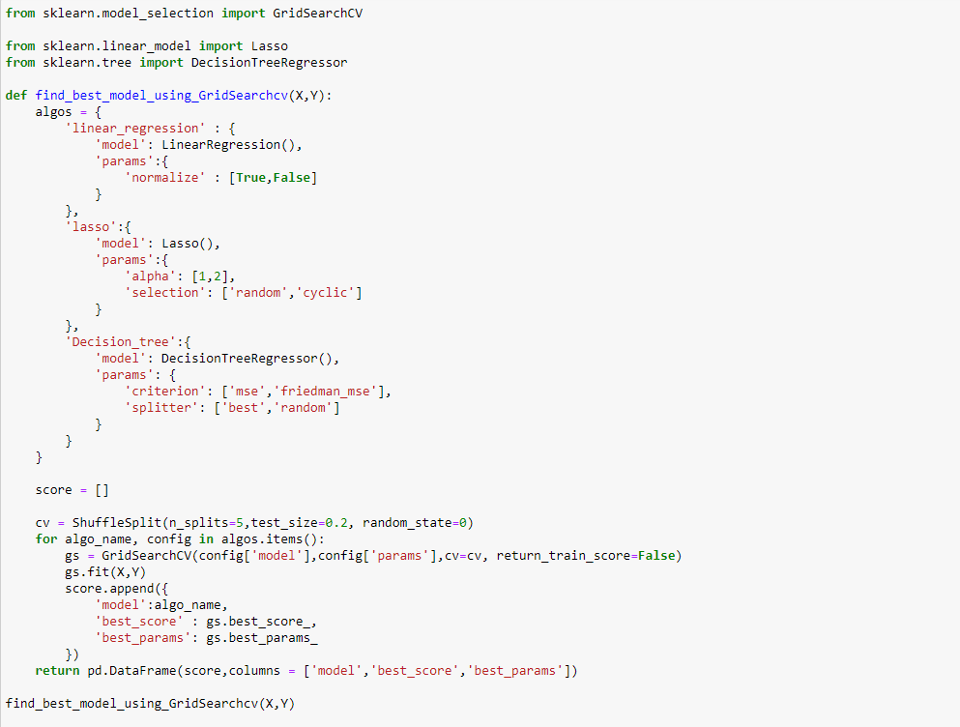
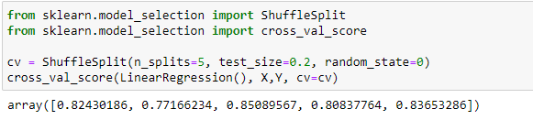
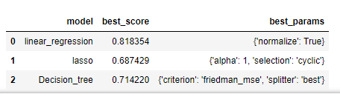
Model Selection
Model Training
Best Score model

