Slide 1
BOOK RECOMMENDATION SYSTEM
PRESENTED BY : ABHILASH T
M.Tech AI&DS
ROLL NO: 1

Slide 2
CONTENTS
INTRODUCTION
APPROACH
DATASET
METHODOLOGY
RESULTS&EVALUATION
ADVANTAGES
DISADVANTAGES
APPLICATIONS

Slide 3
INTRODUCTION
A book recommender system is a tool that suggests books to users based on their interests and reading history.
These systems can be used by libraries, bookstores, or online retailers to help users discover new books that they might enjoy.

Slide 4
APPROACH
1) Popularity Based Book Recommendation
Recommend books with highest number of ratings.
Target new customers with most popular books.

Slide 5
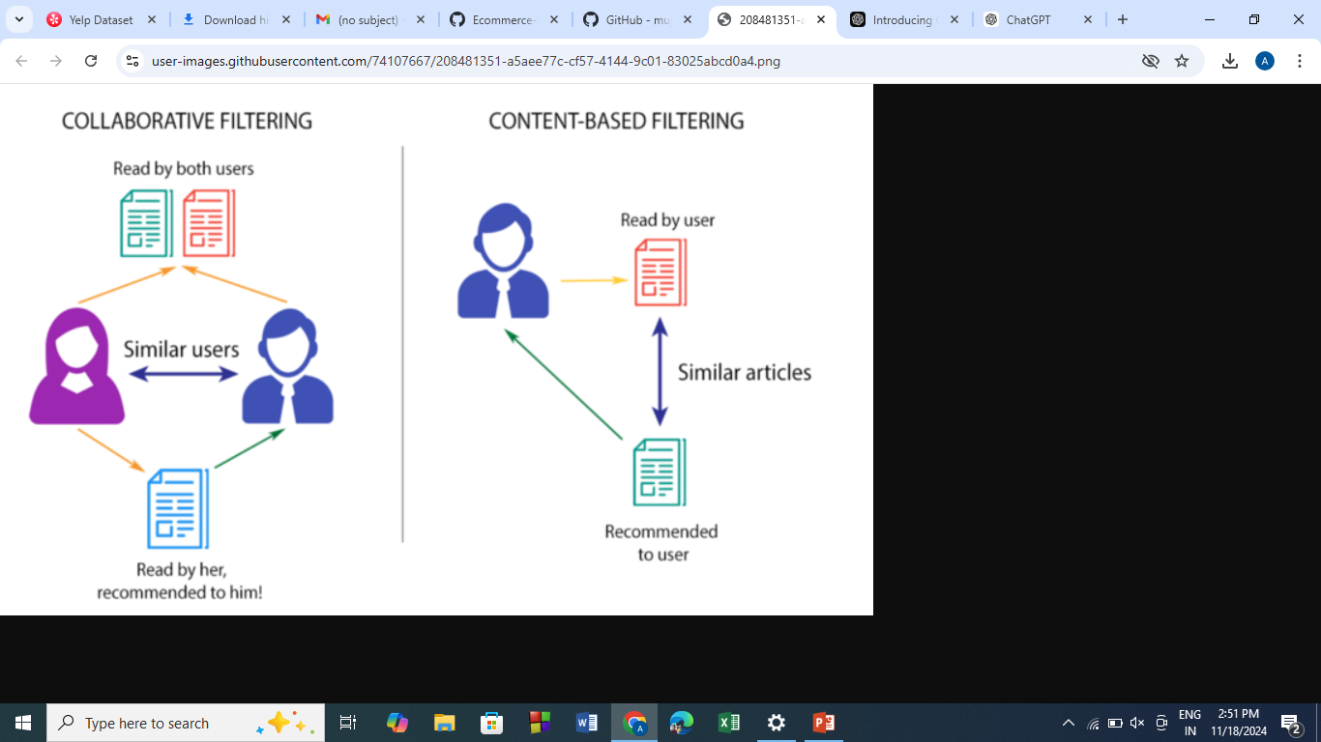
2) Collaborative filtering
Collaborative filtering is a recommendation technique that relies on user-item interaction data (e.g., ratings) to recommend items. It identifies patterns or relationships between users and items to make predictions.

Slide 6
DATASET
The dataset is downloaded from the kaggle website it comprises of:
Books – first are about books which contain all the information related to books like an author, title, publication year, etc.
Users – The second file contains registered user’s information like user id, location.
ratings – Ratings contain information like which user has given how much rating to which book.

Slide 7
METHODOLOGY
Data Collection
Data Preprocessing
Exploratory Data Analysis (EDA)
Building Recommendation Approaches
Popularity-Based Recommendation
Collaborative Filtering
Model Evaluation

Slide 8
DATA PREPROCESSING
Check for Missing Values
Filter Irrelevant Data
Data Merging
Data Type Consistency
Apply Filters

Slide 9
Popularity-Based Recommendation
Aggregate ratings data to calculate the number of ratings or average rating for each item.
Sort items based on the chosen popularity metric (e.g., number of ratings or average rating).
Apply a threshold to filter items with insufficient ratings (optional).
Select the top N items based on the ranking.
Display the most popular items as recommendations.

Slide 10
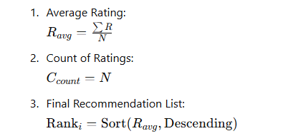
Popularity-Based Recommendation

Slide 11
Collaborative-Based Recommendation System
Types:
User-based Collaborative Filtering: Recommends items by finding users with similar preferences.
Item-based Collaborative Filtering: Recommends items based on the similarity of items.

Slide 12
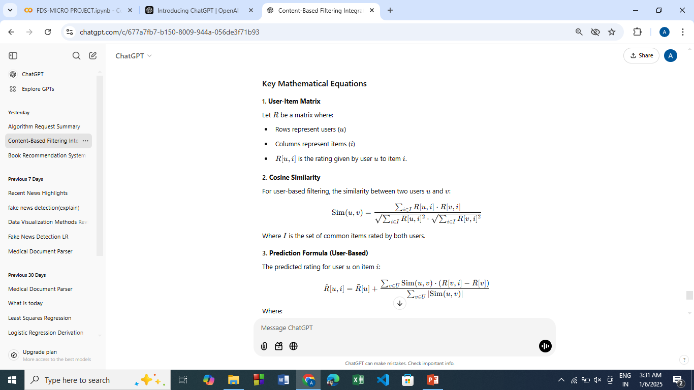

Slide 13
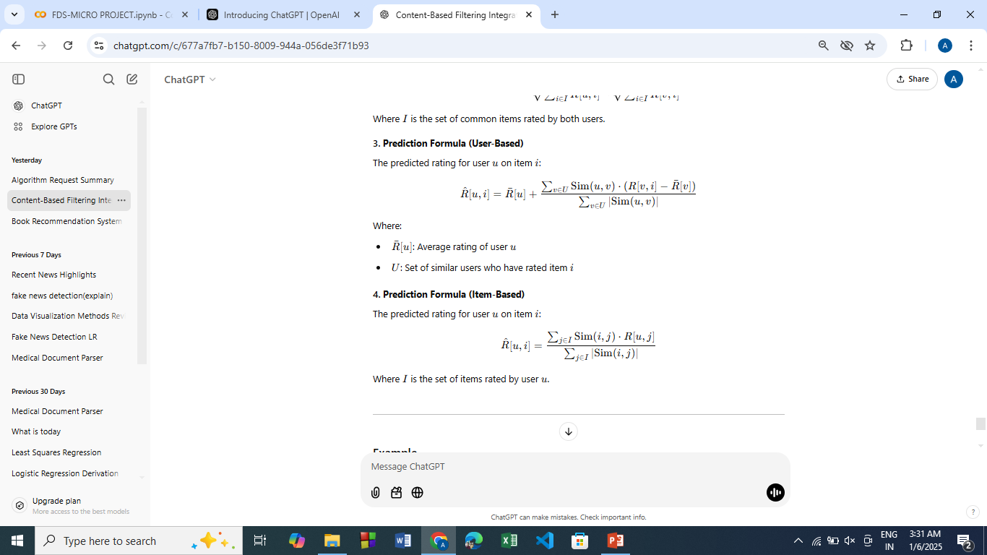

Slide 14
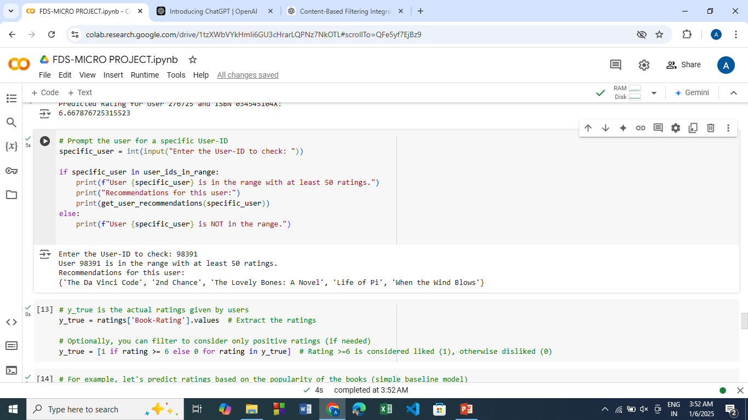
RESULTS AND EVALUATION

Slide 15
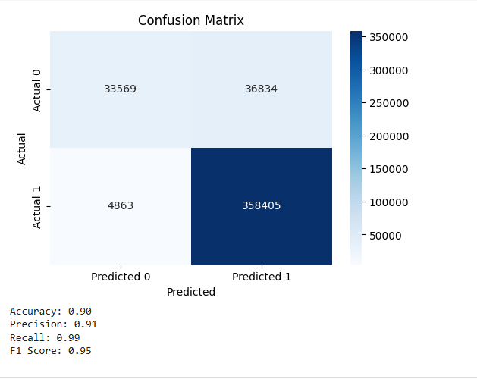

Slide 16
ADVANTAGES
Personalized Recommendations
Time saving
Exposure to New Authors and Genres.
Better Customer Experience
Diverse Author Recommendations

Slide 17
DISADVANTAGES
Bias in Recommendations
Overwhelming Number of Recommendations
Data Privacy Concerns

Slide 18
APPLICATIONS
Online Bookstores & Retailers
E-Book platforms.
Social Media & Book Communities
Educational Platforms
Book Clubs & Reading Groups

Slide 19
THANK
YOU

